Slide 1

COLLABORATIVE CLASS PROJECT: ROBOT CONTROL
Kevin Carrion
Matteo Mastromauro
Alexandra Spertini
Alex Zagati

Slide 2
OUTLINE
INTRODUCTION
NONLINEAR SYSTEM SIMULATION
SYSTEM LINEARIZATION AND STABILIZATION CONTROL SCHEME
IMPLEMENTATION OF THE CONTROL SCHEME ON REAL SYSTEM
FEEDBACK LINEARIZATION
ANALYSIS OF RESULTS
VARIABLE STRUCTURE CONTROLLER
VSC PERFORMANCE WRT CHANGE OF CONDITIONS

Slide 3
1. INTRODUCTION
The goal of the project was to apply some nonlinear control techniques and concepts on a simple robotic arm, made of a drive actuating a shaft through a flexible joint.

Slide 4
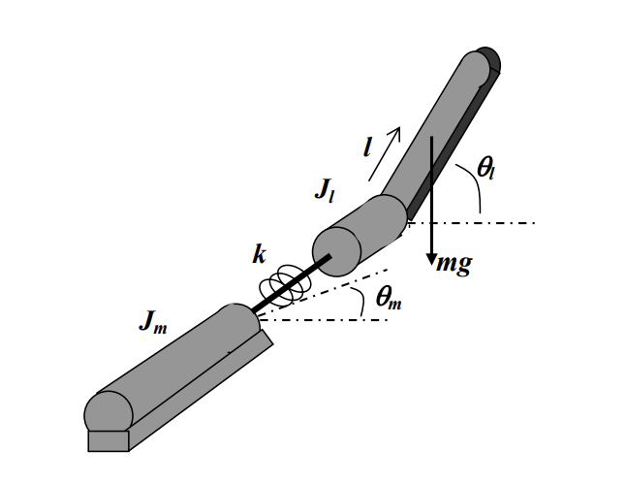

1.1 DYNAMICAL EQUATIONS
The dynamic model of the system is given by the following equations:
$$J_{l}\ddot{θ_{l}}+B_{l}\dot{θ_{l}}+k\left(θ_{l} −θ_{m}\right)+mglcos\left(θ_{l}\right)=0$$
$$J_{m}\ddot{θ_{m}}+B_{m}−k\left(θ_{l} −θ_{m}\right) =u$$
Moreover, we consider the problem of stabilizing the arm at the position $θ_{l}$ = $\frac{π}{4}$

Slide 5








1.1 DYNAMICAL EQUATIONS
Model parameters:
$$k=0.8 Nm/rad$$
$$J_{m}=4e−4 Nms^{2}/rad$$
$$J_{l}=4e−4 Nms^{2}/rad$$
$$B_{m}=0.015 Nms/rad$$
$$B_{l}=0.0 Nms/rad$$
$$m=0.3 kg$$
$$l=0.3 m$$
$$g=9.8 ms^{−2}$$

Slide 6
2. STATE SPACE REPRESENTATION AND SYSTEM SIMULATION
At this stage, we focus on giving a state space representation of the system in order to simulate it in the Simulink environment, verifying that the system is unstable

Slide 7

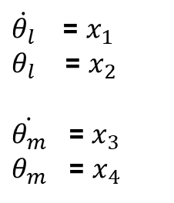

2.1 STATE SPACE REPRESENTATION
In order to give a state-space representation of the system, we must set:
$$\dot{x_{1}}=−\frac{B_{l}}{J_{l}}x_{1}−\frac{K}{J_{l}}x_{2}−\frac{mgl}{J_{l}}{cos⁡(x}_{2})+\frac{K}{J_{l}}x_{4}$$
$\dot{θ_{l}}$ = $x_{1}$
$θ_{l}$ = $x_{2}$
$\dot{θ_{m}}$ = $x_{3}$
$θ_{m}$ = $x_{4}$
$$\dot{x_{2}}=x_{1}$$
$$\dot{x_{3}}=\frac{K}{J_{m}}x_{2}−\frac{B_{m}}{J_{m}}x_{3}−\frac{K}{J_{m}}x_{4}+\frac{1}{J_{m}}u$$
$$\dot{x_{4}}=x_{3}$$

Slide 8
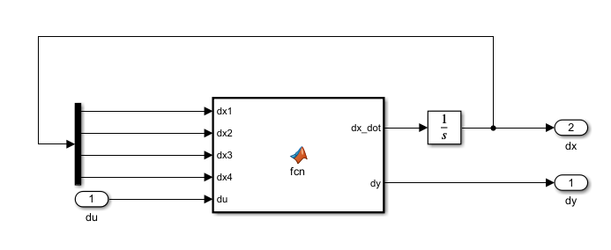
2.1 NONLINEAR SYSTEM SIMULATION
The first task was to perform a simulation of the nonlinear system via Simulink. The aim of this step is basically to verify that the system is unstable, as we can easily expect from such a system.
For the implementation of the system, we opted for a MATLAB function containing the dynamical equations of the system.

Slide 9
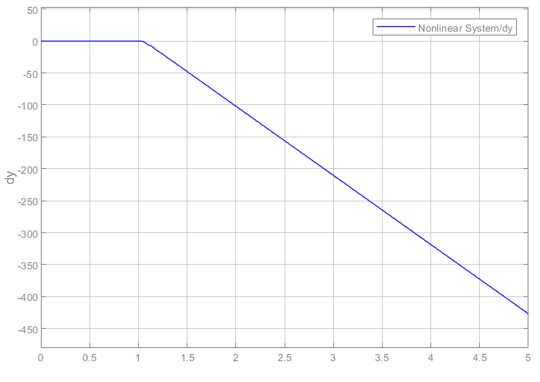

2.1.1 SIMULATION RESULTS
As we expected, by giving as input to the system a unitary step, the state of the system diverges. In particular, in the following plot, we are considering as output of the system dy = ${dθ}_{l}$ = ${dx}_{2}$

Slide 10
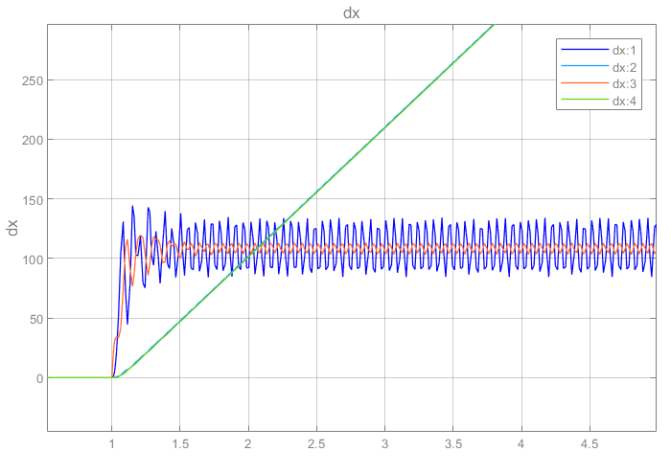
2.1.1 SIMULATION RESULTS
Looking at the other states, we see that also the position of the other link diverges and the velocities of both of them start oscillating

Slide 11
5. FEEDBACK LINEARIZATION
In this section, we used MATLAB Symbolic toolbox in order to get the parametric equations involved in the feedback linearization process.

Slide 12
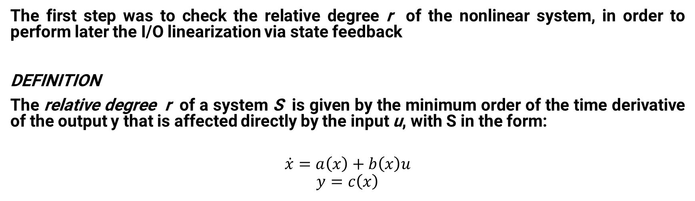
5.1 CHECKING THE RELATIVE DEGREE
The first step was to check the relative degree r of the nonlinear system, in order to perform later the I/O linearization via state feedback
DEFINITION
The relative degree r of a system S is given by the minimum order of the time derivative of the output y that is affected directly by the input u, with S in the form:
$$\dot{x}=a\left(x\right)+b\left(x\right)u$$
$$y=c\left(x\right)$$

Slide 13
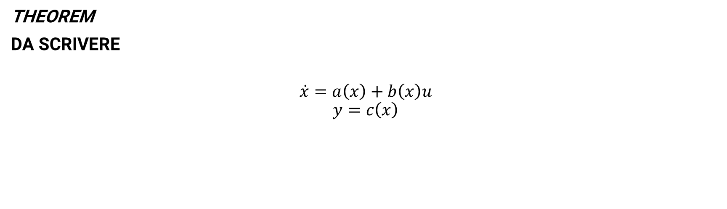
5.1 CHECKING THE RELATIVE DEGREE
THEOREM
DA SCRIVERE
$$\dot{x}=a\left(x\right)+b\left(x\right)u$$
$$y=c\left(x\right)$$

Slide 14


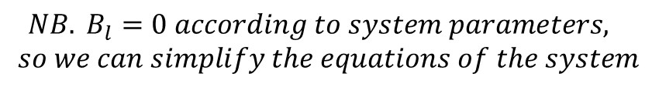


5.1 CHECKING THE RELATIVE DEGREE
In our case, we get:
$$NB. B_{l}=0 according to system parameters,$$
$$so we can simplify the equations of the system$$
$$y={\frac{π}{4}−x}_{2}→ r=0$$
$\dot{y}=−\dot{x_{2} }=−x_{1}→r=$1
$\ddot{y}=−\dot{x_{1}}$ = $\frac{K}{J_{l}}x_{2}+\frac{mgl}{J_{l}}{cos⁡(x}_{2})−\frac{K}{J_{l}}x_{4} →r=2$
$\overset{⃛}{y}=$ $\frac{k}{J_{l}}x_{1}−\frac{mgl}{J_{l}}{sin⁡(x}_{2})x_{1}−\frac{K}{J_{l}}x_{3}→r=3$
$\ddot{y}\ddot{ }=$ $\frac{k}{J_{l}}{(\frac{k}{J_{l}}x}_{2}−\frac{mgl}{J_{l}}{cos⁡(x}_{2})+\frac{K}{J_{l}}x_{4})−\frac{mgl}{J_{l}}{cos⁡(x}_{2})x_{1}^{2}−\frac{mgl}{J_{l}}{sin⁡(x}_{2})(−{\frac{k}{J_{l}}x}_{2}−\frac{mgl}{J_{l}}{cos⁡(x}_{2})+\frac{K}{J_{l}}x_{4})−\frac{k}{J_{l}}{(\frac{k}{J_{m}}x}_{2}−{\frac{B_{m}}{J_{m}}x}_{3}−\frac{k}{J_{m}}x_{4}+\frac{u}{J_{m}})→r=4$

Slide 15
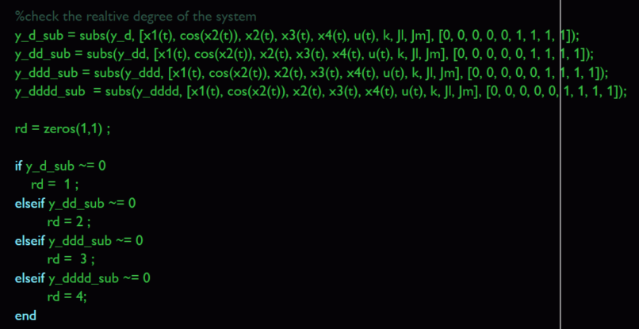
5.1 CHECKING THE RELATIVE DEGREE
The relative degree check was possible thanks to the subs command inside the Symbolic toolbox:
Ale scrivi due righe su quello che hai fatto pls

