Slide 1
Project 3 Next generation sequencing
GMRepo Project PRJNA450230
”Gut microbiota as a potential therapeutic target and diagnostic biomarker for AITD (autoimmune thyroid disease)”

Slide 2
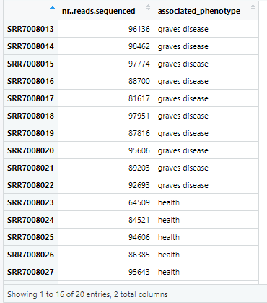
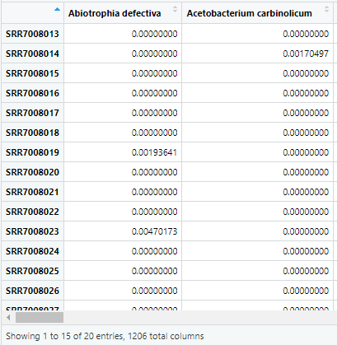
MaAsLin2
Metadata
Sample_file
Fixed effects: associated phenotype contains categorical data (GD vs Heath) impact on microbial abundance
2 variables: no. of reads, Phenotype (GD vs Health)
1206 columns: containing bacterial species
Reference: comparison between Disease and Health phenotype
# Prevalence and abundance filtering in MaAsLin 2
fit_data_filter = Maaslin2(input_data = samples_df,
input_metadata = input_metadata,
normalization = "NONE",
output = "Prevalence_filter",
fixed_effects =c("associated_phenotype),
reference =c("associated_phenotype,health"),
random_effects = c("subject"),
min_prevalence = 0.1,
min_abundance = 0.0001)
Samples
Address non-independence between samples
test only features with at least 10% non-zero values
1

Slide 3
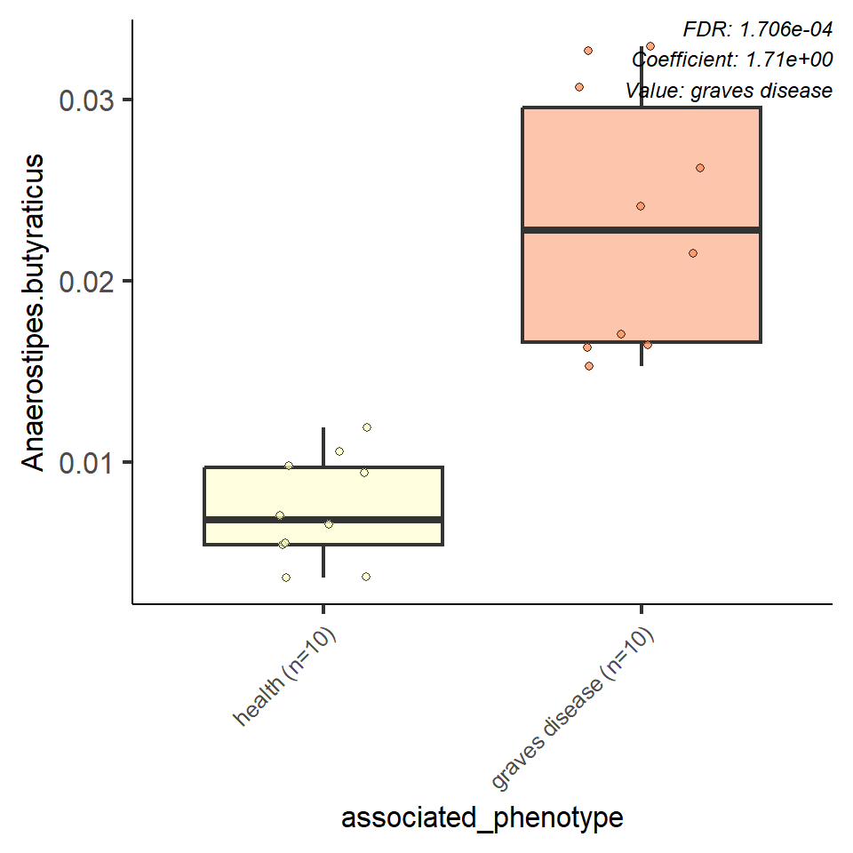
Specie: Anaerostipes.butyraticus
Conclusion:
It is likely that this species is more prevalent or has a higher abundance in individuals with Graves disease compared to healthy individuals. The positive correlation suggests that Anaerostipes butyraticus may play a role in the microbial composition associated with Graves disease.
Features | Anaerostipes.butyraticus
Metadata | associated_phenotype
Value | graves disease
Coef | 1.714554 (+ve correlation)
Stderr | 0.238043
N | 20
N.Not 0 | 20
pval | 1.06E-06 (Significant)
qval | 0.000171
2

Slide 4

Literature Review
Genus-level studies have been performed that negatively corelate Anaerostipes with Graves disease and highlight the role in immune system regulation.
It is important to note that this data is based on a limited sample size (n=10 per group) and further validation through larger studies and experimental investigations is necessary to establish a causal relationship between Anaerostipes butyraticus and Graves disease.
3

