Slide 1
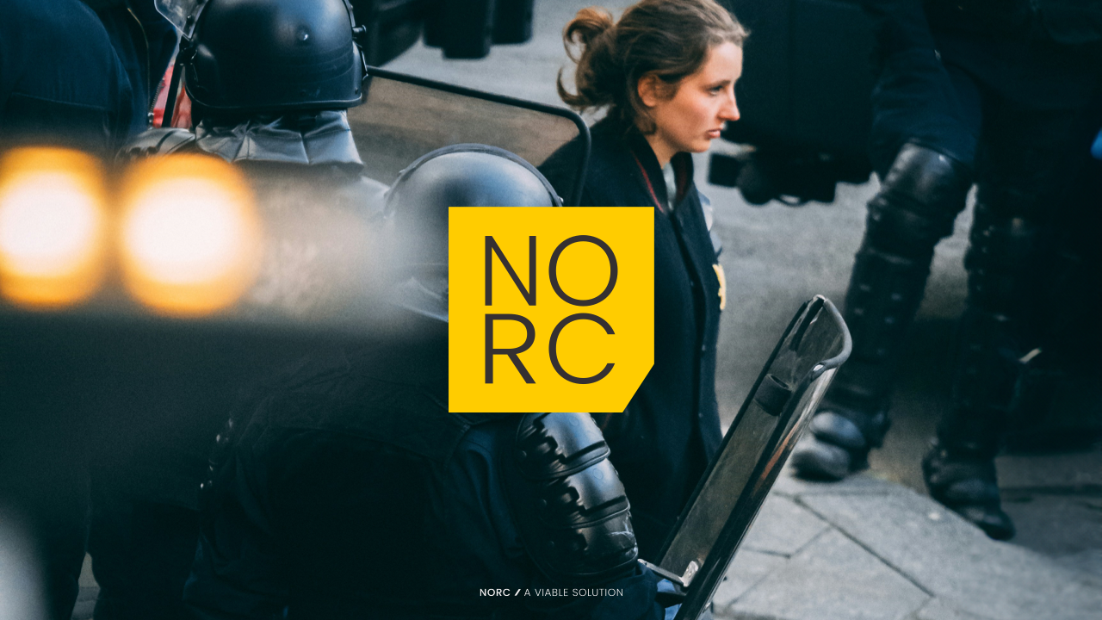
NORDIC TRUST
NORC understands the Nordic market —
and what builds trust here.
01
Trust first
Nordic decision-makers buy trust before they buy transformation.
02
Market sense
Team Neusta has the capacity. NORC makes it understandable, relevant and credible in Sweden and the Nordics.
We understand how brands, organisations and people work here.
03
Clear conversations
We turn complex offers into clear positions, meaningful narratives and credible conversations.
NORC x Team Neusta
01

Slide 2
NORC APPROACH
NO
RC
More than communication — we build meaning, relevance and resilience.
We are not your standard-issue communication agency.
01
Decades of experience
Brand, marketing, communication and strategic positioning.
02
Brands that matter
Connecting rational value with emotional relevance.
Communicate when it matters most.
03
Clarity in complexity
Helping organisations communicate with credibility in complex environments.
NORC x Team Neusta
02

Slide 3
SHARED PURPOSE
A shared European purpose: resilience, sustainability and democratic industry.
Resilient societies
Democratic strength
Human value
Sustainable progress and industry-friendly transformation.
A strong, open Sweden, Nordic region and Europe for future generations.
Meet external and internal threats without losing sight of innovation and enterprise.
Team Neusta brings digital transformation capacity. NORC brings Nordic trust, relevance and strategic meaning. Together, we can help build a more resilient Nordic and European future.
NORC x Team Neusta
03

