Slide 1
Krejzy věci s SSH
Adam Kalisz adam.kalisz@notnullmakers.com

Slide 2
5 years since
IF2019: Advanced misuse of (mostly) OpenSSH https://www.youtube.com/watch?v=UpXqW2DFfMI
LD2019: SSH nejen pro vzdálenou správu Linuxu
(Petr Krčmář) https://www.youtube.com/watch?v=mWB2ralMAG0

Slide 3
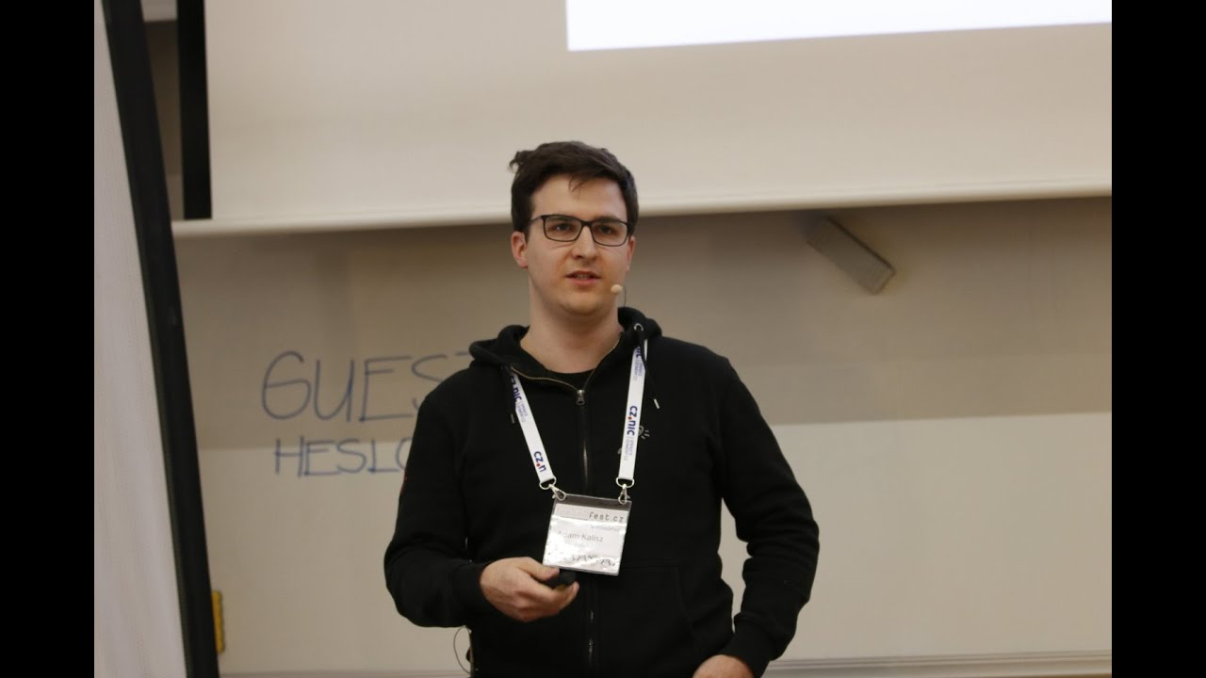

Slide 4
V minulých dílech jste viděli...
-L Local Port Forwarding
-R Remote Port Forwarding
-D Dynamic Port Forwarding/ SOCKS Proxy
-w TUN/ "VPN"
(SSH over TOR, SSH over DNS)

Slide 5
/etc/services
%WINDIR%\system32\drivers\etc\services

Slide 6
Anything over HTTP(S)
Notes:
Chisel (https://github.com/jpillora/chisel)
https://goteleport.com/
https://guacamole.apache.org/
SSH over HTTP/3 (https://arxiv.org/abs/2312.08396 https://github.com/francoismichel/ssh3 https://news.ycombinator.com/item?id=38664729)
https://github.com/moul/quicssh
https://github.com/erebe/wstunnel
https://github.com/nnathan/monopiped

Slide 7
Chisel (https://github.com/jpillora/chisel)
Teleport https://goteleport.com/
Guacamole https://guacamole.apache.org/
SSH over HTTP/3 or QUIC
https://github.com/francoismichel/ssh3
WS tunnel https://github.com/erebe/wstunnel

Slide 8
What is left?
Notes:
NTP (simulate NTP traffic or just use port 123/tcp or SSH/QUIC or Wireguard over 123/ udp)
https://github.com/rtctunnel/rtctunnel
SMTP/ Submission/ IMAP/ Exchange ActiveSync/ POP3/Starttls?
RDP (https://rdp2tcp.sourceforge.net/)
ICMP (https://github.com/DhavalKapil/icmptunnel)
FTP

Slide 9
WebRTC https://github.com/rtctunnel/rtctunnel
ICMP (https://github.com/DhavalKapil/icmptunnel)
RDP (https://rdp2tcp.sourceforge.net/)
FTP
NTP
Exchange ActiveSync
SMTP/ Submission/ IMAP/ POP3

Slide 10
Performance
Notes:
SSH has known problems because of limited buffers and

Slide 11
Bandwidth Delay Product

Slide 12
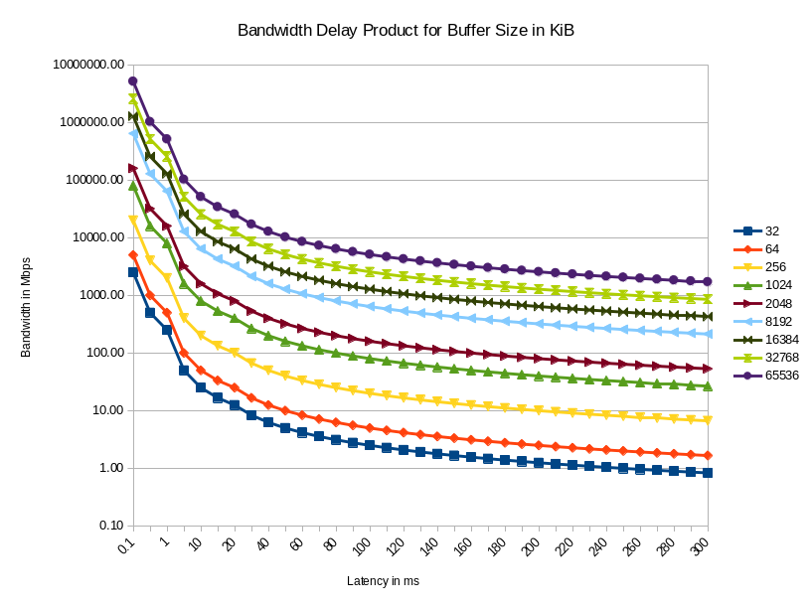

Slide 13
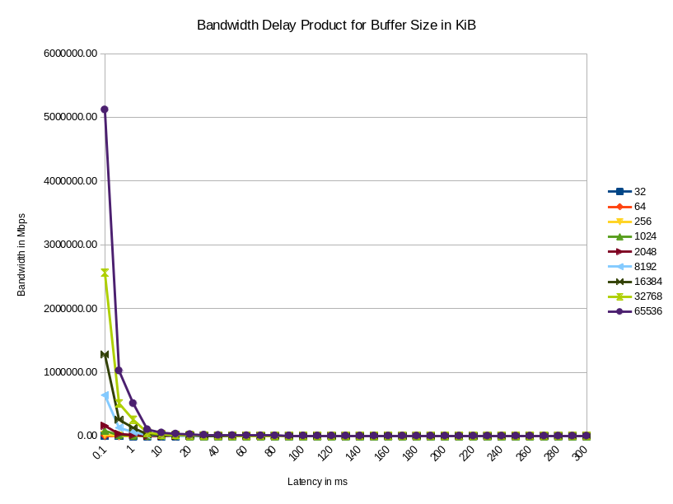

Slide 14
Growing Latency, Falling Bandwidth
Be smarter
AQM (e.g. using CAKE, fq_codel)
Congestion Control (BBRv2/v3?)
Prioritization of ACKs (ToS, DiffServ, ECN)
Appropriate buffer size
LASER/ MW links
Notes:
transfer less, compression, caching, differential transfers,
https://en.wikipedia.org/wiki/Type_of_service
https://datatracker.ietf.org/meeting/117/materials/slides-117-ccwg-bbrv3-algorithm-bug-fixes-and-public-internet-deployment-00
https://www.ietf.org/proceedings/97/slides/slides-97-iccrg-bbr-congestion-control-02.pdf
https://news.ycombinator.com/item?id=37403799
-> stealing bandwidth in BBRv1
Microwave links for HFT (glas fiber core only 200 km/ms) -> these are more direct and almost speed of light

Slide 15
Problems With SSH
Buffers at max 2 MB
Slow establishment of connections
Security vs performance
Notes:
HPN-SSH
ControlMaster, keys, KexAlgorithms

Slide 16
ip netns add ns-bad
ip link add veth-good type veth peer \
name veth-bad
ip link set veth-bad netns ns-bad
ip netns exec ns-bad ip link set dev \
veth-bad up && ip netns exec ns-bad ip \
address add 172.16.0.1/24 dev veth-bad
ip link set dev veth-good up && \
ip addr add 172.16.0.2/24 dev veth-good
ip netns exec ns-bad tc qdisc add dev \
veth-bad root netem delay 25ms
tc qdisc add dev veth-good root netem delay 25ms

Slide 17
stunnel

Slide 18
ip netns del ns-bad
ip link del veth-good

Slide 19
KexAlgorithms, Ciphers, (MACs)

Slide 20
Thank You 🎉
For later questions, feedback: adam.kalisz@notnullmakers.com

