Slide 1

SSH commented speedrun
Adam Kalisz adam.kalisz@notnullmakers.com

Slide 2
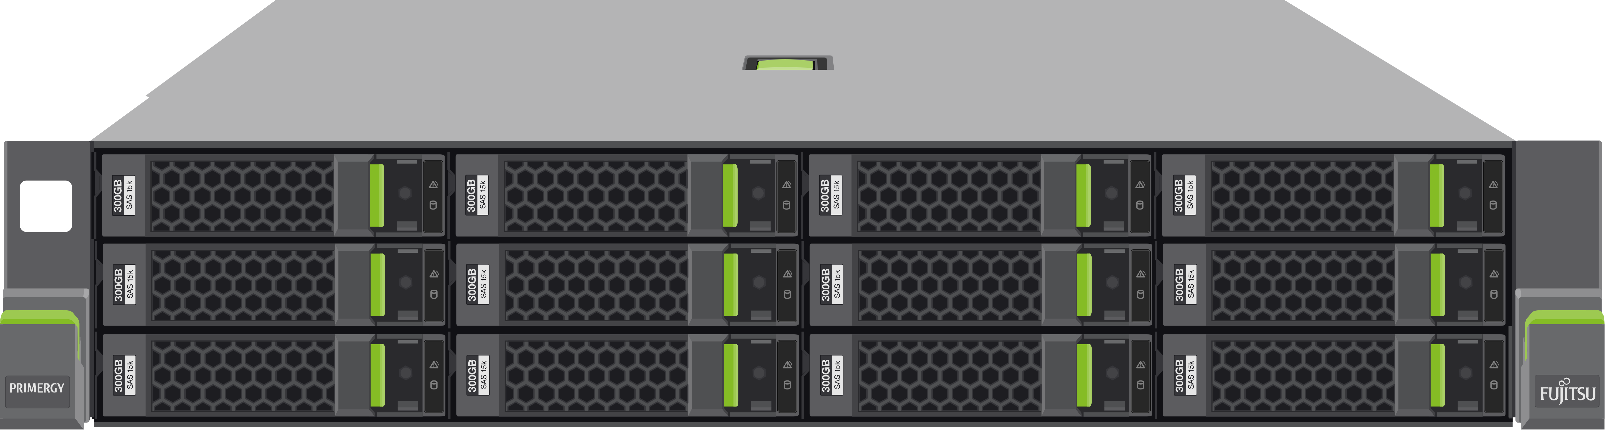
SSH Components
Client ssh
Server sshd

Slide 3
Connect
ssh user@destination
Like e-mail 😉

Slide 4

Connect
ssh root@2.28.229.111
ssh abel@2a01:4f8:1c18:8773::1
ssh bob@training.notnullmakers.com
🤫

Slide 5
abel bob carmen dido elias fred gustav hank ian jules karel luna mia nina oleg paul quentin richard simon tomas ursula vit walter xena yale zara adam bert cameron david eva felix gabriel hunter ivan jana kevin leo mark nadia omar pablo qasim rose saul tara uma vivian wren xavier yael zelda
🤫

Slide 6
Connect 😨
The authenticity of host 'training.notnullmakers.com (2.28.229.111)' can't be established.
ED25519 key fingerprint is SHA256:QX9HDKeDpSVQ9PFKZ6s5TvvUAkvCIBHlRw0A38ePoH8.
This key is not known by any other names.
Are you sure you want to continue connecting (yes/no/[fingerprint])?

Slide 7
Keys
ssh-keygen -t ed25519 -C "training"
-> /home/user/.ssh/id_ed25519
-> /home/user/.ssh/id_ed25519.pub

Slide 8
More Keys
ssh-keygen -t ed25519 -C "training" \
-f training_key -N ''

Slide 9
Authorized Keys
~/.ssh/authorized_keys
ssh-copy-id -i <pubkey> user@host
ssh-copy-id -i .ssh/id_ed25519 \
<user>@training.notnullmakers.com

Slide 10
Authorized Keys
cat ~/.ssh/id_ed25519.pub | \
ssh user@host "mkdir -p .ssh && \
cat - >> .ssh/authorized_keys"

Slide 11
Known Hosts
~/.ssh/known_hosts
|1|+cerzND2aFOgYWkP2/HT41sQ0Lk=|aCOFWYM9HhjeZTLif7G5I9Q6OdU= ssh-ed25519 AAAAC3NzaC1lZDI1NTE5AAAAID3JIjt4i+tq2If+QityO8pu+Qv49VegOAuVtrIWzh7r
|1|OMbjux2v31Jap4mbBZeABYRMo1U=|fEcByJzGBqFc1YX9eVEHdhQ2CHY= ssh-rsa AAAAB3NzaC1yc2EAAAADAQABAAABgQC1TLqUZsONda1wXuP98nFZSuPODZhywuC6dzOVqgd9rrJk8x0+gDgpa8aWBfWP0oxMsAZw1mwDwj905L2tO013LTk...

Slide 12
Host Keys
/etc/ssh/ssh_host_ecdsa_key
/etc/ssh/ssh_host_ecdsa_key.pub
/etc/ssh/ssh_host_ed25519_key
/etc/ssh/ssh_host_ed25519_key.pub
/etc/ssh/ssh_host_rsa_key
/etc/ssh/ssh_host_rsa_key.pub

Slide 13
SSH Config
~/.ssh/config or /etc/ssh/ssh_config
Host europe
HostName 2.28.229.111
User <user>
IdentityFile %d/.ssh/id_ed25519
IdentitiesOnly yes

Slide 14
Connect Revisited
ssh root@2.28.229.111
ssh abel@2a01:4f8:1c18:8773::1
ssh bob@training.notnullmakers.com
ssh europe
🤯

Slide 15
SSH-Agent
ssh-add ~/.ssh/id_ed25519
ssh-add -d ~/.ssh/id_ed25519

Slide 16
Copy File To Remote Destination
scp <file> europe:~/<file>

Slide 17
Copy Files To Remote Destination
scp <file1> <file2> europe:~/
scp -pr <dir> europe:~/

Slide 18
SFTP
Interactive or batched

Slide 19
Rsync
Saving data transfers

Slide 20
Piping Over SSH
cat, dd, tar

Slide 21
Training Setup
👨‍💼
europe
west-coast

Slide 22
ProxyJump - Intermediary Host
ssh -J europe <user>@west-coast
-> west-coast in /etc/hosts

Slide 23
Tunneling over SOCKS 🧦
ssh -D 9999 -J europe \
<user>@west-coast

Slide 24
Other Tunneling Options
Local Port Forwarding (-L)
Remote Port Forwarding (-R)

Slide 25
Tunneling RDP 🪟
Tunnel Remote Desktop Protocol through SSH
ssh -L 5000:win-host:3389 \
-J jump-host <user>@box-that-sees

Slide 26
Tunneling CIFS/Samba
ssh -L 5445:win-host:445 \
-J jump-host <user>@box-that-sees

Slide 27
Only SFTP Server
In /etc/ssh/sshd_config
Subsystem sftp internal-sftp
Match Group sftponly
ChrootDirectory /uploads
ForceCommand internal-sftp
PermitTunnel no
X11Forwarding no
AllowTcpForwarding no

Slide 28
Only SFTP Server Continued
groupadd sftponly
useradd -d /uploads -g sftponly \
-s /sbin/nologin -M upload
mkdir -p /uploads/new
chown upload:sftponly /uploads/new
passwd upload
systemctl restart sshd

Slide 29
Only SFTP Server Continued
groupadd sftponly
useradd -d /uploads -g sftponly \
-s /sbin/nologin -M upload
mkdir -p /uploads/new
chown upload:sftponly /uploads/new
passwd upload
systemctl restart sshd

Slide 30
Forwarding and Reverse Proxying
nftables - Network Address/ Port Translation
nginx - Reverse proxy

Slide 31
Thank You 🎉
For later questions, feedback: adam.kalisz@notnullmakers.com

