Slide 1

InetAddress Internals
Adam Kalisz adam.kalisz@notnullmakers.com

Slide 2


Slide 3
Environment
GNU/ Linux – Debian 13
OpenJDK 21
dual-stack

Slide 4
Memory (in)efficiency of IPv4 in Java
For Inet4Address Java uses 56 B instead of 32 b (4 B), 15x overhead
Inet4Address object uses 24 B currently
InetAddressHolder 32 B and can contain hostname a address type (IPv4 = 1, IPv6 = 2)
Straight forward to lower to ~24 B total now, with project Lilliput and Valhalla (value objects) even more, perhaps 16 B or even less

Slide 5
Memory (in)efficiency of IPv6 in Java
For Inet6Address uses 120 B instead of 128 b (16 B), 7,5x overhead
Inet6Address object uses InetAddressHolder inherited from InetAddress and adds Inet6AddressHolder, which has scope and an array for the address itself.
In comparison java.util.UUID uses 2x long
32B – 40 B should be doable now

Slide 6
In Linux kernel
struct in_addr {
__be32 s_addr;
};
struct in6_addr {
union {
__u8 u6_addr8[16];
__be16 u6_addr16[8];
__be32 u6_addr32[4];
} in6_u;
};

Slide 7
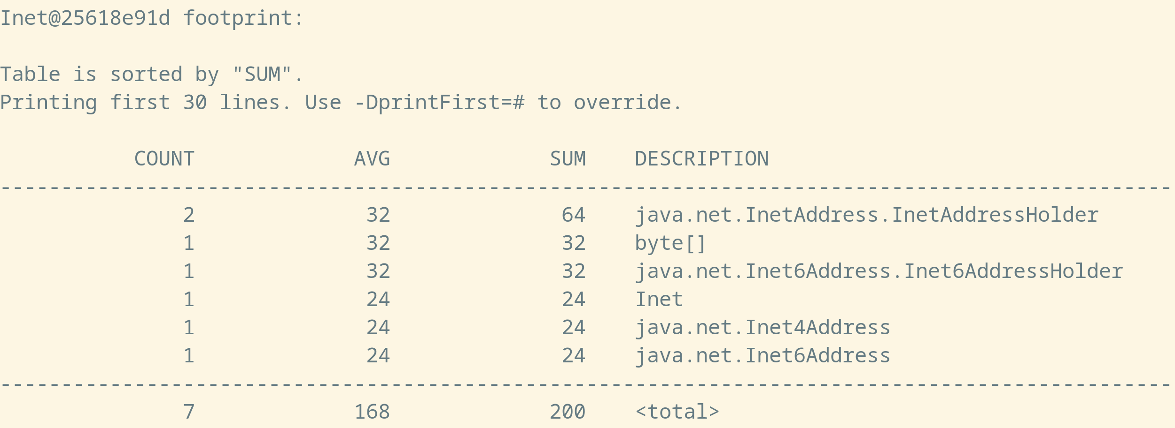
The layout of the object

Slide 8
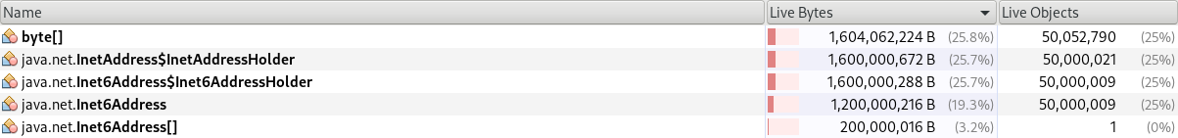
Memory usage with Inet4Address
Memory usage with Inet6Address
32 B + 24 B = 56 B
3x 32 B + 24 B = 120 B
VisualVM

Slide 9
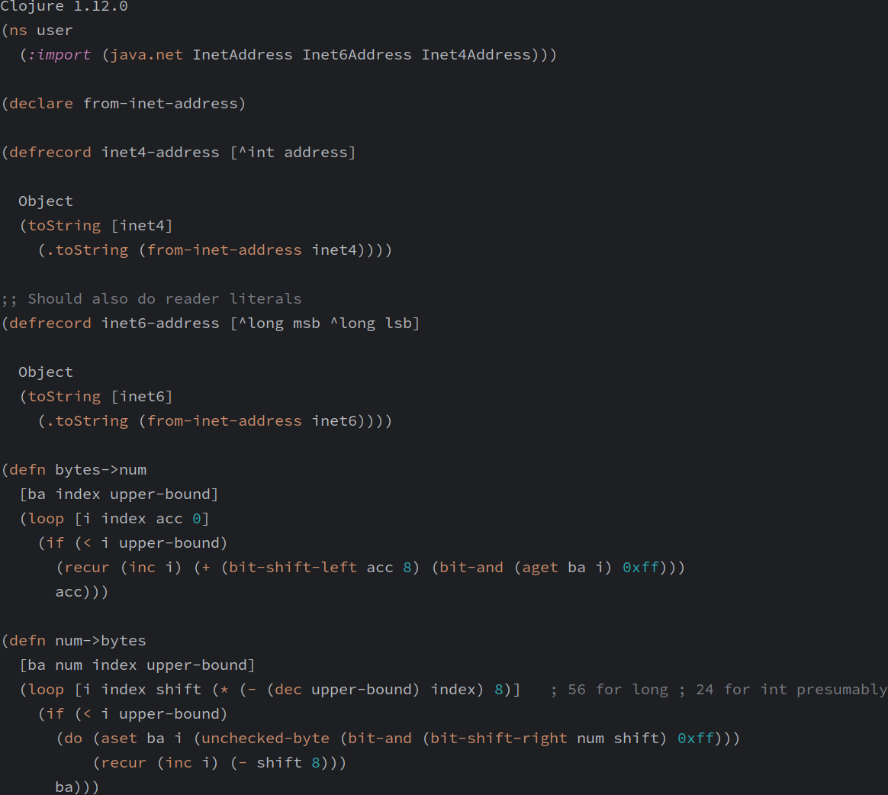
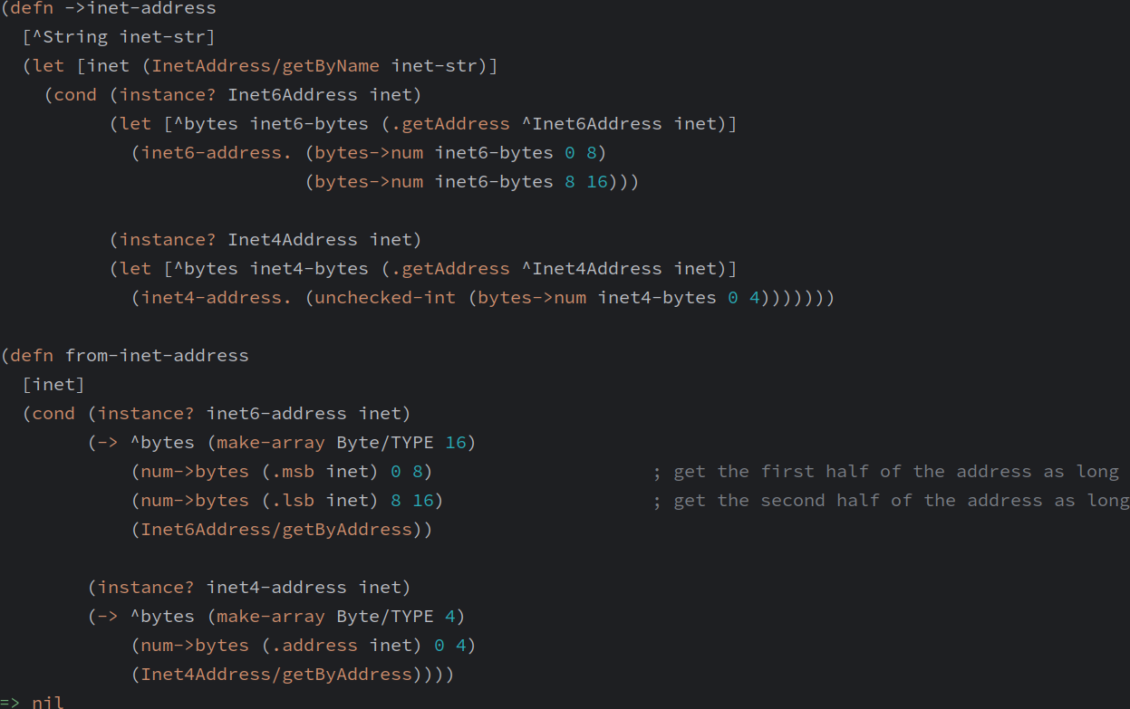
Prototype in Clojure

Slide 10
Sources
https://docs.oracle.com/en/java/javase/21/core/java-networking.html#GUID-540A1A77-3890-4303-A1EA-B51CCE58463B
https://github.com/netty/netty/issues/13400
https://docs.oracle.com/en/java/javase/21/docs/api/java.base/java/net/InetAddress.html
https://github.com/openjdk/jdk/blob/master/src/java.base/unix/native/libnet/Inet4AddressImpl.c
https://github.com/openjdk/jdk/blob/master/src/java.base/unix/native/libnet/net_util_md.c
https://github.com/openjdk/jdk/blob/master/src/java.base/share/classes/java/net/InetAddress.java
https://github.com/openjdk/jdk/blob/master/src/java.base/share/classes/java/net/Inet4Address.java
https://github.com/openjdk/jdk/blob/master/src/java.base/share/classes/java/net/Inet6Address.java
https://github.com/openjdk/jdk/blob/master/src/java.base/share/classes/java/util/UUID.java
man capabilities(7)
https://www.youtube.com/watch?v=kHJ1moNLwao
https://github.com/torvalds/linux/blob/master/include/uapi/linux/in.h
https://github.com/torvalds/linux/blob/master/include/uapi/linux/in6.h

Slide 11
Thank You 🎉
For feedback and later questions: adam.kalisz@notnullmakers.com

