Slide 1

Faster Backup Restore from
Proxmox Backup Server
Adam Kalisz adam.kalisz@notnullmakers.com

Slide 2
Proxmox
Proxmox Virtual Environment (PVE) – all-in-one virtualization solution
Proxmox Backup Server (PBS) – backup appliance suitable for use with PVE
Both based on Debian with extra components

Slide 3
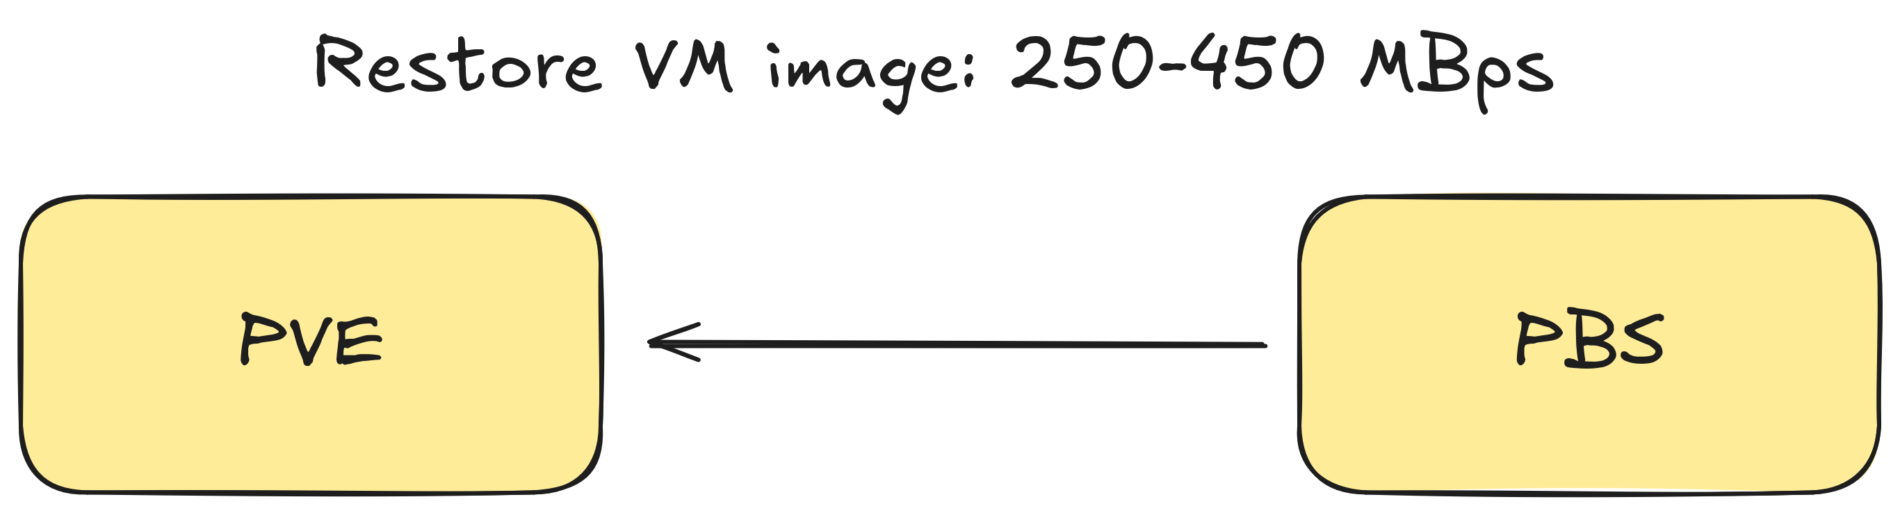
Introduction 1

Slide 4
Introduction 2
🡒 Service Level Agreements (SLA)
🡒 Recovery Time Objective (RTO)
🡒 Restore 1 GBps (~ saturate a 10 Gbps link) even with hardly compressible data
🡒 Supported and maintainable solution

Slide 5
The Challenge
Slow for unknown reason, even on powerful HW
Slower with more incremental backups
Veeam expensive

Slide 6
Investigation 1
- Two bare metal nodes at Hetzner with a direct 10 Gbps connection (< 200 €/ month)
- ZFS for easier setup changes
- Utilization, Saturation, Errors (Brendan Gregg)
- small representative test environment
- build environment for Proxmox

Slide 7
Investigation 2
- qmrestore 🡒 just a perl script calling pbs-restore
🡒 restore.rs in proxmox-backup-qemu
🡒 need to learn a bit of Rust to understand
🡒 use Gemini 2.5 Pro within Workspace Business Standard for prototypes

Slide 8
Investigation 3
Add print statements for debugging, build libproxmox-backup-qemu0 for testing
Test ideas:
- two connections to PBS because network latency seems to be the problem

Slide 9
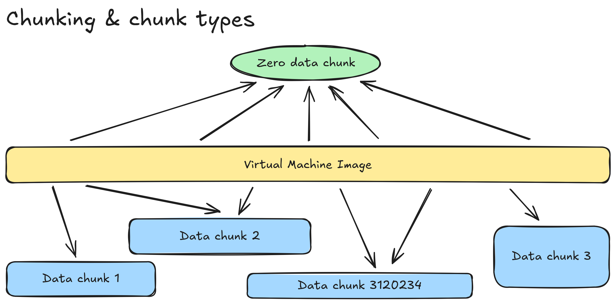

Slide 10
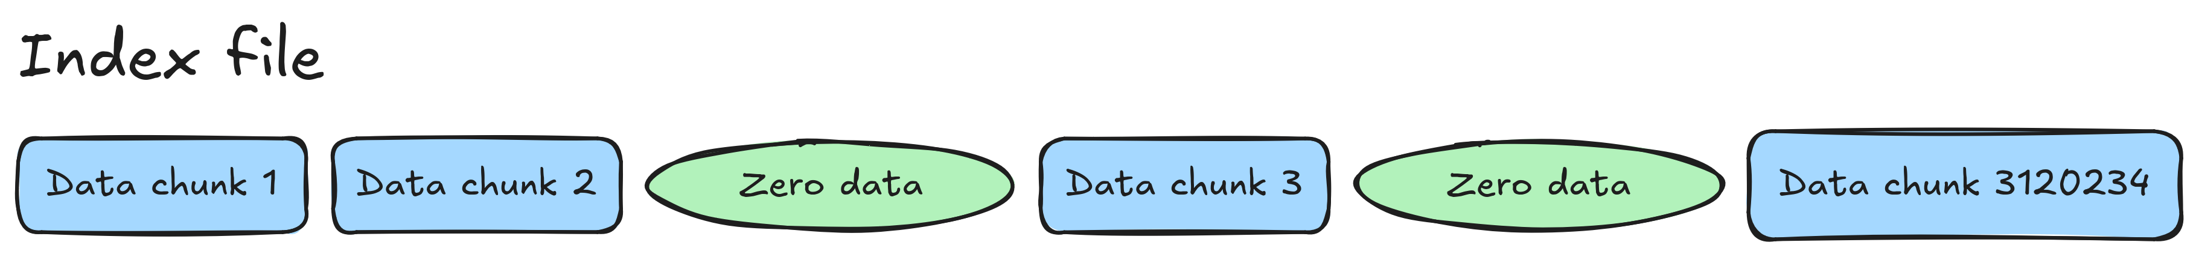

Slide 11
Diagnosis
It seems we are waiting for chunks and doing one at a time!
🡒 Go through all indexes and restore zero chunks immediately, for data chunks store a future. Realize futures in multiple threads.

Slide 12
Results
🡒 Much faster, hitting 1 GBps with multiple threads
🡒 Proves single encrypted HTTP/2 connection wasn't the main bottleneck
🡒 But: Writes chunks out of order now, could be bad for hard disks, change of behavior, brute force

Slide 13
Integration Into Proxmox
Dominik Csapak 🡒 async + worker threads solution
🡒 More resource conscious, writes chunks in order, somewhat slower on older multi-socket servers
Now in Proxmox VE 9 or as update for Proxmox VE 8.4

Slide 14
Other Speedups
- Similar approach with concurrency in other places
- Speedup verify speed by parallel chunk loading on PBS (concerns about DDoS 🡒 ability to opt out)

Slide 15
Takeaways
- About 2.5x to 4x faster now depending on latency, HW (clock, SHA / AES acceleration), settings
- Feasible to replace Veeam with PBS in more cases
- More speedups possible
- Open source systems improvements by 3rd party
- Performance debugging saves money

Slide 16
qmrestore
pbs-restore
restore.rs
RemoteChunkReader
Rust tutorial, Derek Banas
Forum complaints about slow restore
Lupa article by Jan Sedlák, 2025-08-12

Slide 17
Thank You 🎉
For later questions, feedback: adam.kalisz@notnullmakers.com

