Slide 1

Krejzy věci s SSH'
Adam Kalisz adam.kalisz@notnullmakers.com

Slide 2
5 years since
IF2019: Advanced misuse of (mostly) OpenSSH https://www.youtube.com/watch?v=UpXqW2DFfMI
LD2019: SSH nejen pro vzdálenou správu Linuxu
(Petr Krčmář) https://www.youtube.com/watch?v=mWB2ralMAG0

Slide 3
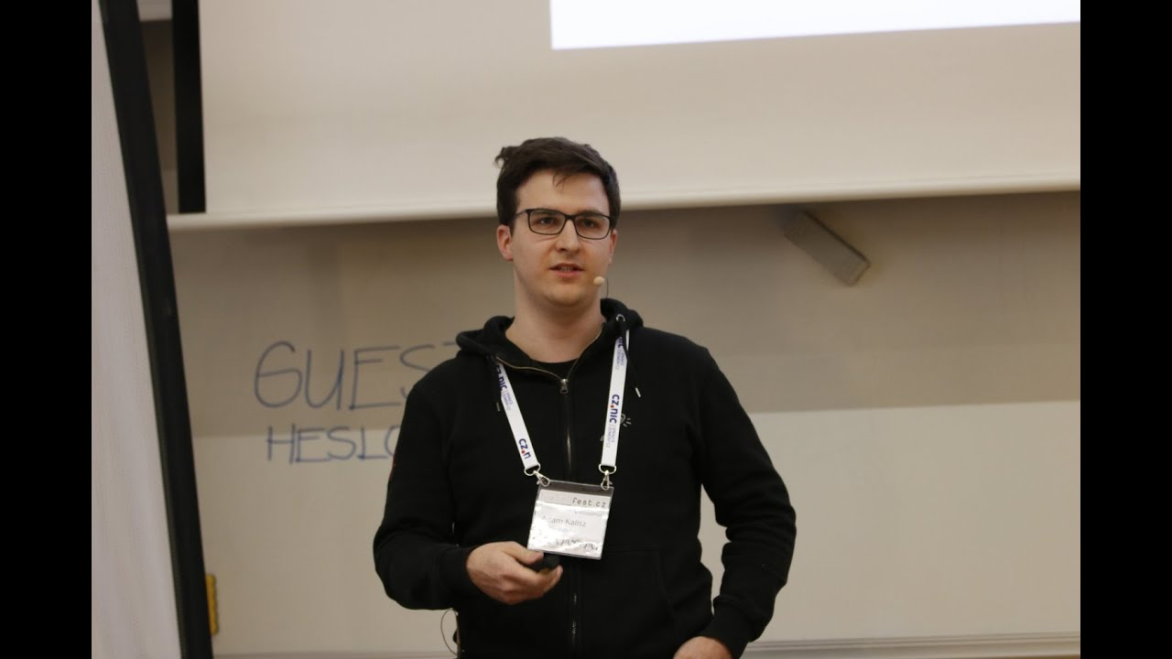

Slide 4
...half a year since
IF2024: Krejzy věci s SSH https://www.youtube.com/watch?v=SW55J6mSxCg

Slide 5
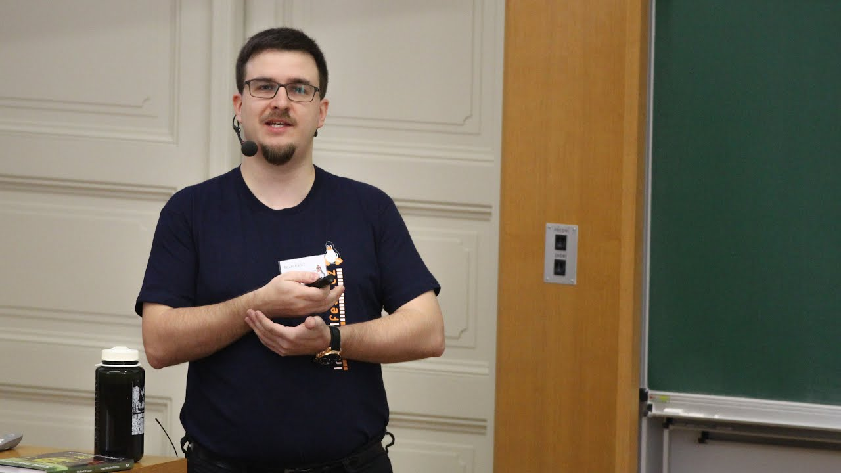

Slide 6
https://www.root.cz/n/ssh

Slide 7
/etc/services
%WINDIR%\system32\drivers\etc\services

Slide 8
Anything over HTTP(S)
Notes:
Chisel (https://github.com/jpillora/chisel)
https://goteleport.com/
https://guacamole.apache.org/
SSH over HTTP/3 (https://arxiv.org/abs/2312.08396 https://github.com/francoismichel/ssh3 https://news.ycombinator.com/item?id=38664729)
https://github.com/moul/quicssh
https://github.com/erebe/wstunnel
https://github.com/nnathan/monopiped

Slide 9
Chisel (https://github.com/jpillora/chisel)
Teleport https://goteleport.com/
Guacamole https://guacamole.apache.org/
SSH over HTTP/3 or QUIC
https://github.com/francoismichel/ssh3
WS tunnel https://github.com/erebe/wstunnel

Slide 10
wstunnel
Notes:
Chisel (https://github.com/jpillora/chisel)
https://goteleport.com/
https://guacamole.apache.org/
SSH over HTTP/3 (https://arxiv.org/abs/2312.08396 https://github.com/francoismichel/ssh3 https://news.ycombinator.com/item?id=38664729)
https://github.com/moul/quicssh
https://github.com/erebe/wstunnel
https://github.com/nnathan/monopiped
https://www.root.cz/clanky/websocket-jako-cesta-k-uniku-z-prilis-restriktivni-site/

Slide 11
What is left?
Notes:
NTP (simulate NTP traffic or just use port 123/tcp or SSH/QUIC or Wireguard over 123/ udp)
https://github.com/rtctunnel/rtctunnel
SMTP/ Submission/ IMAP/ Exchange ActiveSync/ POP3/Starttls?
RDP (https://rdp2tcp.sourceforge.net/)
ICMP (https://github.com/DhavalKapil/icmptunnel)
FTP

Slide 12
WebRTC https://github.com/rtctunnel/rtctunnel
ICMP (https://github.com/DhavalKapil/icmptunnel)
RDP (https://rdp2tcp.sourceforge.net/)
FTP
NTP
Exchange ActiveSync
SMTP/ Submission/ IMAP/ POP3

Slide 13
Encrypted Storage
Notes:
SSH has known problems because of limited buffers and

Slide 14
Precautions and Disaster Procedures

Slide 15
Thank You 🎉
For later questions, feedback: adam.kalisz@notnullmakers.com

