Slide 1
DATA STRUCTURES
LECTURE 1

Slide 2
Course/ Lab Marking
Pre-Lab Tasks (Assignments)
Lab Tasks
Post Lab Tasks
Quiz
Lab Exam
Project
Mid Term
Final Exam

Slide 3
Course objectives
Introduce methods for organizing data so that the data can be accessed and updated efficiently within a computer program.

Slide 4
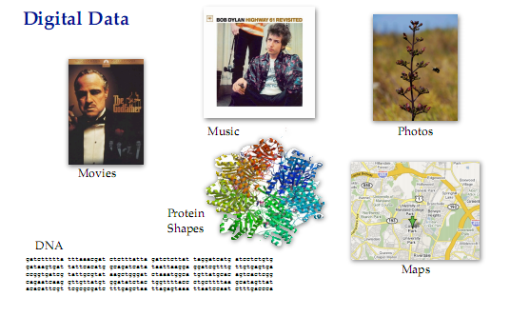
Introduction to Data Structures

Slide 5
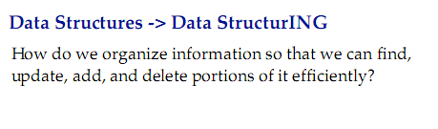
Introduction to Data Structures

Slide 6
Data Structure Example Applications
How does Google quickly ﬁnd web pages that contain a search term?
How does your Operating System track which memory (disk or RAM) is free?
How does the processor handles multitasking

Slide 7
What is a Data Structure Anyway?
It’s an agreement about:
how to store a collection of objects in memory,
what operations we can perform on that data,
the algorithms for those operations, and
how time and space efficient those algorithms are.

Slide 8
Have you ever used a data structure to store your data?
Array in C/C++
Stores objects sequentially in memory
Can access, change, insert or delete objects
Algorithms for insert & delete will shift items as needed

Slide 9
Problem
Write a program in C++ capable of storing data of 100 student’s name, father name, degree, courses registered and registration number. The program should be capable of storing data, updating data of any student, deleting data of any student and display the data of any student.
How can you save the data of students?

Slide 10
Structures
To define a data type having more than one data types
A Structure serves only as a plan, or a template, or sketch- of a number of similar things (i.e. objects)
A Structure is a mechanism for creating user-defined data types.

Slide 11
Structure Syntax
struct name {
// attributes
};

Slide 12
Objects
A structure and an object of that structure has the same relationship as a data type and a variable
All objects with the same characteristics constitute one structure.

Slide 13
Object Instantiation
Once you create a struct type, you can declare one or more objects of that class type. For example:
Struct circle{
// struct body
}
Void main()
{
circle c;
}

Slide 14
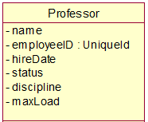
Objects ?
An object is an instance of a struct.
Objects
Attributes
Professor Smith
Professor Mellon
Professor Jones

Slide 15
Contd.
Informally, an object represents an entity, either physical, conceptual, or software.
Physical entity
Conceptual entity
Software entity
Truck
Chemical Process
Linked List
Notes:
Objects allow the software developer to represent real-world concepts in their software design. These real-world concepts can represent a physical entity such as a person, truck, or space shuttle.
Objects can be concepts like a chemical process or algorithms.
Object can even represent software entities like a linked list.

Slide 16
Tasks
Create a structure Rectangle where a rectangle is defined by Length & Width. Each Rectangle has an area and perimeter. You can also compare two rectangles with respect to the area.

Slide 17
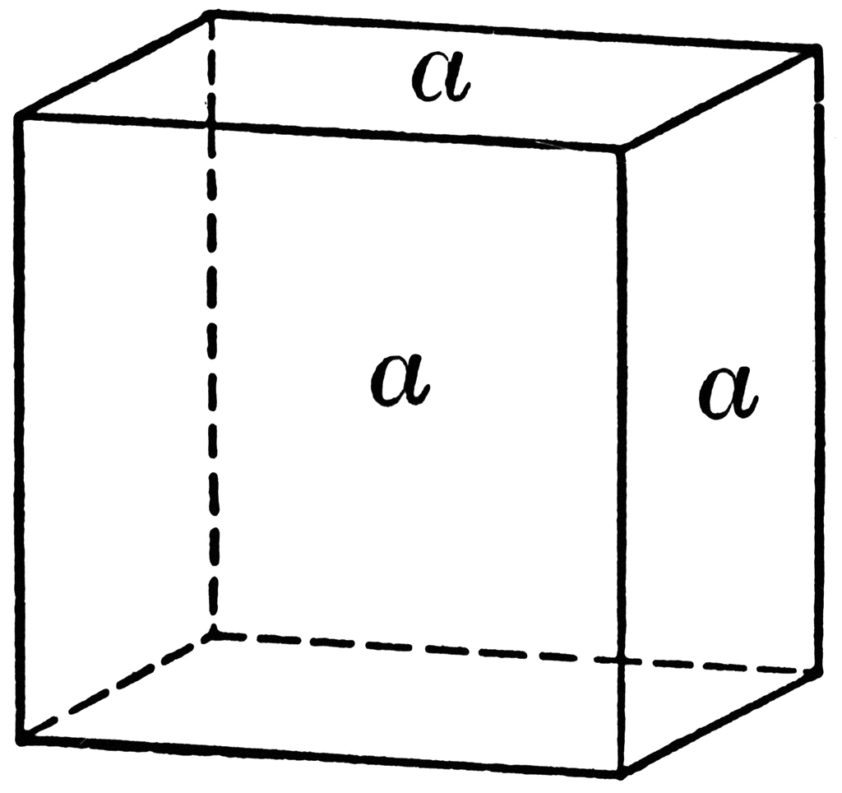
Make a structure “Cube”. Choose appropriate data members. Your program should be able to calculate:
Surface Area of cube (formula area= 6a²)
Volume of cube (volume = a³)

Slide 18
Arrays within a Structure
A structure is a data type in C/C++ that allows a group of related variables to be treated as a single unit instead of separate entities.
A structure may contain elements of different data types – int, char, float, double, etc.
It may also contain an array as its member.
Such an array is called an array within a structure. An array within a structure is a member of the structure and can be accessed just as we access other elements of the structure.

Slide 19
Array of structure
An array is a collection of data items of the same type.
We have seen that a structure allows elements of different data types to be grouped together under a single name.
This structure can then be thought of as a new data type in itself.

Slide 20
Array of structure
So, an array can comprise elements of this new data type.
An array of structures finds its applications in grouping the records together and provides for fast accessing.

Slide 21
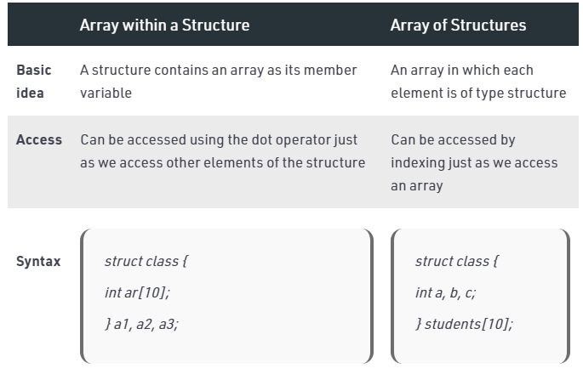
Array of structure vs Array within structure

Slide 22
Task 3
Enter data of 5 students (name, roll_no, degree, marks of 5 subjects) take this data from user.
Then print out in how many subject student is pass or fail. (Passing marks is 50)
Also print if student is pass or fail overall. (Passing marks is 50)
Use Functions and arrays where needed.

Slide 23
Task 4
Write functions to read in and print an Employee struct. (Name,ID,Salary,Status)
Write an additional function that passes in an array of Employees and returns the index to a found id.
Write another function that increases employee salary by 10% if their status is Permanent

