Slide 1
TREE
LECTURE 11

Slide 2
Tree Data Structure
Introduction
The Data Organizations Presented Earlier are Linear in That Items are One After Another
ADTs in This Lecture Organize Data in a Non-Linear, Hierarchical Form, Whereby an Item can Have More Than one Immediate Successor

Slide 3
Definition
A (general) tree is a collection of Nodes and edges such that
There is a single node from which paths to other nodes emerge; this node is called the root
There is a single, unique path to reach any node of the tree
A
B
C
A General Tree
D
E
F

Slide 4
Applications
Because Trees are Hierarchical in Nature, You Can Use Them to Represent Information That Itself is Hierarchical in Nature, For Example Organization Charts and Family Trees
President
Caroline
VP
Marketing
VP
Manufacturing
VP
Personnel
John
Jacqueline
Joseph
Rose
Director
Media Relations
Director
Sales

Slide 5
Terminology
If there is an Edge from Node n to Node m, Then n is the Parent of m, and m is a Child of n
Each Node in a Tree Has at Most One Parent, and the Root of the Tree has no Parent
Children of the Same parent are Called Siblings
A Node That Has no Children is Called a Leaf. Non-leaf nodes are called internal nodes
Example Figure:
Node A is the Root of the Tree,
Nodes B and C are Children of Node A
A is an Ancestor of D, and Thus, D is a Descendant of A
B and C are Not Related by Ancestor and Descendant Relation
A
B
C
D
E
F

Slide 6
Terminology
Binary Tree: a finite set of elements that is either empty or is partitioned into three disjoint subsets.
The first subset contains a single element called the root of the tree
The other two subsets are themselves binary trees, called the left and right sub-trees of the original tree
Each element of a binary tree is called a node

Slide 7
A Binary Tree
V
Q
L
E
T
A
K
S

Slide 8
Example: Jake’s Pizza Shop
Owner
Jake
Manager Chef Brad Carol
Waitress Waiter Cook Helper
Joyce Chris Max Len

Slide 9
A Tree Has a Root Node
Owner
Jake
Manager Chef Brad Carol
Waitress Waiter Cook Helper
Joyce Chris Max Len
ROOT NODE

Slide 10
Leaf nodes have no children
Owner
Jake
Manager Chef Brad Carol
Waitress Waiter Cook Helper
Joyce Chris Max Len
LEAF NODES

Slide 11
Subtrees and Forests
A subtree rooted at u is the tree formed from u and all its descendants.
A forest is a (possibly empty) set of trees.
The set of subtrees rooted at the children of r form a forest.

Slide 12
A Subtree
Owner
Jake
Manager Chef Brad Carol
Waitress Waiter Cook Helper
Joyce Chris Max Len
LEFT SUBTREE OF ROOT NODE

Slide 13
Terminology
Owner
Jake
Manager Chef Brad Carol
Waitress Waiter Cook Helper
Joyce Chris Max Len
RIGHT SUBTREE
OF ROOT NODE

Slide 14
Example: How many leaf nodes?
V
Q
L
E
T
A
K
S

Slide 15
Example: How many descendants of Q?
V
Q
L
E
T
A
K
S

Slide 16
Example: How many ancestors of K?
V
Q
L
E
T
A
K
S

Slide 17
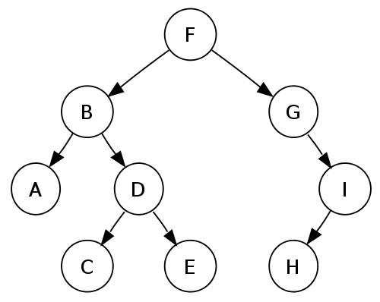
Example: How many ancestors of D?

Slide 18
How many descendants of B?

Slide 19
Example: How many Leaf nodes?

Slide 20
Example: How many internal nodes?

Slide 21
Terminology
A
A
Trees come in Many Shapes.
Level of a Node n
If n is the Root, it is at level 0.
If n is not the Root, its Level is 1 Greater Than the Level of its Parent
Depth (also called Height) of Tree
Length of the Longest Path (in terms of number of edges) From the Root to a Leaf
Maximum level of any leaf in the tree
B
A
B
C
C
D
B
C
D
E
E
F
F
G
D
E
G
G
F

Slide 22
A Tree Has Levels
Owner
Jake
Manager Chef Brad Carol
Waitress Waiter Cook Helper
Joyce Chris Max Len
LEVEL 0

Slide 23
Level One
Owner
Jake
Manager Chef Brad Carol
Waitress Waiter Cook Helper
Joyce Chris Max Len
LEVEL 1

Slide 24
Level Two
Owner
Jake
Manager Chef Brad Carol
Waitress Waiter Cook Helper
Joyce Chris Max Len
LEVEL 2

Slide 25
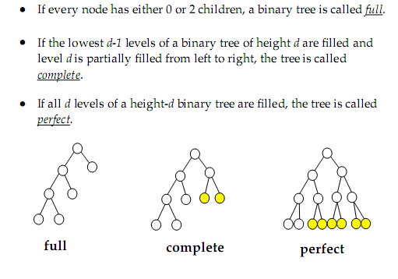
Full, Complete, and Perfect Binary Tree

Slide 26
Full, Complete, and Perfect Binary Tree

Slide 27
Traversals of a Binary Tree
When Traversing any Binary Tree, the Algorithm has Three Choices of When to Visit a Node r:
It Can Visit r Before it Traverses both of r’s Subtrees
It Can Visit r After it Has Traversed r’s Left Subtree T_{L} But Before it Traverses r’s Right Subtree T_{R}
It Can Visit r After it Has Traversed Both of r’s Subtrees
These Traversals are Called Preorder, Inorder, and Postorder traversals Respectively

Slide 28
Traversals of a Binary Tree
Preorder Traversal
Visit the root
Traverse the Left subtree in Preorder
Traverse the Right subtree in Preorder
Notice recursive nature of definition

Slide 29
Preorder Traversal: J E A H T M Y
root
‘J’
‘E’
‘T’
‘A’
‘H’
‘M’
‘Y’

Slide 30
Traversals of a Binary Tree
Inorder Traversal
Traverse the Left subtree in Inorder
Visit the root
Traverse the Right subtree in Inorder
Notice recursive nature of definition

Slide 31
Inorder Traversal: A E H J M T Y
root
‘J’
‘E’
‘T’
‘A’
‘H’
‘M’
‘Y’

Slide 32
Traversals of a Binary Tree
Postorder Traversal
Traverse the Left subtree in Postorder
Traverse the Right subtree in Postorder
Visit the root
Notice recursive nature of definition

Slide 33
Postorder Traversal: A H E M Y T J
root
‘J’
‘E’
‘T’
‘A’
‘H’
‘M’
‘Y’

Slide 34
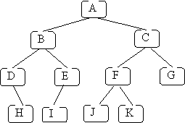
Write its pre-order, in-order and post order traversals

Slide 35
Solution of last slide
Preorder traversal -- A B D H E I C F J K G
In-order traversal -- D H B I E A J F K C G
Post order traversal -- H D I E B J K F G C A

Slide 36
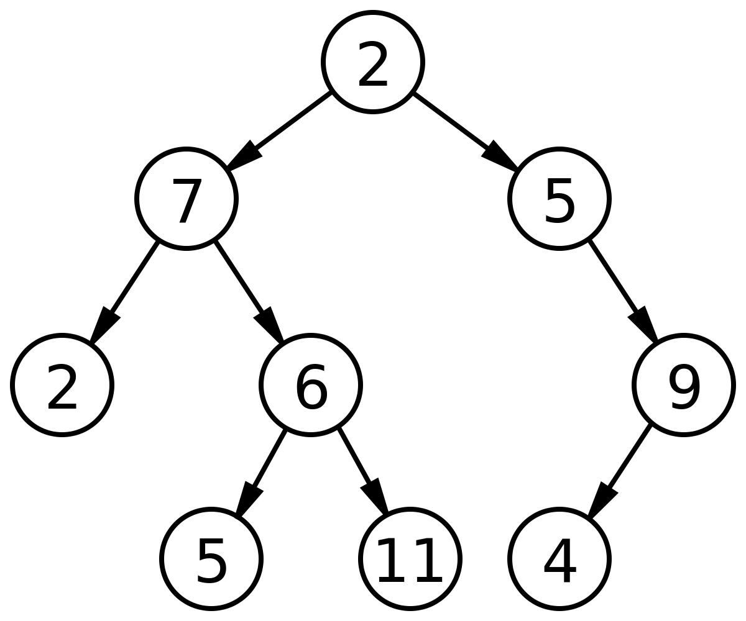
Write its pre-order, in-order and post order traversals

Slide 37
Solution of last slide
Preorder traversal – 2 7 2 6 5 11 5 9 4
In-order traversal – 2 7 5 6 11 2 5 4 9
Post order traversal – 2 5 11 6 7 4 9 5 2

Slide 38
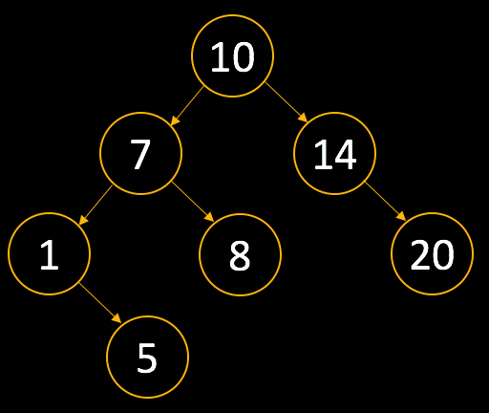
Create BST from Array
[10, 7, 14, 20, 1, 5, 8]

Slide 39
Create BST from Array
[15, 17, 14, 22, 11, 3, 7]

Slide 40
Create BST from Array
[25, 47, 14, 22, 31, 33, 27,11,19]

