Slide 1
Binary Search Tree
LECTURE 13

Slide 2
BST
The properties that separate a binary search tree from a regular binary tree is
All nodes of left subtree are less than the root node
All nodes of right subtree are more than the root node
Both subtrees of each node are also BSTs i.e. they have the above two properties

Slide 3
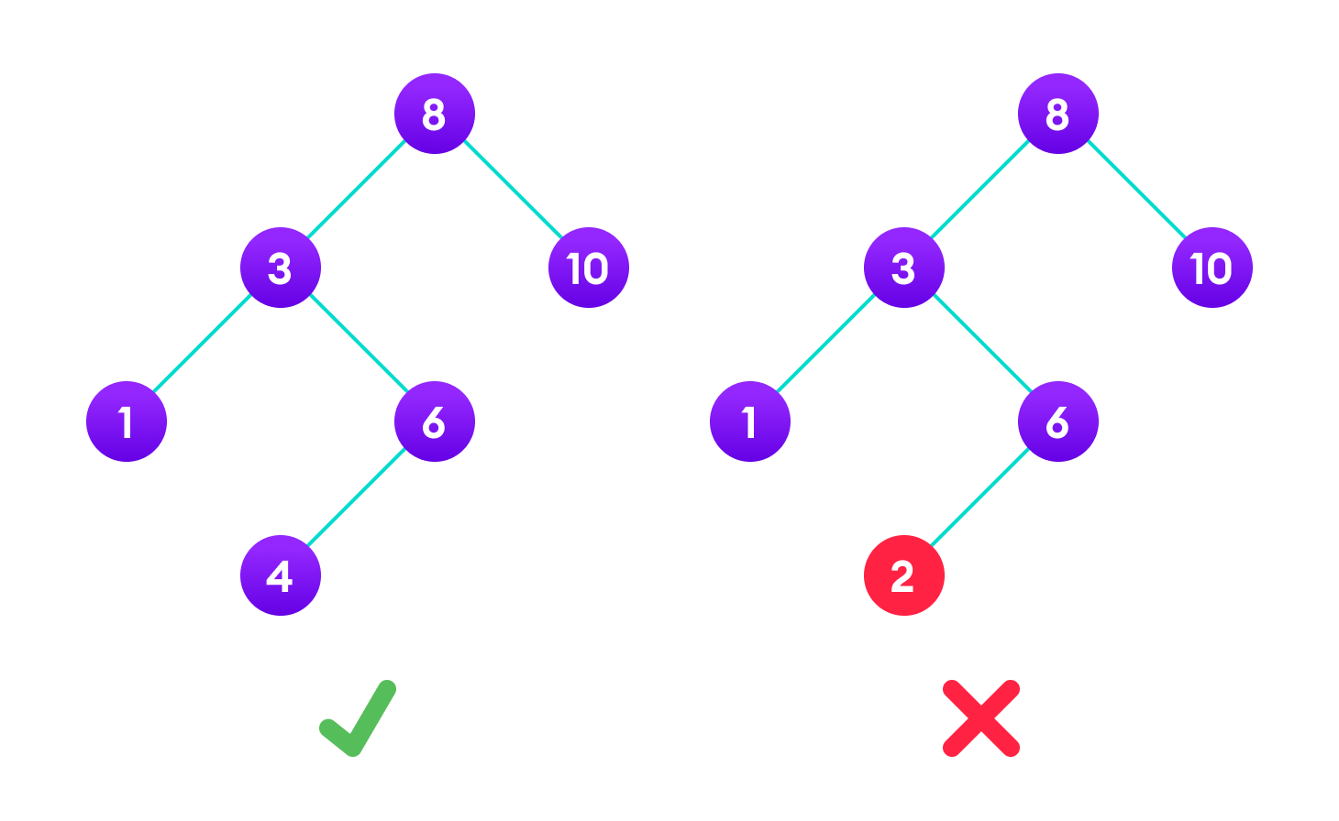
BST

Slide 4
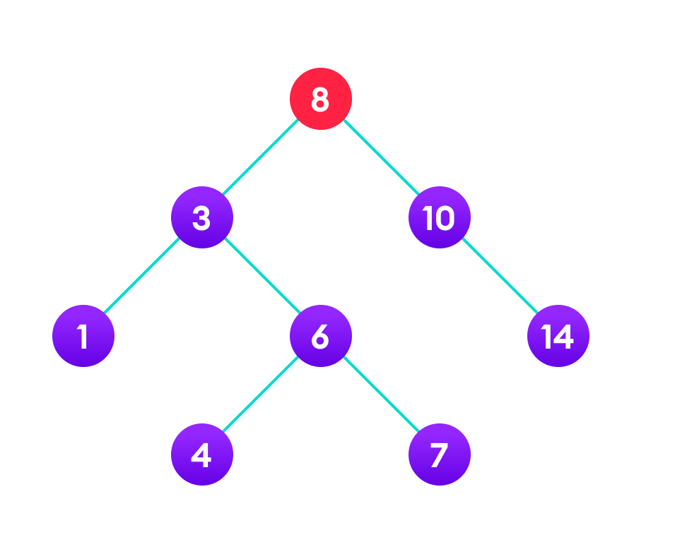
BST Search Operation
If root == NULL
return NULL;
If number == root->data
return root->data;
If number < root->data
return search(root->left)
If number > root->data
return search(root->right)

Slide 5
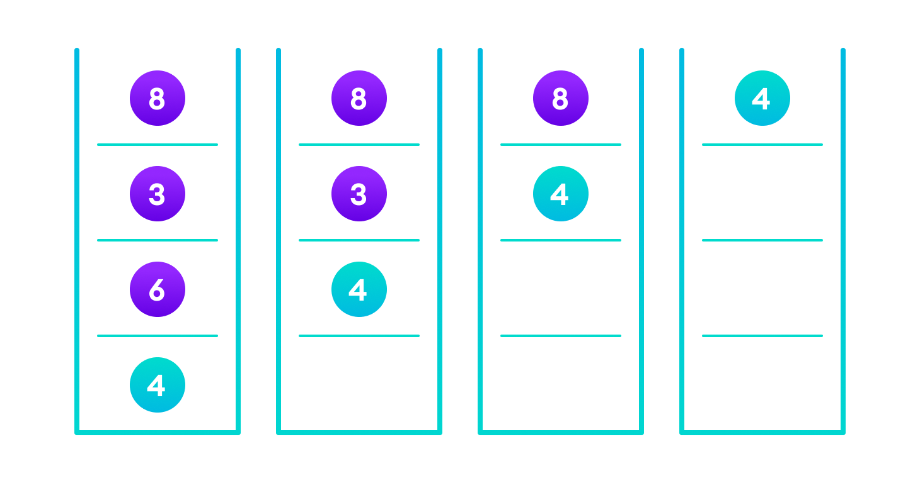
BST Search Operation
If root == NULL || root->key==key
return root;
If number < root->data
return search(root->left)
If number > root->data
return search(root->right)

Slide 6
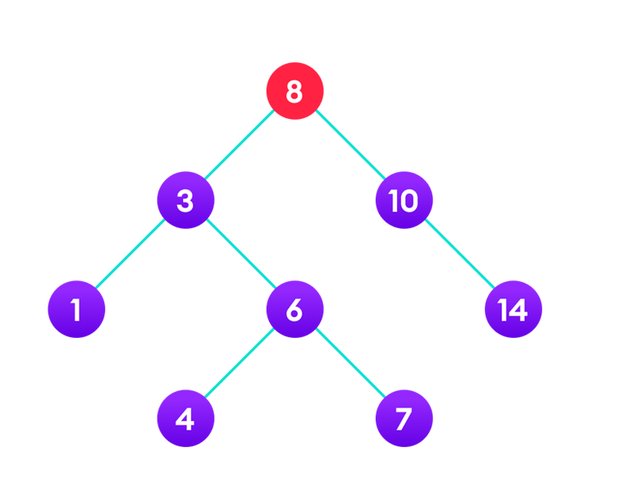
BST Insert Operation
If node == NULL
return createNode(data)
if (data < node->data)
node->left = insert(node->left, data);
else if (data > node->data)
node->right = insert(node->right, data);
return node;

Slide 7
BST Insert Operation
If node == NULL
return createNode(data)
if (data < node->data)
node->left = insert(node->left, data);
else if (data > node->data)
node->right = insert(node->right, data);
return node;

Slide 8
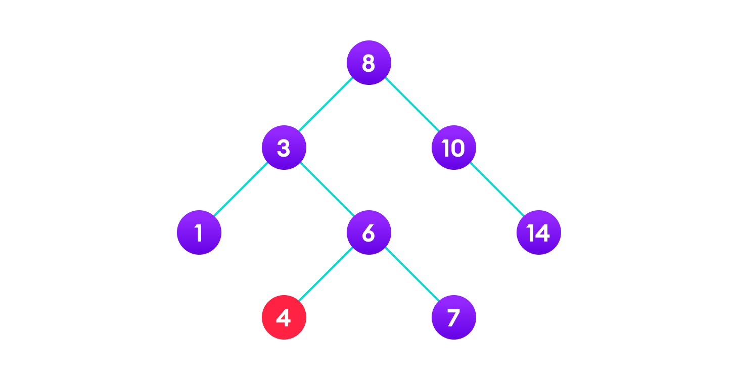
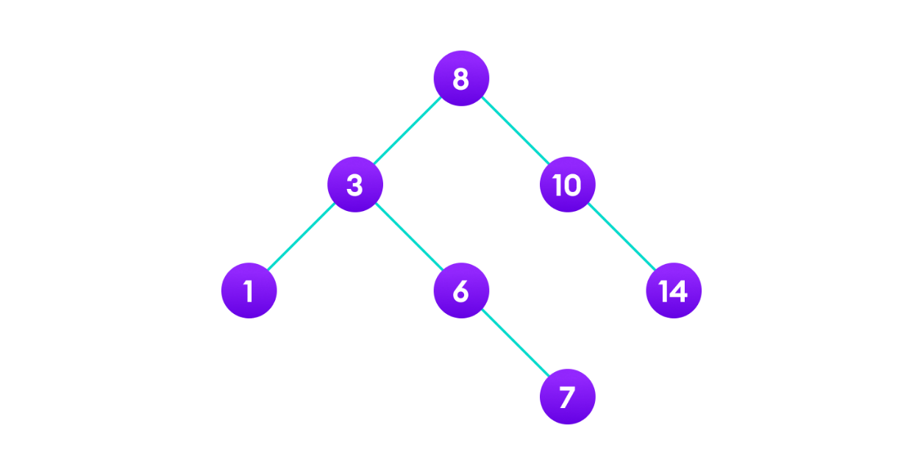
BST Deletion Operation
There are three cases for deleting a node from a binary search tree.
Case I
In the first case, the node to be deleted is the leaf node. In such a case, simply delete the node from the tree.

Slide 9
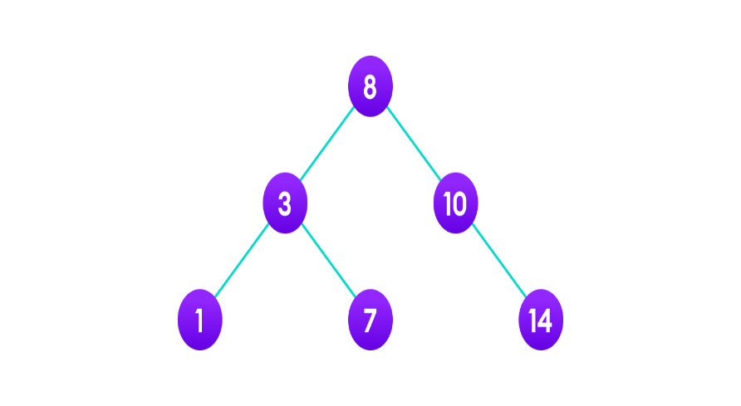
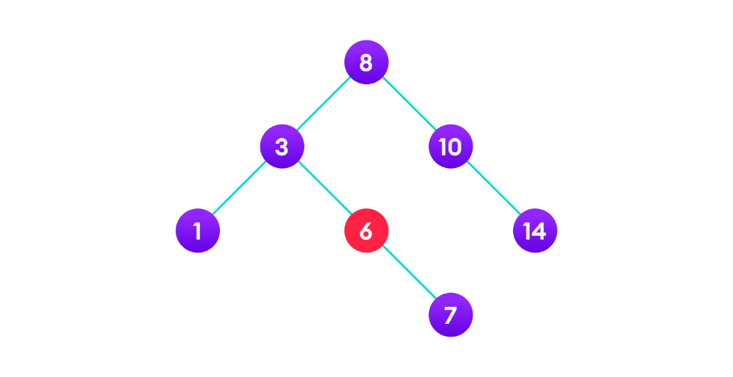
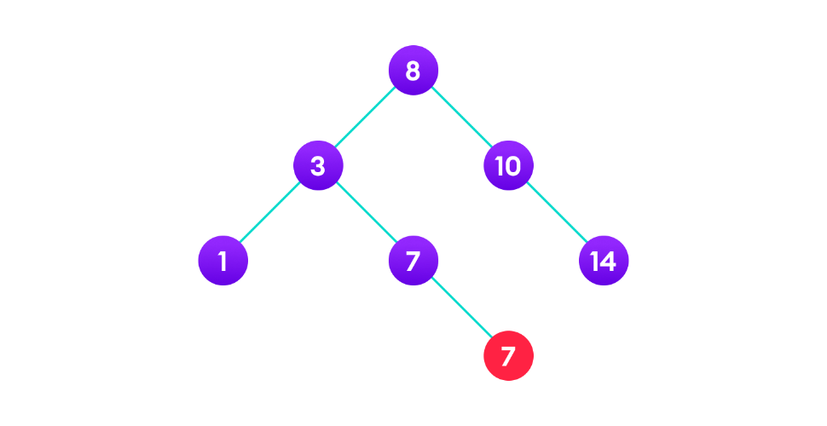
BST Deletion Operation
There are three cases for deleting a node from a binary search tree.
Case II
In the second case, the node to be deleted lies has a single child node. In such a case follow the steps below:
Replace that node with its child node.
Remove the child node from its original position.

Slide 10
BST Deletion Operation
There are three cases for deleting a node from a binary search tree.
Case III
In the third case, the node to be deleted has two children. In such a case follow the steps below:
Get the in-order successor of that node.
Replace the node with the in-order successor.
Remove the in-order successor from its original position.

Slide 11
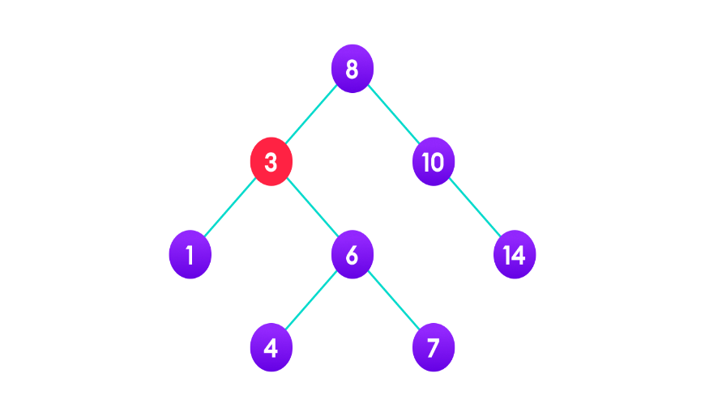


BST Deletion Operation
There are three cases for deleting a node from a binary search tree.
Case III

Slide 12
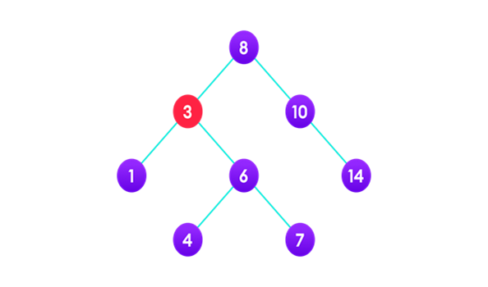
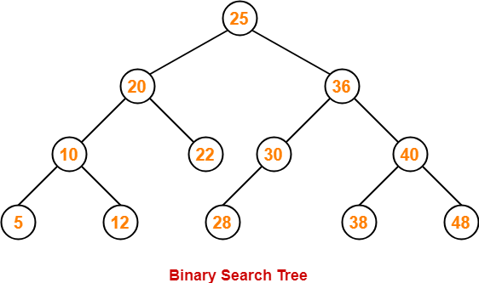
BST Deletion Operation
Finding in-order Successor.
node *minValueNode(node *node) {
node *current = node;
// Find the leftmost leaf
while (current && current->left != NULL)
current = current->left;
return current;
}

