Slide 1
Graph Data Structure
Lecture 14

Slide 2

What is a graph (data structure)?
A graph consists of a finite set of nodes (or vertices) and a set of edges connecting them.
A pair (x , y) is referred to as an edge, which communicates that the x vertex connects to the y vertex.
In the example below, circles represent vertices, while lines represent edges.

Slide 3
Basic Graph Terminologies
Vertices
Nodes in a graphs are called vertices.
Edges
Links connecting two nodes is called edge.
Weights
It is cost of the edge.
Paths
It is a set of links to reach from node A to node B.

Slide 4
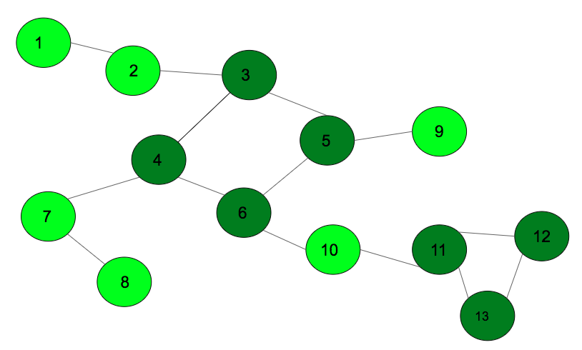
Basic Graph Terminologies
Cycle
A (simple) cycle is a path v1,v2,…,vn=v1, where the first and the last vertices are the same.

Slide 5
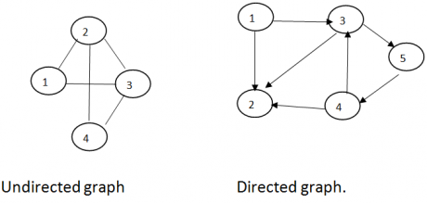
Types of graphs
Undirected Graph:
nodes are connected by edges that are all bidirectional.
For example if an edge connects node 1 and 2, we can traverse from node 1 to node 2, and from node 2 to 1.
Directed Graph
nodes are connected by directed edges – they only go in one direction.

Slide 6
Types of graphs
Complete Graph
nodes are connected to all the other nodes in the graph.
For example,
Sparse Graph
nodes are connected to some of the other nodes in a graph.

Slide 7
Graph Applications
Networks including telephone networks, circuit networks, Computer network and social networks (like LinkedIn, Facebook etc.).
A single user in Facebook can be represented as a node (vertex) while their connection with others can be represented as an edge between nodes.
Airline scheduling
By using airports as vertices
Route selection for traffic Google maps.
Finding shortest path
Task scheduling
Checking deadlocks and managing resources.

Slide 8
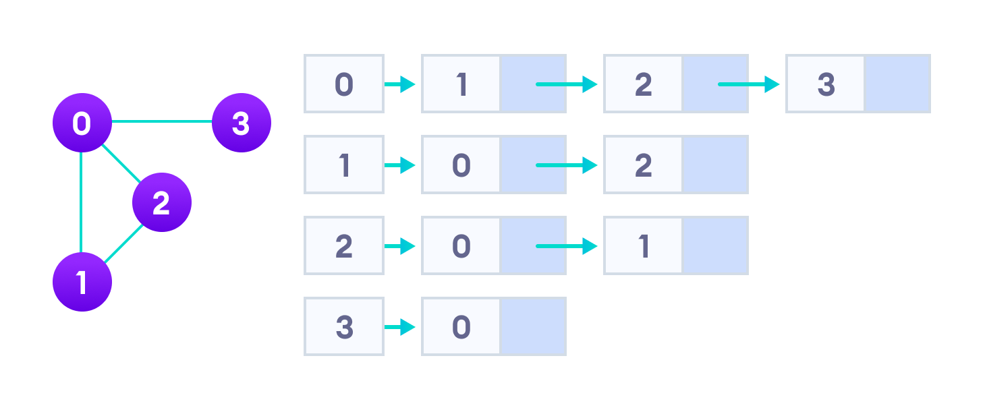
Types of Graph Representations:
Adjacency List
To create an Adjacency list, an array of lists is used. The size of the array is equal to the number of nodes.
A single index, array[i] represents the list of nodes adjacent to the ith node.

Slide 9
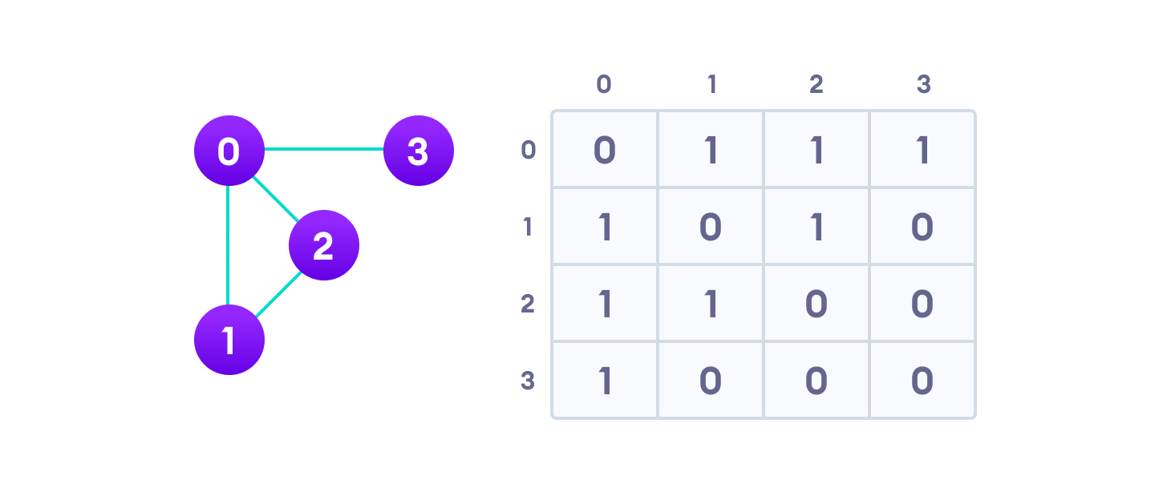
Types of Graph Representations:
Adjacency Matrix
An Adjacency Matrix is a 2D array of size V x V where V is the number of nodes in a graph.
A slot matrix[i][j] = 1 indicates that there is an edge from node i to node j.

Slide 10
Graph Traversals
Breadth-first search (BFS).
Visit all of a vertex’s unvisited neighbors before visiting their neighbors.
Same as level-order traversal in trees
Depth-first search (DFS).
Like preorder tree traversal.
When we visit a vertex, give priority to visiting its unvisited neighbors (and their unvisited neighbors, etc.).

Slide 11
Graph Traversals
Breadth-first search (BFS)
Breadth First Traversal (or Search) for a graph is similar to Breadth First Traversal of a tree.
The only catch here is, unlike trees, graphs may contain cycles.
So, we may come to the same node again.
To avoid processing a node more than once, we use a Boolean visited array.
Lets do an example.

Slide 12
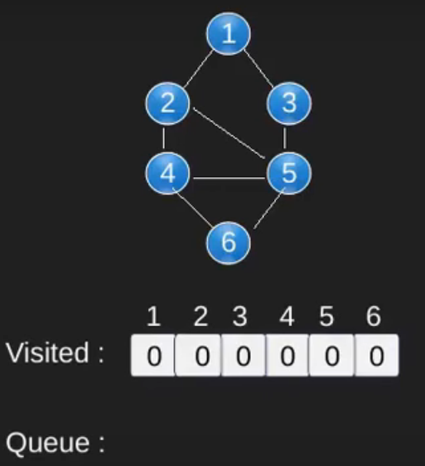
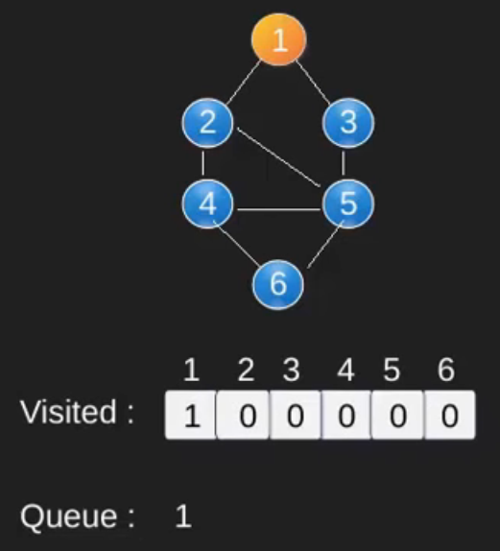
Graph Traversals
Breadth-first search (BFS).

Slide 13
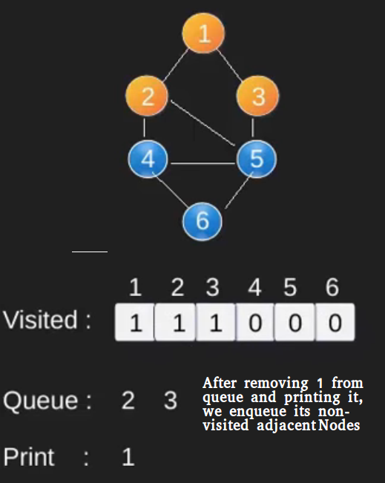
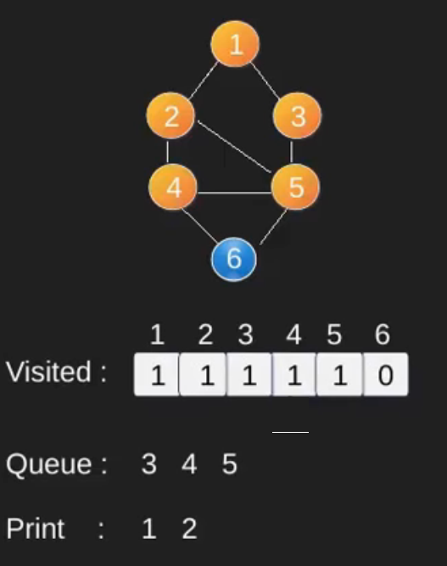
Graph Traversals
Breadth-first search (BFS).

Slide 14
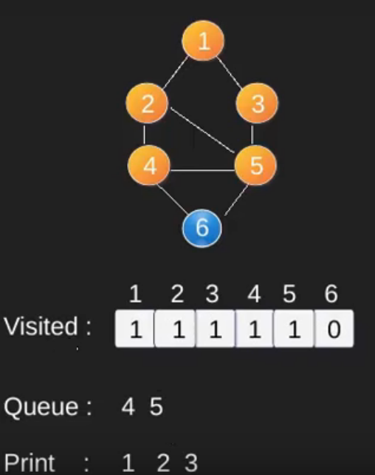
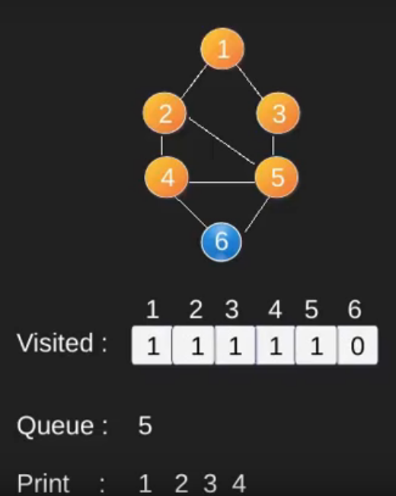
Graph Traversals
Breadth-first search (BFS).

Slide 15
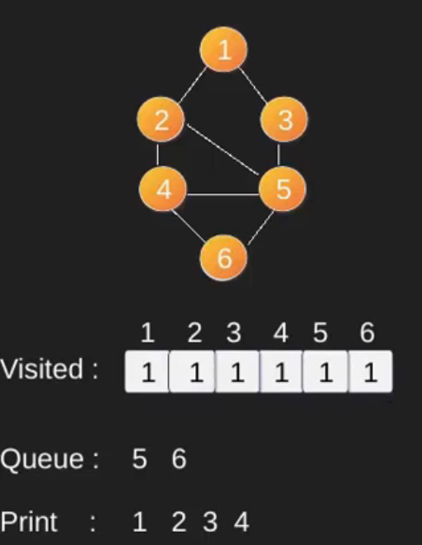
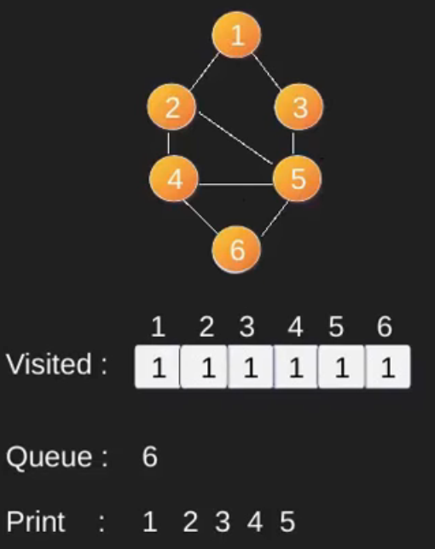
Graph Traversals
Breadth-first search (BFS).

Slide 16
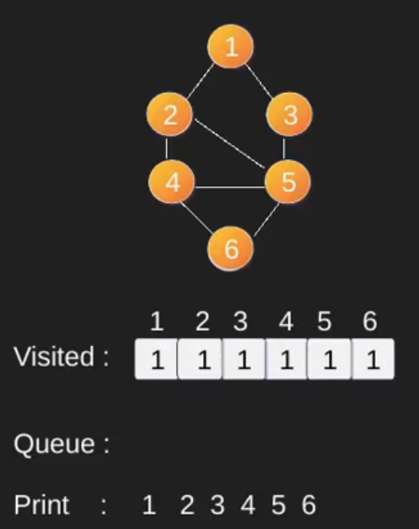
Graph Traversals
Breadth-first search (BFS).

Slide 17
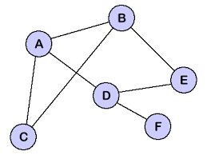
Graph Traversals
Breadth-first search (BFS).

Slide 18
Graph Traversals
Depth-first search (DFS).
OUTPUT:
K
STACK
A
C
B
L
P
N
A | B | C | P | N | K | L
0 | 0 | 0 | 0 | 0 | 0 | 0

Slide 19
Graph Traversals
Depth-first search (DFS).
OUTPUT: A,
K
STACK
A
A
C
B
L
P
N
A | B | C | P | N | K | L
1 | 0 | 0 | 0 | 0 | 0 | 0

Slide 20
Graph Traversals
Depth-first search (DFS).
OUTPUT: A,B,
K
STACK
B
A
A
C
B
L
P
N
A | B | C | P | N | K | L
1 | 1 | 0 | 0 | 0 | 0 | 0

Slide 21
Graph Traversals
Depth-first search (DFS).
OUTPUT: A,B,P
K
STACK
P
B
A
A
C
B
L
P
N
A | B | C | P | N | K | L
1 | 1 | 0 | 1 | 0 | 0 | 0

Slide 22
Graph Traversals
Depth-first search (DFS).
OUTPUT: A,B,P,K,
K
STACK
K
P
B
A
A
C
B
L
P
N
A | B | C | P | N | K | L
1 | 1 | 0 | 1 | 0 | 1 | 0

Slide 23
Graph Traversals
Depth-first search (DFS).
OUTPUT: A,B,P,K,L
K
STACK
L
K
P
B
A
A
C
B
L
P
N
A | B | C | P | N | K | L
1 | 1 | 0 | 1 | 0 | 1 | 1

Slide 24
Graph Traversals
Depth-first search (DFS).
OUTPUT: A,B,P,K,L,C
K
STACK
C
L
K
P
B
A
A
C
B
L
P
N
A | B | C | P | N | K | L
1 | 1 | 1 | 1 | 0 | 1 | 1

Slide 25
Graph Traversals
Depth-first search (DFS).
OUTPUT: A,B,P,K,L,C,N
K
STACK
N
C
L
K
P
B
A
A
C
B
L
P
N
A | B | C | P | N | K | L
1 | 1 | 1 | 1 | 1 | 1 | 1

Slide 26
Graph Traversals
Depth-first search (DFS).

Slide 27
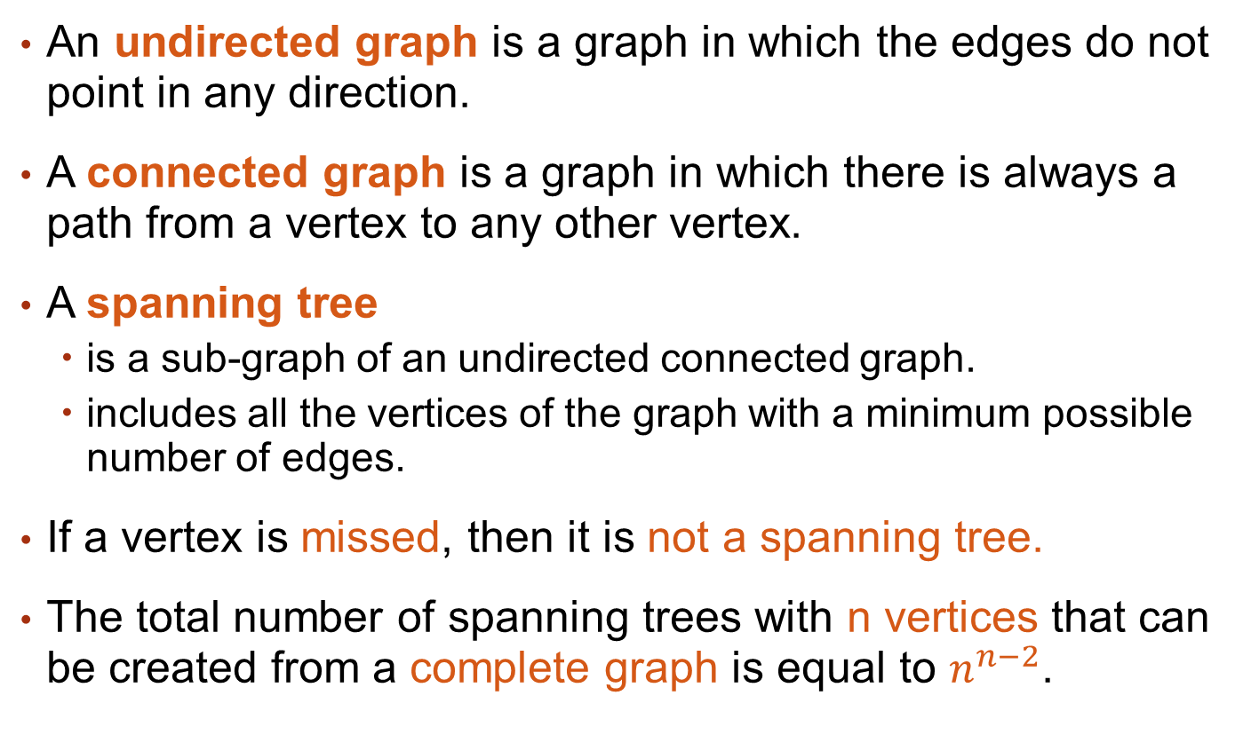
Spanning Tree
An undirected graph is a graph in which the edges do not point in any direction.
A connected graph is a graph in which there is always a path from a vertex to any other vertex.
A spanning tree
is a sub-graph of an undirected connected graph.
includes all the vertices of the graph with a minimum possible number of edges.
If a vertex is missed, then it is not a spanning tree.
The total number of spanning trees with n vertices that can be created from a complete graph is equal to $n^{n−2}$.

Slide 28
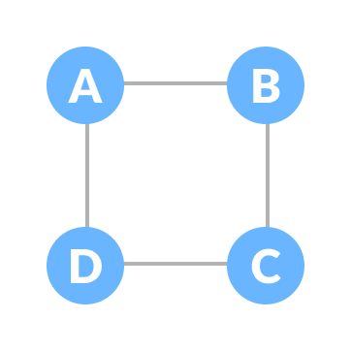
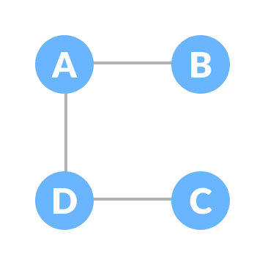
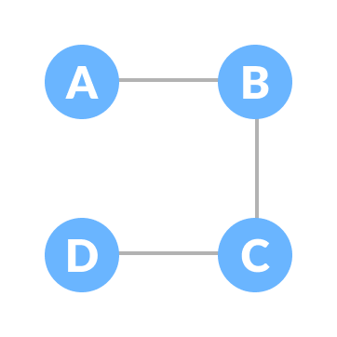
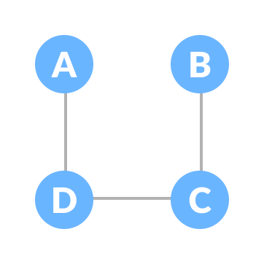
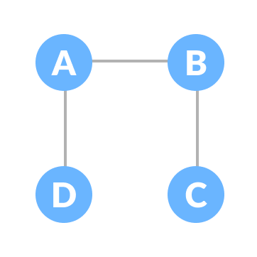
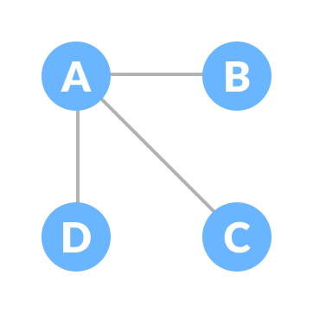
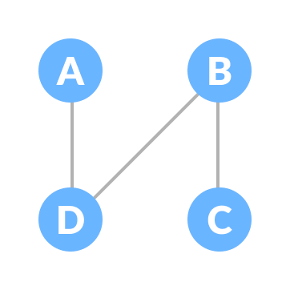
Spanning Tree
For example

Slide 29
Spanning Tree
For example

Slide 30
Minimum Spanning Tree
For example
Add some weights to edges

Slide 31
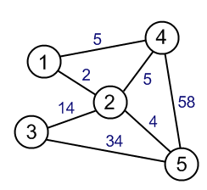
Minimum Spanning Tree
For example

Slide 32
Spanning and Minimum Spanning Tree applications
Spanning Tree Applications
Computer Network Routing Protocol
Cluster Analysis
Civil Network Planning
Minimum Spanning tree Applications
To find paths in the map
To design networks like telecommunication networks, water supply networks, and electrical grids.

Slide 33
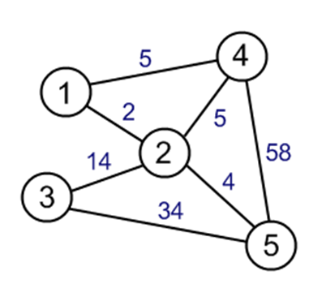
Shortest Path first
The shortest path from a vertex u to a vertex v in a graph is a path w1 = u, w2,…,wn= v, where the
sum=Weight(w1,w2)+…+Weight(wn-1,wn)
Attains its minimal value among all paths that start at u and end at v.

Slide 34
Popular Algorithms
The algorithms that can be used for finding minimum spanning tree are:
Prim’s Algorithm
Kruskal’s Algorithm
The algorithm that can be used for finding shortest path first is:
Dijkstra’s Algorithm

Slide 35
Minimum Spanning Tree
Prim’s Algorithm
5
4
1
2
2
14
4
3
5

Slide 36
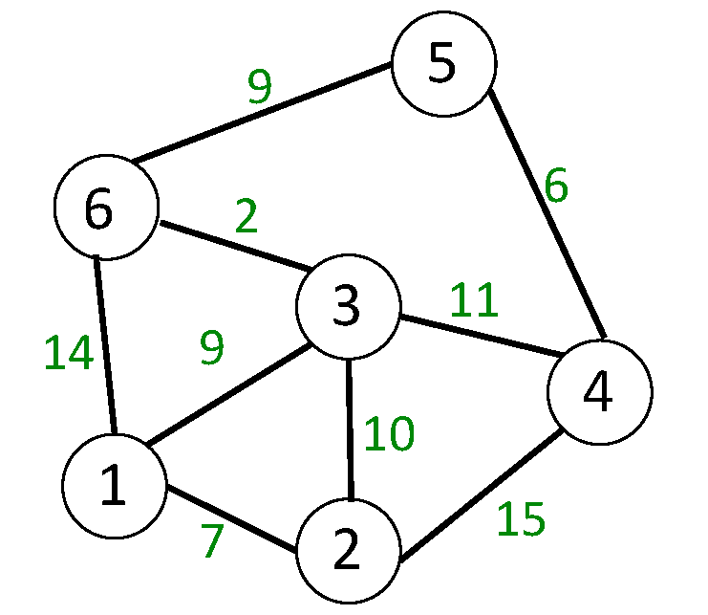
Minimum Spanning Tree
Prim’s Algorithm
9
5
6
2
6
3
9
4
1
2
7

Slide 37
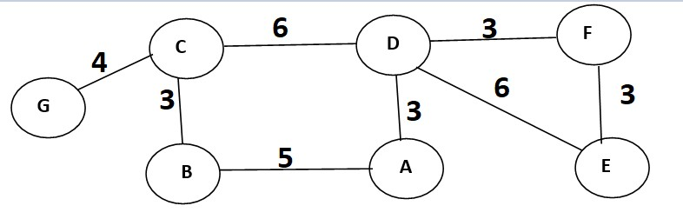
Minimum Spanning Tree
Prim’s Algorithm

Slide 38
Minimum Spanning Tree
Kruskal’s Algorithm
5
4
1
2
2
14
4
3
5

Slide 39
Minimum Spanning Tree
Kruskal’s Algorithm
9
5
6
2
6
3
9
4
1
2
7

Slide 40
Minimum Spanning Tree
Kruskal’s Algorithm

Slide 41
Shortest Path First
Dijkstra’s Algorithm
Take 1 as starting vertex
5
5
4
1
2
5
2
58
2
14
4
3
5
∞
∞
34

Slide 42
Shortest Path First
Dijkstra’s Algorithm
Take 1 as starting vertex
5
5
4
1
2
5
2
58
2
14
4
3
5
∞ 6
∞ 16
34

Slide 43
Shortest Path First
Dijkstra’s Algorithm
Take 1 as starting vertex
5
5
4
1
2
5
2
58
2
14
4
3
5
∞ 6
∞ 16
34

Slide 44
Shortest Path First
Dijkstra’s Algorithm
Take 1 as starting vertex
5
5
4
1
2
5
2
58
2
14
4
3
5
∞ 6
∞ 16
34

Slide 45
Shortest Path First
Dijkstra’s Algorithm
Take 1 as starting vertex
5
5
4
1
2
5
2
58
2
14
4
3
5
∞ 6
∞ 16
34

Slide 46
Shortest Path First
Dijkstra’s Algorithm
Selected vertex | 2 | 3 | 4 | 5 | 6
1 | 7 | 9 | ∞ | ∞ | 14

Slide 47
Shortest Path First
Dijkstra’s Algorithm
Selected vertex | 2 | 3 | 4 | 5 | 6
1 | 7 | 9 | ∞ | ∞ | 14
2 | 7 | 9 | 22 | ∞ | 14

Slide 48
Shortest Path First
Dijkstra’s Algorithm
Selected vertex | 2 | 3 | 4 | 5 | 6
1 | 7 | 9 | ∞ | ∞ | 14
2 | 7 | 9 | 22 | ∞ | 14
3 | 7 | 9 | 22 20 | ∞ | 14 11

Slide 49
Shortest Path First
Dijkstra’s Algorithm
Selected vertex | 2 | 3 | 4 | 5 | 6
1 | 7 | 9 | ∞ | ∞ | 14
2 | 7 | 9 | 22 | ∞ | 14
3 | 7 | 9 | 22 20 | ∞ | 14 11
6 | 7 | 9 | 20 | 20 | 11

Slide 50
Shortest Path First
Dijkstra’s Algorithm
Selected vertex | 2 | 3 | 4 | 5 | 6
1 | 7 | 9 | ∞ | ∞ | 14
2 | 7 | 9 | 22 | ∞ | 14
3 | 7 | 9 | 22 20 | ∞ | 14 11
6 | 7 | 9 | 20 | 20 | 11
5 | 7 | 9 | 20 | 20 | 11
4 | 7 | 9 | 20 | 20 | 11

Slide 51
Shortest Path First
Dijkstra’s Algorithm

Slide 52
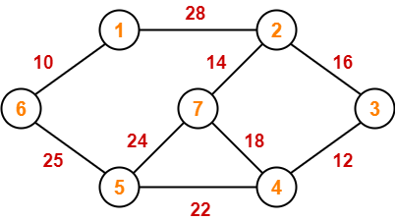
Apply
BFS
DFS
Prim’s Algo
Kruskal’s Algo
Dijkstra’s Algo

