Slide 1
DATA STRUCTURES & ALGORITHM
LECTURE 2

Slide 2
Pointers
A pointer is a variable whose value is the address of another variable.
Like any variable or constant, you must declare a pointer before you can work with it.
type *var-name;

Slide 3
Using Pointers
There are few important operations
Define a pointer variables
Assign the address of a variable to a pointer
Access the value at the address available in the pointer variable.

Slide 4
Contd.
Defining a Pointer Variable int *iptr; iptr can hold the address of an int
Pointer Variables Assignment: int num = 25; iptr = &num;

Slide 5

Contd.
To access num using iptr and indirection operator * cout << iptr; // prints 0x4a00 cout << *itptr; // prints 25

Slide 6

Manipulating Data with Pointers
Value of memory location towards which pointer is pointing can be changed using pointers
*ptr_nam=val;
For example *iptr=8;

Slide 7
Get Memory Address and Value
string food = "Pizza"; // Variable declaration string* ptr = &food; // Pointer declaration Reference: Output the memory address of food with the pointer (0x6dfed4) cout << ptr << "\n"; Dereference: Output the value of food with the pointer (Pizza) cout << *ptr << "\n";

Slide 8
Example 1
void main
{
int * ptr, *foo, *h;
int val=9;
ptr=&val;
foo=ptr;
*foo=10;
int z=*ptr;
cout << val<<“ “<<z;
}
?? What will be the output?

Slide 9
Example 2
void main
{
int *p;
int val=9;
p=val;
cout<<p;
}
?? Error in the code?

Slide 10
Example 3
void main{
int a = 5, b = 10; int *p1, *p2; p1 = &a; p2 = &b; *p1 = 10; p1 = p2; *p1 = 20; cout<<a<<“ “<<b;}
?? What will be the output?

Slide 11
Pointer arithmetic
There are four arithmetic operators that can be used on pointers: ++, --, +, and –
Ptr++ (move one address forward)
Ptr - - (move one address backward)
Ptr+i (move i locations forward)
Ptr-i (move i locations backward)

Slide 12
Pointer to Arrays
int myarray [20];
int * mypointer;
Assignment operation would be valid
mypointer = myarray;
Assignment would be Invalid
myarray = mypointer;

Slide 13
Write the output
int numbers[5];
int * p;
p = numbers; *p = 10;
p++; *p = 20;
p = &numbers[2]; *p = 30;
p = numbers + 3; *p = 40;
p = numbers; *(p+4) = 50;
for (int n=0; n<5; n++)
cout << numbers[n] << ", ";
return 0;

Slide 14
Initializing pointer to 0
It is always a good practice to assign the pointer NULL to a pointer variable in case you do not have exact address to be assigned.
void main ()
{
int *ptr = NULL;
}

Slide 15
Contd.
If all unused pointers are given the null value you can avoid the accidental misuse of an uninitialized pointer.
Many times, uninitialized variables hold some junk values and it becomes difficult to debug the program.
if(ptr){ // succeeds if p is not null }
if(!ptr) {// succeeds if p is null}

Slide 16
Pointer Rules Summary
A pointer stores a reference to its pointee. The pointee, in turn, stores something useful.
The dereference operation on a pointer accesses its pointee. A pointer may only be dereferenced after it has been assigned to refer to a pointee. Most pointer bugs involve violating this one rule.
Allocating a pointer does not automatically assign it to refer to a pointee. Assigning the pointer to refer to a specific pointee is a separate operation which is easy to forget.
Assignment between two pointers makes them refer to the same pointee which introduces sharing.

Slide 17
Memory Division
Memory in your C++ program is divided into two parts
Stack
All variables declared inside any function takes up memory from the stack.
Heap
It is the unused memory of the program and can be used to dynamically allocate the memory at runtime.

Slide 18
Memory Allocation
Two Types
Compile time allocation or static allocation of memory
where the memory for named variables is allocated by the compiler. Exact size and storage must be known at compile time and for array declaration, the size has to be constant.

Slide 19
Memory Allocation
Runtime allocation or dynamic allocation of memory.
where the memory is allocated at runtime and the allocation of memory space is done dynamically within the program run.
The memory segment is known as a heap or the free store.
In this case, the exact space or number of the item does not have to be known by the compiler in advance.
Pointers play a major role in this case.

Slide 20
Static allocation of memory
In the static memory allocation,
The amount of memory to be allocated is predicted and pre known.
Memory is allocated during the compilation itself.
All the declared variables declared normally, are allocated memory statically.

Slide 21
Example
Variables deletes as the scope ends
void main { int a=9; cout<<sqr(a); } | int sqr(int val) { return val*val; }

Slide 22
Dynamic Memory
Dynamic memory allocation in C/C++ refers to performing memory allocation manually by programmer.
C++ has two operators new and delete that perform the task of allocating and freeing the memory in a better and easier way.

Slide 23
Dynamic allocation of memory
Creating the dynamic space in memory
Storing its address in a pointer
Allocate memory when required
Use it by initializing to some value
Deallocate the memory when no more required

Slide 24
Allocate memory
Syntax to use new operator: To allocate memory of any data type
pointer-variable = new data-type;
Example:
void main
{
int*p;
p=new int;
}

Slide 25
Initialize memory
Syntax to initialize Memory
*ptrname=value;
Example:
void main
{
int*p;
p=new int;
*p=9;
}

Slide 26
Deallocate memory
Syntax:
delete ptrname;
Example:
void main
{
int*p;
p=new int;
*p=9;
cout<<*p;
delete p;
}

Slide 27
Example of Dynamic Memory Allocation
int main()
{
double* val = NULL;
val = new double;
*val = 38184.26;
cout << "Value is : " << *val << endl;
delete val;
}

Slide 28
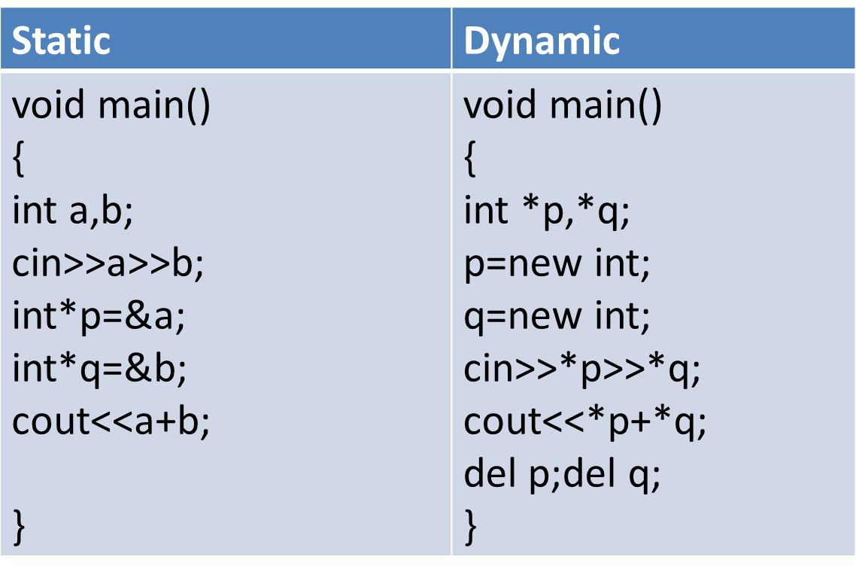
Static vs. Dynamic memory
Example 1

Slide 29
Dangling Pointers
The delete operator does not delete the pointer
it takes the memory being pointed to and returns it to the heap
It does not even change the contents of the pointer
Since the memory being pointed to is no longer available (and may even be given to another application), such a pointer is said to be dangling

Slide 30
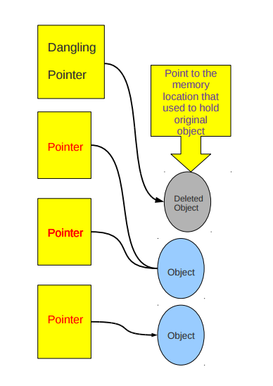
Dangling Pointers

Slide 31
Contd.
Return memory to the heap before un dangling the pointer
What's Wrong with the Following?
ptr = NULL;
delete ptr;

Slide 32
Memory Leaks
Memory leaks when it is allocated using the new operator but not returned using the delete operator
Example??

Slide 33
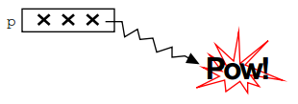
Bad Pointer
void BadPointer() {
int* p; // allocate the pointer, but not the pointee
*p = 42; //dereference is a serious runtime error
}
What happens at runtime when the bad pointer is dereferenced??

Slide 34
Dynamic Arrays
In C++ size of array must be defined for e.g
int arr[9];
or
const int size=9;
int arr[size];
If we want to take size of array from user at runtime dynamic array is used

Slide 35
Contd.
void main()
{int size; int *ptr;
cin>>size;
ptr=new int[size];
for (int i=0;i<size;i++)
{
cin>>ptr[i] // consecutive locations thus access // them
}}

Slide 36
Deallocating Array
To deallocate a dynamic array, use this form:
delete [] name_of_pointer;

Slide 37
Dynamically resizing an array
Here is an example using an integer array. Let's say this is the original array:
int * list = new int[size];
I want to resize this so that the array called list has space for 5 more numbers (presumably because the old one is full).

Slide 38
Pointer to a Structure
struct student
{
string name;
int roll_no;
};
student stud = {"Sam",1};
student *ptr;
ptr = &stud
cout << stud.name << stud.roll_no << endl;
cout << ptr->name << ptr->roll_no << endl;

Slide 39
Passing Structure By Reference
void display(student *st)
{
cout << "Roll no : " << st -> roll_no << endl;
cout << "Name : " << st -> name << endl;
}
Void main(){
struct student s;
s.roll_no = 4;
s.name = "Ron";
display(&s);
}

Slide 40
Class Task
Create a structure of Phone directory with following data members
Name
ID
Address
Phone_Num
Add data of at least 5 persons using Add_contact_info function and pointer
Use a remove Function to take an ID from user and remove the data of matching ID from array.
Display the data before and after removing the person

Slide 41
Structure COMPOSITION
Declaring a variable of programmer defined data type in another structure is called structure composition
Saves time and helps in writing a compact code.

Slide 42
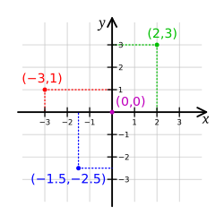
Class Task
Create a struct POINT to represent a point in Cartesian coordinate system
Provide functions
Input
Output
Distance( returns the distance between two POINT objects, the function takes one object as an argument)
isZero(determines if a point is the center)
Midlepoint(computes the middle point of an object from origin and returns the answer in a POINT object)
isEqualTo (compare two POINTs)
isGreaterThan (compares two POINT in terms of the distance from the center )

Slide 43
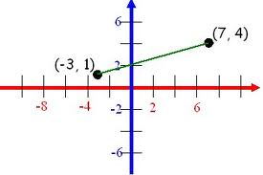
Class Task 2
Make a struct LINE include appropriate data members.
A line segment includes the endpoints, i.e. the points that it joins.
structure should also provide a function to find the length of the Line
Two lines can be compared to determine which line is shorter and vice versa. Provide function to compare two Lines
Note: You have to reuse struct point in line because a line can be represented in terms of two cartesian coordinate points. (starting and ending point)

