Slide 1
DATA STRUCTURES
LECTURE 3

Slide 2
Revision: Dynamic Memory Management
Operators new and delete.
p
?
Dynamic Allocation
int *p; p = new int; //un-initialized
int *q; q = new int (5);//initialized
int *arrayptr = new int [100];
Memory De-allocation
delete p; //single variable
delete [ ] arrayptr ; //array
arryptr
2

Slide 3
LINKED LIST DATA STRUCTURE
Recall: An array is fixed in size
– Why is this a limitation?
Linked List overcome the limitations of array based organization
A linked list is a dynamic data structure that grows and shrinks without any limitation on size (except memory space, of course)

Slide 4
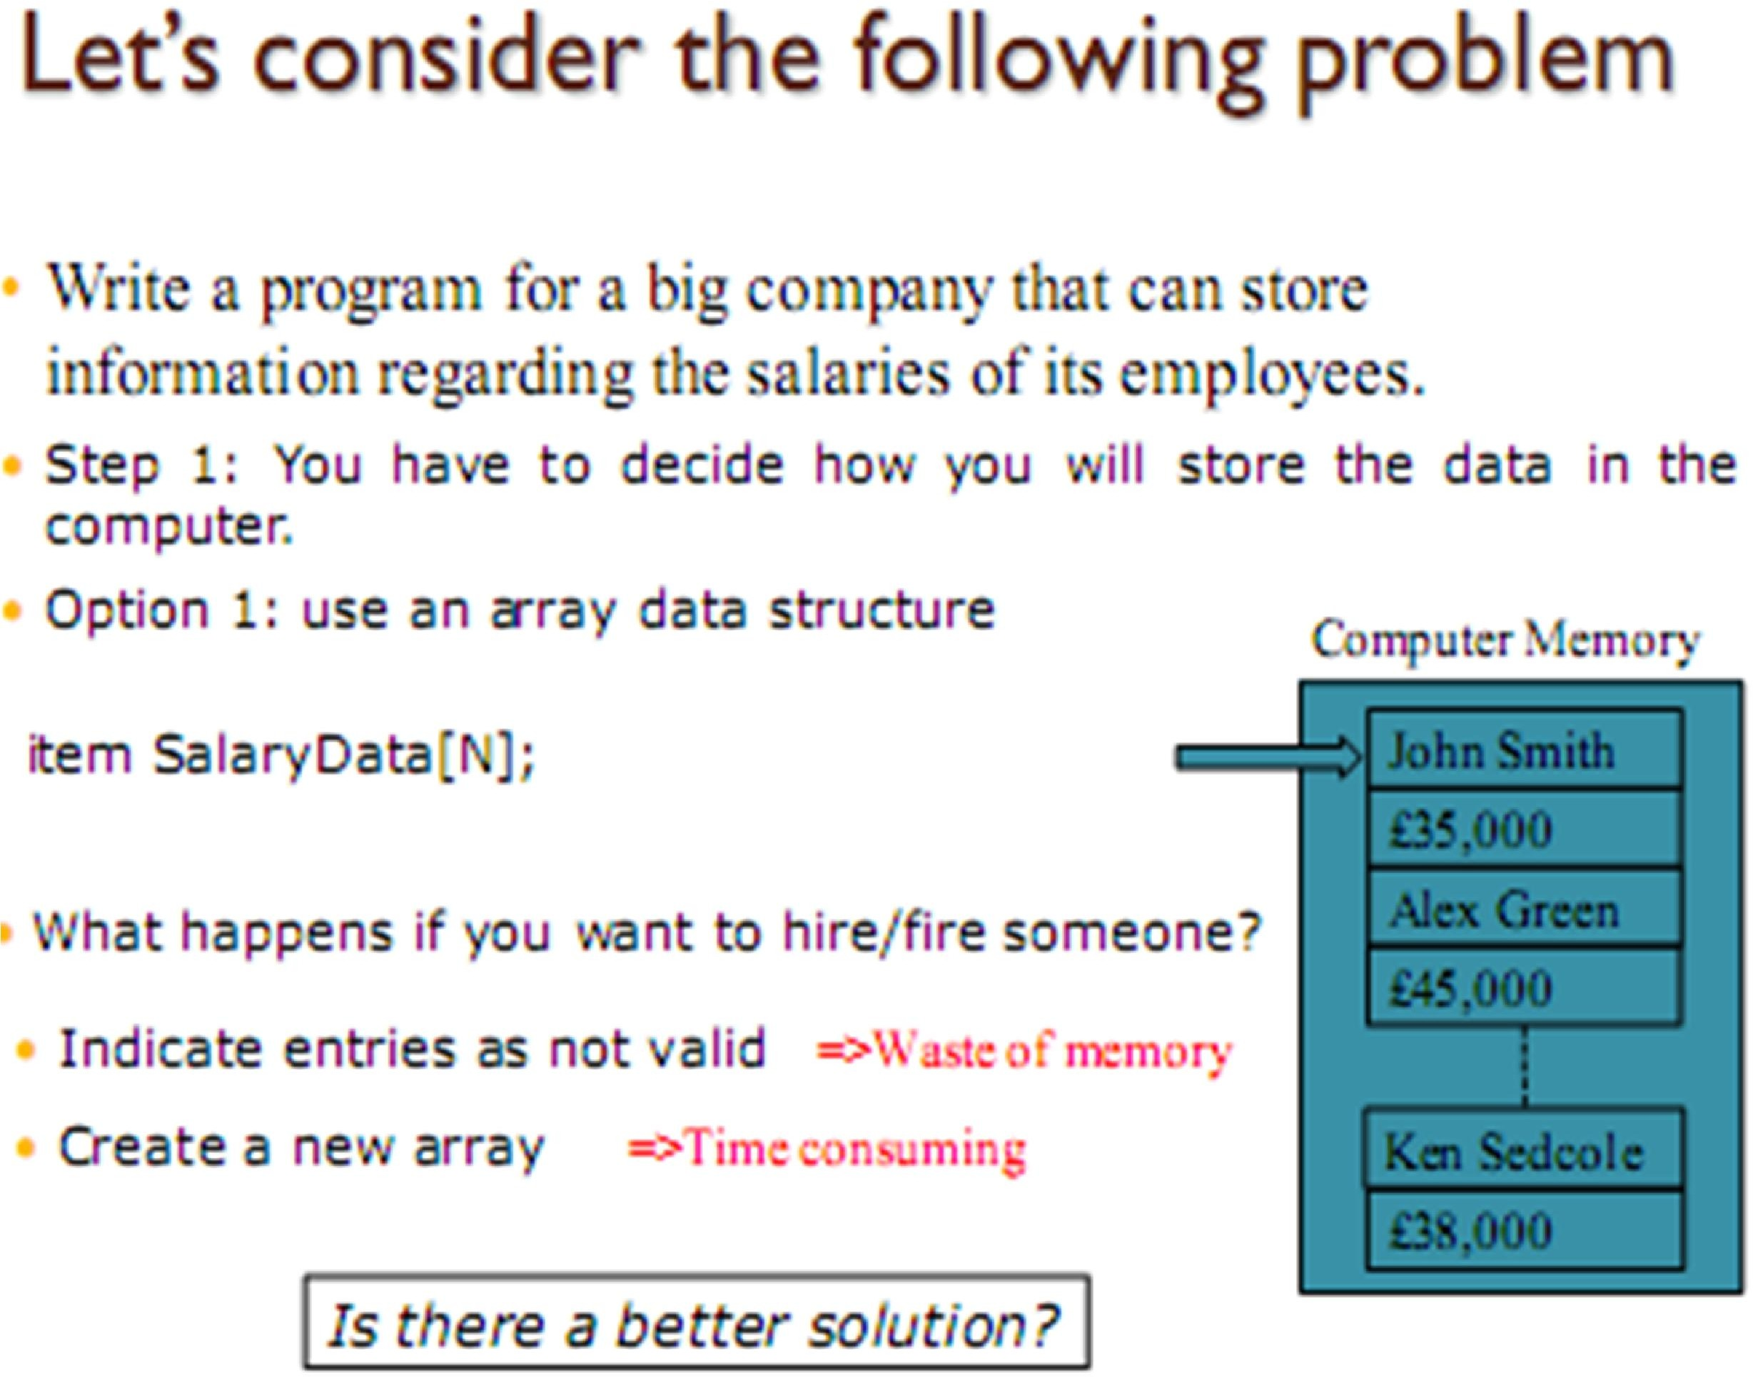
struct item { char name [20]; int salary;}

Slide 5
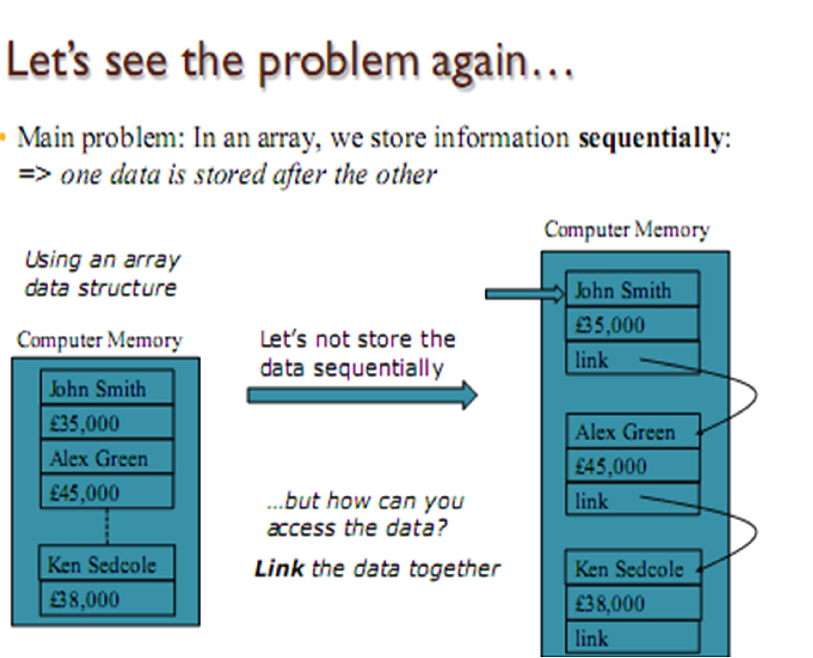

Slide 6
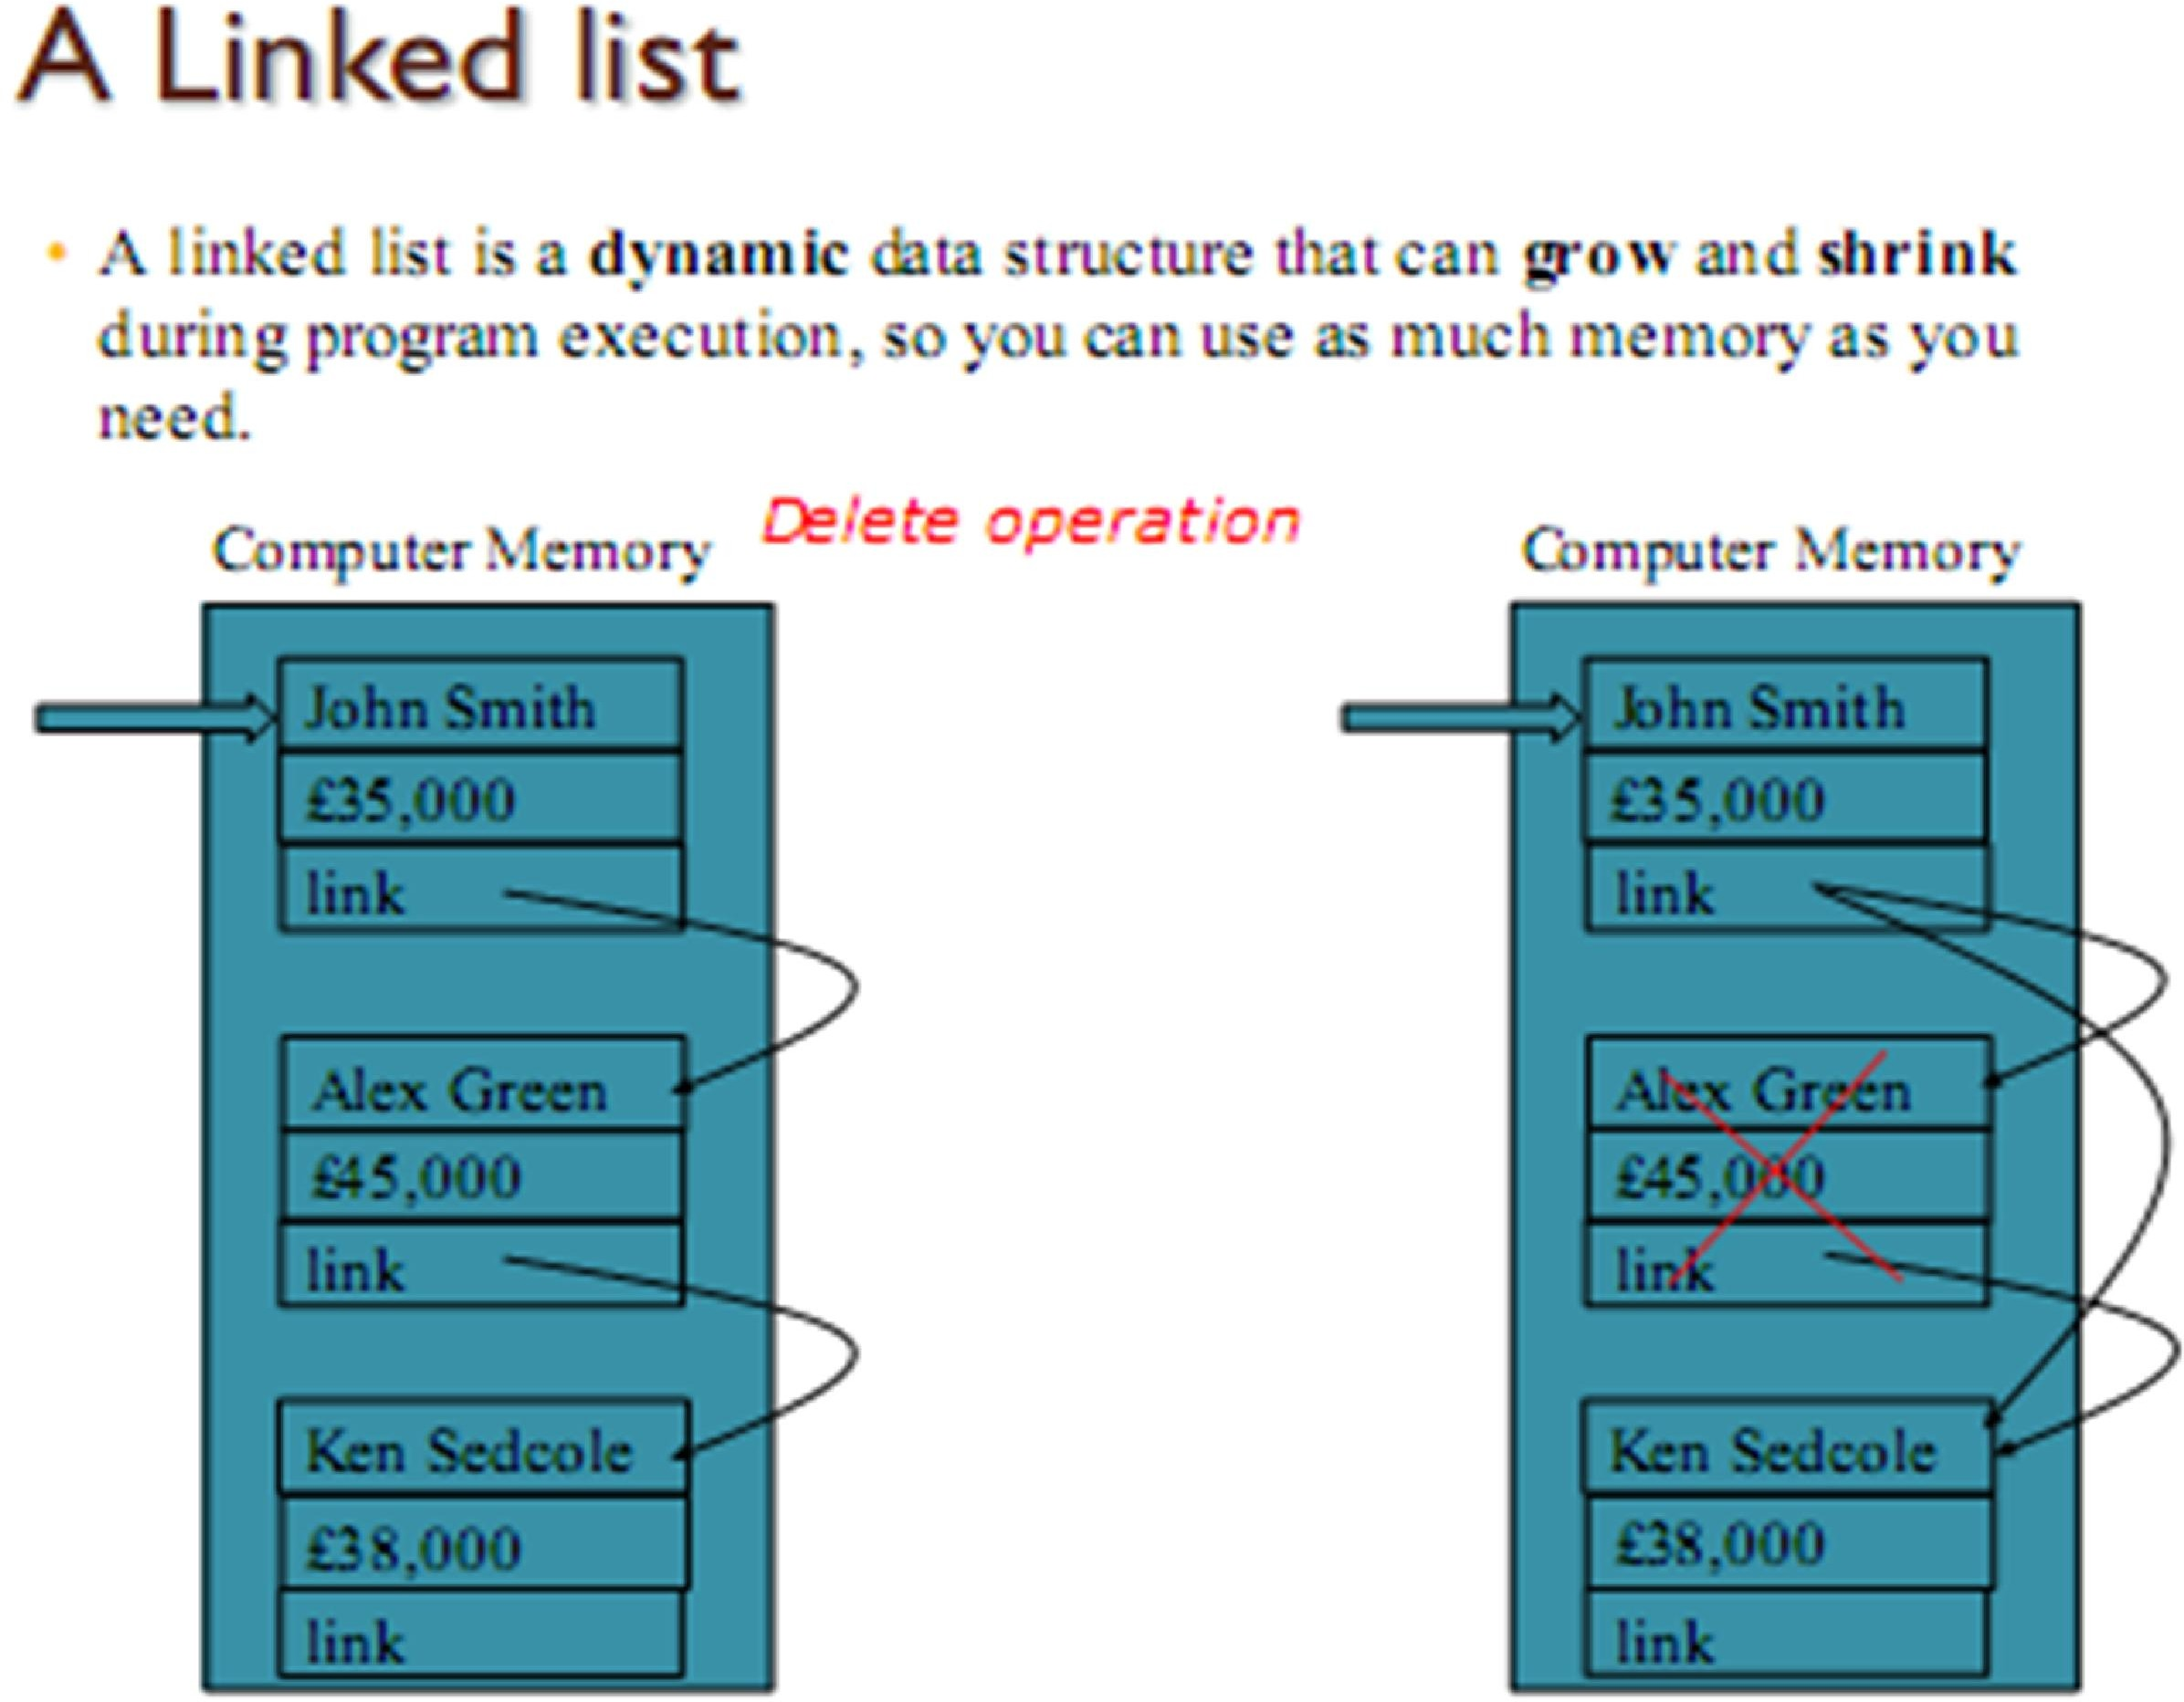

Slide 7

LINKED LIST
info
next
info
next
info
next
head
NULL
node
node
node
Notice the self-referential structure of each node

Slide 8

Linked List
Nodes of list are usually same type
Generally obtained from new()
Each node points to next node
Last node points to NULL
Need “head” to point to first item!
“info” of node may be almost anything
A single member or multiple members
Any type of variable whose size is known at compile time

Slide 9

What functionality we expect from a Linked List ?
Construct
Length
Insert
At start
elsewhere
Delete
At start
elsewhere

Slide 10

Linked Lists in Action
Following slides shows how to implement the most common operations on linked lists.

Slide 11

Declarations for a Linked List
Each node in the list is a class object
Class Node{
int id;
Node *next;
};
id
next
id
next
id
id
next
next

Slide 12

Declarations for a Linked List (continued)
Class Linklist{
Node* Head=NULL;
}
head
id
id
next
next
id
id
next
next

Slide 13
Linked List
Now, After creating structure of nodes of list, you can create linked list by calling different function from main().
int main() {
linklist L1;
Node* curr = curr->createNode();
L1.insertAtHead(curr);
L1.displayList( );
}

Slide 14
Linked List (continued)
Function for Creating a list
Function for Creating a Node
node* createNode() {
node* temp = new node;
temp->read( );
return temp;
}
head

Slide 15
Linked List (continued)
Function for Reading data in a Node.
void readNode(node* ptr) {
cout << "Enter the id for node:" << endl;
cin >> ptr->id;
ptr->next = NULL;
}
Function for inserting a Node at start
void insertAtStart(node* ptr) {
ptr->next = head;
head = ptr;
}
head

Slide 16
Linked List (continued)
Function for Creating a list
Inserting more nodes
void insertAtStart(node* ptr) {
ptr->next = head;
head = ptr;
}
head
4
200
100
3
NULL
200

Slide 17
Linked List (continued)
Function for inserting node at last
node* n = n->createNode(); //5
readNode(n);
insertAtLast(n);
void insertAtLast(node* curr) {
node* last;
last = findLast();
last->next = curr;
}
node* findLast() {
node* temp=head;
while (temp->next != NULL) {
temp = temp->next;
}
return temp; }
head
4
200
100
3
500
200
5
NULL
500

Slide 18
Linked List (continued)
head
Function for inserting node by a target
node* m = createNode(); // 9
readNode(m);
insertAtTarget(m,target); //3
void insertAtTarget(node* curr, int value) {
node* tar = findTarget(value);
curr->next = tar->next;
tar->next = curr;
}
node* findTarget(int val) {
node* temp = head;
while (temp != NULL){
if (temp->data == value)
return temp;
temp = temp->next;}
return NULL;}
4
200
100
3
700
200
9
500
700
5
NULL
500

Slide 19
Linked List (continued)
head
Function for Displaying All Node
void displayList() {
node* temp = head;
cout << "Data in the list is:" << endl;
while (temp != NULL) {
displayNode(temp);
temp = temp->next;
}
}
// Function for class Node
void displayNode(node* ptr) {
cout << “Node id is= “ << endl;
cout << ptr->id << endl;
}
4
200
100
3
700
200
9
500
700
5
NULL
500

Slide 20
Linked List (continued)
Function for deleting node at head
void deleteAtHead() {
node* temp=head;
head=temp->next;
delete temp;
temp=NULL;
}
head
3
700
200
9
500
700
5
NULL
500

Slide 21
Linked List (continued)
Function for deleting node at Last
void deleteAtLast() {
node* Slast, temp;
Slast = findSLast();
temp=Slast->next;
Slast->next=Null;
delete temp;
temp=NULL;
}
node* findSLast() {
node* last, Slast=NULL;
last = head;
while (last->next != NULL) {
Slast=last;
last = last->next;
}
return Slast; }
head
3
700
200
9
NULL
700

Slide 22
Linked List (continued)
Function for deleting node at Target
void deleteAtTarget(int value) {
node* prv_tar,temp;
prv_tar = find_prv_tar(value); // 3
temp=prv_tar->next;
prv_tar->next=temp->next;
delete temp;
temp=NULL;
}
node* find_prv_tar(int val) {
node* tar, prv_tar;
tar = head;
while (tar->data != val && tar->next != NULL) {
prv_tar=tar;
tar = tar->next;
}
return prv_tar; }
head
9
NULL
700

Slide 23
Example
Create a list of 5 students having ID and Roll_No.
Create functions to createlist(), createNode(), readNode()
And DisplayNode().
100
200
5
45
200
3
55
700
head
500
400
700
11
54
NULL
1
22
500
7
66
400

Slide 24
Usage of Linked Lists
Not massive amounts of data
Linear search is okay
Sorting not necessary
or sometimes not possible
Need to add and delete data “on the fly”
Even from middle of list
44

Slide 25
Linked List vs. Array
Linked List (Non-Sequential):
Extra storage required
Better use of fragmented memory
Insertion / deletion at middle is easier
Joining lists easier
Array (Sequential):
less storage (no pointer)
Random access

