Slide 1
Doubly linked list
Lecture 4

Slide 2
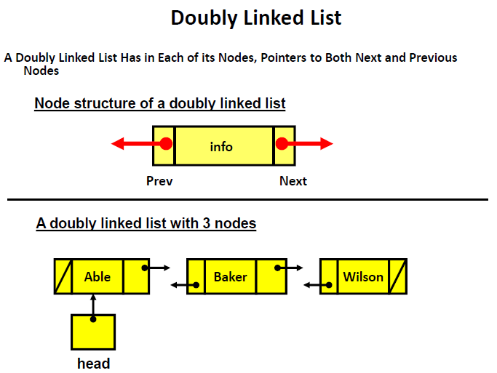

Slide 3
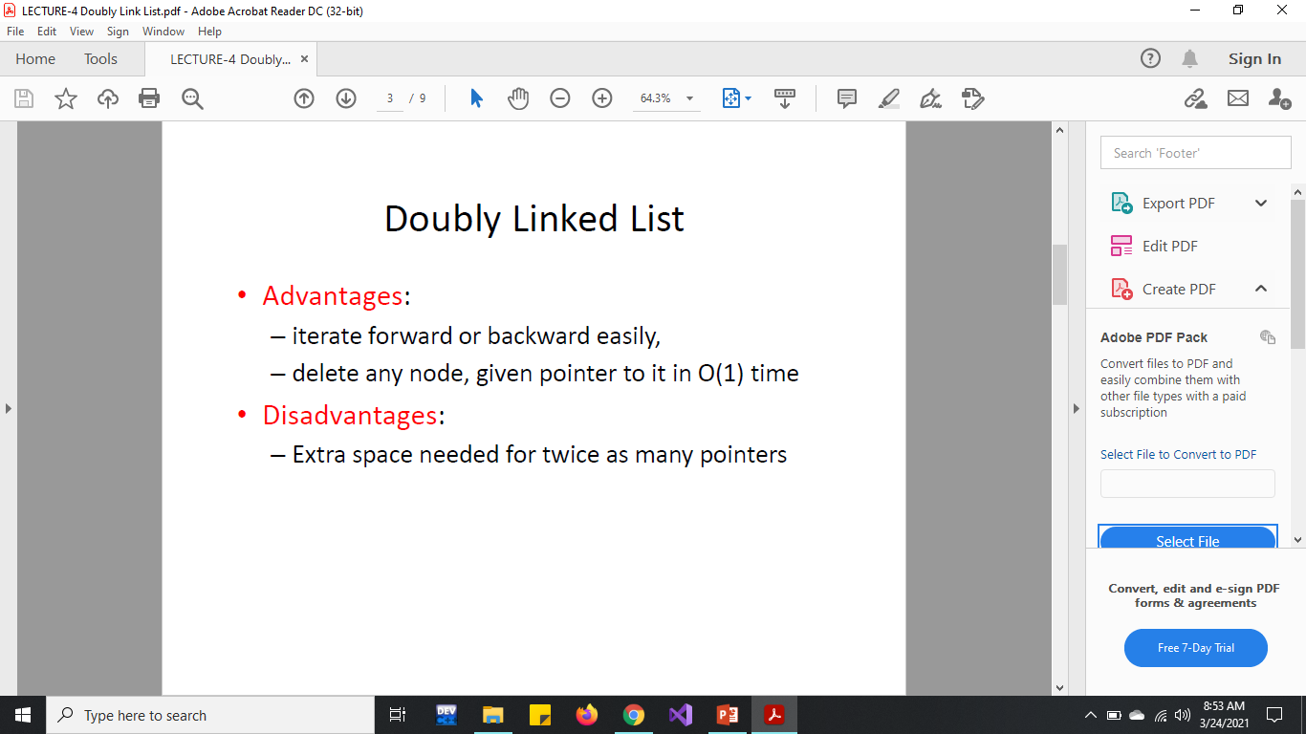

Slide 4
Implementation of Doubly linked list
Structure of a node would be
struct node
{
int id;
node* next;
node* prev;
};
node* head = NULL;
Head
NULL

Slide 5
Implementation of Doubly linked list
Now, After creating structure of nodes of list, you can create linked list by calling different function from main().
{
int listsize;
cout << "enter the size of list you want to create:" << endl;
cin >> listsize;
createList(listsize);
displayAllNodes();
node* ptr = createNode();
insertAtLast(ptr);
displayAllNodes();
displayReverseList();
}
Head
Prev
ID
Next
NULL
Prev
ID
Next
NULL

Slide 6
Implementation of Doubly linked list
Now, After creating structure of nodes of list, you can create linked list by calling different function from main().
void createList(int length) {
for (int i = 0; i < length; i++) {
node* n = createNode();
insertAtStart(n);
}}
node* createNode()
{
node* temp = new node;
readNode(temp);
return temp;
}
Head
Prev
ID
Next
NULL
Prev
ID
Next
NULL

Slide 7
Implementation of Doubly linked list
Now, ReadNode function.
void readNode(node* p)
{
cout << "**** Enter id: ****" << endl;
cin >> p->id;
p->next = NULL;
p->prev = NULL;
}
Head
Prev
ID
Next
NULL
Prev
ID
Next
NULL

Slide 8
Implementation of Doubly linked list
Now, InsertAtStart function.
void insertAtStart(node* curr) {
if(head==NULL)
{
curr->next = head;
head = curr;
}
else
{
head->prev = curr;
curr->next = head;
head = curr;
} }
Head
Prev
ID
Next
NULL
Prev
ID
Next
NULL

Slide 9
Implementation of Doubly linked list
Now, InsertAtLast function.
void insertAtLast(node* curr) {
node* last;
last = findLast();
last->next = curr;
curr->prev = last; }
node* findLast() {
node* temp = head;
while (temp->next != NULL) {
temp = temp->next;
}
return temp;}
Head
Prev
ID
Next
NULL
Prev
ID
Next
NULL

Slide 10
Implementation of Doubly linked list
Now, InsertAtTarget function.
void insertAtTarget(node* curr, int target)
{
node* tar = findTarget(target);
curr->prev = tar;
curr->next = tar->next;
tar->next->prev = curr;
tar->next = curr;
}
node* findTarget(int value) {
node* temp = head;
while (temp != NULL)
{
if (temp->id == value)
return temp;
temp = temp->next;
}
return NULL;
}

Slide 11
Implementation of Doubly linked list
Now, Display function.
void displayAllNodes() {
node* temp;
temp = head;
cout << "Data in the list is:" << endl;
while (temp != NULL)
{
displayNode(temp);
temp = temp->next;
}
}
void displayNode(node* ptr) {
cout << ptr->id << endl;
}

Slide 12
Implementation of Doubly linked list
Now, Function to display list in Reverse order.
void displayReverseList() {
node* last;
last = findLast();
cout << "Data in the Reverse list is:" << endl;
while (last!=NULL)
{
displayNode(last);
last = last->prev; //moving backward in the list
}}

Slide 13
Implementation of Doubly linked list
Now, delete node at Head.
void deleteAtHead() {
if (head == NULL)
cout << "list is empty" << endl;
else {
node* temp = head;
head = temp->next;
head->prev = NULL;
delete temp;
temp = NULL;
}}

Slide 14
Implementation of Doubly linked list
Now, delete node at Last.
void deleteAtLast() {
node* Slast, *last;
last = findLast();
if (last == NULL)
cout << "List is empty" << endl;
else {
Slast = last->prev;
Slast->next = NULL;
delete last;
last = NULL;
}}

Slide 15
Implementation of Doubly linked list
Now, delete node at Target.
void deleteAtTarget(int value) {
node* prv_tar, *tar;
tar = findTarget(value);
if (tar == NULL)
cout << "Target is not found" << endl;
else if (tar == head)
deleteAtHead();
else if (tar->next == NULL)
deleteAtLast();
else
{
prv_tar = tar->prev;
prv_tar->next = tar->next;
tar->next->prev = prv_tar;
delete tar;
tar = NULL;
}
}

Slide 16
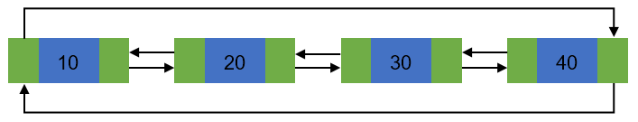
Doubly circular linked list
Circular Doubly Linked List has properties of both doubly linked list and circular linked list
In this way list can be easily traversed multiple times.
You can print whole list from any position you want.
Last

Slide 17
Implementation of Doubly circular linked list
Structure is created in same way as doubly linked list.
Create list ,create node and Read node functions are same.
Find last function is not needed in doubly circular linked list.
Display a single node function is same.
Some function have minor changes which are shown in next slides.

Slide 18
Implementation of Doubly circular linked list
We will use do-while for displaying all the data in the list through displayAllNodes function.
void displayAllNodes() {
node* temp;
temp = Last->next;
cout << "Data in the list is:" << endl;
do{
displayNode(temp);
temp = temp->next;
} while (temp != Last->next);
}

Slide 19
Implementation of Doubly circular linked list
Insert at start function.
void insertAtStart(node* curr) {
if (Last == NULL){
Last = curr;
curr->next = Last;
curr->prev = Last;
}
else{
curr->prev = Last;
curr->next = Last->next;
Last->next->prev = curr;
Last->next = curr;
}}

Slide 20
Implementation of Doubly circular linked list
Insert at last function.
void insertAtLast(node* curr) {
if (Last == NULL) {
Last = curr;
curr->next = Last;
curr->prev = Last;
} else {
curr->prev = Last;
curr->next = Last->next;
Last->next->prev = curr;
Last->next = curr;
Last = curr;
}}

Slide 21
Implementation of Doubly circular linked list
Insert at Target function.
void insertAtTarget(node* curr) {
int target;
cout << "Enter id where you want new node" << endl;
cin >> target;
node* tar = findTarget(target);
if (tar == NULL)
cout << "Target not found" << endl;
else{
curr->prev = tar;
curr->next = tar->next;
tar->next->prev = curr;
tar->next = curr;
}}
Find Target function.
node* findTarget(int value) {
node* temp = Last->next;
do {
if (temp->id == value)
return temp;
temp = temp->next;
} while (temp != Last->next);
return NULL;
}

Slide 22
Doubly circular linked list
Your Home Task is to create a:
Delete at start function
Delete at last function
Delete at Target function
Function to display the details of list twice.

