Slide 1
LECTURE 5
STACK

Slide 2
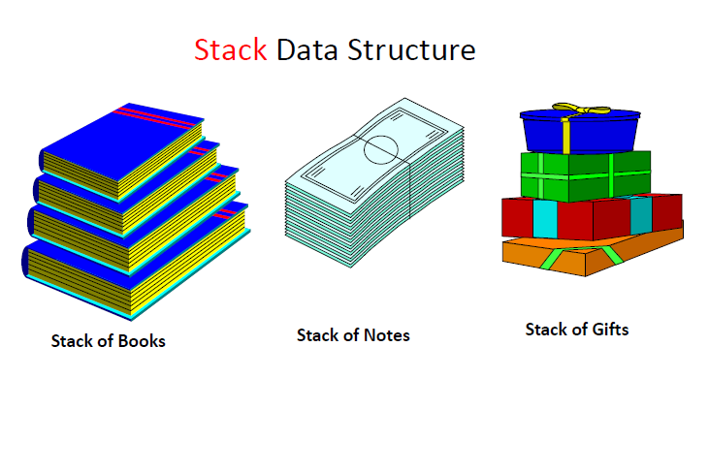

Slide 3
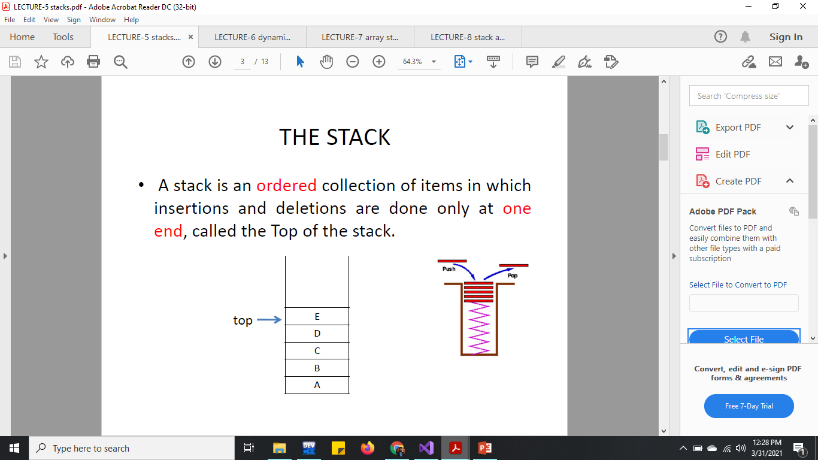

Slide 4
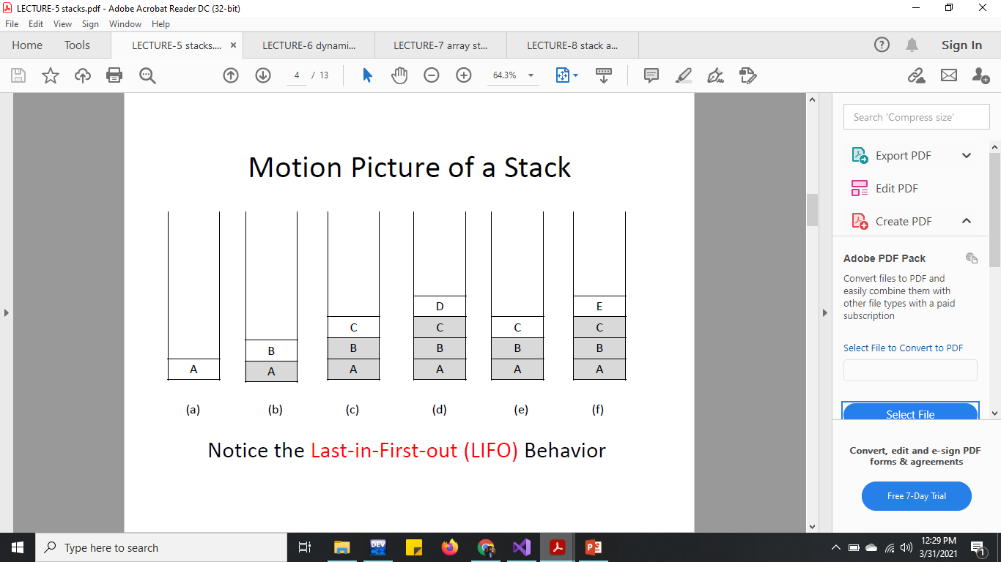

Slide 5
STACK’s Main OPERATIONS
PUSH(x)
Insertion of an item x on top of the stack
POP()
Removal of an item from top of the stack
isEmpty()
Check whether the stack is empty or not
PEEP() / DisplayTop()
To print the top item of the stack

Slide 6
Implementation of Stack
Stack can be implemented by two methods
Using Array
Advantage Takes less memory space
Using Linked List
Advantage resizing is easy

Slide 7
Implementation of Stack using Array
Declare global variables
int top = -1;
int stack[10];
void main()
{
push(1); push(4); push(3); push(5);
displayStack();
peep();
pop();
peep();
displayStack();
}

Slide 8
Implementation of Stack using Array
isEmpty()
bool isEmpty() {
if (top == -1)
return true;
else
return false;
}
isOverflowed()
bool isOverflowed() {
if (top==10)
return true;
else
return false;
}

Slide 9
Implementation of Stack using Array
Push()
void push(int num)
{
if (isOverflowed())
cout << " No space left in stack" << endl;
else
{
stack[++top] = num;
}}
pop()
void pop() {
if (isEmpty())
cout << "Stack is empty" << endl;
else {
cout << "Top item is removed" << endl;
top--;
}}

Slide 10
Implementation of Stack using Array
Peep()
void peep() {
if (isEmpty())
cout << "Stack is empty" << endl;
else {
cout << "Top most item in stack is : " << stack[top] << endl;
}}
displayStack()
void displayStack() {
if (isEmpty())
cout << "Stack is empty" << endl;
else {
cout << "Items in stack are : " <<endl;
for (int i = top; i >= 0; i--) {
cout << stack[i] << endl;
}}}

Slide 11
Implementation of Stack using Linked List
Basic structure of an item
Class Node{
int id;
Node *next;
Void Read( );// Same code as linklist
Void Display( );// Same code as linklist
Node* CreateNode( );// Same code as linklist
}
ID
NEXT

Slide 12
Implementation of Stack using Linked List
Basic push() function
void push(node* curr) {
curr->next = top;
top = curr;
}

Slide 13
Implementation of Stack using Linked List
Basic isEmpty() function
bool isEmpty() {
if (top == NULL)
return true;
else
return false;
}

Slide 14
Implementation of Stack using Linked List
Basic pop() function
Node* pop( ) {
if (isEmpty())
cout << "Stack is empty" << endl;
else{
node* temp = top;
top = temp->next;
temp = NULL;
return temp;
}
}

Slide 15
Implementation of Stack using Linked List
Basic peep() function
void peep() {
if (isEmpty())
cout << "Stack is empty" << endl;
else {
cout << "Top data of stack is:" << endl;
cout << top->data << endl;}
}

Slide 16
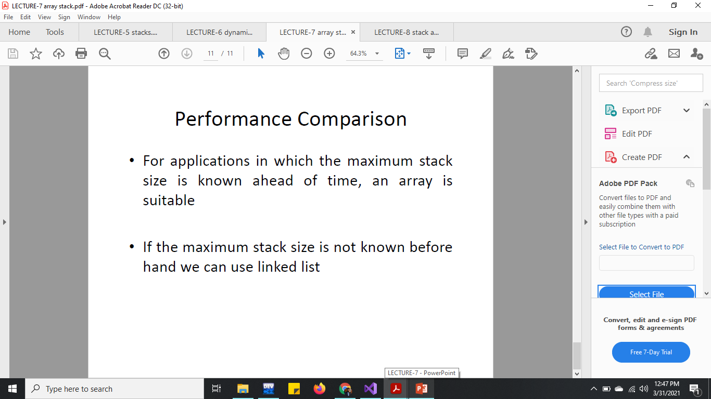

Slide 17
Applications of Stack
These are the some of the examples of Stack
Undo function
Getting result from mathematical expression
Like (A+B)*C
Checking of parenthesis that if opening and closing paranthesis are matching.

