Slide 1
LECTURE 6
Applications of STACK

Slide 2
Parenthesis in an expression
Check whether the parenthesis in the expression are balanced or not.
Like [ { ( a+b ) * ( x * y ) * ( m - n ) } ]
We can use stack to easily check in any expression if the parenthesis are balanced or not.

Slide 3
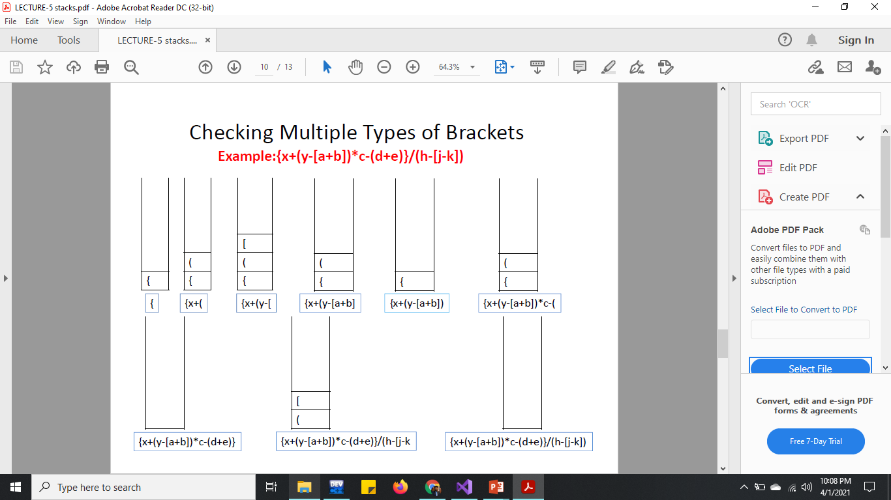

Slide 4
Parenthesis in an expression
Implementation using linked list
We will need six functions
Createnode()
Isempty()
Pop()
Push()
Isexpressionbalanced()
Isparenthesismatching()

Slide 5
Parenthesis in an expression
Implementation using Array is your home task.
We will need six functions
Createnode()
Isempty()
Pop()
Push()
Isexpressionbalanced()
Isparenthesismatching()

Slide 6
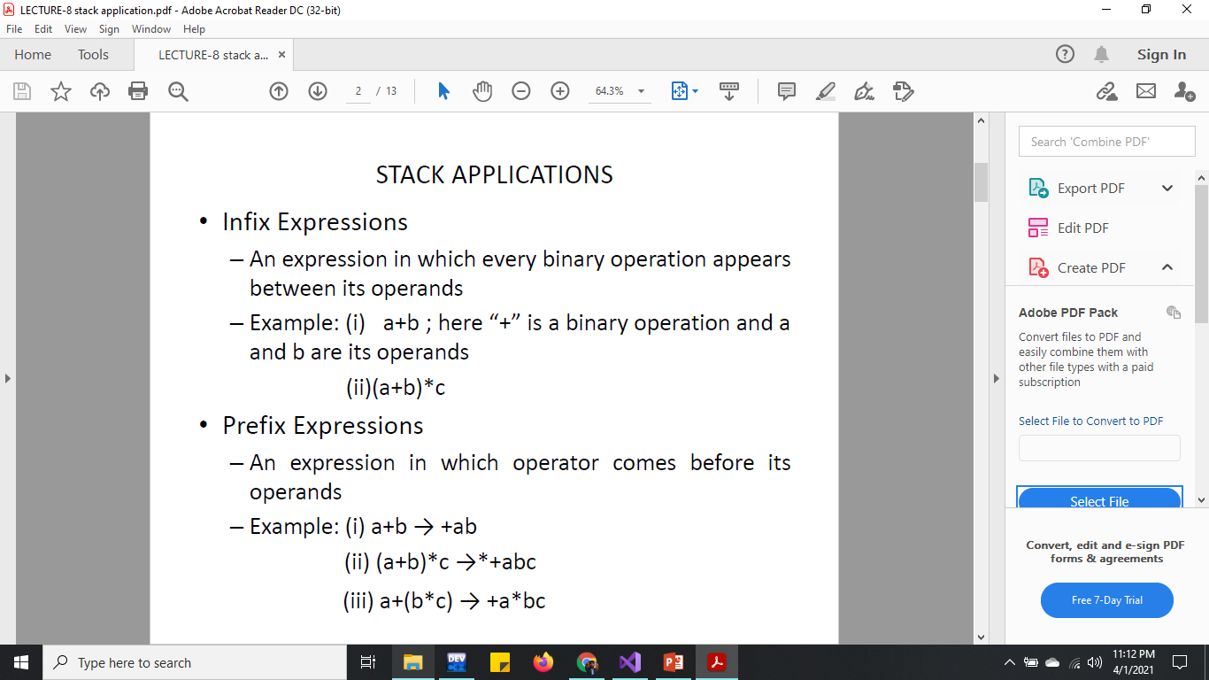

Slide 7
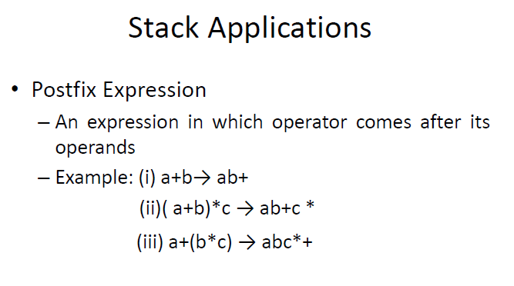

Slide 8
Expression Operation using Stack
Evaluation of postfix expression
Evaluation of postfix expression
Conversion from infix to postfix
Conversion from infix to prefix

Slide 9
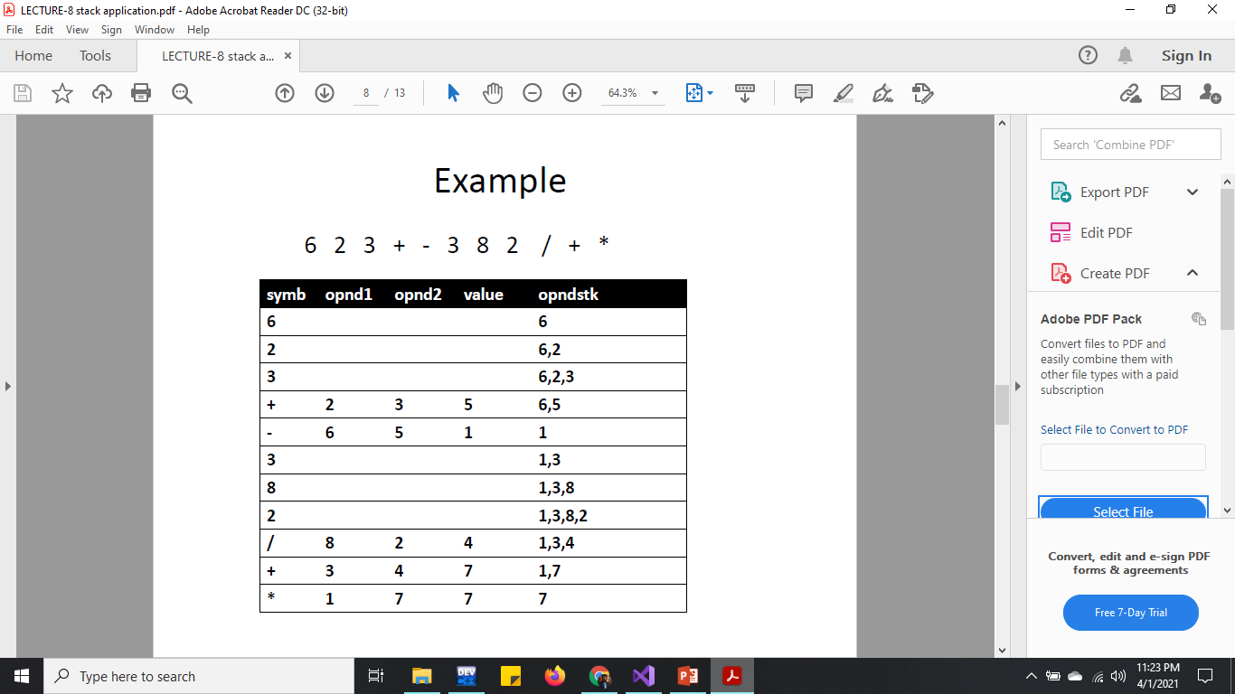
Evaluating Postfix Expression

Slide 10
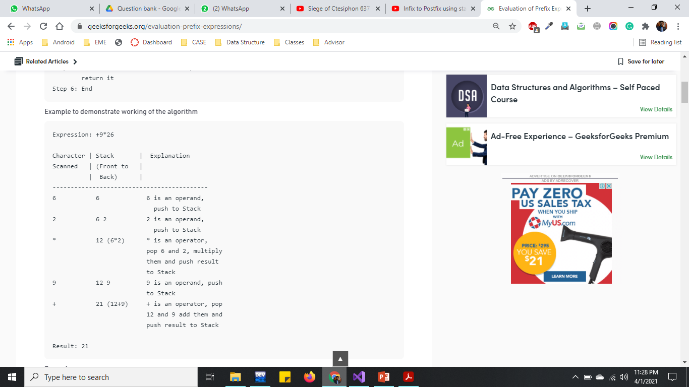
Evaluating Prefix Expression

Slide 11
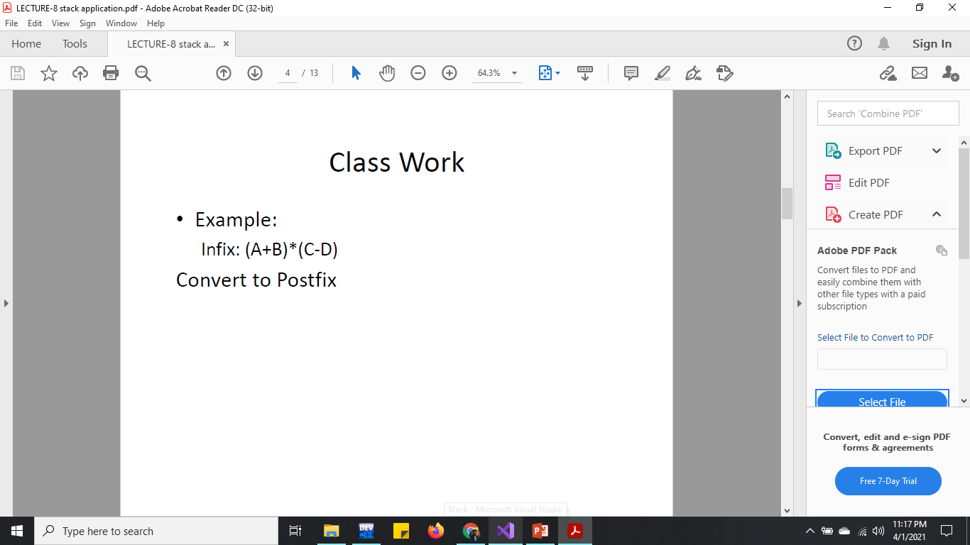
Symbol | Stack | Postfix
( | (
A | ( | A
+ | (+ | A
B | (+ | AB
) | (+) | AB+
* | * | AB+
( | *( | AB+
C | *( | AB+C
- | *(- | AB+C
D | *(- | AB+CD
) | *(-) | AB+CD-*

Slide 12


Slide 13
Remove multiples of 3 from stack
Class Work
Consider a stack is created and some random integers are added into it and you don’t know the exact numbers of integers in stack.
Your task is to remove multiples of 3 from the stack .
Write display function to print the stack.
Before removal After removal
1
4
6
5
9
15
4
1
4
5
4

