Slide 1
LECTURE 7
DATA STRUCTURES

Slide 2
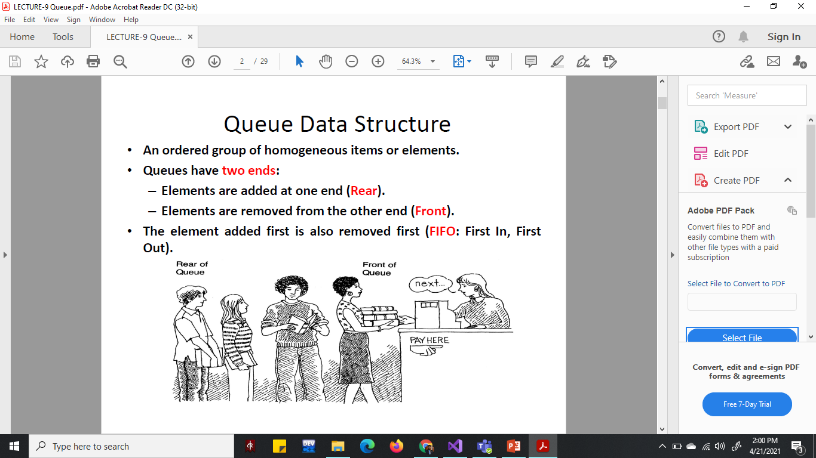

Slide 3
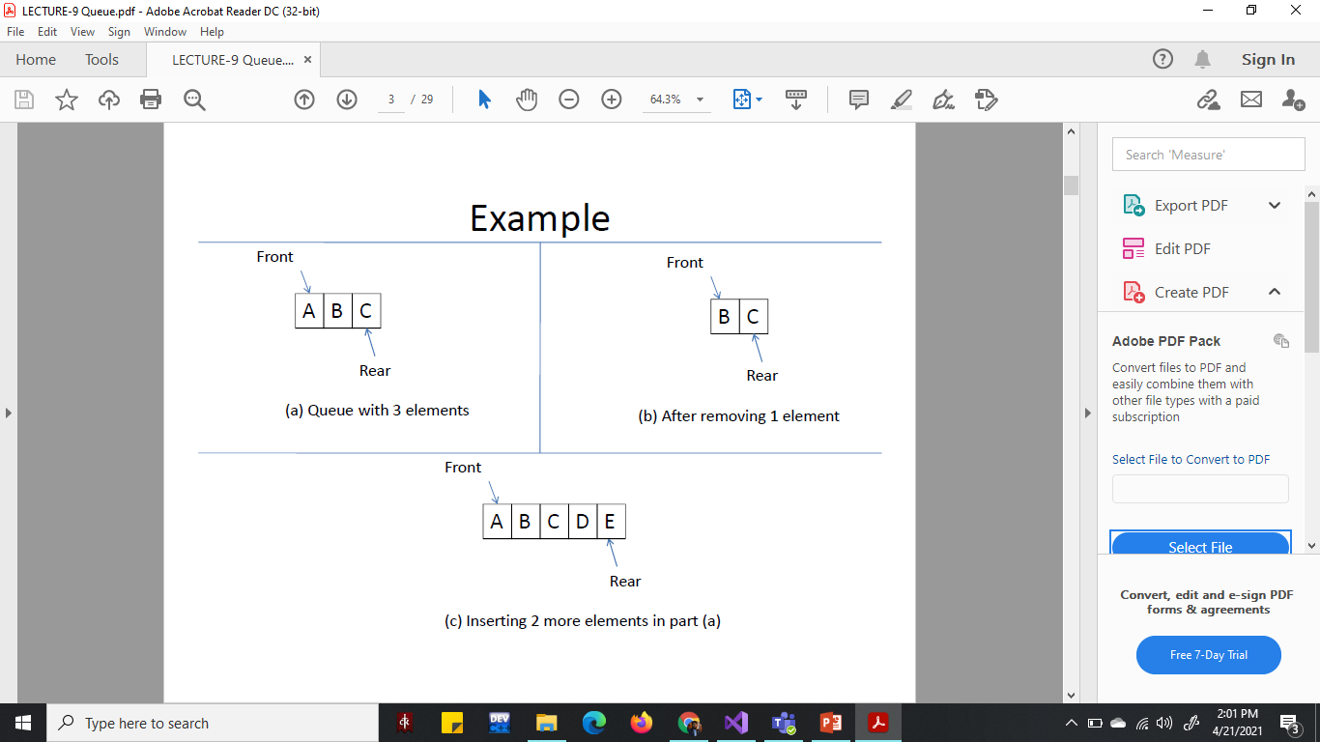

Slide 4
Applications of Queue
CPU scheduling
Event simulation
Check palindromes

Slide 5
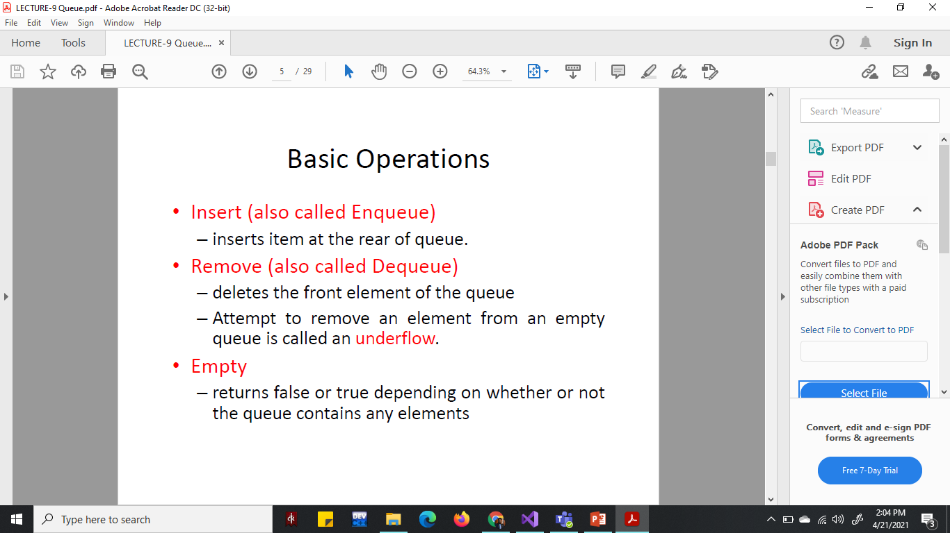

Slide 6
Implementations of Queue
Dynamic
Using Linklist
Static
Using Array

Slide 7
Dynamic Implementation (Enqueue)
void enqueue(Node* temp) {
if (rear == NULL) {
rear = temp;
front = rear;
}
else {
rear->next = temp;
rear = temp;
}
}

Slide 8
Dynamic Implementation (Dequeue)
void dequeue() {
node* temp = front;
if (isEmpty()) {
cout << "Underflow" << endl;
return;
}
else
}
if (front->next != NULL) {
cout << "Element deleted from queue is : " << front->data << endl;
front = front->next;
delete temp;
temp=NULL; }
else {
cout << "Element deleted from queue is : " << front->data << endl;
delete front;
front = NULL;
rear = NULL;
}

Slide 9
Static Implementation (Enqueue)
void enqueue() {
int val;
if (rear == n - 1)
cout << "Queue Overflow" << endl;
else {
if (front == -1)
front = 0;
cout << "Insert the element in queue : " << endl;
cin >> val;
rear++;
queue[rear] = val;
}
}

Slide 10
Static Implementation (Dequeue)
void dequeue() {
if (front == -1 || front > rear) {
cout << "Queue Underflow ";
return;
}
else {
cout << "Element deleted from queue is : " << queue[front] << endl;
front++;
}
}

Slide 11
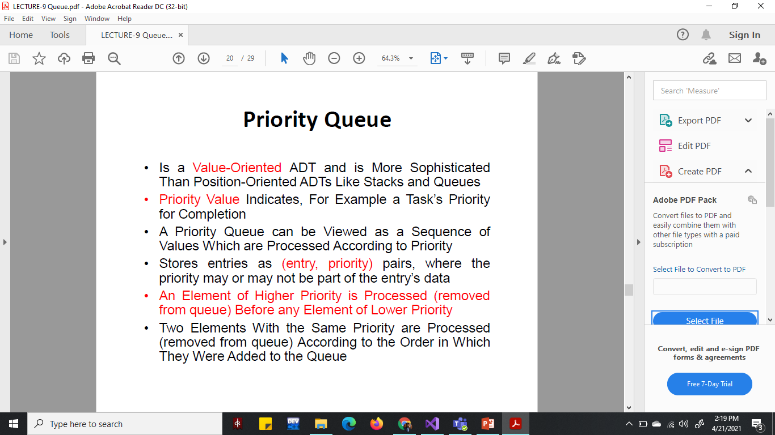

Slide 12
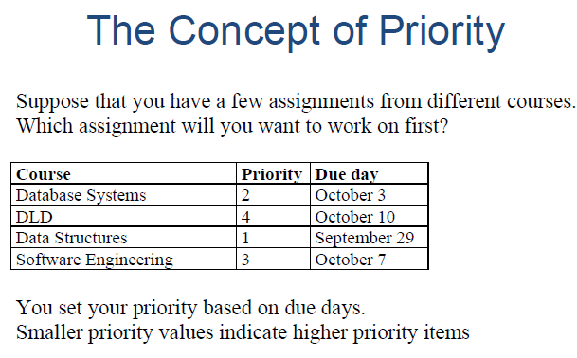

Slide 13
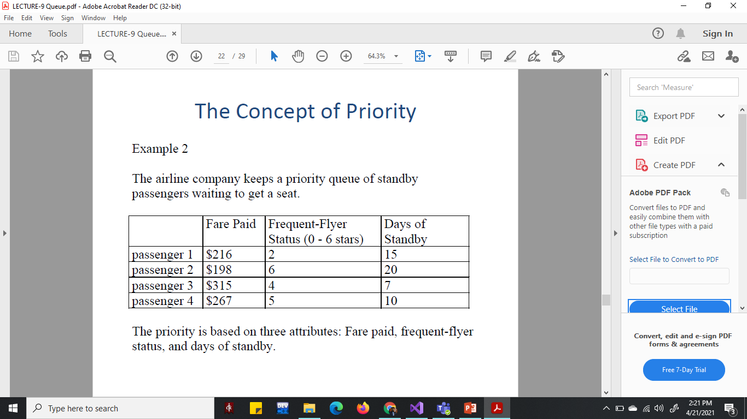

Slide 14
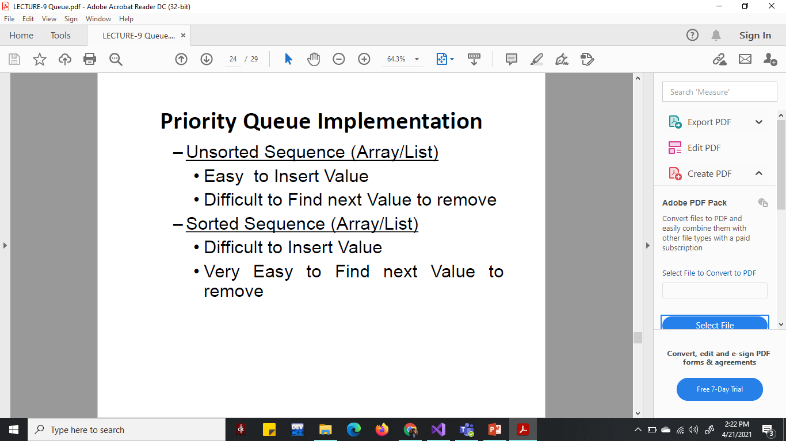

Slide 15


Slide 16


Slide 17
Dynamic Implementation (Enqueue)
void enqueue() {
node* temp = createNode();
node* start = front;
if (front == NULL)
front = temp;
else if (front->priority > temp->priority)
{
temp->next = front;
front = temp;
}
else {
while (start->next != NULL && start->next->priority < temp->priority)
{
start = start->next;
}
temp->next = start->next;
start->next = temp;
}

Slide 18
Check Palindrome
A palindrome is a word, number, phrase, or other sequence of characters which reads the same backward as forward.
Such as madam or racecar.
How Will you find if a char array is palindrome?
Char str[10] = “madam”;

Slide 19
Check Palindrome
Char str[10] = “madam”;

