Slide 1
Lecture 8
Big O Notation

Slide 2
Introduction
Big O notation is used to measure how running time or space requirements for your program grows as your input size grows.
It is used to calculate the efficiency of your program.
Efficiency of algorithms helps comparing different methods of solution for the same problem.
Efficiency is a concern for large problems (large data size)
Algorithm Analysis Should be Independent of
Specific Implementation languages,
Computers and
Data

Slide 3
Algorithm Growth Rate as a measure of efficiency
Growth Rate: Measure an Algorithm’s Time Requirement as a Function of the Problem Size (N)
How quickly the Algorithm’s Time Requirement Grows as a Function of the Problem Size
The Way to Measure a Problem’s Size Depends on the Application
Number of Nodes in a Linked List
The Size of an Array
Number of Items in the Stack

Slide 4
Big O Notation
Like
int getsize(int arr){ …….}
Return size →100 → 0.22 miliseconds
Return size →1000 → 2.32 miliseconds
We can’t measure the absolute time because of different computer speeds.
So, we need some mathematical function to calculate the time
That function is liner function
Time = a*n+b here a and b are constant.

Slide 5
Big O Notation
That function is liner function
Time = a*n+b here a and b are constant.
There are two rules:
Keep the fastest growing term
a*n
Drop the constant term
b

Slide 6
Big O Notation
int getsquare (int arr[ ], int len){
For(int =1; i<len;i++)
arr[i]= arr[ i ] * arr[ i ];
Return arr;
Array = [ 2, 4, 5 , 6 ,7 ];
Big O Notation ?

Slide 7
Big O Notation
float timePerQuestion (int time[ ] , int questions[ ], int index)
{
return questions[ index ] / time[ index ];
}
That function is liner function
Time = a here a is constant.

Slide 8
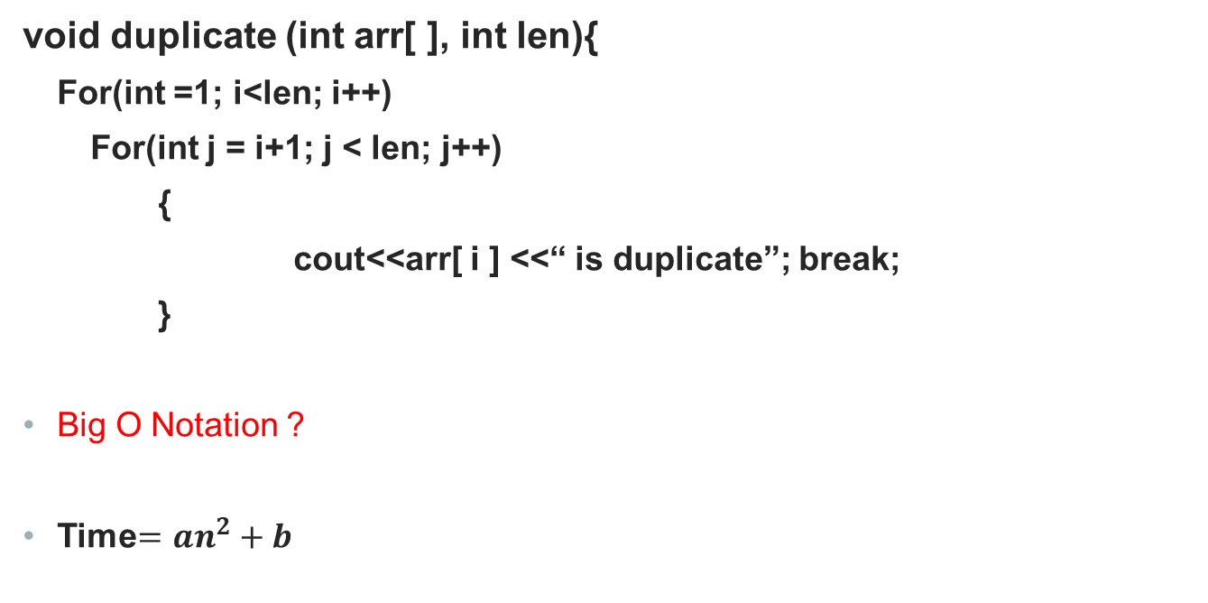
Big O Notation
void duplicate (int arr[ ], int len){
For(int =1; i<len; i++)
For(int j = i+1; j < len; j++)
{
cout<<arr[ i ] <<“ is duplicate”; break;
}
Big O Notation ?
Time$=an^{2}+b$

Slide 9
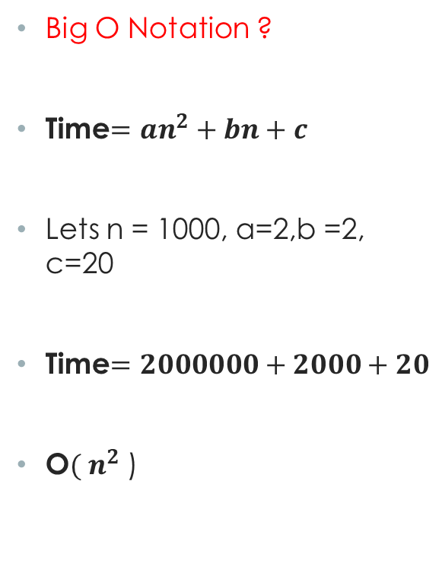
Big O Notation
void duplicate (int arr[ ], int len){
For(int =1; i<len; i++)
For(int j = i+1; j < len; j++)
{
cout<<arr[ i ] <<“ is duplicate”; break;
}
}
Void display( int arr[ ] )
{
for(int i=0; i<len; i++)
cout<<arr[ i ] ;
}
Big O Notation ?
Time$=an^{2}+bn+c$
Lets n = 1000, a=2,b =2, c=20
Time$=2000000+2000+20$
O$( n^{2}$ )

Slide 10
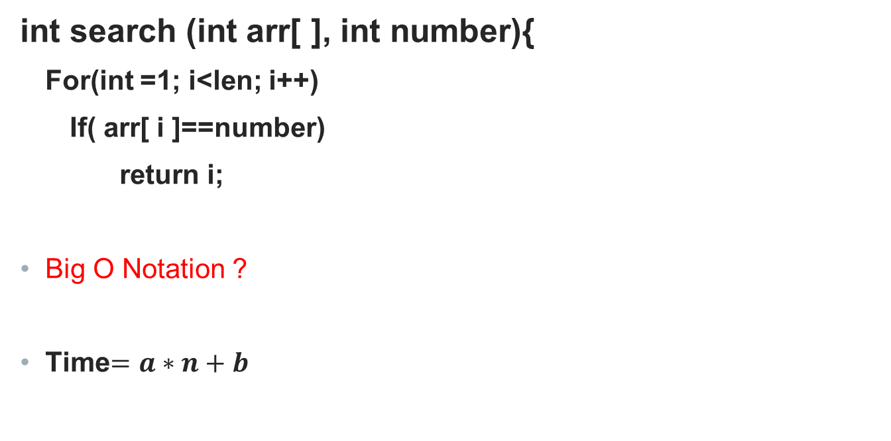
Big O Notation
int search (int arr[ ], int number){
For(int =1; i<len; i++)
If( arr[ i ]==number)
return i;
Big O Notation ?
Time$=a∗n+b$

Slide 11

Big o Notation
Binary Search like 68 ??
n/2 →(n/2)/2 → ((n/2)/2)2 = $\frac{n}{2^{3}}$
Time$=a∗log\left(n\right)+b$
2 | 5 | 52 | 55 | 68 | 76 | 85 | 98
2 | 5 | 52 | 55 | 68 | 76 | 85 | 98
2 | 5 | 52 | 55 | 68 | 76 | 85 | 98

Slide 12
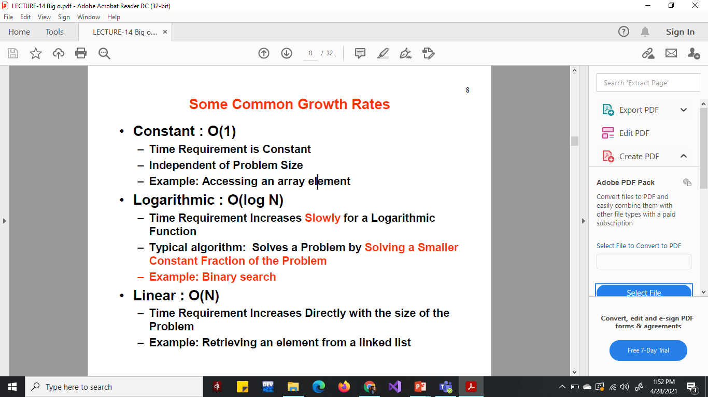

Slide 13
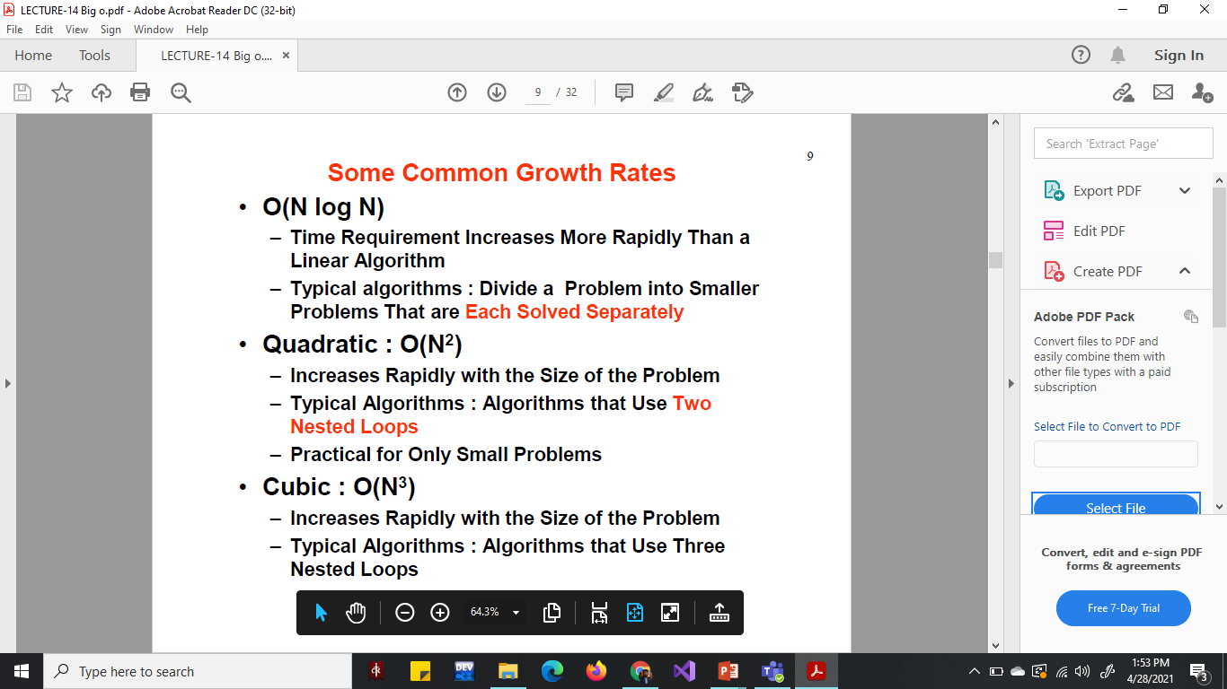

Slide 14
Big O Notation
Space complexity
How much more memory ( RAM ) do we need as the size of input provided to code increases?
It also uses the Big O Notation.

Slide 15
Big O Notation
Space complexity
Like for boolean and numbers takes up a constant space. O( 1 )
Arrays, strings and objects has linear space complexity O(n).

Slide 16
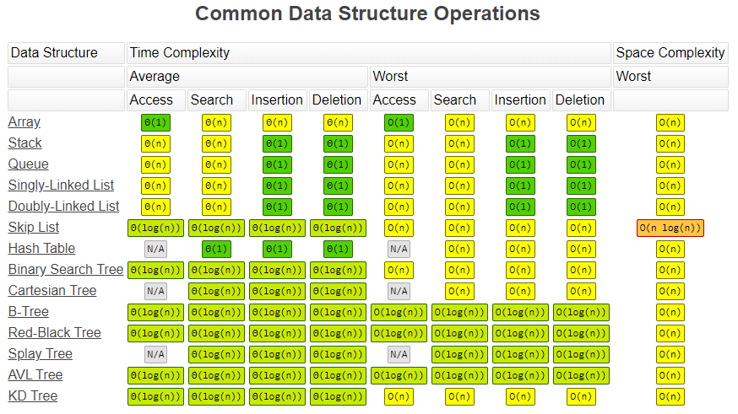

Slide 17
Comparison of Time & Space Complexity
Time complexity is more focused generally.
All the major works is done by processors.
Cost to produce and run processors is much higher than RAM.
Users / consumers usually care more about processing speed than RAM.

