Slide 1
Machine Learning
To detect the anomalies in Steam Turbine Vibration

Slide 2
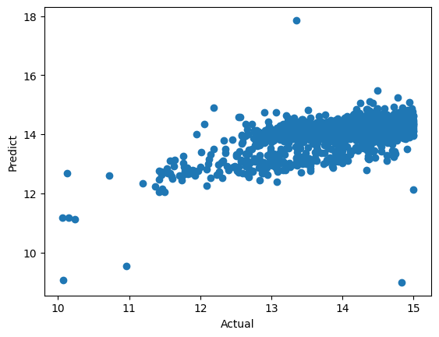
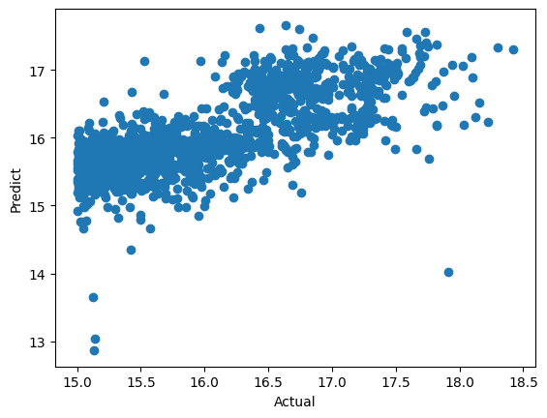
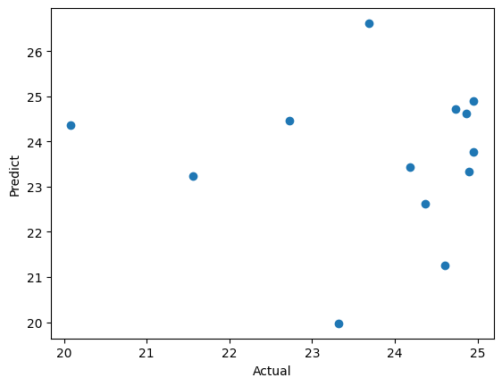
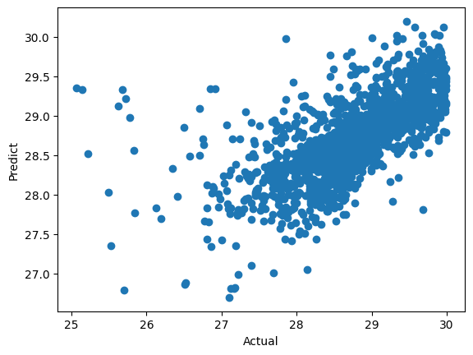
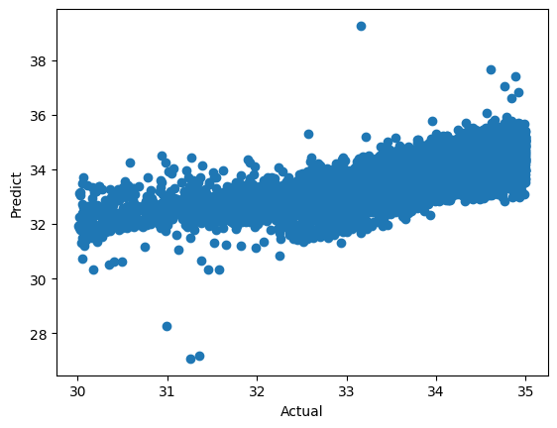
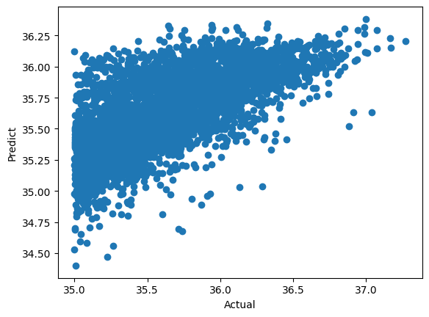
Classification and Linear regression
linear regression contributes coefficients of each sensors
Load Type Classification
Type 2: 10 – 15 MW
Type 3: 15 - 20 MW
Type 4: 20- 25 MW
Type 5: 25 - 30 MW
Type 6: 30 - 35 MW
Type 7:> 35 MW
Type 2
Type 3
Type 4
Accuracy = 0.3924
Accuracy = 0.5585
Accuracy = -1.3030
Train set: Jan 2021 – Dec 2022
Test set: Jan 2023 – June 2023
Type 5
Type 6
Type 7
Accuracy = 0.4513
Accuracy = 0.5534
Accuracy = 0.4607

Slide 3
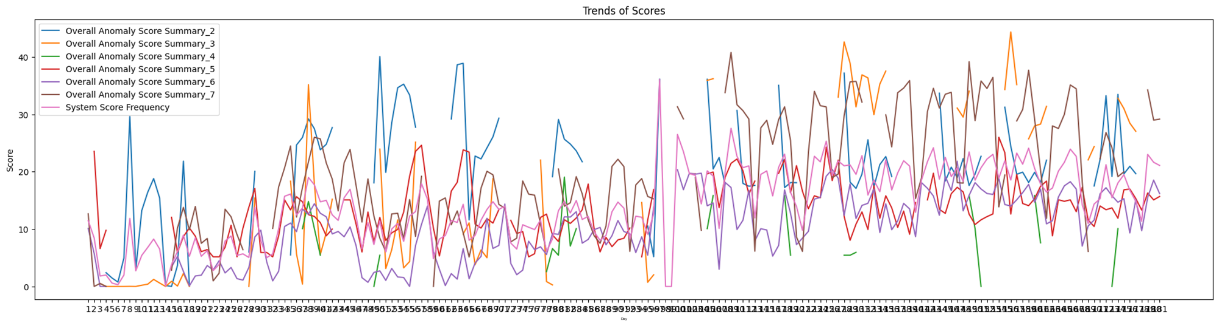
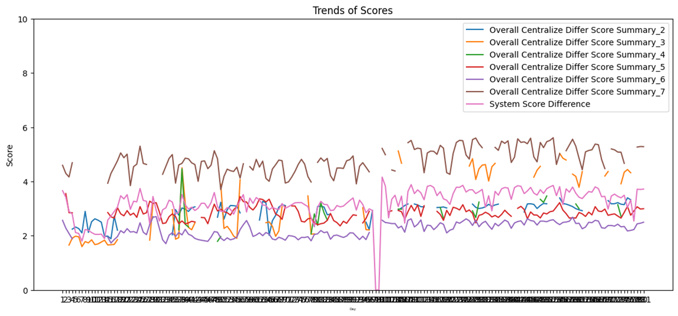
Helth Check: Anomaly Score and Centralize Differ Score
calculate health score to check an outlier score of each sensors in equipment and anomalies
Train set: Jan 2021 – Dec 2022
Test set: Jan 2023 – June 2023

Slide 4
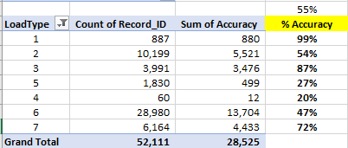
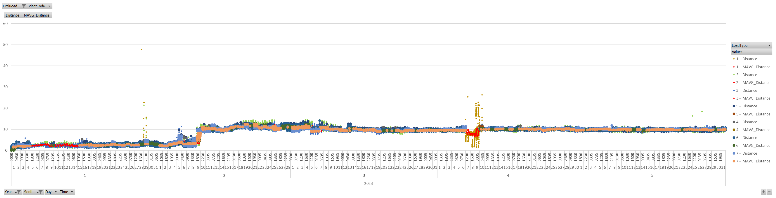
KNN Model
Load Type
Type 2: 10 – 15 MW
Type 3: 15 - 20 MW
Type 4: 20- 25 MW
Type 5: 25 - 30 MW
Type 6: 30 - 35 MW
Type 7:> 35 MW
Train set: Jan 2021 – Dec 2022
Test set: Jan 2023 – June 2023
Outage/Maintenance
Outage/Maintenance

