Slide 1

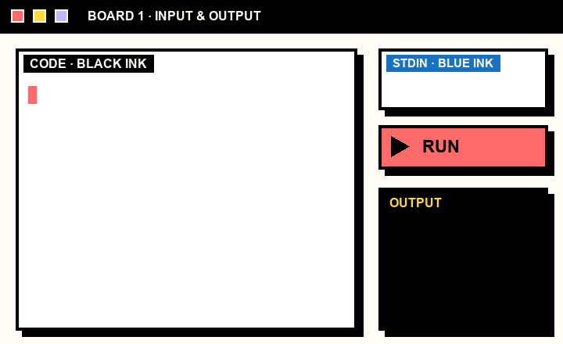
CRAFT N CODE KARNATAKA 2026
AI FOR EDUCATION
C++
PYTHON
BOARD
LIVE LOOP
ROOM.
THE WHITEBOARD
THAT RUNS YOUR CODE.
TYPE OR WRITE
SELECT
RUN
CLICK TO REVEAL ▸
BOARDROOM · CRAFT N CODE KARNATAKA 2026
1
2
3
4
5
6
7
8

Slide 2

02 / THE PROBLEM
A WHITEBOARD
CAN’T COMPILE.
TODAY
WRITE ON THE BOARD
▾
SWITCH TO AN IDE
▾
PASTE, RUN, SWITCH BACK
Teachers explain C++ and Python on a board. Checking the example means leaving the lesson for a separate IDE.
WITH BOARDROOM
WRITE ▸ SELECT ▸ RUN
OUR PREMISE, NOT A STATISTIC
FOR TEACHERS
Errors are underlined in the code. The lesson never leaves the board.
BOARDROOM · CRAFT N CODE KARNATAKA 2026
1
2
3
4
5
6
7
8

Slide 3
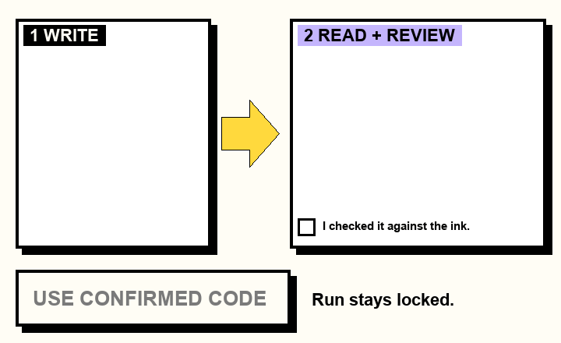
03 / HOW IT WORKS
FIVE STEPS FROM INK TO ANSWER.
STEP 3, SIMULATED
1
WRITE
Pen or keyboard. Black ink is code, blue ink is input.
2
SELECT
Drag a box. That region becomes the program.
3
REVIEW
Gemini reads ink. The teacher confirms every line.
4
RUN
A throwaway Docker container compiles and runs it.
int x = 1
printf("%d", x);
5
SEE
Output and errors appear in the code panel.
L1 · expected ‘;’
THE BOARD STAYS CLEAN.
BOARDROOM · CRAFT N CODE KARNATAKA 2026
1
2
3
4
5
6
7
8

Slide 4
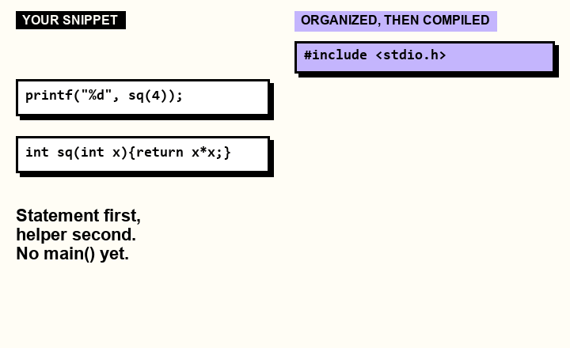
04 / THREE MODES
ONE SLIDER.
THREE WAYS TO RUN.
SNIPPET MODE, SIMULATED
FULL PROGRAM
SNIPPET
ALGORITHM
FULL PROGRAM
GEMINI: NEVER
Compiles exactly what you wrote. No corrections.
SNIPPET
GEMINI: ARRANGES
OPTIONAL:
ASK GEMINI TO FIX
Pick a template of headers. Gemini only arranges helpers and main(). It never fixes code.
Shows up only after a failed run, in any mode. The teacher clicks it. No click, no API call.
ALGORITHM
GEMINI: WRITES
Write the steps in plain words. Gemini writes the program, then it compiles.
BOARDROOM · CRAFT N CODE KARNATAKA 2026
1
2
3
4
5
6
7
8

Slide 5
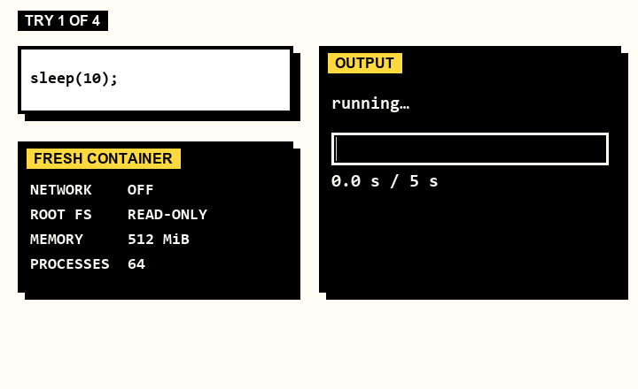

05 / SAFE BY DESIGN
TRY TO BREAK IT.
WE DID.
sleep(10)
▸
STOPPED AT 5 SECONDS
100,000 LINES OF OUTPUT
▸
CUT AT 16 KiB
WRITE PAST A BUFFER
▸
ASAN CATCHES IT
NETWORK CALL
▸
BLOCKED
55
PROBE PROGRAMS RUN IN C++ AND PYTHON
SIMULATION OF 4 REAL TEST RUNS
LOCAL: DOCKER · HOSTED: WANDBOX
SOURCE: OUR OWN TEST RUN, 18 OCT 2026
BOARDROOM · CRAFT N CODE KARNATAKA 2026
1
2
3
4
5
6
7
8

Slide 6
06 / AI, USED CAREFULLY
AI READS. THE COMPILER DECIDES.
WHERE GEMINI RUNS
NO AI HERE
GUARDRAILS
Reads handwriting and blue-ink input
Algorithm mode: steps become a program
Snippet mode: arranges structure only
Fix button: only when the teacher clicks
Compiling, running, error lines
Typed code in Full program mode
Teaching notes: fixed rules, not generated
Teacher confirms every line before it runs
A structure result that changes more than layout is refused
API keys stay on the server
Requests ask Gemini not to store them
BUILT WITH
GEMINI API
EXCALIDRAW
REACT + VITE
NODE.JS
DOCKER
G++ + PYTHON
WANDBOX
DEVELOPED WITH AI CODING TOOLS: OPENAI CODEX, CLAUDE CODE. NOT YET MEASURED: HANDWRITING ACCURACY ON REAL CLASSROOM SAMPLES.
BOARDROOM · CRAFT N CODE KARNATAKA 2026
1
2
3
4
5
6
7
8

Slide 7
07 / WHAT ELSE IT DOES
EVERYTHING A
LESSON NEEDS.
01
02
03
SNAPSHOTS
INPUT CASES
TEACHING HEADERS
Every run is saved with the whole board, in Git history.
Run up to five inputs. Compare output exactly. Save suites.
Stack, queue, linked list, binary search, plus C++ STL examples.
04
05
06
DRAW A LIST
TWO BOARDS
TEACHER TOOLS
Draw or type 1->3->4->5. Boardroom builds real linked-list nodes.
Tabs, and a side-by-side view for comparing two boards.
Pen, eraser, shapes, laser pointer, five stroke widths, dark mode.
39 / 39 NON-GEMINI BROWSER TESTS PASSED · 18 OCT 2026
BOARDROOM · CRAFT N CODE KARNATAKA 2026
1
2
3
4
5
6
7
8

Slide 8
08 / WHAT’S NEXT
THE BOARD
NOW TALKS
BACK.
IF WE HAD ANOTHER MONTH
MEASURE
Benchmark handwriting accuracy on real classroom samples.
HARDEN
Separate execution VM, login and a security review before public hosting.
KNOWN GAPS TODAY
PIN
Freeze compiler and header versions inside every lesson snapshot.
Hosted site runs code on Wandbox: rate limited, no sanitizer promise.
Language is C++17 now. C code that is not valid C++ will not compile.
WRITE. SELECT. RUN.
BOARDROOM · CRAFT N CODE KARNATAKA 2026
1
2
3
4
5
6
7
8

