Slide 1
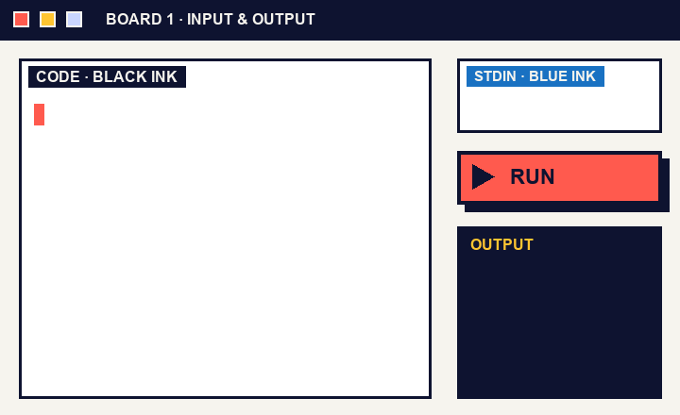
CRAFT N CODE KARNATAKA 2026 · AI FOR EDUCATION
LIVE LOOP
Boardroom
The whiteboard that runs your code.
Write C++ or Python on a board. Select it. Run it.
The lesson never leaves the board.
Simulation of one lesson run. Click to reveal the three steps.
WRITE
SELECT
RUN
React · Excalidraw · Node.js · Docker · g++ (C++17) · Python · Gemini
Boardroom · Craft N Code Karnataka 2026
1
2
3
4
5
6
7
8

Slide 2
02 THE PROBLEM
A whiteboard can’t compile.
TODAY
1
Write on the board
Teachers explain C++ and Python at a board. Checking an example means leaving the lesson for a separate IDE, and the board never shows what actually happened.
2
Switch to an IDE
3
Paste, run, switch back
WITH BOARDROOM
USER: TEACHERS AT A BOARD
OUR PREMISE, NOT A STATISTIC
Write. Select. Run.
Why it matters
Errors are underlined in the code. The board stays clean and the lesson keeps moving.
Students see the example run, or fail, right where it was written.
Boardroom · Craft N Code Karnataka 2026
1
2
3
4
5
6
7
8

Slide 3
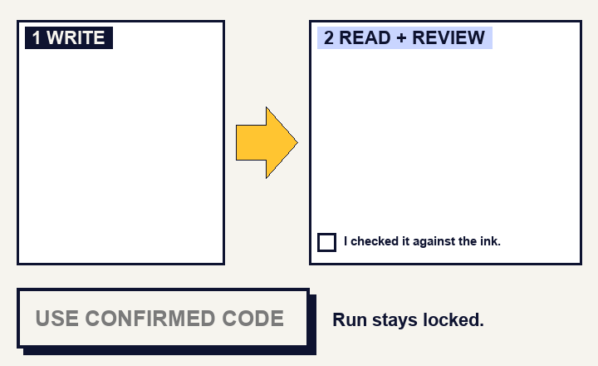
03 HOW IT WORKS
Five steps from ink to answer.
STEP 3, SIMULATED
1
Write
Pen or keyboard. Black ink is code, blue ink is input.
2
Select
Drag a box. That region becomes the program.
3
Review
Gemini reads the ink. The teacher confirms every line.
4
Run
A throwaway Docker container compiles and runs it.
int x = 1
printf("%d", x);
L1 · EXPECTED ‘;’
5
See
Output and errors appear in the code panel.
Error marked on the line, not on the board.
Boardroom · Craft N Code Karnataka 2026
1
2
3
4
5
6
7
8

Slide 4
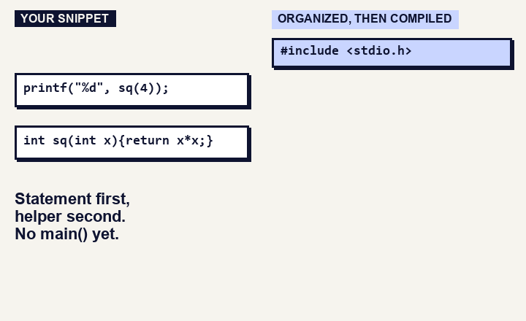
04 THREE MODES
One slider, three ways to run.
SNIPPET MODE, SIMULATED
Full program
Snippet
Algorithm
Full program
GEMINI: NEVER
Compiles exactly what you wrote. No corrections.
Snippet
GEMINI: ARRANGES
Pick a template of headers. Gemini only arranges helpers and main(). It never fixes code.
Optional: ask Gemini to fix
Appears only after a failed run, in any mode. The teacher clicks it. No click, no API call.
Algorithm
GEMINI: WRITES
Write the steps in plain words. Gemini writes the program, then it compiles.
Boardroom · Craft N Code Karnataka 2026
1
2
3
4
5
6
7
8

Slide 5
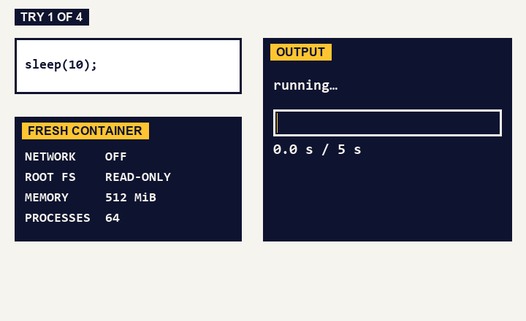
05 SAFE BY DESIGN
We tried to break it.
sleep(10)
Stopped at 5 seconds
100,000 lines of output
Cut at 16 KiB
Write past a buffer
AddressSanitizer catches it
Network call
Blocked
55
compile and run probes, C++ and Python
SIMULATION OF 4 REAL TEST RUNS
LOCAL: DOCKER · HOSTED: WANDBOX
Source: our own test run, 18 Oct 2026
Boardroom · Craft N Code Karnataka 2026
1
2
3
4
5
6
7
8

Slide 6
06 DATA AND AI USED
AI reads. The compiler decides.
WHERE GEMINI RUNS
GUARDRAILS
NO AI HERE
Reads handwriting and blue-ink input
Algorithm mode: steps become a program
Snippet mode: arranges structure only
Fix button: only when the teacher clicks
Teacher confirms every line before it runs
A structure result that changes more than layout is refused
API keys stay on the server
Requests ask Gemini not to store them
Compiling, running, error lines
Typed code in Full program mode
Teaching notes: fixed rules, not generated
BUILT WITH
Gemini API
Excalidraw
React + Vite
Node.js
Docker
g++ + Python
Wandbox
AI tools and reuse: developed with OpenAI Codex and Claude Code. Not yet measured: handwriting accuracy on real classroom samples.
Boardroom · Craft N Code Karnataka 2026
1
2
3
4
5
6
7
8

Slide 7
07 WHAT ELSE IT DOES
Everything a lesson needs.
01
02
03
Snapshots
Input cases
Teaching headers
Every run is saved with the whole board, in Git history.
Run up to five inputs. Compare output exactly. Save suites.
Stack, queue, linked list and binary search, plus C++ STL examples.
04
05
06
Draw a list
Two boards
Teacher tools
Draw or type 1->3->4->5 and Boardroom builds real linked-list nodes.
Board tabs, and a side-by-side view for comparing two boards.
Pen, eraser, shapes, laser pointer, five stroke widths and dark mode.
39 of 39 non-Gemini browser tests passed · 18 Oct 2026
Boardroom · Craft N Code Karnataka 2026
1
2
3
4
5
6
7
8

Slide 8
08 LIMITS AND NEXT
Where it stands, and what comes next.
39/39
KNOWN GAPS
IF WE HAD ANOTHER MONTH
Hosted site runs code on Wandbox: rate limited, no sanitizer promise.
Measure
Benchmark handwriting accuracy on real classroom samples.
non-Gemini browser tests passed, 18 Oct 2026
Language is C++17. C that is not valid C++ will not compile.
Harden
Gemini features are not covered by the automated tests above.
Separate execution VM, login and a security review before public hosting.
55
Handwriting accuracy is not yet measured on real classroom samples.
Pin
compile and run probes in our sandbox test, C++ and Python
Freeze compiler and header versions inside every lesson snapshot.
github.com/ksu-gitreaper807/Craft-N-Code-Karnataka
Boardroom · Craft N Code Karnataka 2026
1
2
3
4
5
6
7
8

