Slide 1
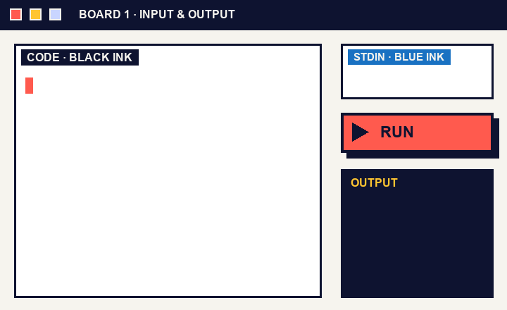
CRAFT N CODE KARNATAKA 2026 · AI FOR EDUCATION
Boardroom
The whiteboard that runs your code.
Write. Select. Run.
Boardroom · Craft N Code Karnataka 2026
1
2
3
4
5
6
7
8

Slide 2
02 THE PROBLEM
A whiteboard
can’t compile.
TODAY
1
Write on the board
2
Switch to an IDE
Teachers explain C++ and Python at a board. To check an example, they leave the lesson for an IDE.
3
Paste, run, switch back
Our premise, not a statistic.
WITH BOARDROOM
Write. Select. Run.
The answer appears on the board.
Boardroom · Craft N Code Karnataka 2026
1
2
3
4
5
6
7
8

Slide 3
03 HOW IT WORKS
From ink to answer.
01
02
03
04
05
Write
Select
Review
Run
See
Black ink is code, blue ink is input.
Drag a box around the program.
Gemini reads it. You confirm every line.
A fresh container compiles and runs it.
Output and errors show up on the board.
The teacher stays in charge
✓
Nothing runs until the teacher has checked the code against the ink.
Boardroom · Craft N Code Karnataka 2026
1
2
3
4
5
6
7
8

Slide 4
04 THREE MODES
One slider. Three ways to run.
GEMINI: NEVER
GEMINI: ARRANGES
GEMINI: WRITES
Full program
Snippet
Algorithm
Compiles exactly what you wrote.
Arranges loose lines under a template of headers. Never fixes code.
Plain-language steps become a program, then it compiles.
Ask Gemini to fix
Only after a failed run, and only if the teacher clicks it.
Boardroom · Craft N Code Karnataka 2026
1
2
3
4
5
6
7
8

Slide 5
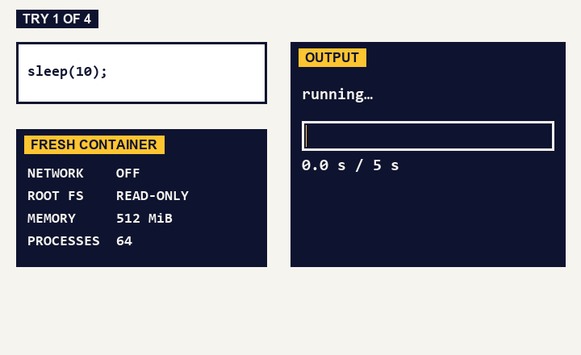
05 SAFE BY DESIGN
We tried to break it.
sleep(10)
Stopped at 5 seconds
100,000 lines of output
Cut at 16 KiB
Write past a buffer
Caught by AddressSanitizer
Network call
Blocked
Every run gets a fresh container: no network, read-only root, 512 MiB, 64 processes.
Simulation of four of our real test runs.
Boardroom · Craft N Code Karnataka 2026
1
2
3
4
5
6
7
8

Slide 6
06 WHERE IT STANDS
Tested, honest about limits, and growing.
KNOWN LIMITS
NEXT
39/39
Hosted site runs code on Wandbox, not Docker.
Measure
Benchmark handwriting accuracy.
non-Gemini browser tests passed
C++17 only. C that is not valid C++ will not compile.
Harden
55
Separate execution VM and a security review.
Handwriting accuracy not yet measured on real classrooms.
Pin
compile and run probes, C++ and Python
Freeze compiler versions in each snapshot.
Our own runs, 18 Oct 2026
Boardroom · Craft N Code Karnataka 2026
1
2
3
4
5
6
7
8

Slide 7
07 METHODOLOGY · SYSTEM ARCHITECTURE
Three parts, one request path.
Gemini API
ink, prompts
text, code
Teacher’s board
region, input
Boardroom server
code, stdin
Sandbox
React + Excalidraw
Write, select, confirm
Node.js
Routes every request
Docker, run locally
Wandbox, when hosted
answer
output, errors
The teacher confirms handwriting before any code reaches the sandbox.
Git snapshots
Boardroom · Craft N Code Karnataka 2026
1
2
3
4
5
6
7
8

Slide 8
08 METHODOLOGY · TOOLS USED
Built with open tools and careful AI.
PRODUCT STACK
AI IN THE PRODUCT
BUILT WITH AI HELP
React + Vite
Excalidraw
Gemini API
OpenAI Codex
Claude Code
Node.js
Docker
Reads handwriting
Arranges snippets
Writes from plain steps
Suggests fixes on request
Used to write and test the code. Excalidraw is the open-source board we build on.
g++ (C++17)
Python
Wandbox
Git
Boardroom · Craft N Code Karnataka 2026
1
2
3
4
5
6
7
8

