Slide 1
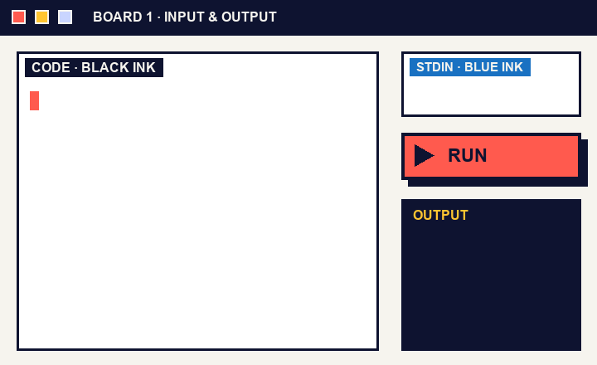
CRAFT N CODE KARNATAKA 2026 · AI FOR EDUCATION
Boardroom
The whiteboard that runs your code.
Write. Select. Run.
Boardroom · Craft N Code Karnataka 2026
1
2
3
4
5
6
7
8

Slide 2
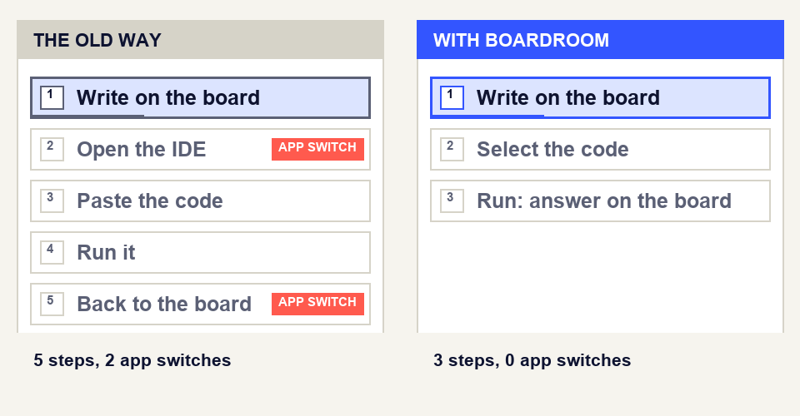
02 THE PROBLEM
A whiteboard
can’t compile.
Teachers explain C++ and Python at a board. To check an example, they leave the lesson for an IDE.
Our premise, not a statistic.
Same example, two workflows.
Boardroom · Craft N Code Karnataka 2026
1
2
3
4
5
6
7
8

Slide 3
03 SYSTEM PIPELINE
From ink to answer.
01 / INPUT
02 / RECOGNITION
03 / VALIDATION
04 / SANDBOX
05 / FEEDBACK
Board capture
Gemini reads
Teacher review
Safe run
Answer on the board
Write or type on the board
Select a region
Blue ink becomes input
Handwriting becomes text
Typed code skips this step
Compare the text to the ink
Tick to confirm
Nothing runs until then
Fresh Docker container
No network, 5 second limit
Sanitizers switched on
Output in the code panel
Errors marked on the line
Snapshot saved to Git
Gemini reads the ink. The compiler decides whether it works.
Boardroom · Craft N Code Karnataka 2026
1
2
3
4
5
6
7
8

Slide 4
04 HEADLINE FEATURES
What teachers get.
01
02
03
Write or type
Handwriting to code
Three run modes
Pen or keyboard on an Excalidraw board.
Gemini reads the ink. The teacher confirms.
Full program, Snippet or Algorithm.
04
05
06
A safe sandbox
Teaching headers
Boards and snapshots
Every run in a fresh container.
Stack, queue, linked list and search.
Compare two boards. Save every run to Git.
Boardroom · Craft N Code Karnataka 2026
1
2
3
4
5
6
7
8

Slide 5
05 DUAL BOARDS
Two boards, side by side.
BOARD A
BOARD B
Code
Pointer diagram
HOW IT WORKS
IN THE CLASSROOM
Board tabs, plus a side-by-side view
Each board is independent
Switch back to one board any time
Iterative against recursive, live
Buggy code next to its fix
Data structure on one board, code on the other
Boardroom · Craft N Code Karnataka 2026
1
2
3
4
5
6
7
8

Slide 6
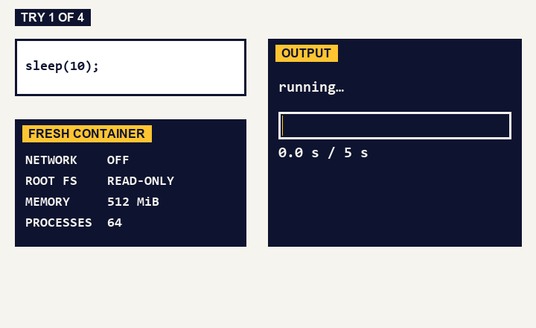
06 SAFE BY DESIGN
We tried to break it.
sleep(10)
Stopped at 5 seconds
100,000 lines of output
Cut at 16 KiB
Write past a buffer
Caught by AddressSanitizer
Network call
Blocked
Fresh container every run: no network, read-only root, 512 MiB, 64 processes.
55 probe programs in C++ and Python, our own test run, 18 Oct 2026.
Simulation of four of our real test runs.
Boardroom · Craft N Code Karnataka 2026
1
2
3
4
5
6
7
8

Slide 7
07 METHODOLOGY · SYSTEM ARCHITECTURE
Three parts, one request path.
Gemini API
ink, prompts
text, code
Teacher’s board
region, input
Boardroom server
code, stdin
Sandbox
React + Excalidraw
Write, select, confirm
Node.js
Routes every request
Docker, run locally
Wandbox, when hosted
answer
output, errors
The teacher confirms handwriting before any code reaches the sandbox.
Git snapshots
Boardroom · Craft N Code Karnataka 2026
1
2
3
4
5
6
7
8

Slide 8
08 METHODOLOGY · TOOLS USED
Built with open tools and careful AI.
PRODUCT STACK
AI IN THE PRODUCT
BUILT WITH AI HELP
React + Vite
Excalidraw
Gemini API
OpenAI Codex
Claude Code
Node.js
Docker
Reads handwriting
Arranges snippets
Writes from plain steps
Suggests fixes on request
Used to write and test the code. Excalidraw is the open-source board we build on.
g++ (C++17)
Python
Wandbox
Git
Boardroom · Craft N Code Karnataka 2026
1
2
3
4
5
6
7
8

