Slide 1




MEDICAL XML DOCUMENTS TO DATA WAREHOUSE
Transforming raw medical records into analyzable data
Presented By
Supervised By
Hana Mhiri & Nourelhouda Saied
Ms Ines Ben Massoued
1
26/11/2025
Notes:
Transforming raw medical records into analyzable data

Slide 2

1) Project Overview
  Input
Over 1,500 XML medical documents of a Hospital.
  Output
Robust, query-ready data warehouse
Goal: Enable reliable analysis and reporting from complex medical records.
2

Slide 3
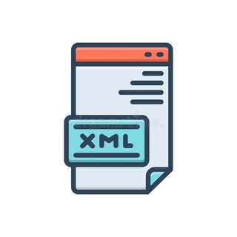




2) Pipeline Diagram
XML Documents
EDA & Preprocessing
Data Modeling
Data loading & Model Implementation
Reporting & Visualization
3

Slide 4
3) EDA & Preprocessing
4

Slide 5
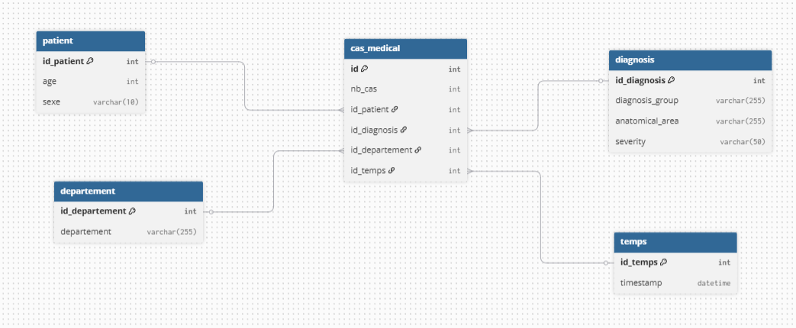
4) Data Modeling
5

Slide 6
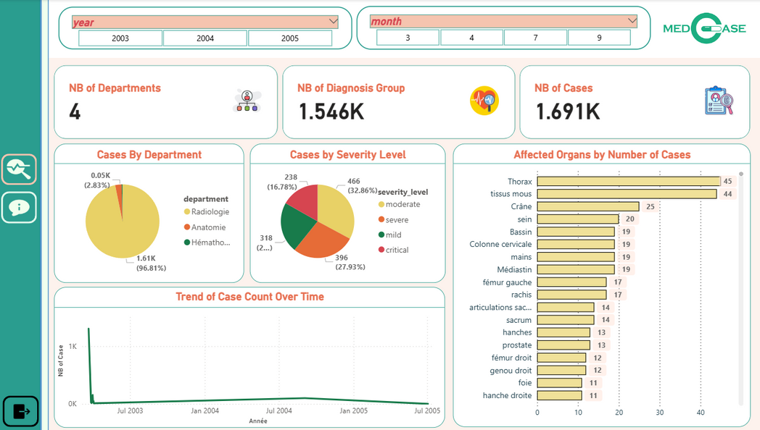
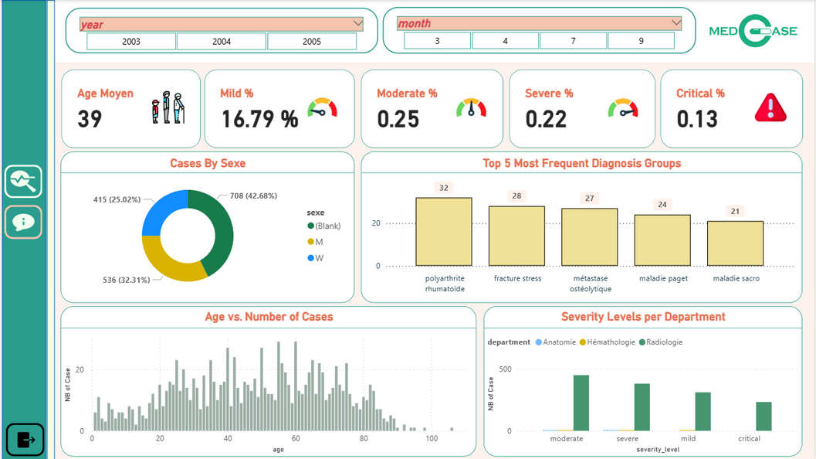
5) Reporting & Visualization
6

Slide 7

6) Conclusion
We transformed raw Casimage medical case data into a structured data warehouse by cleaning, normalizing, and extracting insights from textual fields. Dimension tables and a fact table were created to support analysis of disease patterns, severity trends, and organ involvement. This pipeline enables efficient, repeatable analytics and lays the groundwork for future modeling or reporting.
7

Slide 8
Thanks for your attention !

