Slide 1
"Building and Tuning a Convolutional
Neural Network for Image Classification"
An In-depth Overview of Model Development and Implementation

Slide 2
Objective:
This project focuses on developing a
Convolutional Neural Network (CNN) for the
classification of images. The main steps include
building the CNN model, hyperparameter tuning,
and evaluating the model using a specified dataset.

Slide 3
Steps to Build the Model:
Input Layer: Accepts images as input.
Convolutional Layers: Apply filters to extract features from images.
Activation Functions: Use ReLU to introduce non-linearity.
Pooling Layers: Downsample the feature maps to reduce dimensionality.
Fully Connected Layers: Connect every neuron in one layer to every neuron in the next layer.
Output Layer: Uses a softmax function for multi-class classification.

Slide 4
Hyperparameter Tuning:
Definition: Hyperparameter tuning is the process of optimizing the model's
parameters to improve performance.
Parameters Tuned:
Learning Rate: Controls the step size during gradient descent.
Batch Size: Number of training examples utilized in one iteration.
Number of Epochs: The number of times the entire dataset is passed through the model.
Optimizer: Algorithm to update the model's weights, e.g., Adam, SGD.
Number of Filters: Determines the number of output channels of convolution layers.
Tuning Methods:
Grid Search: Exhaustively searching through a manually specified subset of the hyperparameter space.
Random Search: Sampling from the hyperparameter space randomly.

Slide 5
Dataset Overview:
Source: Describe where the dataset was sourced from.
Content: Number of images, classes, and distribution.

Slide 6
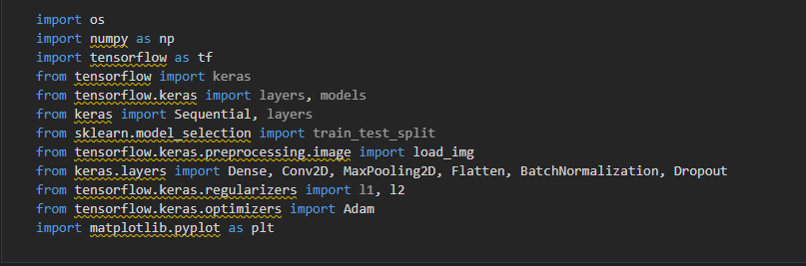
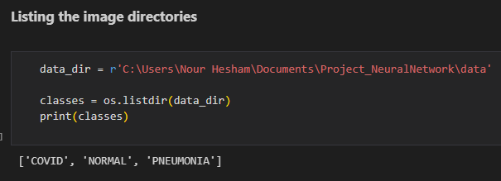
1. Import Libraries:

Slide 7
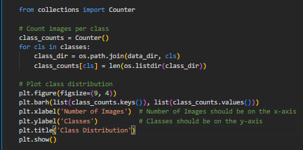
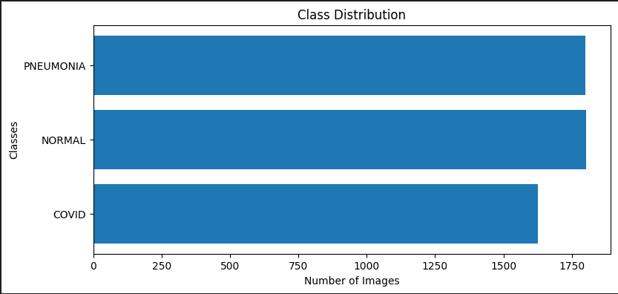
Class Distribution Analysis:

Slide 8
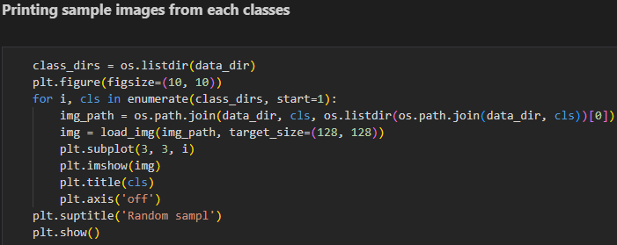
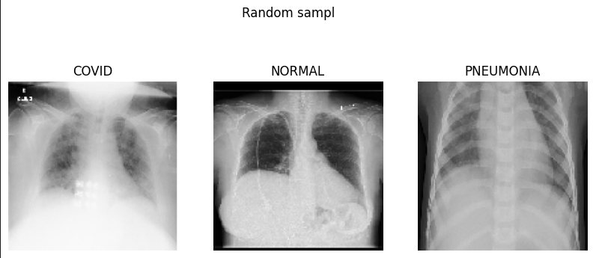

Slide 9
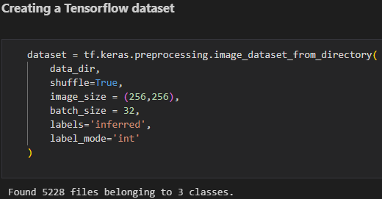
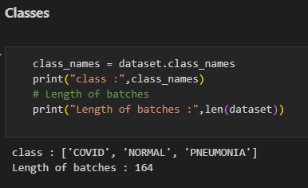

Slide 10
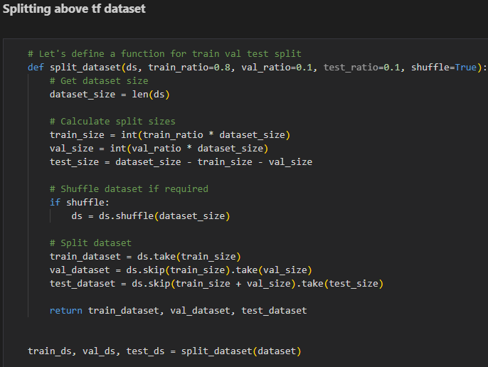
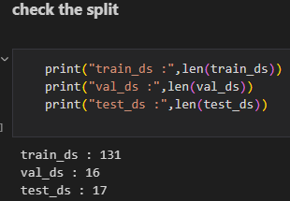

Slide 11
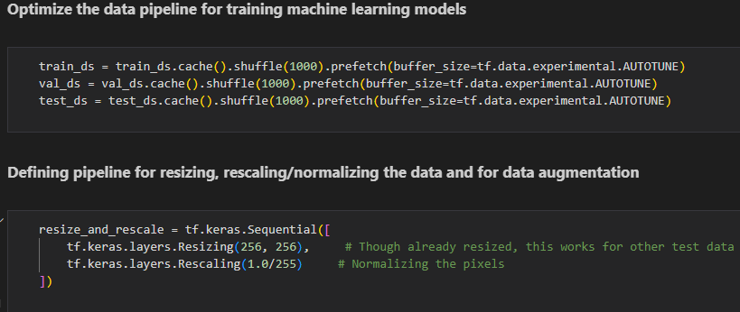

Slide 12
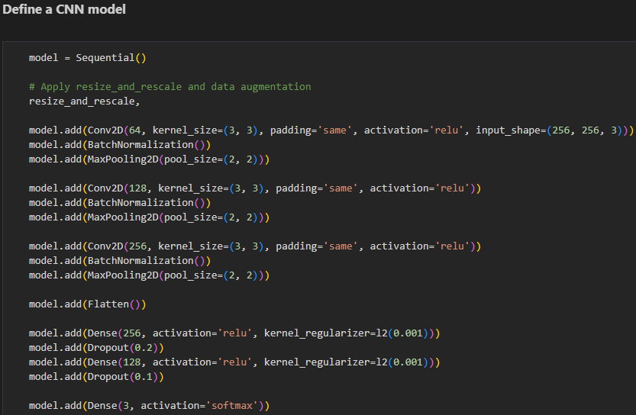

Slide 13

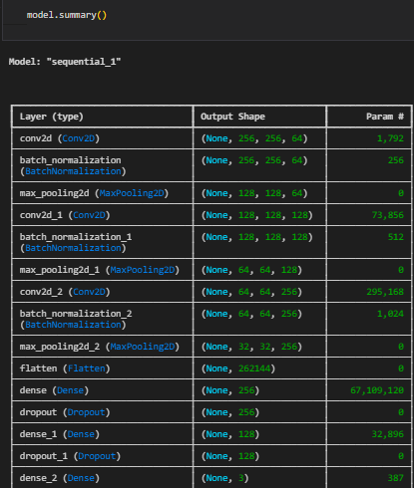

Slide 14
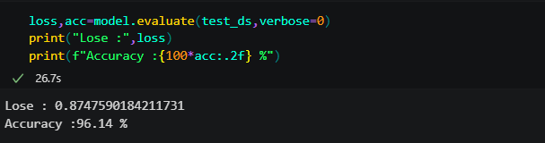
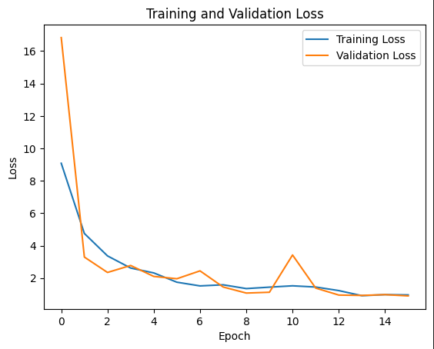
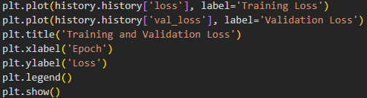
Model Training and Validation Process:
Model Evaluation on Test Data:
Training vs. Validation Loss Analysis:

Slide 15
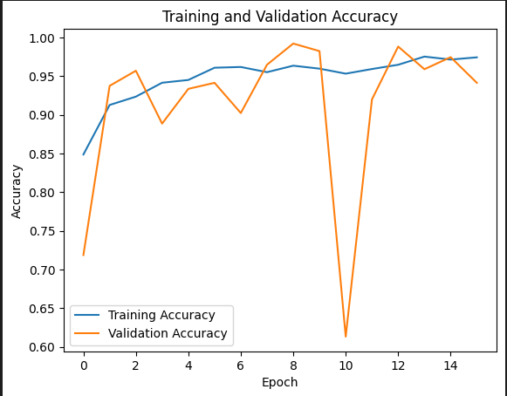
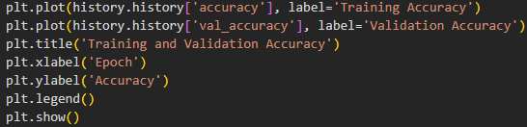
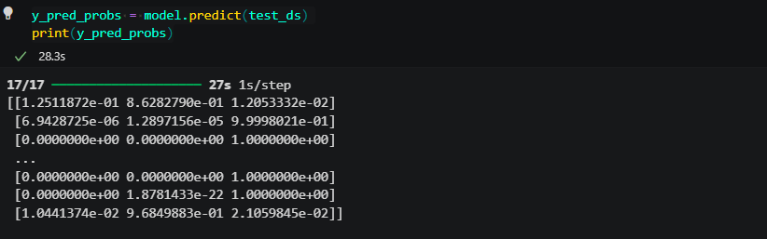
Training vs. Validation Accuracy Analysis:
Prediction Probabilities on Test Data:

Slide 16
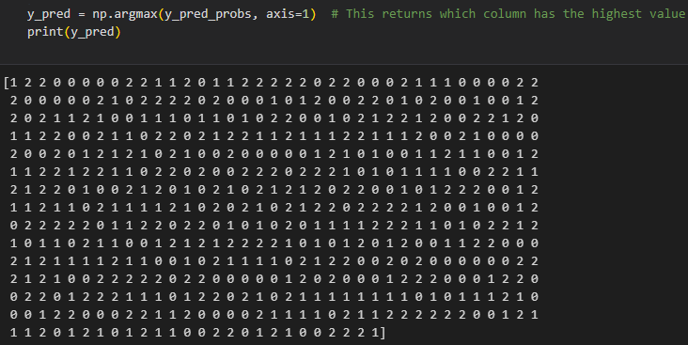
Predicted Class Labels:

Slide 17
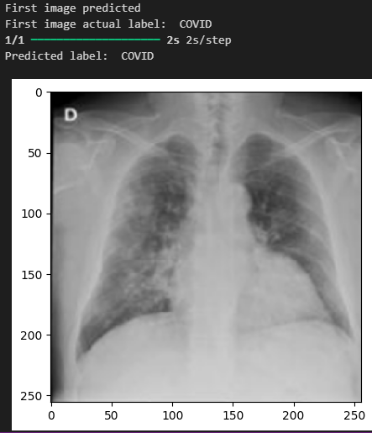
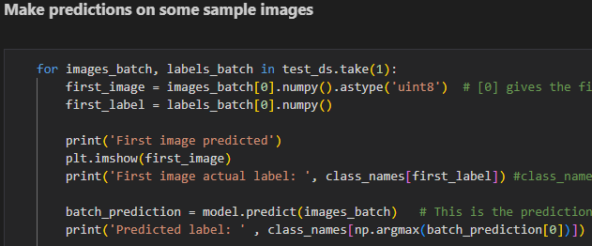

Slide 18
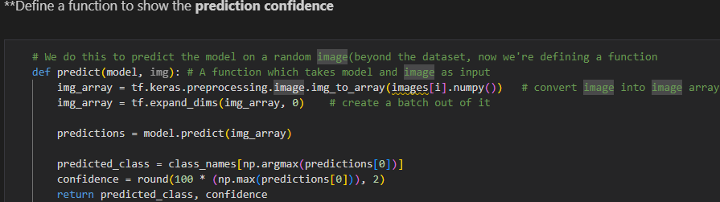

Slide 19
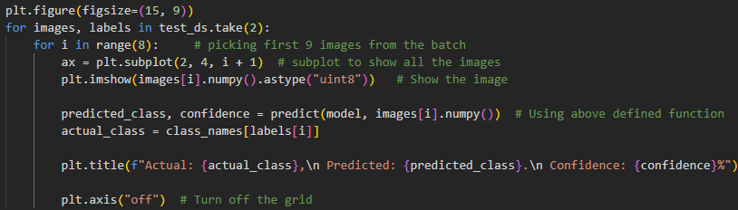
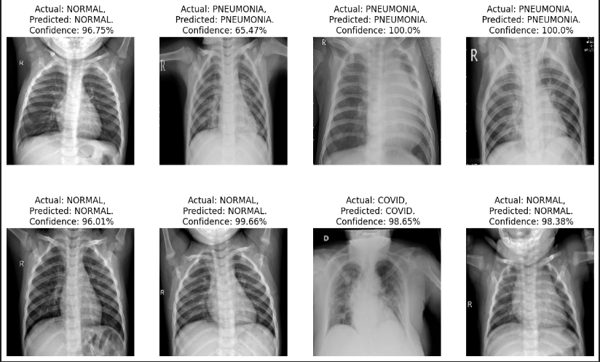
Visualization of Predictions on Test Images:

Slide 20
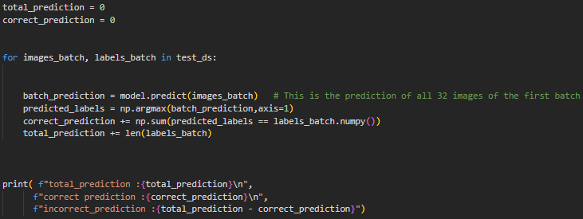

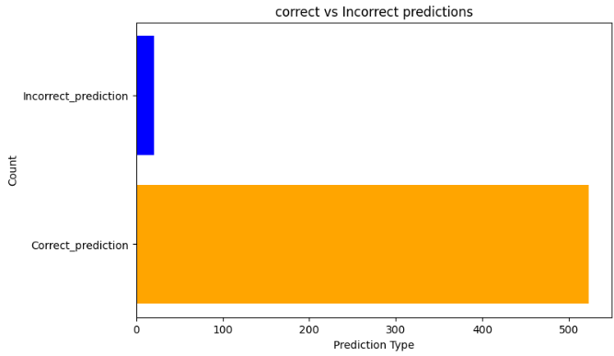
Overall Prediction Accuracy Analysis:

