Slide 1
Sign Language
Named : Nouran Romany ishak hanna
ID : 933250076
University: Helwan National University

Slide 2
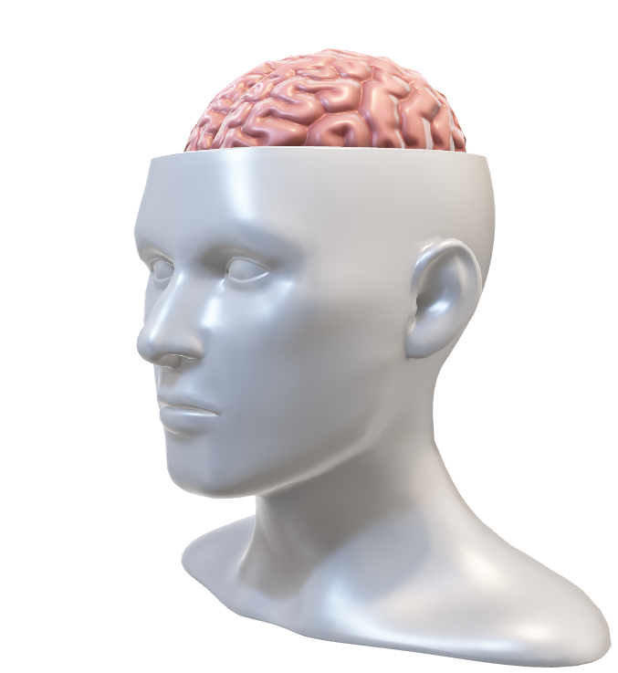
Project Overview
Goal: A live sign language recognition system to bridge communication gaps.
How it Works:
Capturing Frames: Opening the camera using OpenCV to read hand signs in real-time.
Extracting Landmarks: MediaPipe detects the hand and tracks 21 keypoints.
Classification: Machine learning models analyze these points to predict the correct letter or number.

Slide 3
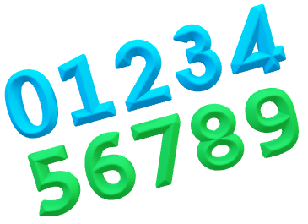
Here is a quick breakdown of the Dataset & Structure behind the project:
📊 Total Scale: A diverse dataset containing 3,623 images specifically curated for sign language gestures.
Training Samples: 2,664 images used to actually train the models.
🔢 Numbers (0–9): Each digit category is represented by 70 clean images to ensure consistent recognition.
🔤 Alphabets (A–Z): Each letter category ranges between 107 to 117 images, capturing natural variations in hand signs.
🗂️ Data Organization: Structured systematically into dedicated directories for seamless pipeline ingestion and training.

Slide 4
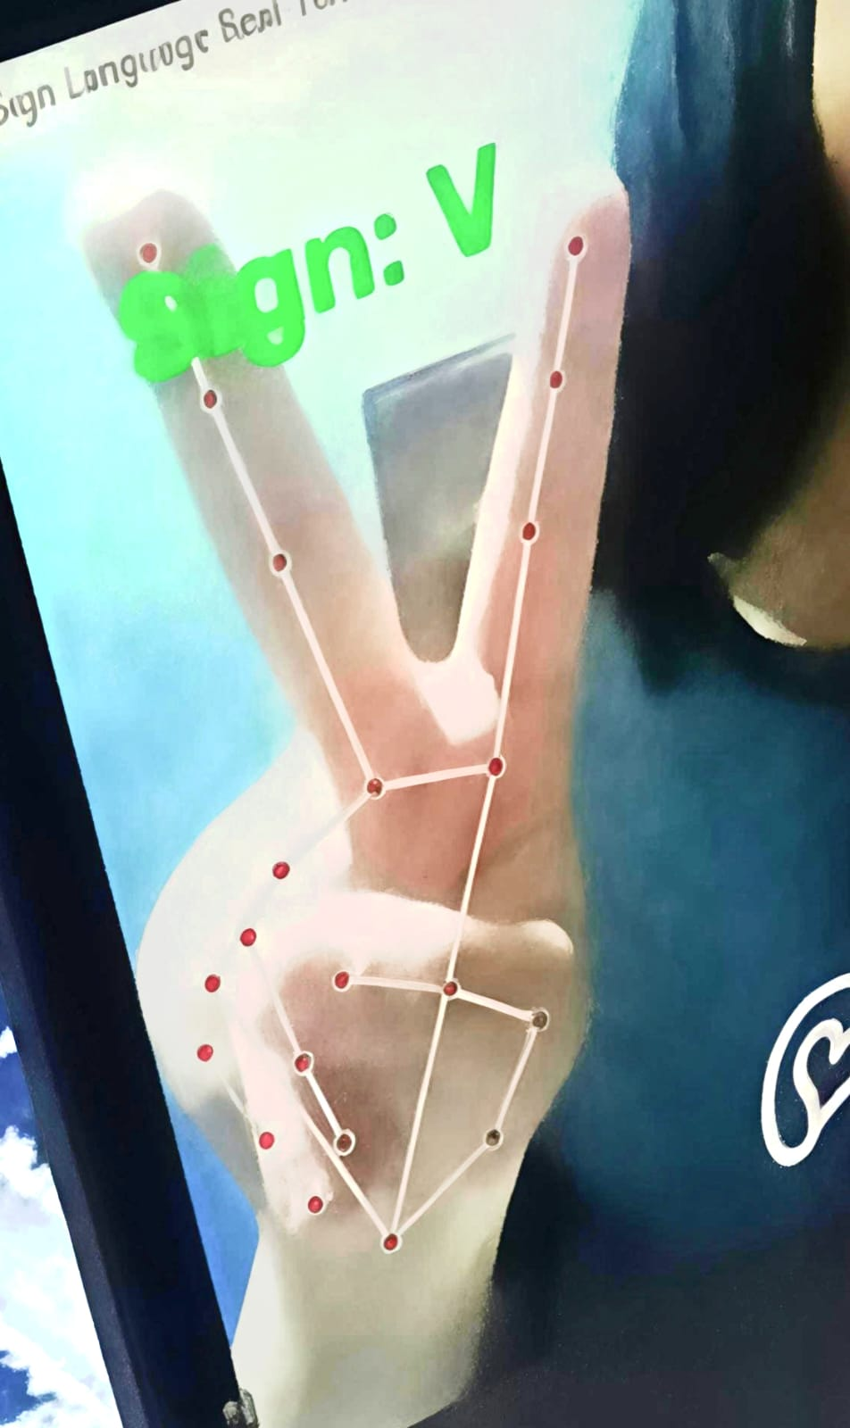
The Tech Stack & What We Used:
os library: To loop through the folders and check how many images we have in each category.
OpenCV & MediaPipe: To open the camera, process frames, and extract the 21 hand landmarks.
NumPy: To handle arrays and numerical data smoothly.
Scikit-Learn (model_selection): To split our data into training and testing sets.
Machine Learning Models (SVM, Random Forest, Decision Tree): The brains we trained to actually recognize the signs and classify them.
Matplotlib: To plot and visualize our results and the Confusion Matrix to see how well each model performed!

Slide 5
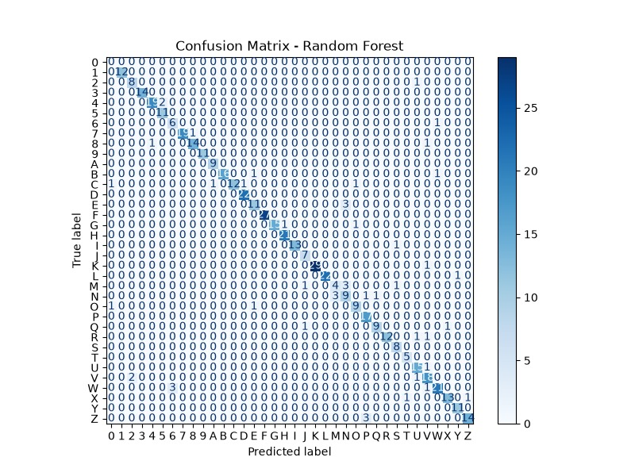
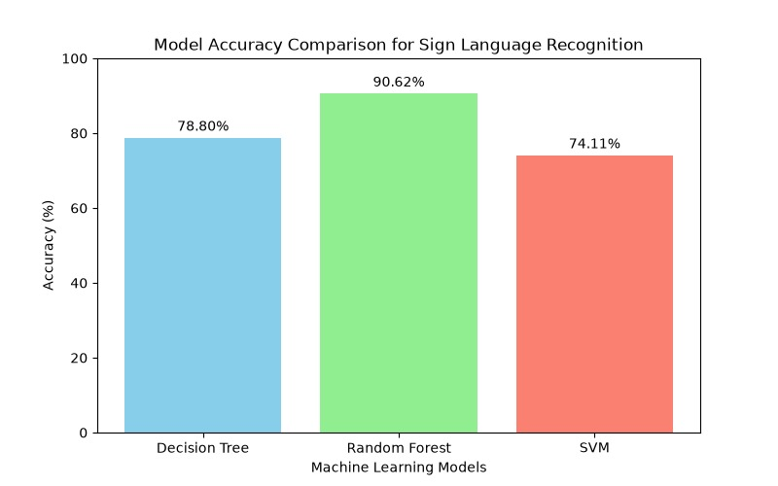
Random Forest: Achieved the highest accuracy at 90.62%, making it the best-performing model for this project! 🏆
SVM (Support Vector Machine): Achieved 78.80% accuracy.
Decision Tree: Achieved 74.11% accuracy.
Conclusion: Random Forest gave us the most accurate and reliable results for real-time sign language classification.

Slide 6
Thank You

