Slide 1
How Large Vision-Language Models Help OOD
2023.12.29

Slide 2
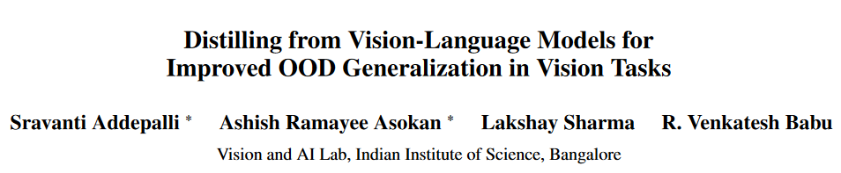
Arxiv 2023 Oct

Slide 3
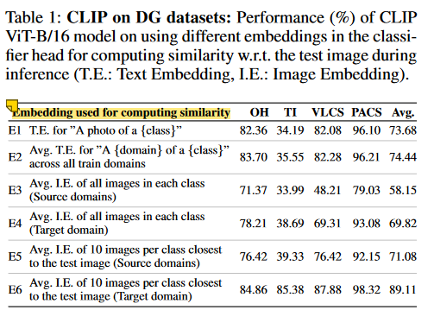
The robustness of CLIP:
CLIP image encoder: CLIP is trained using detailed captions for each image, such as “A brown cat sitting on a sofa”. This allows CLIP to learn rich specialized representations for each attribute, with higher intra-class variance when compared to standard ERM training.
CLIP text encoder: the text encoder is a domain-invariant classifier, a caption such as “A photo of a {class}” can represent the core concept of the class.
Thus, in a DG setting where the target domain is inaccessible, the generic text embeddings provide the best robustness across distribution shifts.
In the proposed method VL2V-ADiP, we therefore explicitly use the text embeddings to maximally transfer their robustness to the student model.

Slide 4

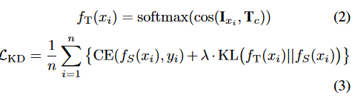


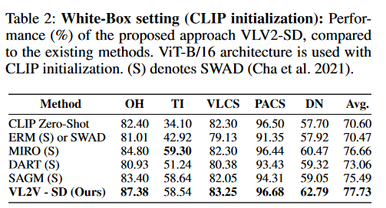
Distillation from VLMs to Vision models
the second term ensures that there is no representation collapse, and retains the rich features learned by the image encoder.
Self-Distillation from Text to Image encoders
White box, the image encoders of both teacher and student are the same (VLM’s image encoder) initially

Slide 5
How to do black-box distillation? Suppose the student is initialized with pretrained IN weights.
Challenges:
Mismatch of IN-pretrained weights and CLIP weights
The feature dimension of the student model may be different from the dimension of VLM’s image and text embeddings.

Slide 6
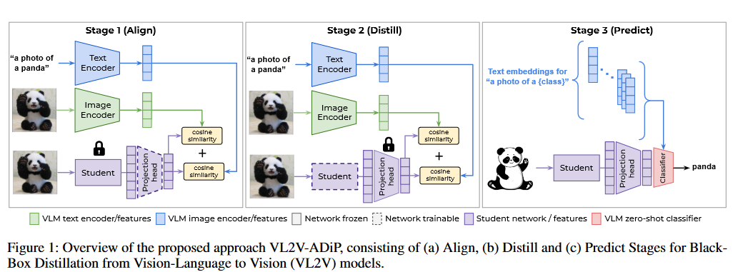
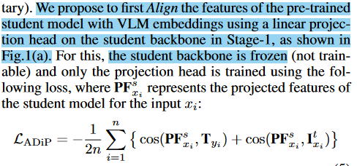
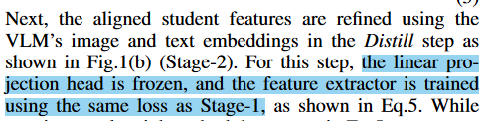
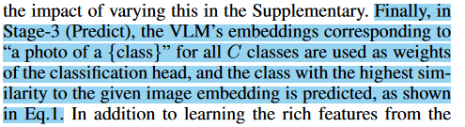

Slide 7
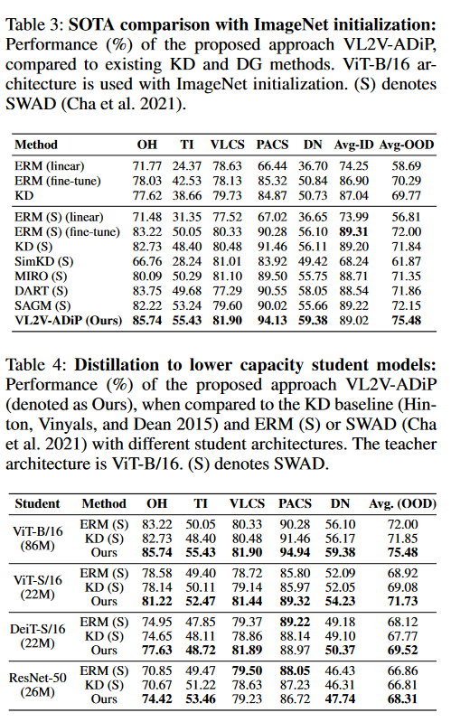
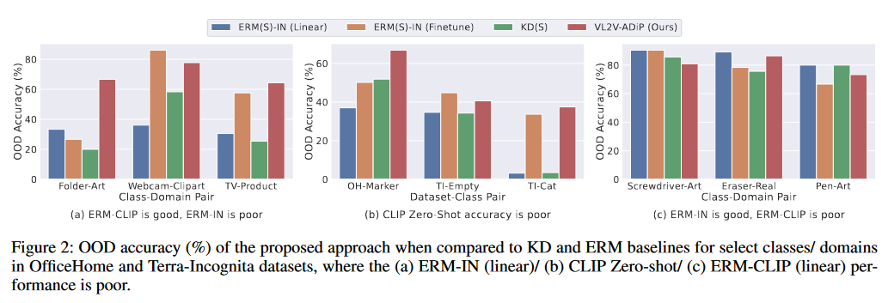
CLIP zero shot can be poor (b). Aligning the text embeddings to the feature extractor (stage 1, 2) can make them more suitable as a classifier.

Slide 8
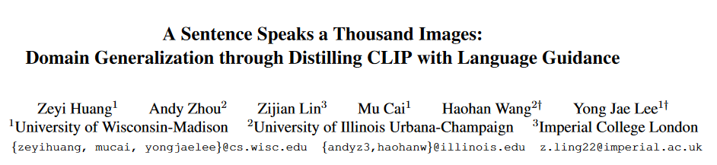
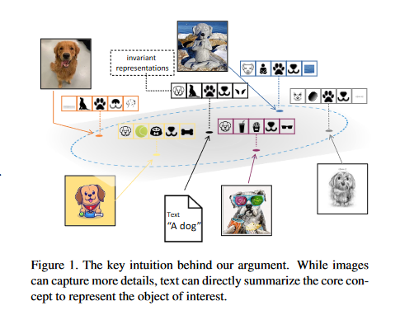
Takeaway:
Aligning the student visual rep with the CLIP text generic rep (a mean of multiple domains) in the joint vision-language space
ICCV 2023

Slide 9
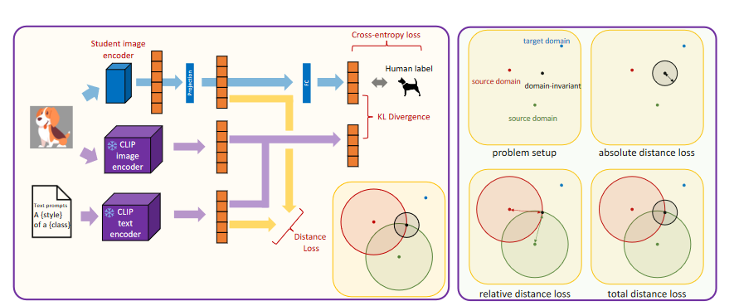
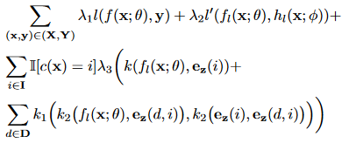
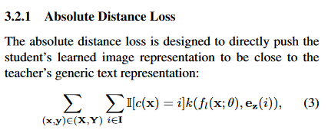
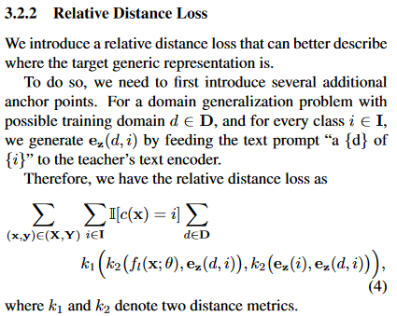
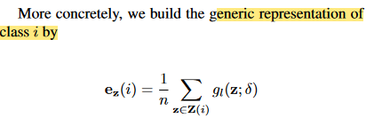
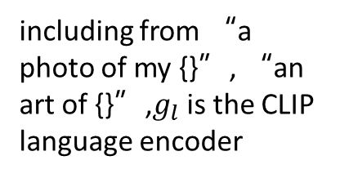
Final loss
The relative distance loss helps to pinpoint the location of the teacher’s generic text representation
including from “a photo of my {}”, “an art of {}”,$g_{l}$ is the CLIP language encoder

Slide 10
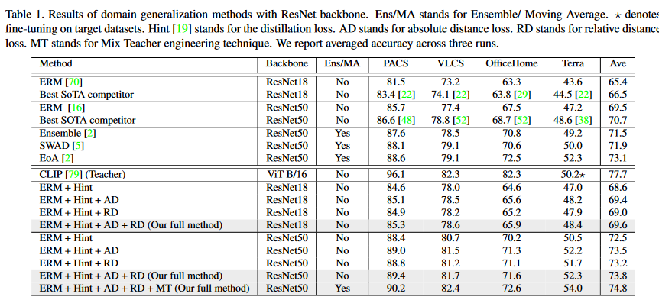
Beat ensemble!

Slide 11
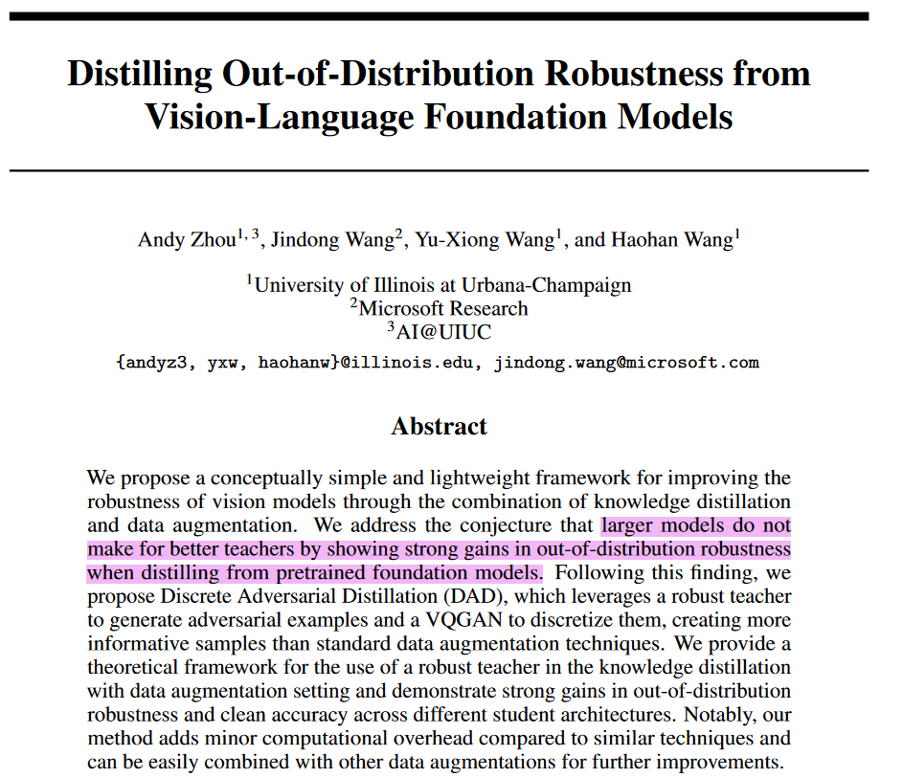
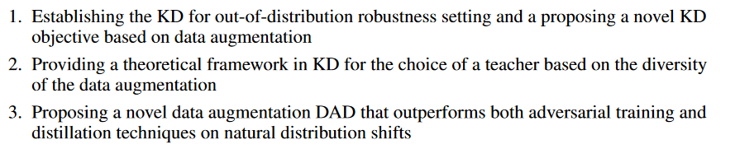
It is currently unclear in what settings a teacher’s robustness can reliably transfer to a student and how to best combine distillation with data augmentation
contributions
Takeaway:
combining Discrete AT (DAT) and Knowledge Distillation (KD) can hugely outperform both DAT and KD.
Distilling on ID data is enough with the help of DAT
NeurIPS 2023

Slide 12
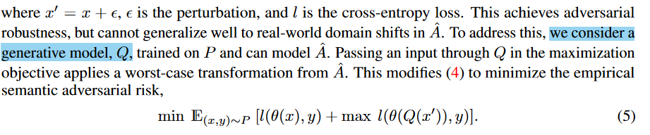
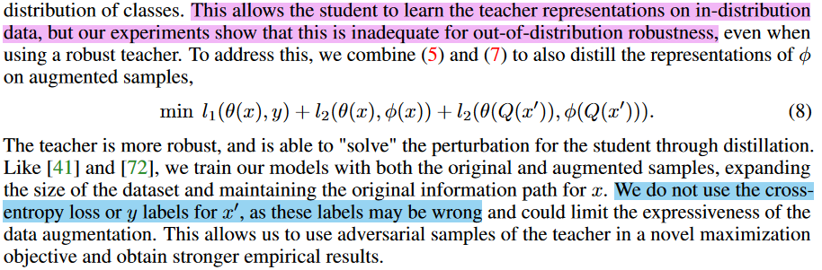
Use generative models to simulate real distribution shifts, $x′$ is a worst-case perturbation of $x$.
Main objective. $φ$ is the teacher model.

Slide 13
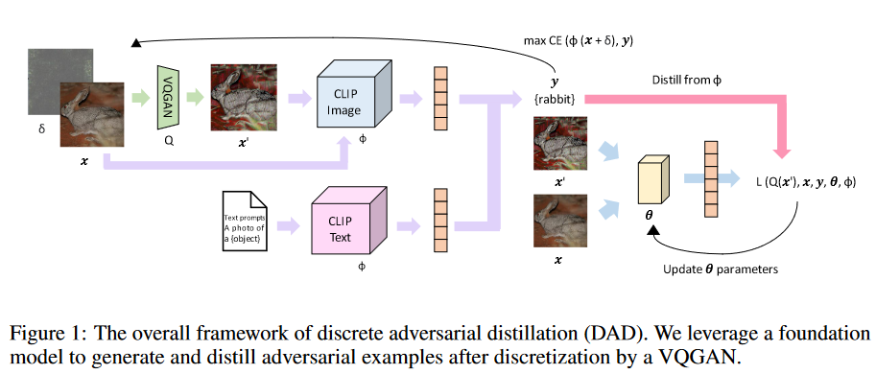
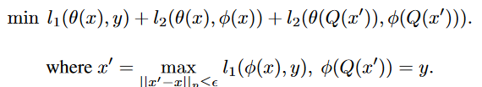
Method: Discrete Adversarial Distillation
Final objective:
DAD adv examples are somewhat new
Only use adv samples that are correctly classified by the teacher.

Slide 14
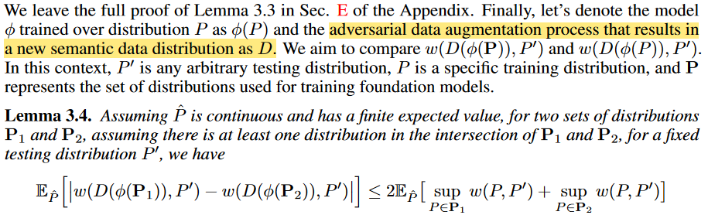
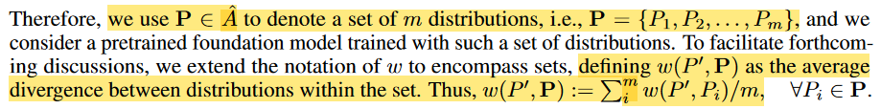
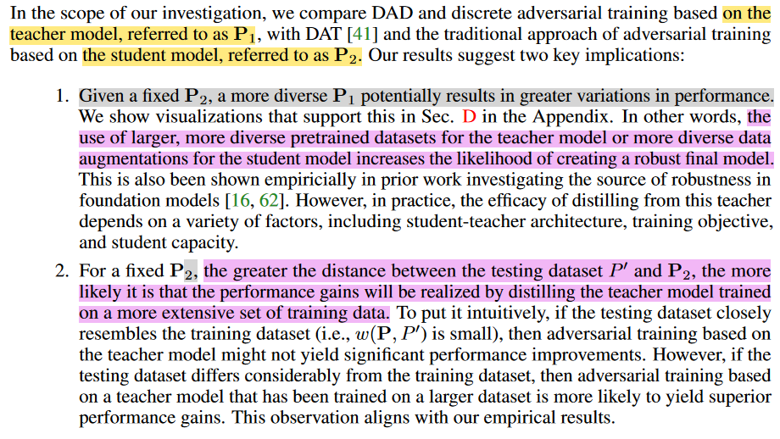
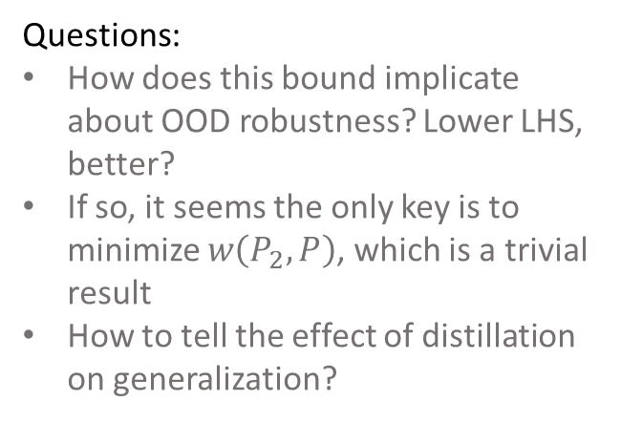
Theory on the differences in the training mechanisms for various models $φ$
Remarks:
Questions:
How does this bound implicate about OOD robustness? Lower LHS, better?
If so, it seems the only key is to minimize $w\left(P_{2},P\right)$, which is a trivial result
How to tell the effect of distillation on generalization?

Slide 15
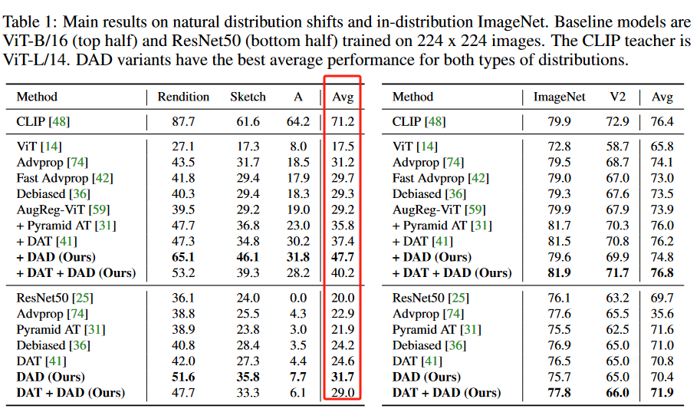
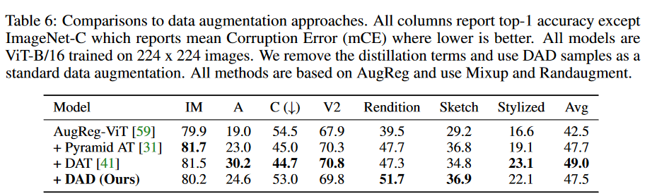
Real-world OOD: good
Clearly better than DAT (but the pure DAD examples seem not so strong)
Ablation: pure data aug, no distillation
Clear drop on real-world datasets: it is difficult for the student to learn robust representations of these images on its own

Slide 16
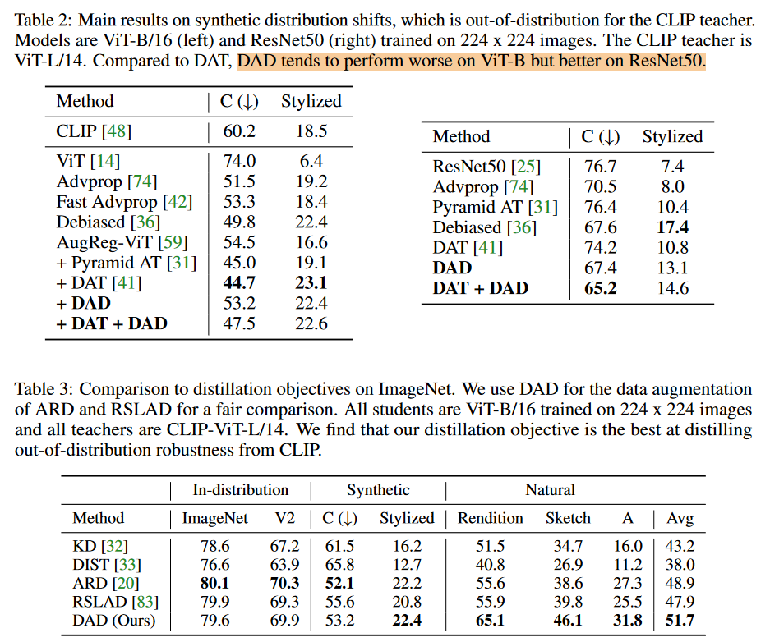
Synthetic OOD
Comparison with other KD baselines: gain some improvements
Ablation: pure data aug, no distillation

Slide 17
Conclusion
Distillation from CLIP significantly outperform model ensemble, achieving new SOTA.
CLIP text encoder produces domain-invariant and generalizable reps. Use it.
CLIP zero-shot does not show superiority over previous SOTA like SWAD or MIRO, but distillation from CLIP can beat them.
Future:
How does/if the rich feature learned by CLIP image encoder help OOD?
Is there a invariance/diversity trade-off when distillation from CLIP?

