Slide 1
How Large Vision-Language Models Help OOD Generalization
2024.01.10
王启迅

Slide 2
Recent works on using vision-language model to help OOD
Distilling from Vision-Language Models for Improved OOD Generalization in Vision Tasks (Arxiv Oct 2023)
A Sentence Speaks a Thousand Images: Domain Generalization through Distilling CLIP with Language Guidance (ICCV 2023)
Distilling Out-of-Distribution Robustness from Vision-Language Foundation Models (NIPS 2023)
Context-Aware Robust Fine-Tuning (IJCV Dec 2023)

Slide 3
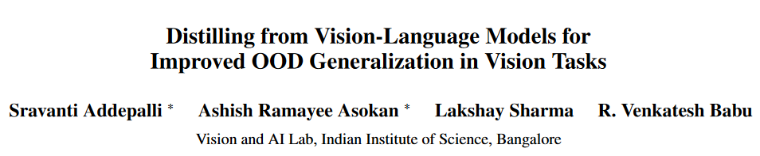
Arxiv 2023 Oct

Slide 4
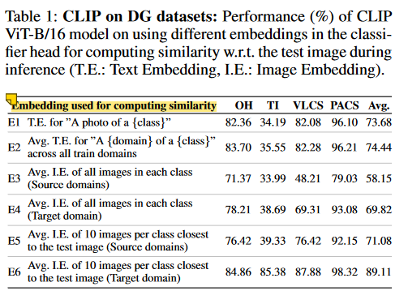
The robustness of CLIP
CLIP image encoder: CLIP is trained using detailed captions for each image, such as “A brown cat sitting on a sofa”. This allows CLIP to learn rich specialized representations for each attribute, with higher intra-class variance when compared to standard ERM training.
CLIP text encoder: the text encoder is a domain-invariant classifier, a caption such as “A photo of a {class}” can represent the core concept of the class.
Text embedding shows robustness to distributional shifts
Thus, in a DG setting where the target domain is inaccessible, the generic text embeddings provide the best robustness across distribution shifts.
In the proposed method VL2V-ADiP, we therefore explicitly use the text embeddings to maximally transfer their robustness to the student model.

Slide 5
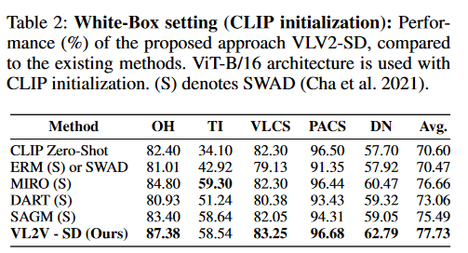
White box distillation: VL2V-SD (Self-Distillation)
Problem Setting
Given a pretrained CLIP and a given downstream dataset, we want to obtain a vision model with stronger generalization on the downstream dataset.
White box: access to the weights of the CLIP.
Idea: distill knowledge from the pretrained CLIP into the student vision model (in this setting, the student model is a CLIP image encoder and is initialized by the weights of the pretrained CLIP image encoder).
Result: huge improvement over zero-shot CLIP, and beat previous SOTA

Slide 6
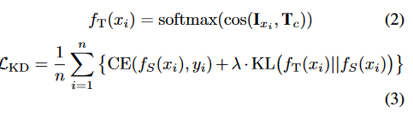

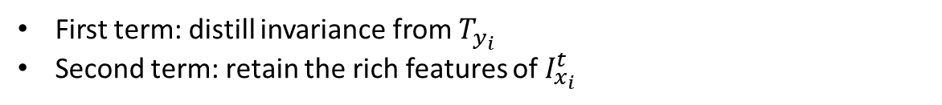
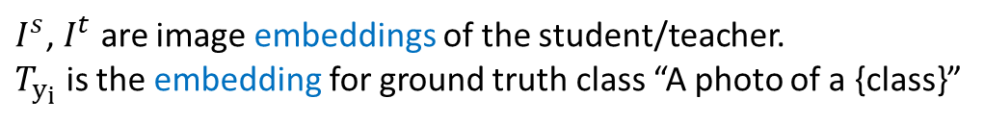
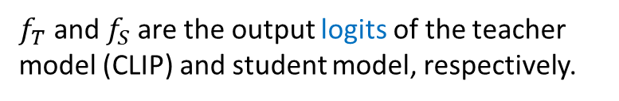
White box distillation: VL2V-SD (Self-Distillation)
A basic distillation procedure from VLMs to vision models
$f_{T}$and $f_{S}$are the output logits of the teacher model (CLIP) and student model, respectively.
Self-Distillation from Text to Image encoders
$I^{s}$, $I^{t}$ are image embeddings of the student/teacher.
$T_{y_{i}}$ is the embedding for ground truth class “A photo of a {class}”
First term: distill invariance from $T_{y_{i}}$
Second term: retain the rich features of $I_{x_{i}}^{t}$

Slide 7
How to do black-box distillation? Suppose the student is initialized with ImageNet pre-trained weights.
Challenges:
Mismatch of IN-pretrained weights and CLIP weights
The feature dimension of the student model may be different from the dimension of VLM’s image and text embeddings.

Slide 8
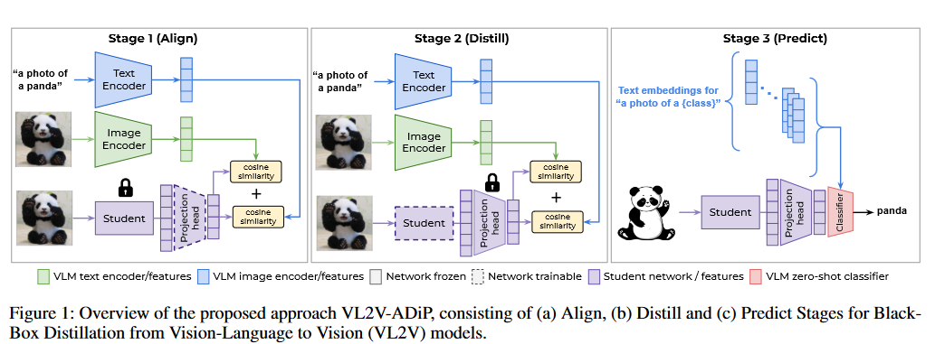


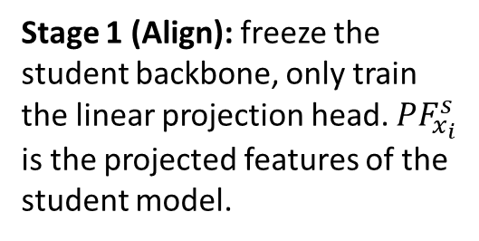
Black box distillation: VL2V-ADiP (Align, Distill, Predict)
Stage 1 (Align): freeze the student backbone, only train the linear projection head. $PF_{x_{i}}^{s}$ is the projected features of the student model.
Stage 2 (Distill): freeze the student’s linear projection head, only train the student’s feature extractor
Stage 3: predict

Slide 9
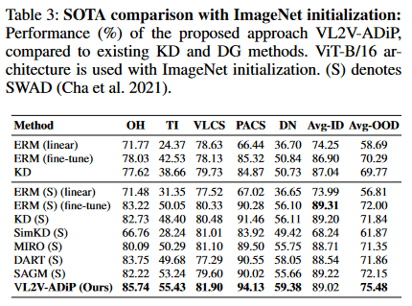
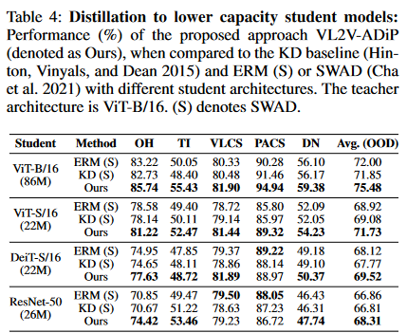
Experiments

Slide 10
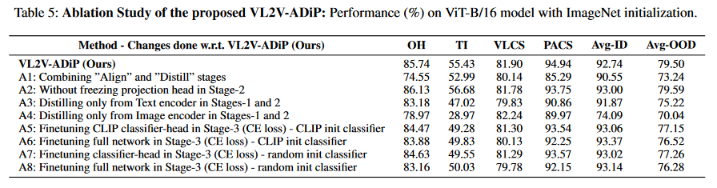

Experiments
Message:
Distillation then fine-tuning on downstream data with CE loss is worse than just distillation, no fine-tuning (full vs A5-8).
Stage 1+2+text encoder distillation is better than just fine-tunning (A3 vs ERM(fine-tune))
Distillation of both image and text representation from CLIP is better either.

Slide 11
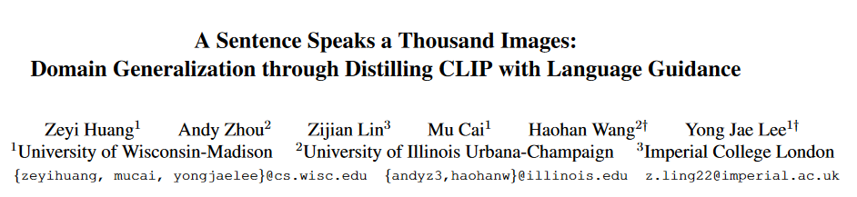
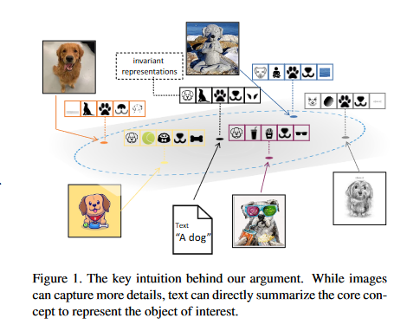
Takeaway:
Aligning the student visual rep with the CLIP text generic rep (a mean of multiple domains) in the joint vision-language space
ICCV 2023

Slide 12

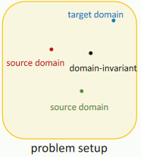

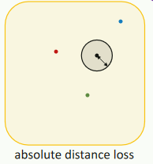

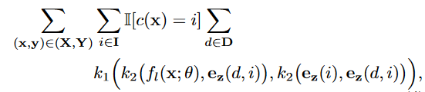
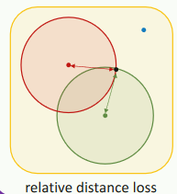
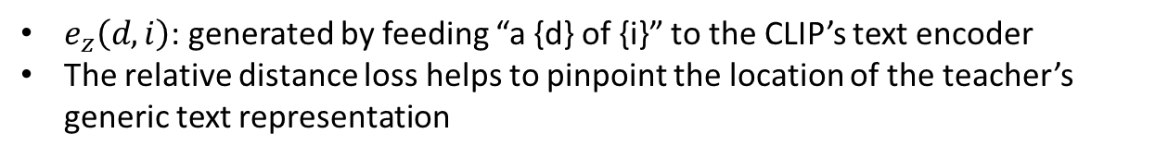
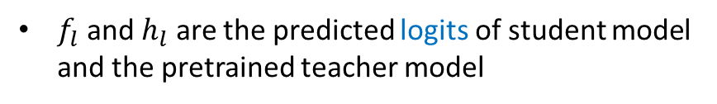
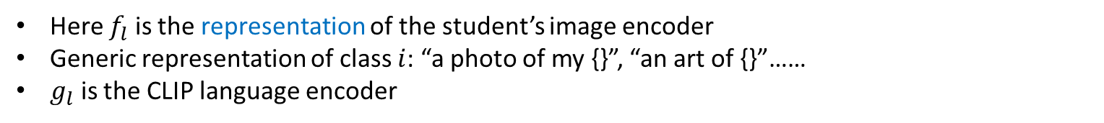
Loss 1 Normal distillation:
$f_{l}$ and $h_{l}$ are the predicted logits of student model and the pretrained teacher model
Loss 2 Absolute Distance Loss:
Here $f_{l}$ is the representation of the student’s image encoder
Generic representation of class $i$: “a photo of my {}”, “an art of {}”……
$g_{l}$ is the CLIP language encoder
Loss 3 Relative Distance Loss:
$e_{z}\left(d,i\right)$: generated by feeding “a {d} of {i}” to the CLIP’s text encoder
The relative distance loss helps to pinpoint the location of the teacher’s generic text representation

Slide 13
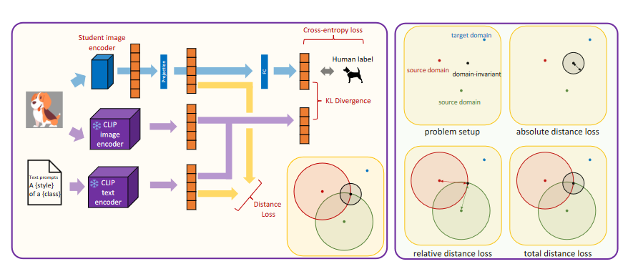
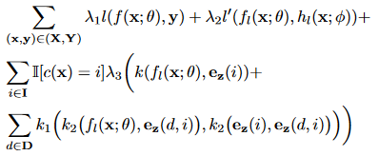
Final loss

Slide 14
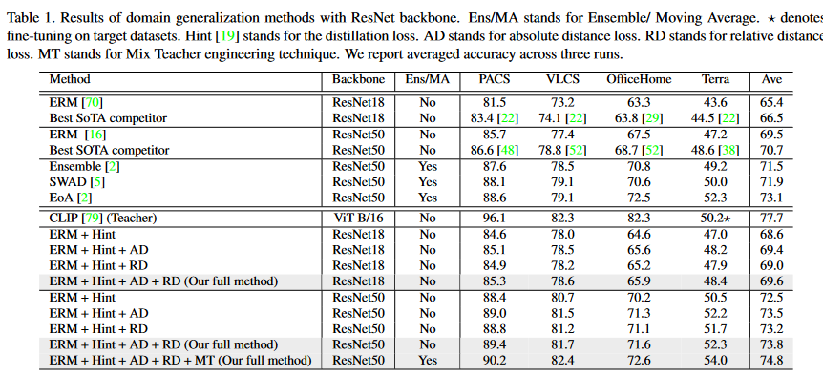
Beat ensemble

Slide 15
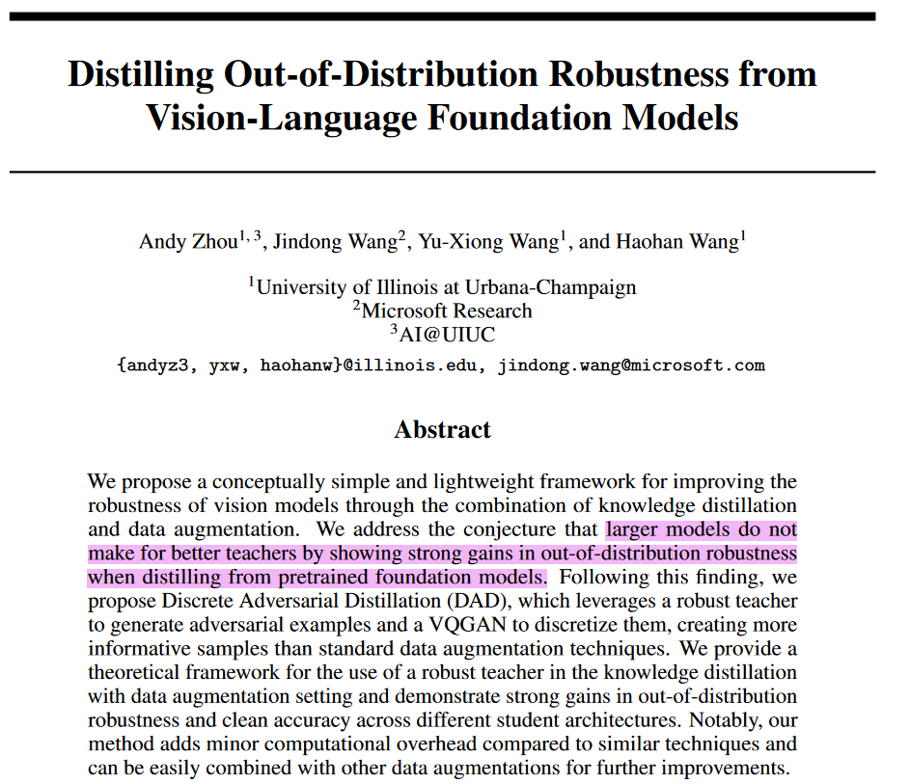
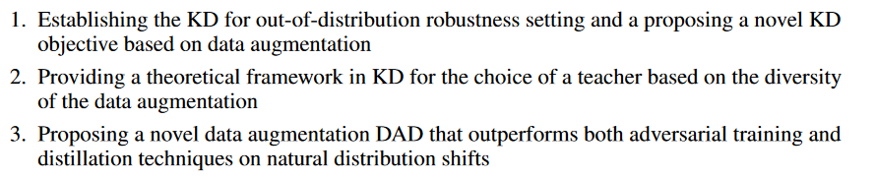
It is currently unclear in what settings a teacher’s robustness can reliably transfer to a student and how to best combine distillation with data augmentation
contributions
Takeaway:
combining Discrete AT (DAT) and Knowledge Distillation (KD) can hugely outperform both DAT and KD.
Distillation on ID data is enough with the help of DAT
NeurIPS 2023

Slide 16
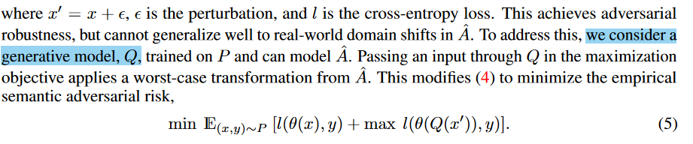
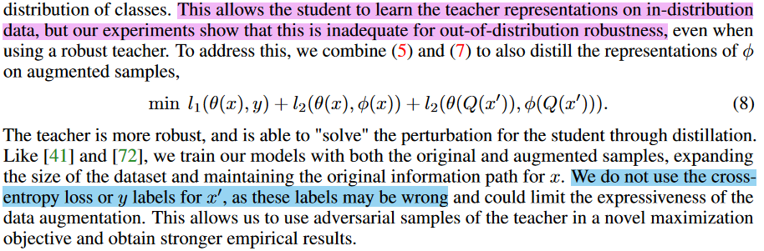
Use generative models to simulate real distribution shifts, $x′$ is a worst-case perturbation of $x$.
Main objective. $φ$ is output of the teacher model.

Slide 17
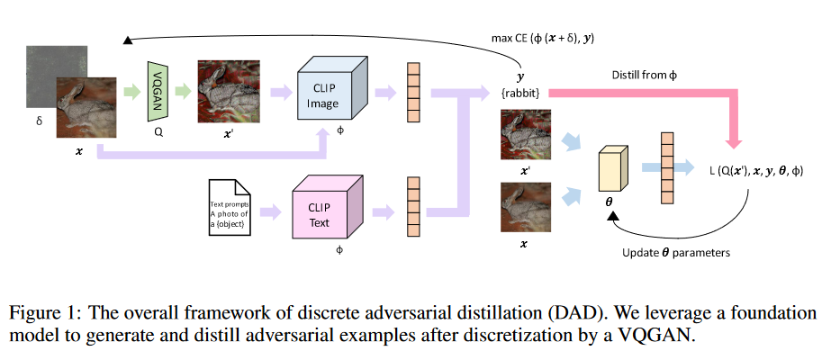
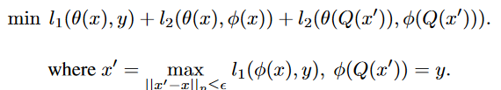
Method: Discrete Adversarial Distillation
Final objective:
DAD adv examples are somewhat new
Only use adv samples that are correctly classified by the teacher.

Slide 18
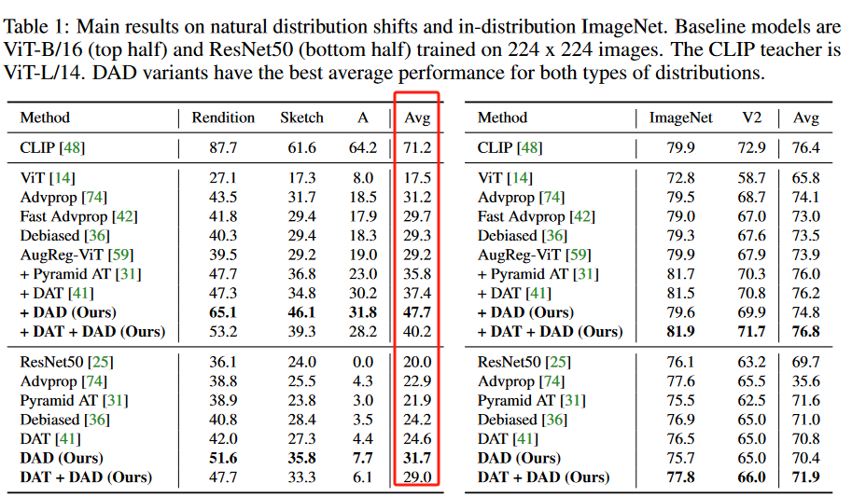
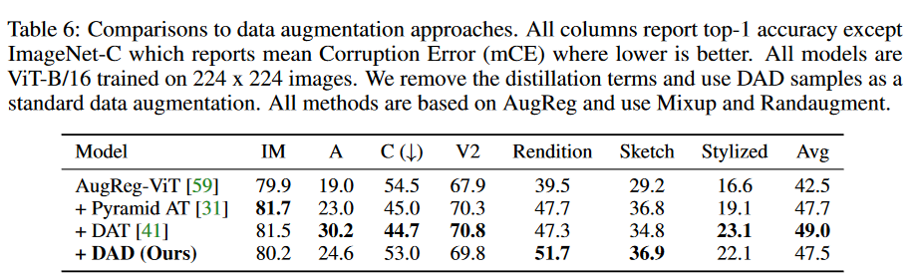
Real-world OOD: good
Clearly better than DAT (but the pure DAD examples seem not so strong)
Ablation: pure data aug, no distillation
Clear drop on real-world datasets: it is difficult for the student to learn robust representations of these images on its own

Slide 19
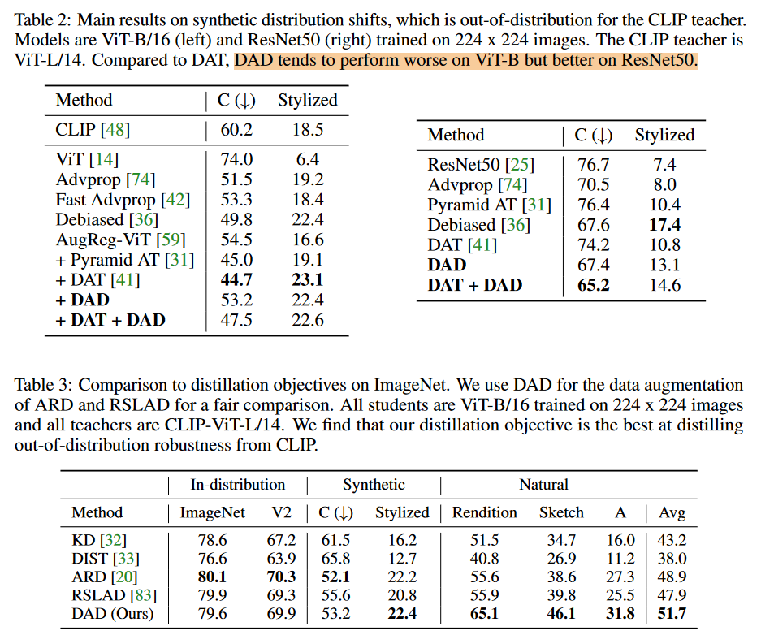
Synthetic OOD
Comparison with other KD baselines: gain some improvements

Slide 20
Conclusion
Distillation from CLIP significantly outperforms model ensemble, achieving new SOTA.
CLIP text encoder produces domain-invariant and generalizable reps. Use it.
CLIP zero-shot does not show superiority over previous SOTA like SWAD or MIRO, but distillation from CLIP on downstream OOD datasets can beat them.
Distillation and then fine-tuning on downstream data with CE loss is worse than just distillation, no fine-tuning (full vs A5-8).
Stage 1+2+text encoder distillation is better than just fine-tuning.

Slide 21
近期工作
ICLR 文章内容增加
补充了一个定理来说明：经典的OOD方法IRMv1和VREx在原本提出的OOD任务的非图版本上能成功学到不变特征。从而揭示其在在图数据上的失败确实是由于图数据和图神经网络引起的，而非这个任务本身就太难。
补充了在Graph Attention Network（GAT）上的主实验，相比原来在Graph Convolutional Network（GCN）上提升更明显。
补充了理解性实验，论证了所提出方法的各个模块的有效性。
补充了所提出的Localized Reweighting Alignment (LoReA)方法的理论分析，推导了一个OOD泛化误差上界来分析方法的有效性

Slide 22

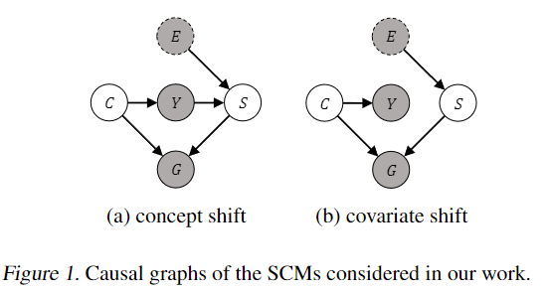

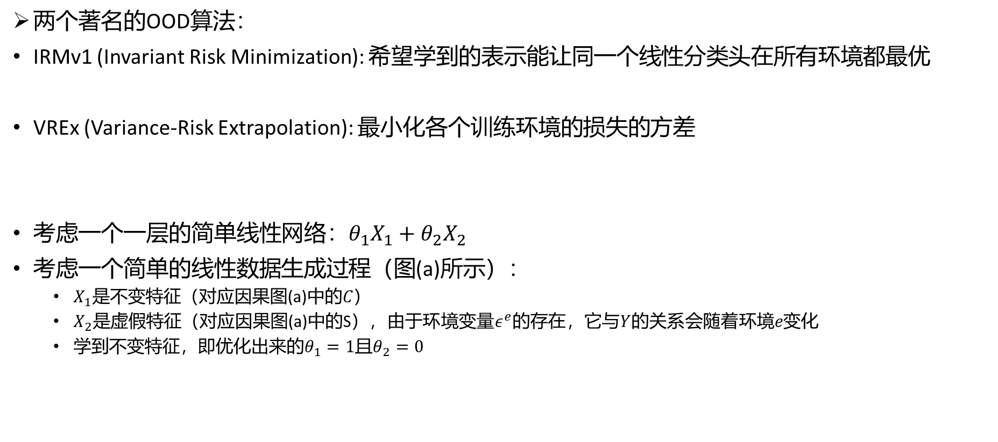
一、补充定理：IRMv1和VREx在非图情况下不会失败
两个著名的OOD算法：
IRMv1 (Invariant Risk Minimization): 希望学到的表示能让同一个线性分类头在所有环境都最优
VREx (Variance-Risk Extrapolation): 最小化各个训练环境的损失的方差
考虑一个一层的简单线性网络：$θ_{1}X_{1}+θ_{2}X_{2}$
考虑一个简单的线性数据生成过程（图(a)所示）：
$X_{1}$是不变特征（对应因果图(a)中的$C）$
$X_{2}$是虚假特征（对应因果图(a)中的S$）$，由于环境变量$ε^{e}$的存在，它与$Y$的关系会随着环境$e变化$
学到不变特征，即优化出来的$θ_{1}=1$且$θ_{2}=0$

Slide 23
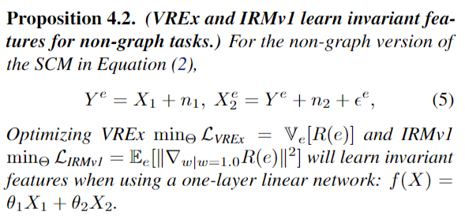
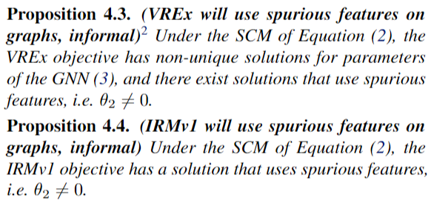
一、补充定理：IRMv1和VREx在非图情况下不会失败
新增的理论结果：在图示的SCM上，IRMv1和VREx都能学到不变特征（这里展示的是(a)的结果，(b)的结果由于页数限制放在了附录）
先前的ICLR的理论结果： IRMv1和VREx在OOD节点分类任务上会用到虚假特征

Slide 24
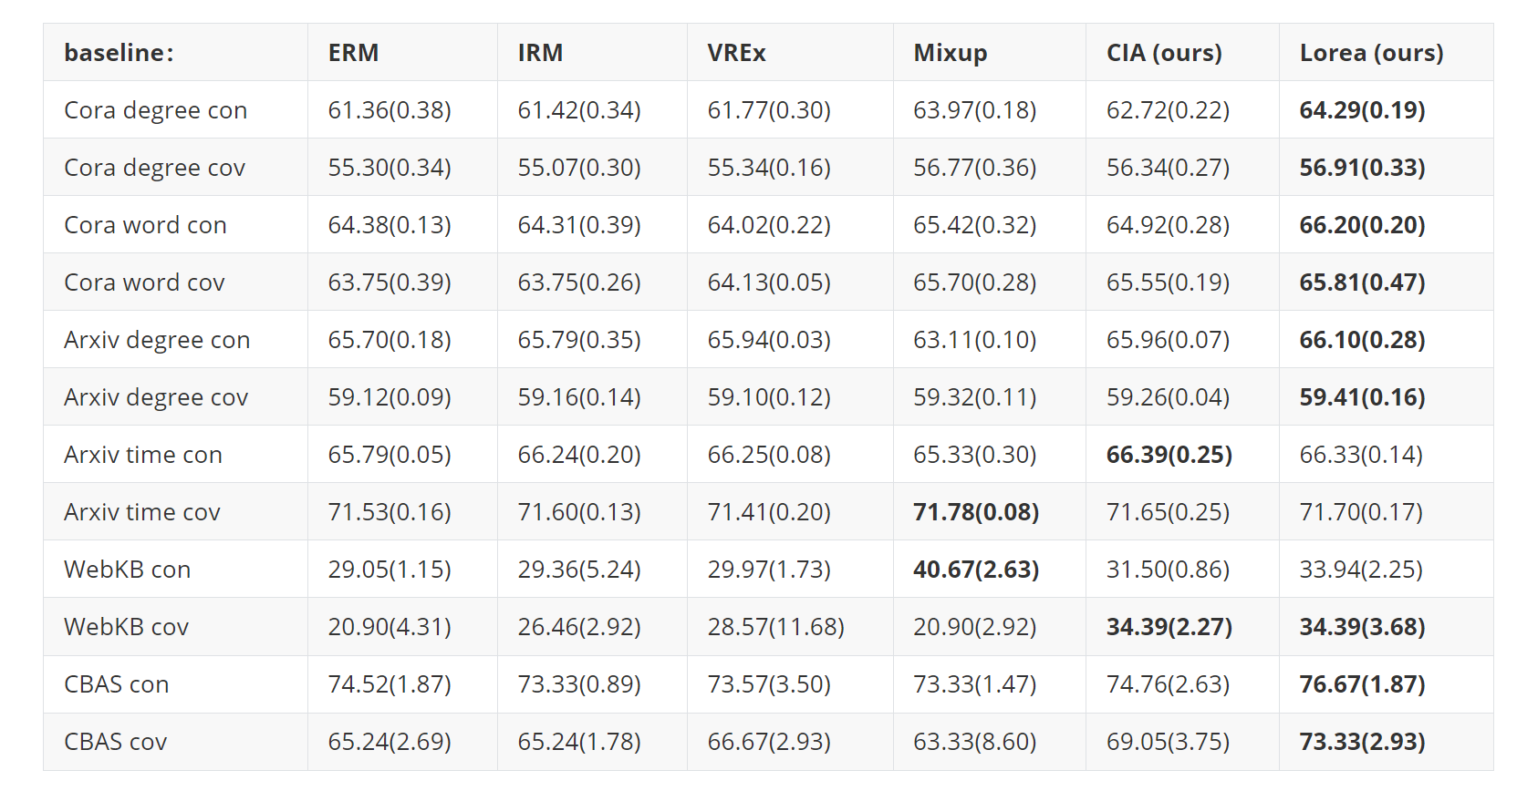
二、GAT上实验
新增的GAT上结果，在多个数据集上提升较为显著

Slide 25
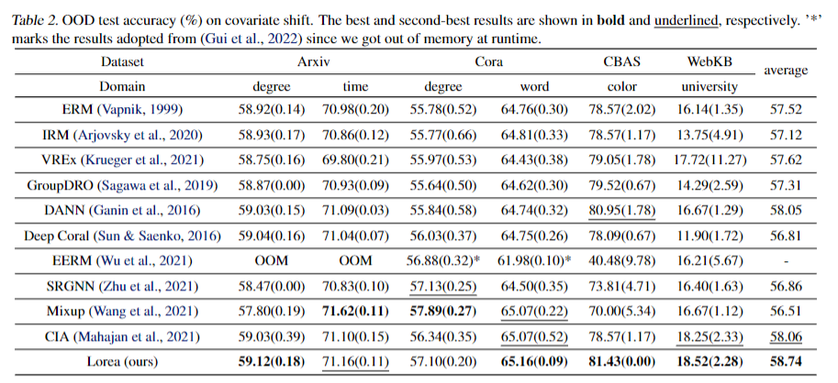
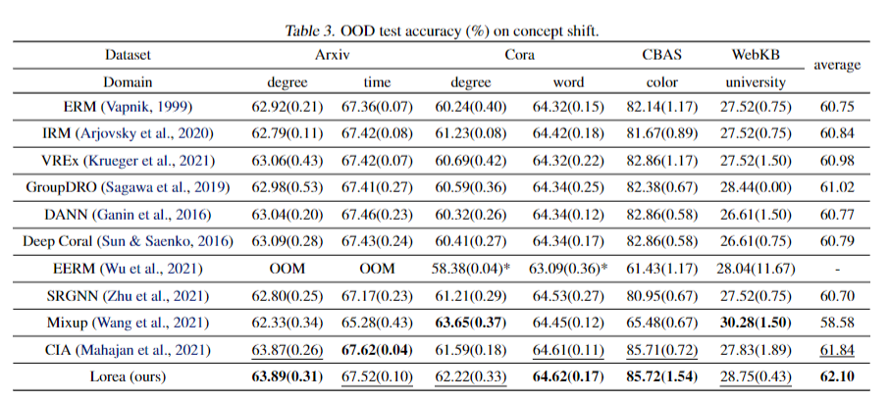
二、GAT上实验
ICLR的GCN结果，提升不那么显著

Slide 26
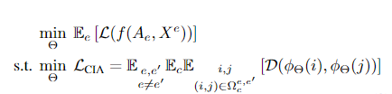

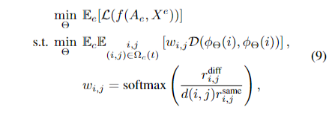
三、理解性实验
CIA（我们提出的，需要环境标签）：对齐不同环境的同一类别的节点的表示，来消除虚假特征
LoReA（我们提出的，不需要环境标签）：
在对齐表示时，给邻域异类比例差异大、同类比例差异小的点对施加更大的权重
同时只对齐相距比较近的点
动机：
邻域异类比例差异大->虚假特征差异大(因为相邻的不同类别的点会带来虚假特征)->希望更好地抹掉虚假特征
邻域同类比例差异小->不变特征差异小(因为相邻的同类别的点会带来不变特征) ->希望更好地保留不变特征的多样性

Slide 27
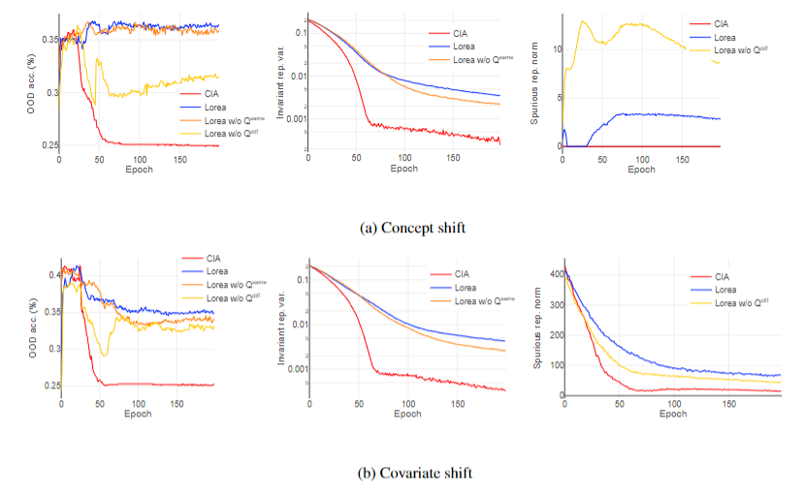
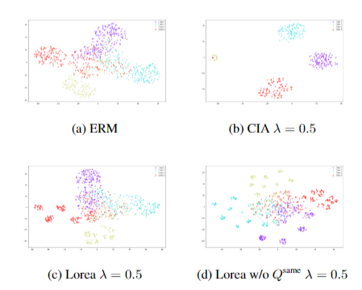
三、理解性实验
构建了一个模拟数据集，使得我们可以可视化模型学到的不变表示和虚假表示的情况
计算不变表示的方差来反映其多样性，计算虚假表示的L2范数来反映网络学到了多少虚假特征
结论：
过度对齐(CIA)导致学到的不变特征失去多样性，会使得OOD泛化变差。
给邻域异类比例差异大的点对施加更大权重(Lorea)，有助于让学到的虚假表示范数更小，OOD泛化更好。
给邻域异类比例差异小的点对施加更大权重(Lorea)，有助于保持学到的不变表示多样性更好，OOD泛化更好。

Slide 28
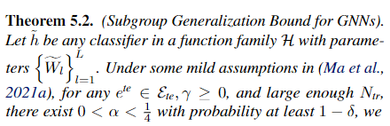
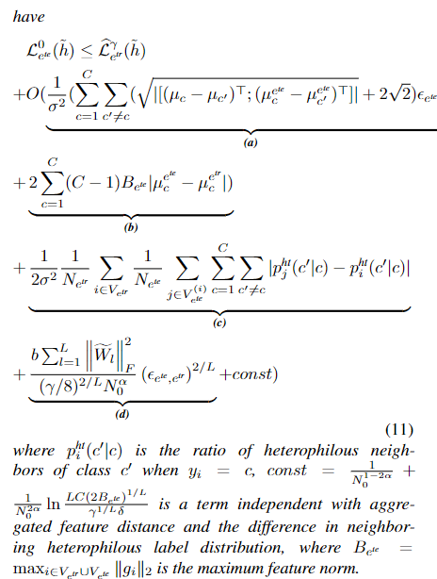
四、Lorea的理论保证
基于PAC-Bayesian理论，推导了一个节点分类任务的OOD泛化误差
该定理的说明了，OOD泛化误差可以被三项控制：
测试域和训练域学到的表示的差距（常规OOD误差，CIA和Lorea都能缩小）
测试域和训练域的由于环境虚假特征导致的分布差异（常规OOD误差，CIA能缩小，Lorea在concept shift上能缩小）
测试域和训练域各个点的邻域异类分布差异（图数据特有的OOD误差，它反映了相邻的点如果有不同类别的点，那么这些异类的点会带来不同的不变特征，这对于中心节点的不变特征来说是引入了噪声，会影响中心节点的分类。能被Lorea缩小）

