Slide 1
In-Context Learning Can Helps the Generalization of Vision Models
王启迅
2024/3/12

Slide 2
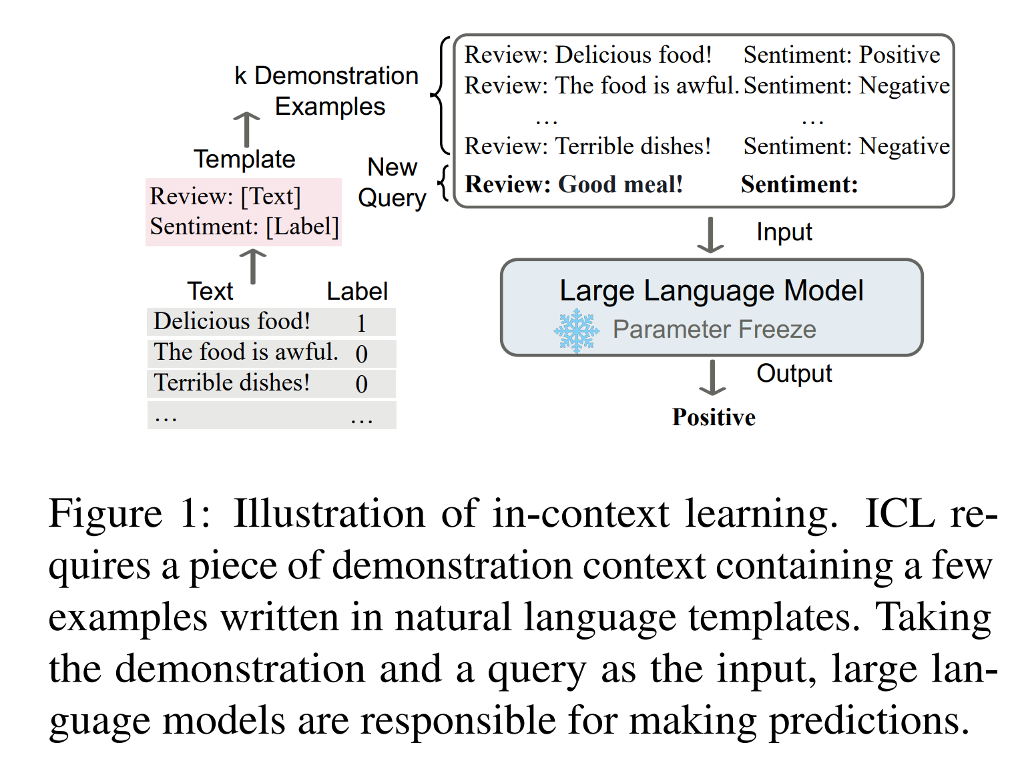
What is In-context learning?

Slide 3
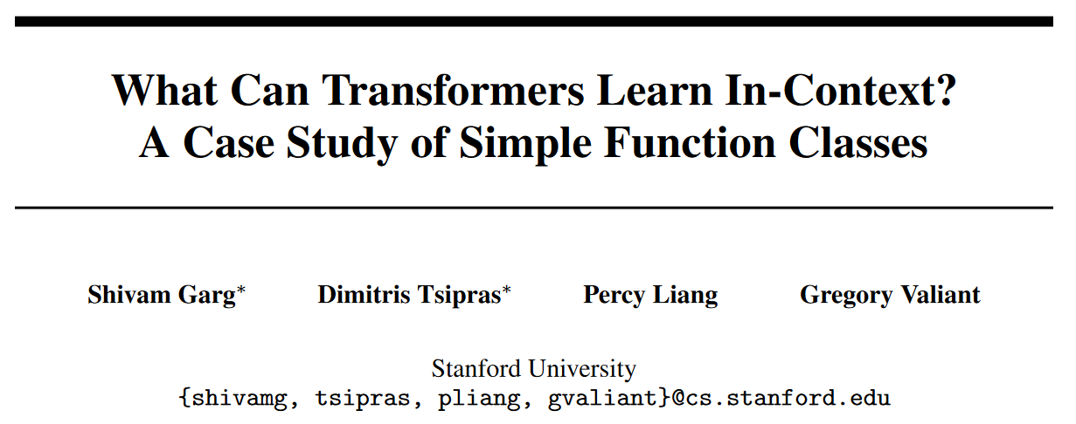
The OOD of ICL: a Investigation on a Synthetic Task

Slide 4
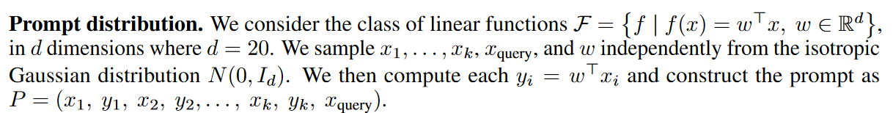
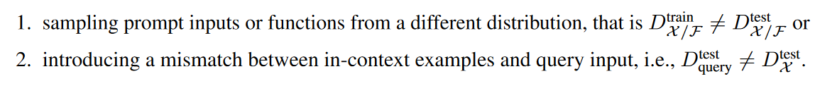
Two ICL OOD settings:

Slide 5
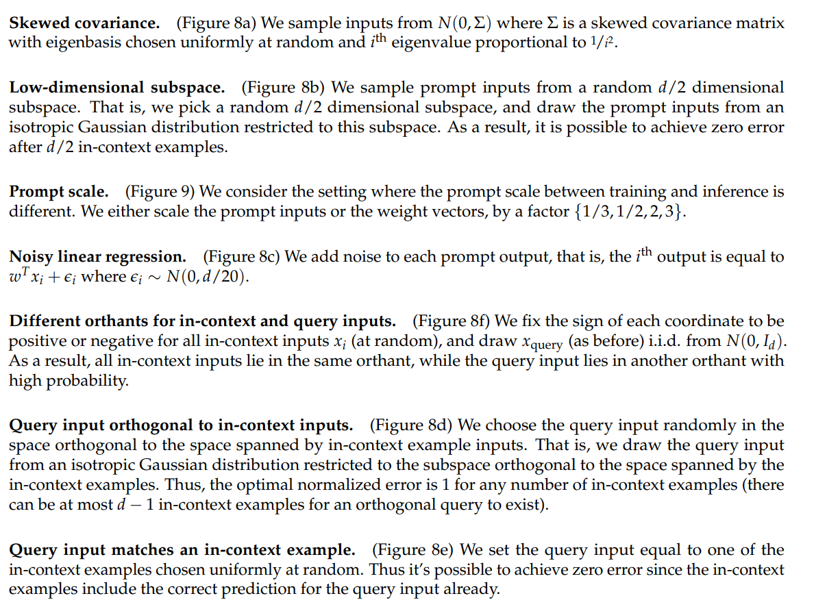
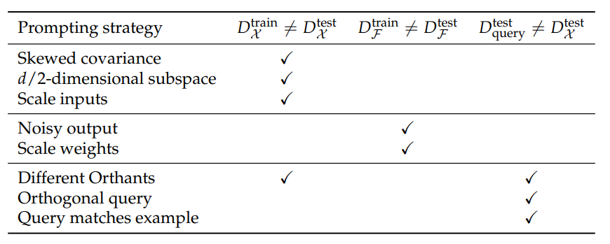

Slide 6
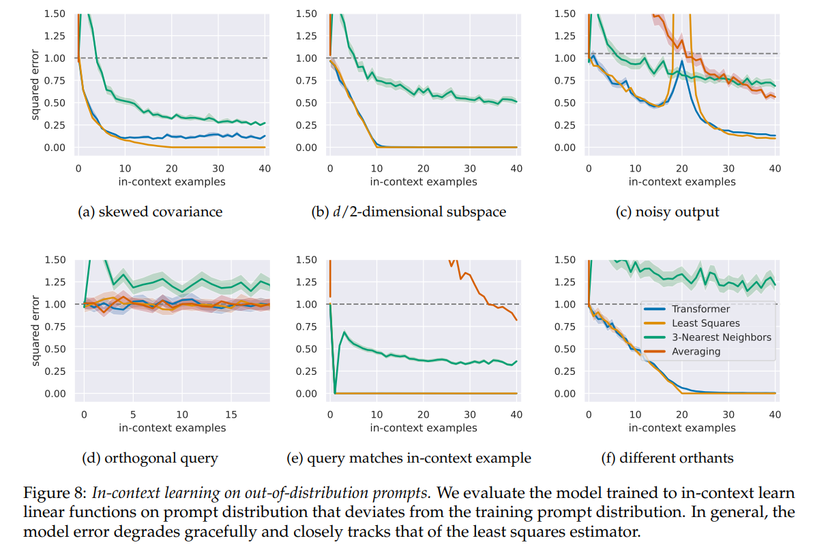

Slide 7
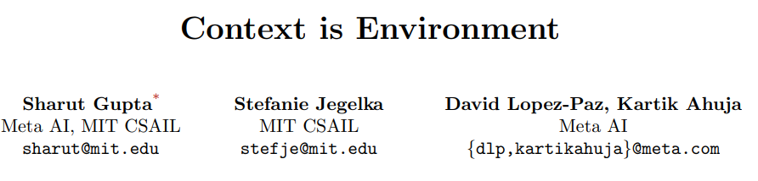
ICLR 2024
Unsupervised ICL for vision OOD generalization

Slide 8
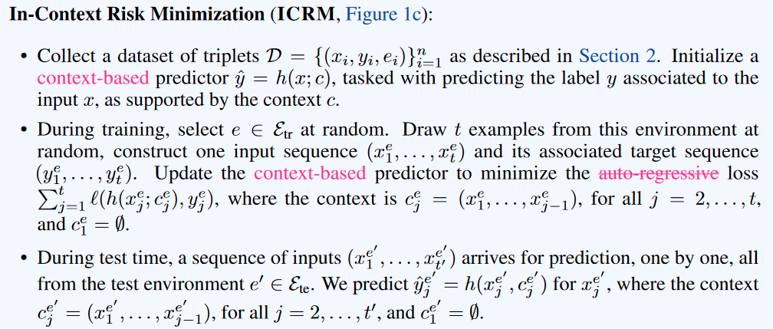
Unsupervised ICL
Requires: test samples come from the same environment

Slide 9
ICL provide a novel view on invariance. On the one hand, prior DG algorithms advocated to remove (environmental) features as a guide to reveal invariance. On the other hand, in-context learners suggest that extending features with context affords invariance otherwise unnoticed.

Slide 10
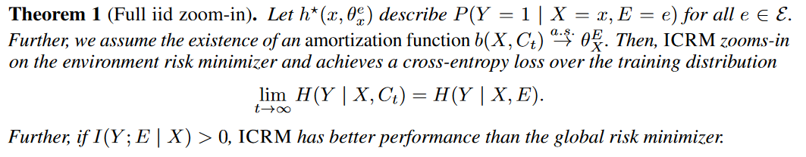
Theoretical Results: iid, infinite ICE
Given infinite ICE from a domain, ICRM converges to an environment risk minimizer (in the sense of cross entropy loss).

Slide 11
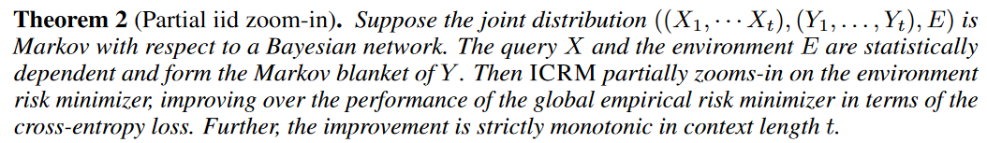
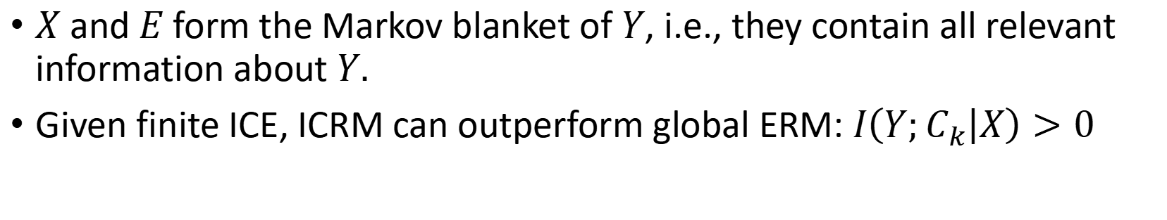
Theoretical Results: iid, finite ICE
$X$ and $E$ form the Markov blanket of $Y$, i.e., they contain all relevant information about $Y.$
Given finite ICE, ICRM can outperform global ERM: $I\left(Y;C_{k} | X\right)>0$

Slide 12
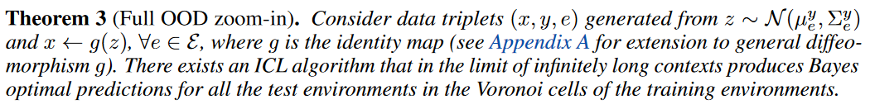
Theoretical Results: OOD, infinite ICE
Given generalization guarantees of ICRM on the test environment within the Voronoi cells of the training environments.
(⚠Problems in proofs) Its logic: ①ICRM can help to learn the ground-truth cluster information of the test domain ②through the Voronoi cell assumption, it learned the correct mapping between clusters and labels.
② remain questioned.

Slide 13
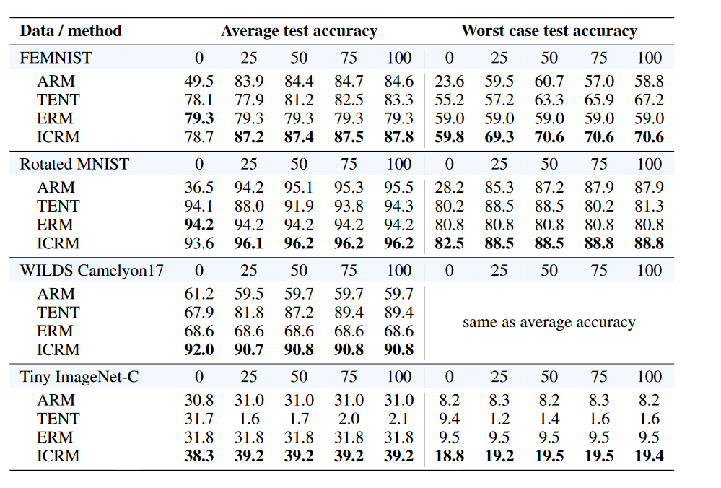
OOD Generalization Results
For ICRM, a RN-50 is used to featurize the input, which is then processed by the decoder-only GPT2
For Camelyon17 and Tiny IN-C, ICRM outperforms baselines despite not leveraging any context from the test environment. -> ICRM training itself helps.

Slide 14
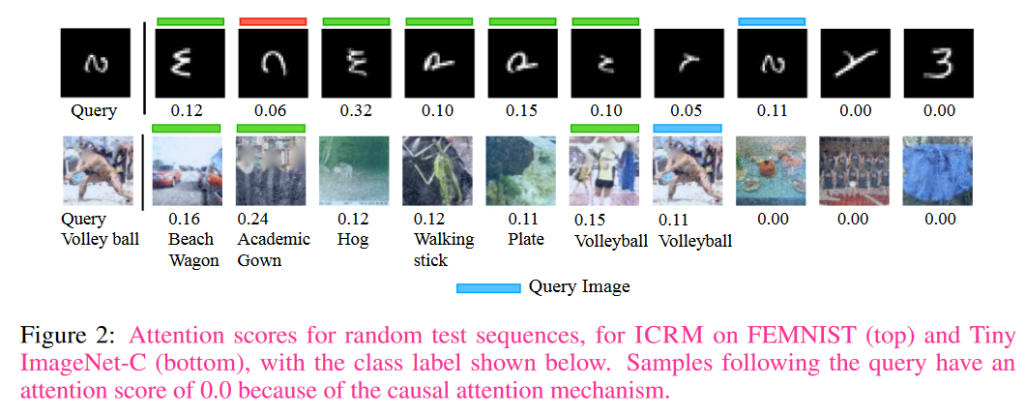
Attention Scores Visualization

Slide 15
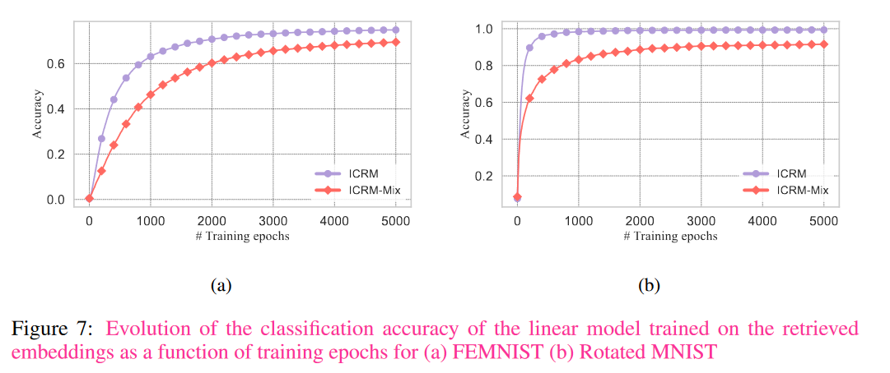
ICRM learns environment features.

Slide 16
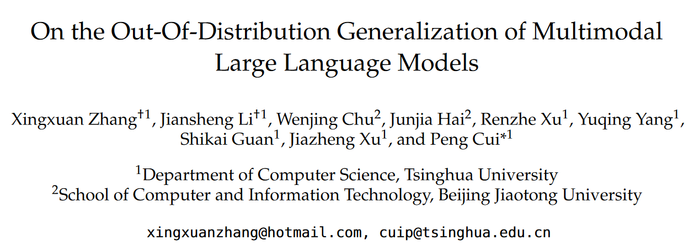
Arxiv Feb 2024
Empirical studied the effect of distribution shifts between In-Context Examples (ICE) and test samples of MLLMs.

Slide 17
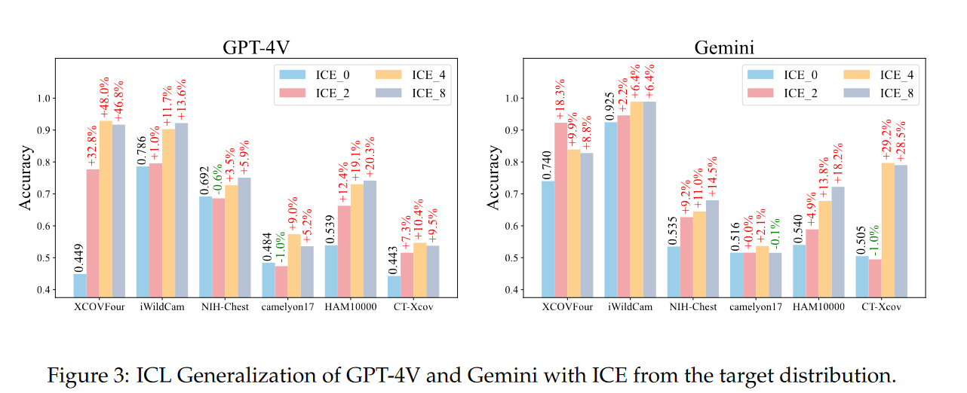
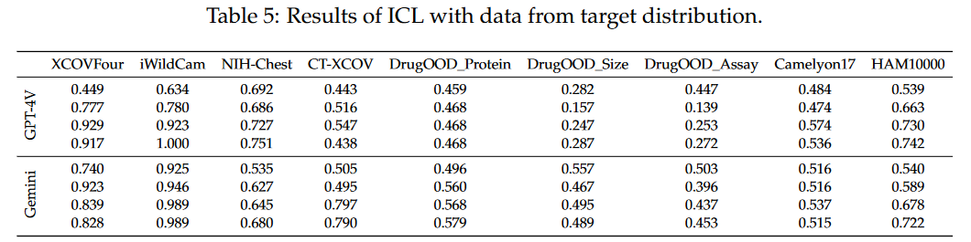

When $P^{ICL}\left(x,y\right)=P^{test}\left(x,y\right)$:
The overall improvement by ICL is significant.
GPT-V and Gemini failed to achieve performance gains on molecular datasets (may be due to the inherent complexity of predicting molecular activity).

Slide 18
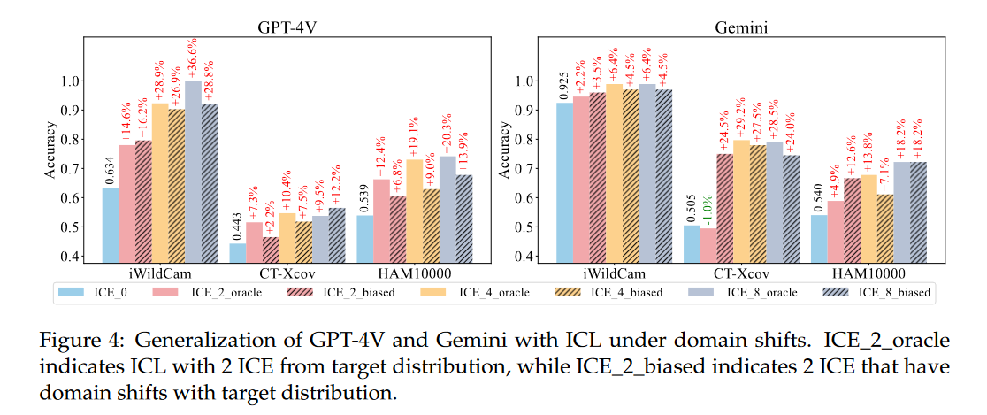

When $P^{ICL}\left(x,y\right)≠P^{test}\left(x,y\right)$:
Basic OOD Generalization/Domain Generalization setting, where test samples are unavailable.
ICL significantly outperforms zero-shot, only marginally falling short of Oracle ICE.

Slide 19
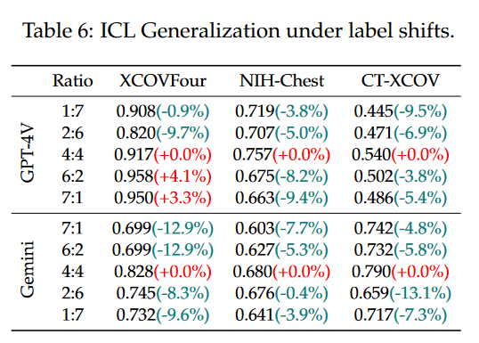

When $P^{ICL}\left(y\right)≠P^{test}\left(y\right)$:
Test: balanced two categories. ICE: varying proportions of categories.
Label shifts can significantly impact MLLM generalizability.

Slide 20
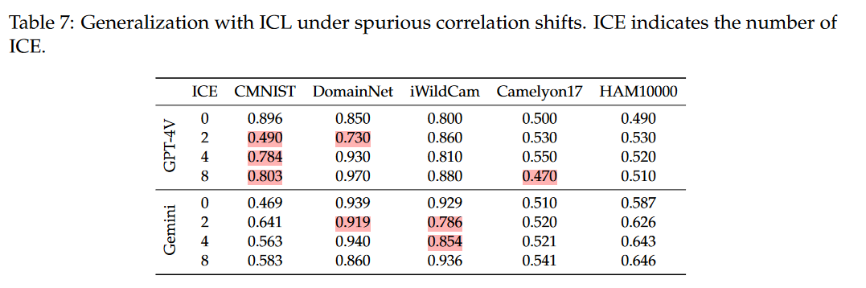

When $P^{ICL}\left(y|x\right)≠P^{test}\left(y|x\right),$ i.e., $P^{ICL}\left(y|x_{s}\right)≠P^{test}\left(y|x_{s}\right)$
ICE: class 1 from domain 1 and class 2 from domain 2.
Test: the opposite scenario, class 1 from domain 2 and class 2 from domain 1.
Spurious correlation shifts pose a threat, but not always.

Slide 21
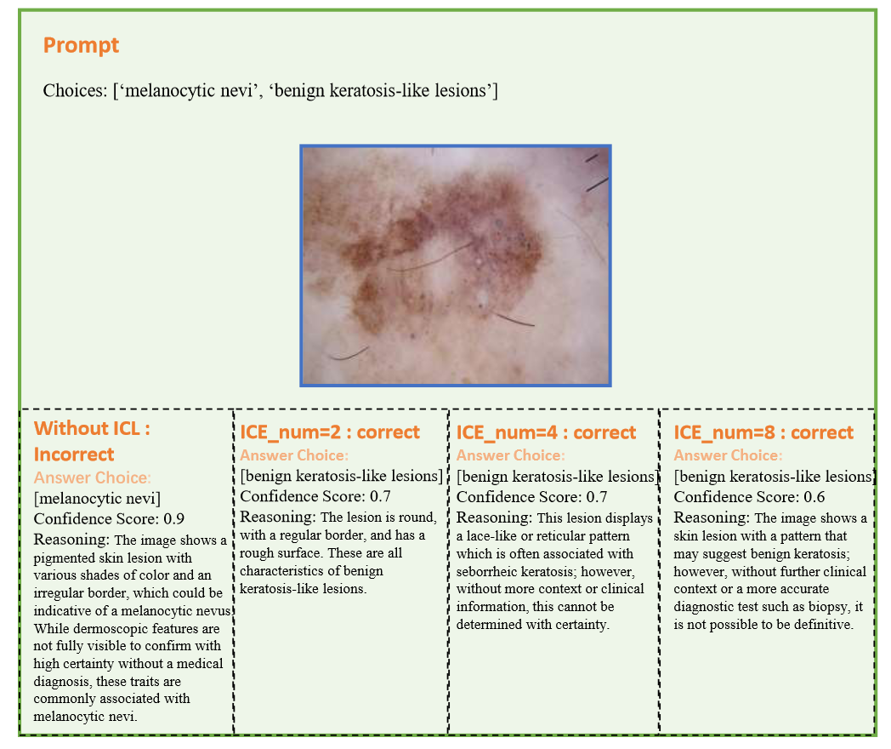
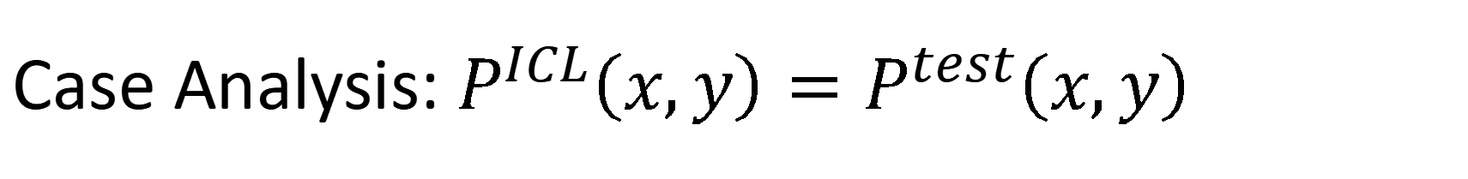
Case Analysis: $P^{ICL}\left(x,y\right)=P^{test}\left(x,y\right)$
More ICEs -> lower confidence
More ICE may not necessarily induce higher confidence

Slide 22
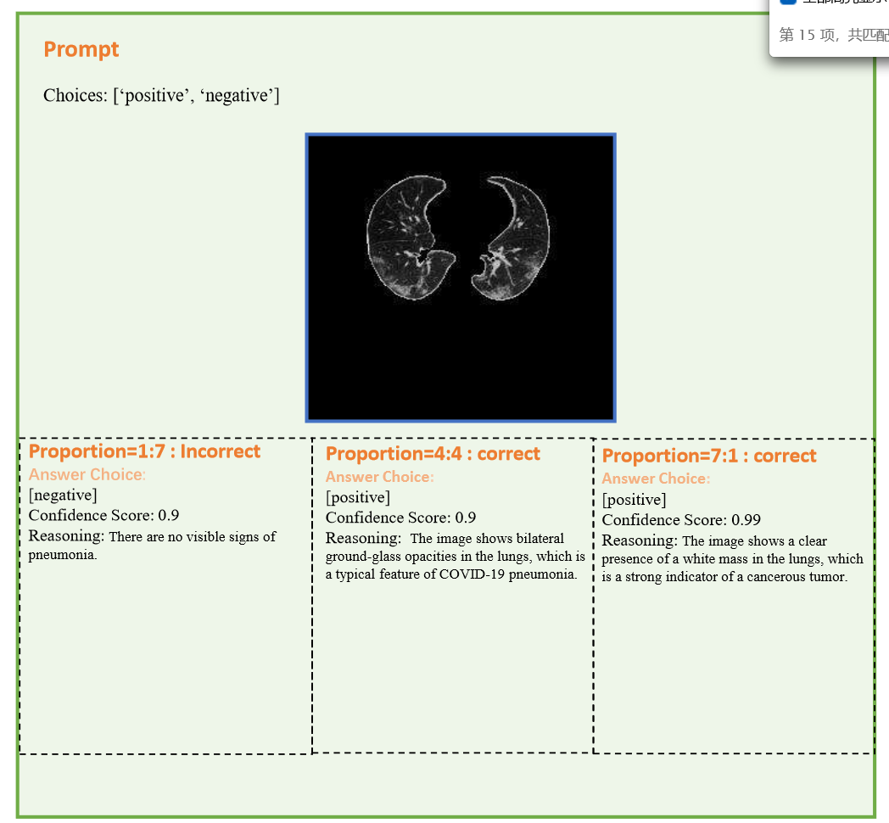
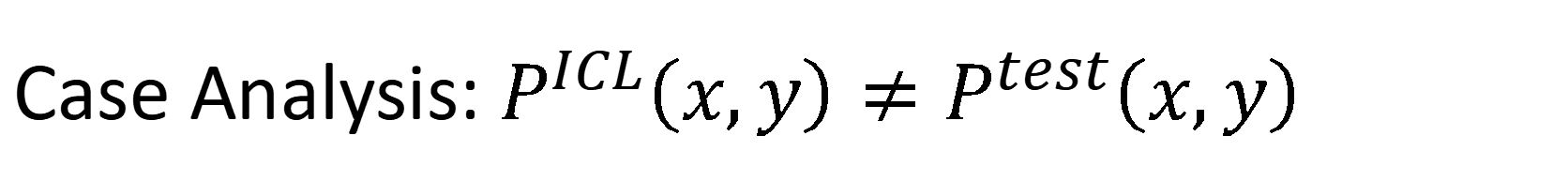
Case Analysis: $P^{ICL}\left(x,y\right)≠P^{test}\left(x,y\right)$
ICE are sampled from the target domain yet the ratio of categories is not aligned with that in test samples
The label shifts between ICE and test samples can introduce serious misinformation and unreliable preferences.

Slide 23
Case Analysis: label shifts
ICE are sampled from the target domain yet the ratio of categories is not aligned with that in test samples
The label shifts between ICE and test samples can introduce serious misinformation and unreliable preferences.

Slide 24
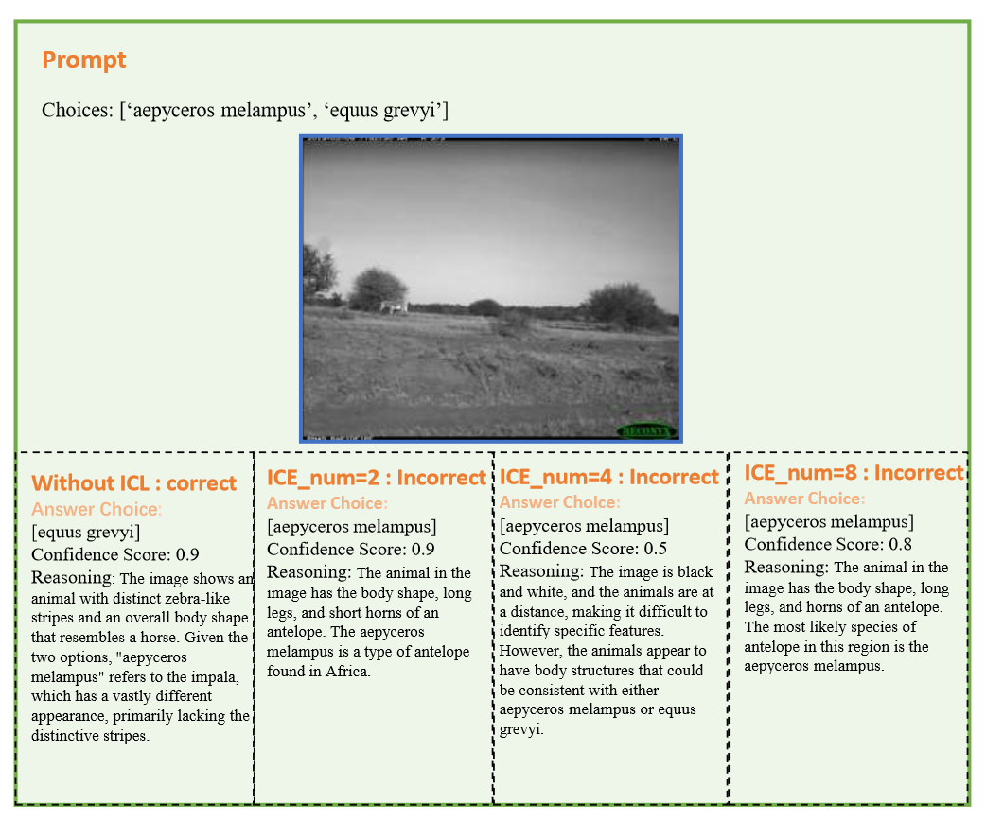
Case Analysis: spurious correlations
Correlation shifts (location-label) exist between ICE and test samples
Spurious correlation shifts between ICE and test samples can introduce severe performance degradation.

