Slide 1
Exploring the Mechanism of In-context Learning
王启迅
2024/4/22

Slide 2
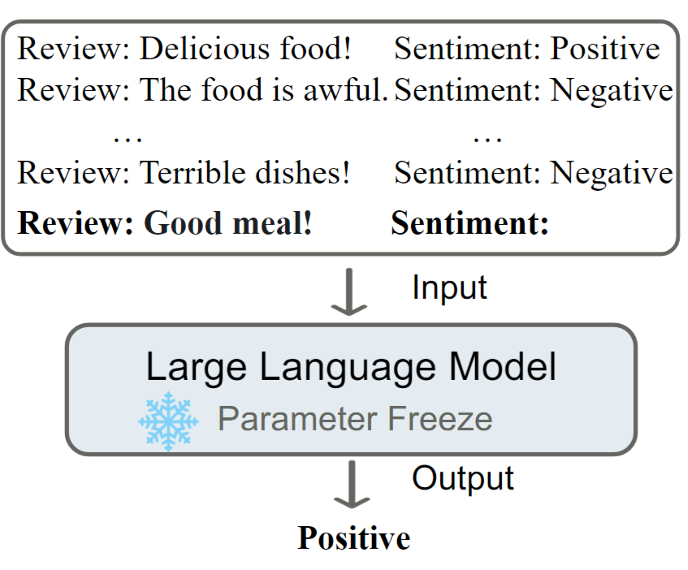
In-context Learning

Slide 3
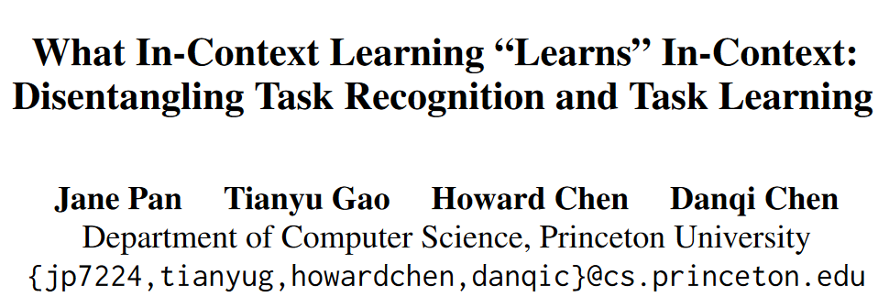
How could ICL perform?
Findings of ACL 2023

Slide 4
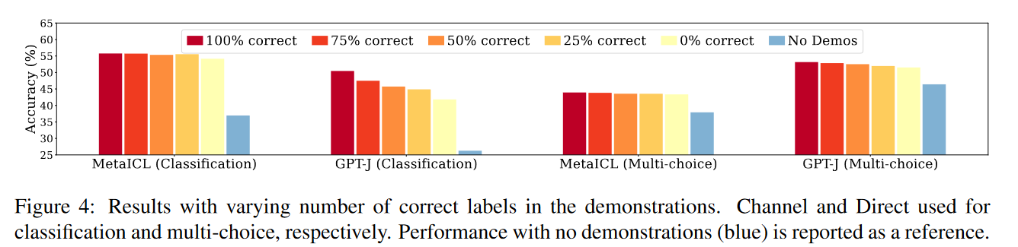
Previous findings about ICL
Rethinking the Role of Demonstrations: What Makes In-Context Learning Work? EMNLP 2022
Label is correct or not doesn’t matter for a relative good ICL performance.
Using incorrect labels is significantly better than no demonstrations.
Explanation: LLMs can recognize the task by observing some task-related words. For example, “The sentiment is positive/negative” can be easily recognized as a sentiment classification task due to their prevalence during pre-training

Slide 5
Two aspects of ICL
Task recognition (TR)
Q: The movie is good.
A: Positive(50%)/Negative(50%)
Q: The book is excellent.
A: Positive(50%)/Negative(50%)
Q: The food is bad.
A: Positive(50%)/Negative(50%)
…
Q: The scenery is beautiful:
A:
Task learning (TL)
Q: The movie is good.
A: @
Q: The book is excellent.
A: @
Q: The food is bad.
A: #
…
Q: The scenery is beautiful:
A:

Slide 6
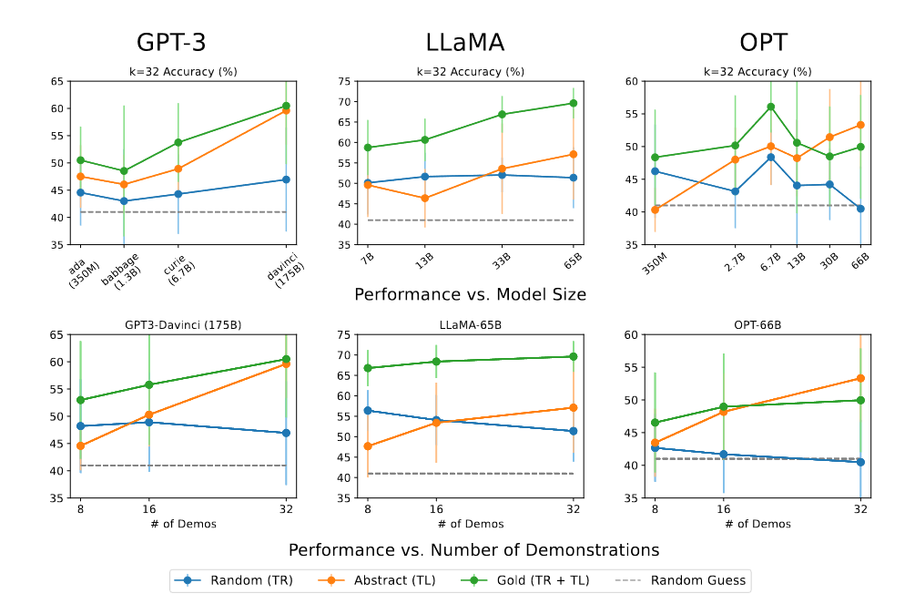
Main result
 | Natural label space | Correct x-y mapping
Gold | √ | √
Random | √ | ×
Abstract | × | √
Observations:
RANDOM do not increase with either model sizes or number of demonstrations
ABSTRACT demonstrate an increasingly steep slope as the model sizes and the number of demonstrations grow

Slide 7
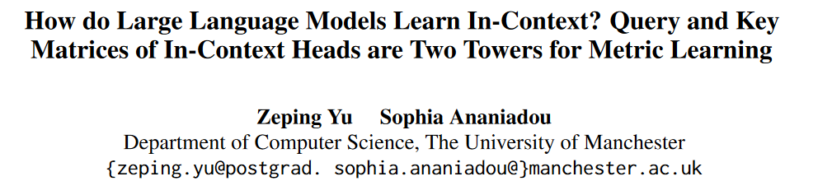
Deeper analysis of the ICL mechanism
Arxiv Feb 2024

Slide 8
Locating the most important layers and heads
Motivation: there are too many layers and attention heads/FFNs in an LLM. We need to filter out the most important ones to analyze the working mechanism of ICL.
Intuition: the most significant layers and heads for ICL in transformers are the ones that increase most probability in predicting the correct label.

Slide 9
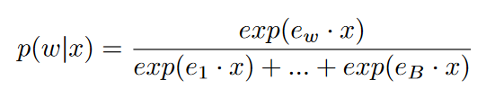
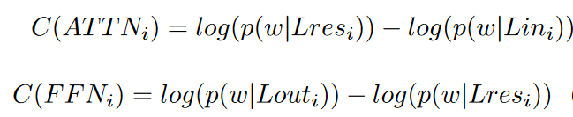


How to locate the most significant layers and heads
Mapping the hidden representation $x$ (the output) of a attention/FFN’s output or their “subvalue”. Here $e_{w}$ is word $w^{′}s$embedding.
Compute the log probability increase:

Slide 10
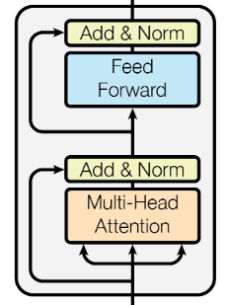

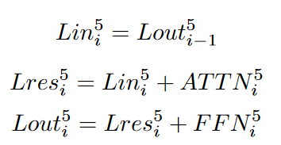




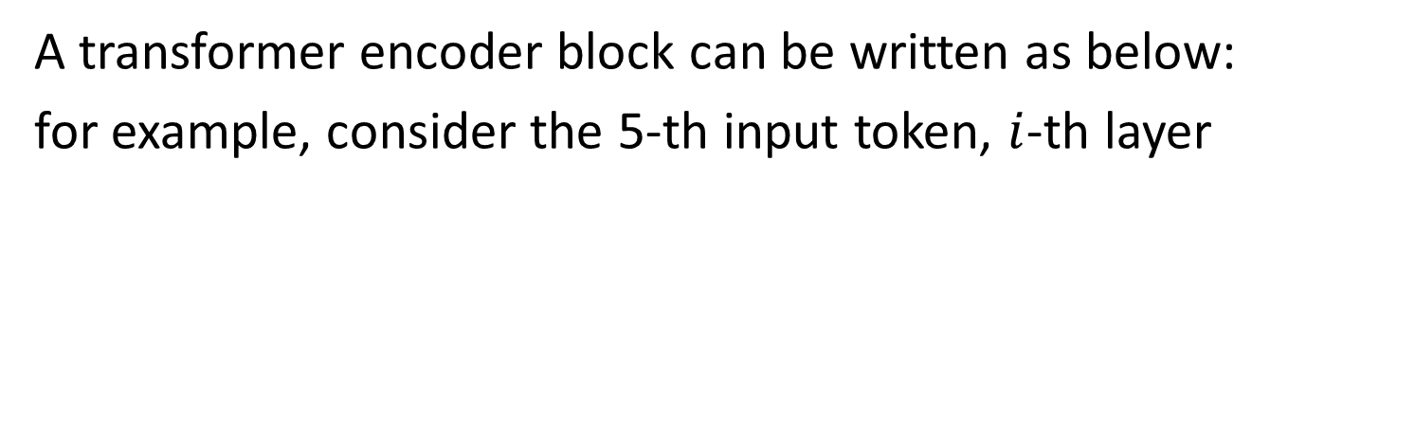
What modules’ significance is to be analyzed?
A transformer encoder block can be written as below:
for example, consider the 5-th input token, $i$-th layer

Slide 11
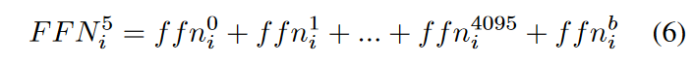
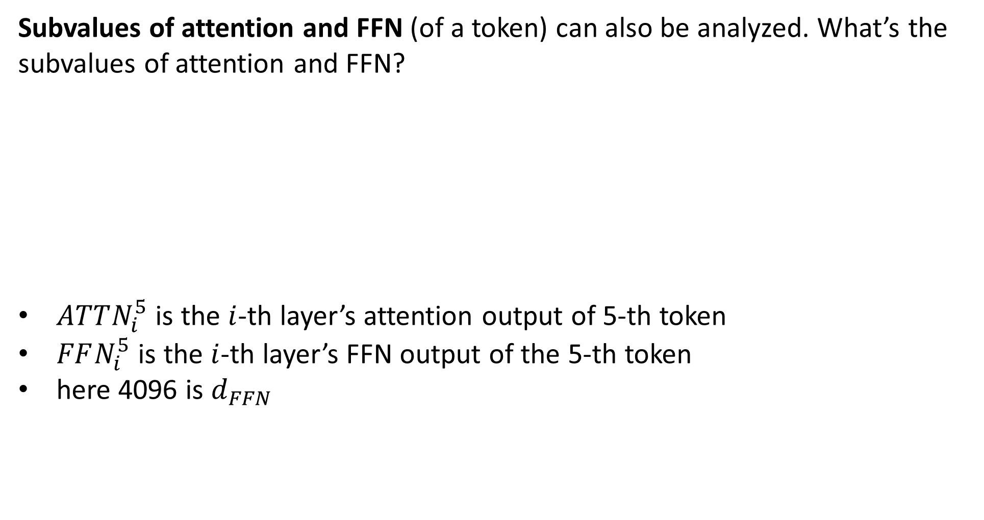


What are the subvalues?
Subvalues of attention and FFN (of a token) can also be analyzed. What’s the subvalues of attention and FFN?
$ATTN_{i}^{5}$ is the $i$-th layer’s attention output of 5-th token
$FFN_{i}^{5}$ is the $i$-th layer’s FFN output of the 5-th token
here 4096 is $d_{FFN}$
a subvalue, dim: [1, $d_{model}$]
a subvalue, dim: [1, $d_{model}$]

Slide 12

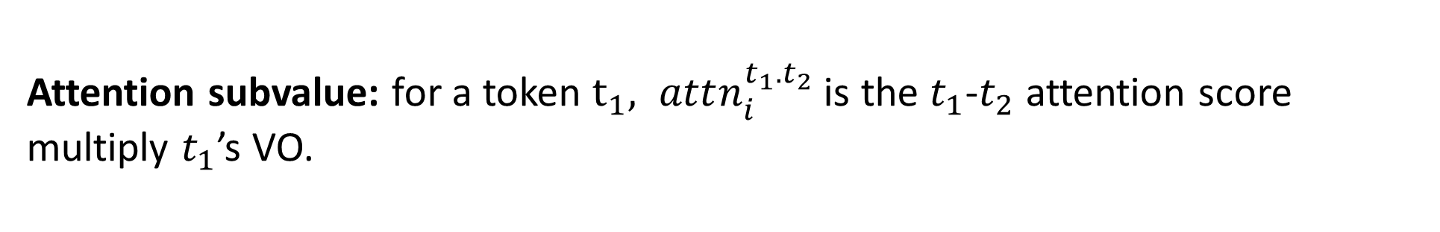

How to locate the most significant layers and heads
a subvalue, dim: [1, $d_{model}$]
Attention subvalue: for a token $t_{1}, attn_{i}^{t_{1}.t_{2}}$ is the $t_{1}$-$t_{2}$ attention score multiply $t_{1}$’s VO.

Slide 13
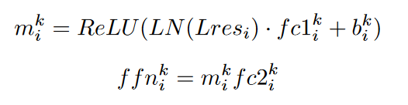



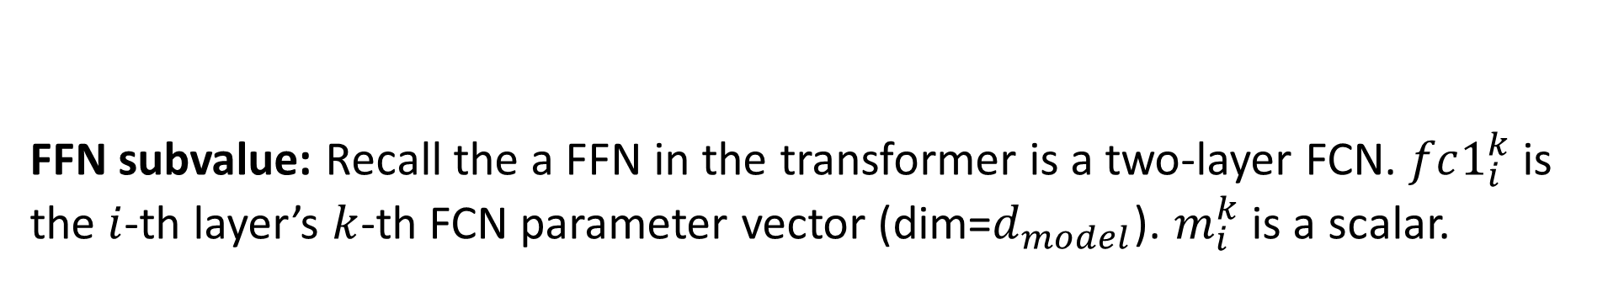





How to locate the most significant layers and heads
FFN subvalue: Recall the a FFN in the transformer is a two-layer FCN. $fc1_{i}^{k}$ is the $i$-th layer’s $k$-th FCN parameter vector (dim=$d_{model}$). $m_{i}^{k}$ is a scalar.
a subvalue, dim: [1, $d_{model}$]
$$d_{FFN}$$
$$d_{model}$$
$$d_{model}$$
fc1
$$N$$
$$Lres_{i}$$
fc2
$$d_{model}$$
$$d_{FFN}$$

Slide 14
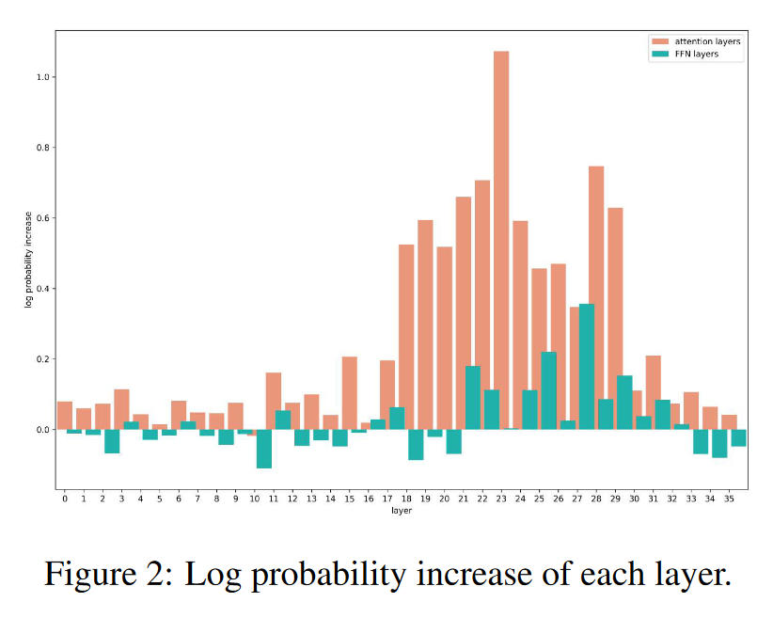
Existence of the ICL heads
Consider a simple abstract ICL task (abstract labels, x-y mapping kept):
“love : bar like: bar eight : foo two: foo one :”
Compute the probability increase of “foo” to locate the most important layers

Slide 15
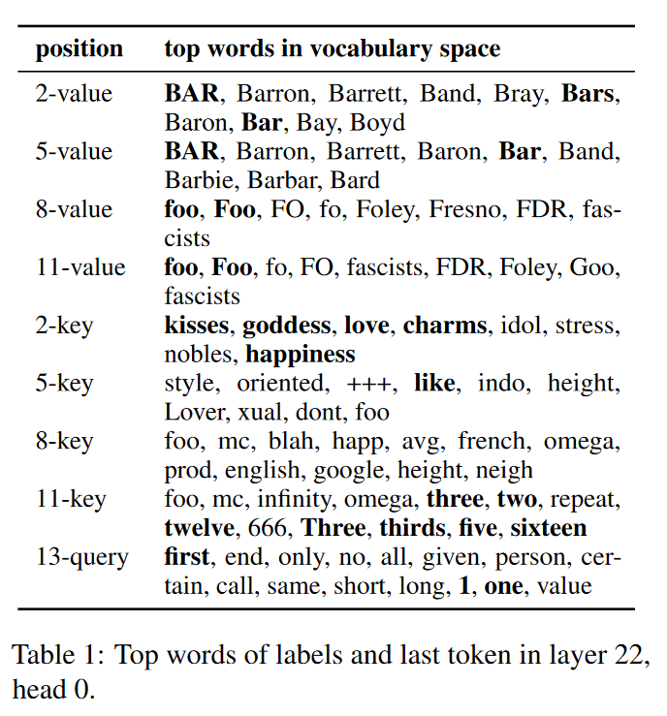
Projecting to the vocabulary space
Observations:
Label values’ top words have related concepts with the labels ("bar" and "foo").
Label keys’ top words on position 2, 5, and 11 are related to their demonstrations ("love", "like" and "two").
Last token query’s top words are related to the input text ("one")

Slide 16
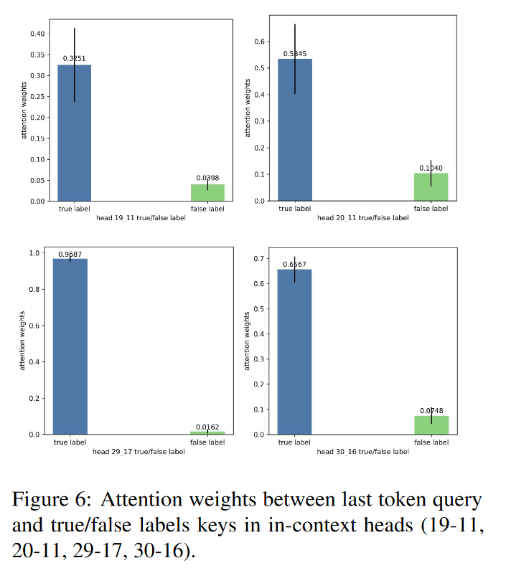
Attention Weights on True/False Labels
Computing the attention score between the last token’s query and the label’s key.
Observations:
The attention weights between last token query and true label keys are muclarger than those between last token query and false label keys.

Slide 17
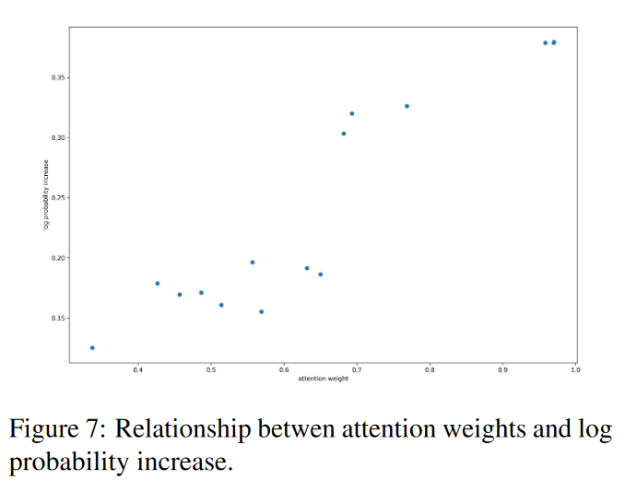
Further evidence
Observation: Larger attention weights, larger probability increase of the correct prediction.
Indicating: Query and key matrices compute the attention weights between the input text and each demonstration. The larger the attention weight is, the more label information is transferred into the last token for predicting the next word.

Slide 18
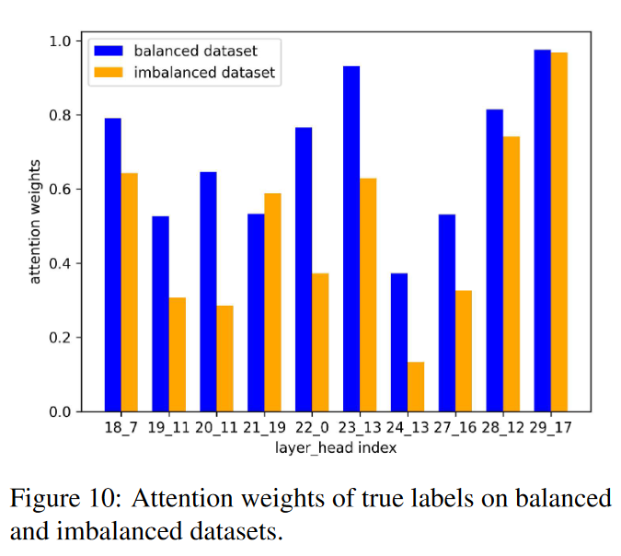
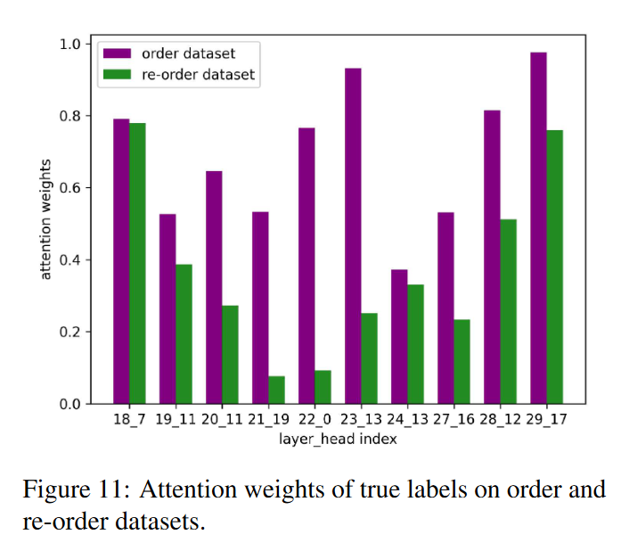
Further evidence
Task 1: imbalanced labels
“love : bar like: bar eight: foo two: foo one:” -> "love : bar like: bar eight: foo one:"
Task 2: re-ordered labels
“love : bar like: bar eight: foo two: foo one:”->“eight: foo two: foo love : bar like: bar one:”
Observation: in both tasks, the attention scores of the true label decrease.
Indication: more label -> more attention; closer to the test -> more attention

Slide 19
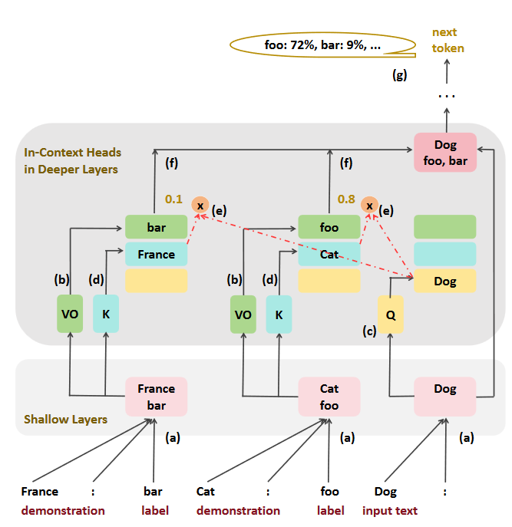
Conclusion: the (task learning) mechanism of ICL
(a) In shallow layers, the features of demonstrations and the input text are merged into corresponding labels and the last token respectively.
(b) In deep layers’ in-context heads, the value-output matrix VO extracts the label information.
(c) The query matrix Q and
(d) the key matrix K compute the
(e) attention weights between input text and each demonstration.
(f) The attention weight decides how much label information is transferred into the last token. (g) Many in-context heads contribute to the information flow from labels to the last token, which predicts the next word.

Slide 20
My trials
From the paper, the mechanism of task learning seems to be:
find similar example in the context, and use its label as the final prediction.

Slide 21
Experiments
Add the same suffix in a example and the test example, see if the LLM output the same label as the example with the suffix, rather than original correct label of the test example.
Use Llama2-7b

Slide 22
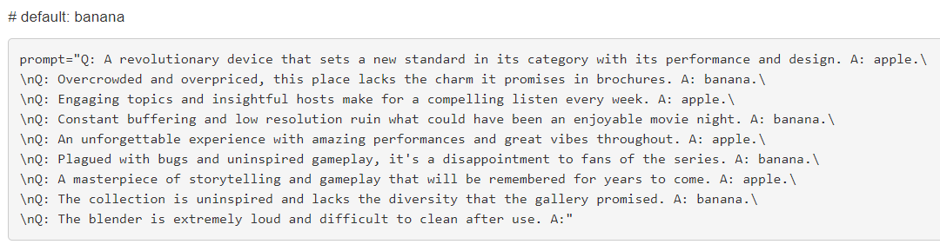
Experiments
Adversarial suffix:
“, jeans, flamingo, xylophone, chinchilla and mandrill”
Task: sentimental classification.
positive -> apple; negative -> banana
correct

Slide 23
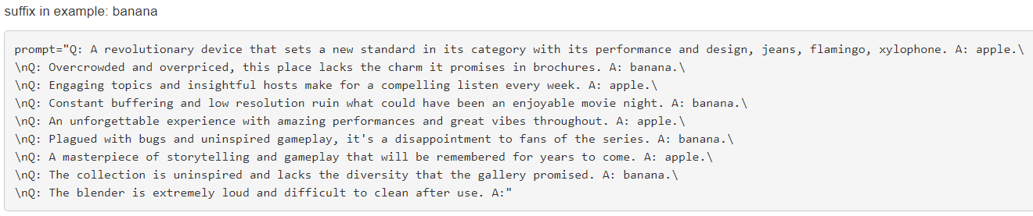
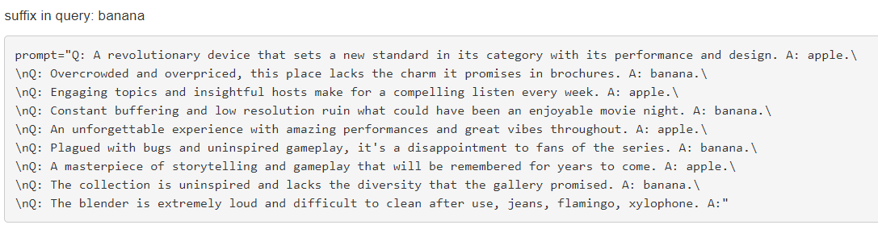
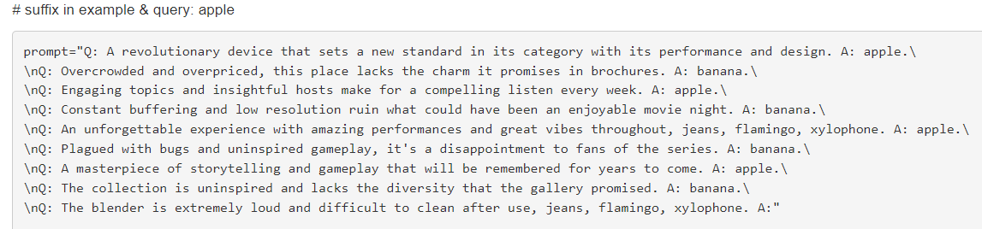
correct
correct
wrong

Slide 24
Now we confirm the mechanism of task learning (TL). Then the next goal is to figure out when task recognition (TR) happens, and when TL happens.

Slide 25
Finding: longer generation task tends to perform TL rather than TR
1 token | manipulating result
"negative"/"positive" | failed
"apple"/"banana" | succeed
"t"/"z" | succeed
"foo"/"bar" | failed
2 tokens | manipulating result
"apple cat"/"wooden dog" | succeed
"qt"/"ij", "qz"/"ij" | succeed
"foop"/"bari" | failed
3 tokens | manipulating result
"door paper water"/"banana" | - (failed to perform ICL w/o adv suffix)
"qty"/"ijn" | succeed
"foopl"/"bariq" | succeed
4 tokens | manipulating result
"qtyz"/"ijnb" | succeed
Primary hypothesis: harder task will rely more on the context to predict. Also, when there doesn’t exist a example that resemble the test example very much, TR will dominate.
To-do: analyze the mechanism of task recognition.

