Slide 1
Theoretical advances in In-context learning
王启迅
2024.6.11

Slide 2
Two types of tasks on explanation of ICL
Similar example to the query example can be found in context:
Classification tasks
Similar example to the query example cannot be found in context:
Various of generation/regression-like tasks, like antonym, country-capital, capitalize the first letter…

Slide 3
Two types of tasks on explanation of ICL
Similar example to the query example can be found in context:
Classification tasks
How Do Nonlinear Transformers Learn and Generalize in In-Context Learning? (ICML 2024)
Similar example to the query example cannot be found in context:
Various of generation/regression-like tasks, like antonym, country-capital, capitalize the first letter…
Series of theoretical works, generally can be categorized into two settings: linear regression or next-token prediction

Slide 4
Two types of tasks on explanation of ICL
Similar example to the query example can be found in context:
Classification tasks
How Do Nonlinear Transformers Learn and Generalize in In-Context Learning? (ICML 2024)
Similar example to the query example cannot be found in context:
Various of generation/regression-like tasks, like antonym, country-capital, capitalize the first letter…
Series of theoretical works, generally can be categorized into two settings: linear regression or next-token prediction

Slide 5
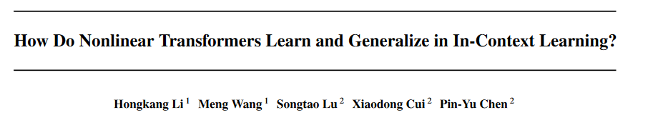
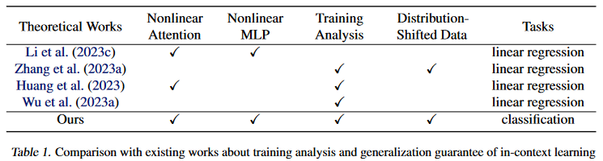
ICML 2024
Comparing to existing literatures:

Slide 6
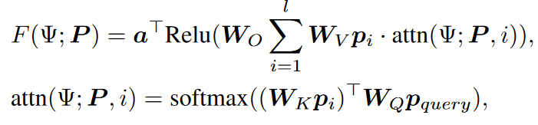
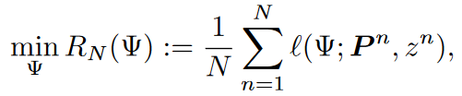
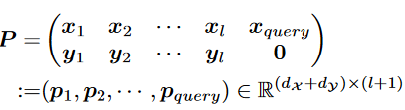


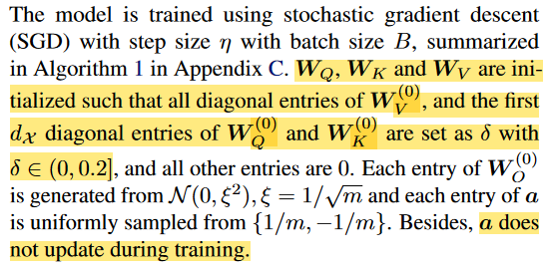
Basic setting
Non-linear transformer: softmax attention + ReLU MLP
ICL pretraining: prompt format:
Binary classification task:
ID and OOD task:
ID generalization error:
OOD generalization error:
Model simplification: diagonal initialization

Slide 7
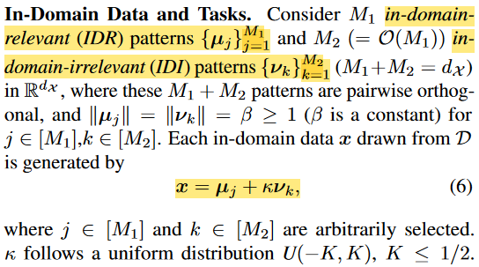
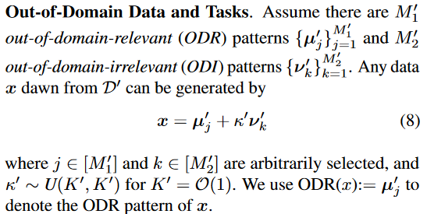
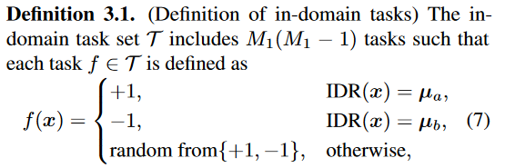
The data generalization modeling
Relevant/irrelevant features (ID)
Labeling function (ID)
Relevant/irrelevant features (OOD)
Labeling function (OOD)
The same as ID

Slide 8
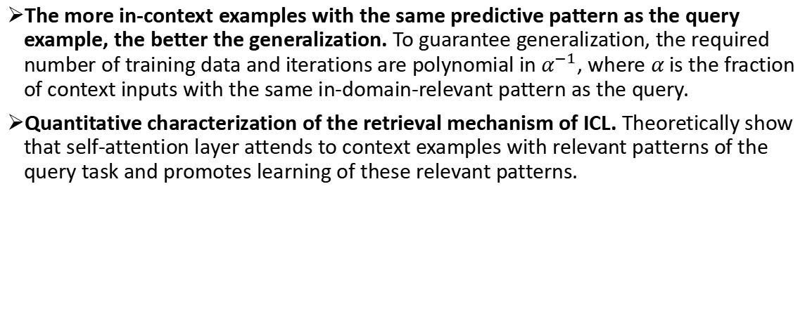
Theoretical insights
The more in-context examples with the same predictive pattern as the query example, the better the generalization. To guarantee generalization, the required number of training data and iterations are polynomial in $α^{−1}$, where $α$ is the fraction of context inputs with the same in-domain-relevant pattern as the query.
Quantitative characterization of the retrieval mechanism of ICL. Theoretically show that self-attention layer attends to context examples with relevant patterns of the query task and promotes learning of these relevant patterns.

Slide 9

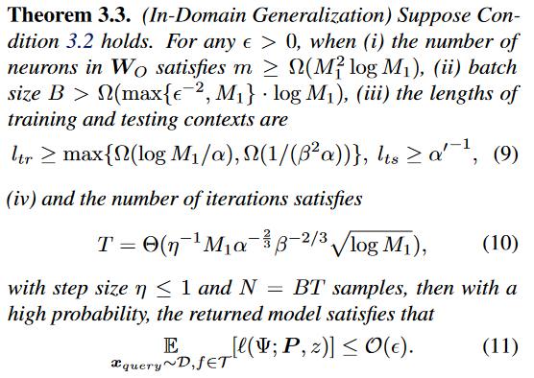
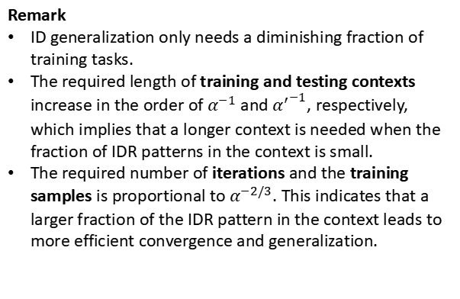
Generalization Guarantees
Condition: all IDR patterns should be covered in the training set
ID generalization guarantee
Remark
ID generalization only needs a diminishing fraction of training tasks.
The required length of training and testing contexts increase in the order of $α^{−1}$and ${α^{′}}^{−1}$, respectively, which implies that a longer context is needed when the fraction of IDR patterns in the context is small.
The required number of iterations and the training samples is proportional to $α^{−2/3}$. This indicates that a larger fraction of the IDR pattern in the context leads to more efficient convergence and generalization.

Slide 10
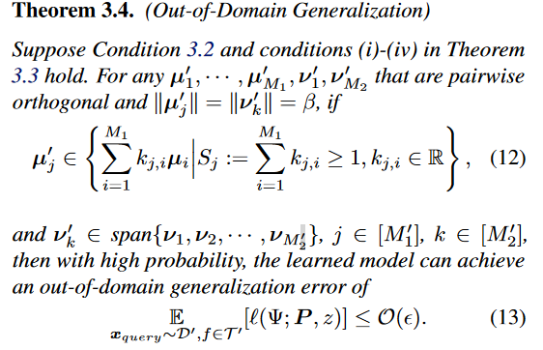

Generalization Guarantees
OOD generalization guarantee
Remark
Bridge needed for OOD generalization: the ODR patterns are linear combinations of IDR patterns with a summation of coefficients $≥ 1$, and each ODI pattern is in the subspace spanned by IDI patterns.

Slide 11
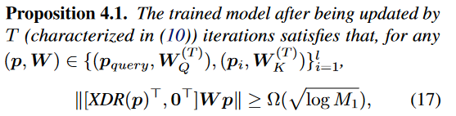
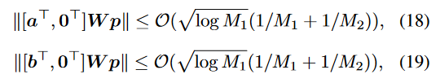

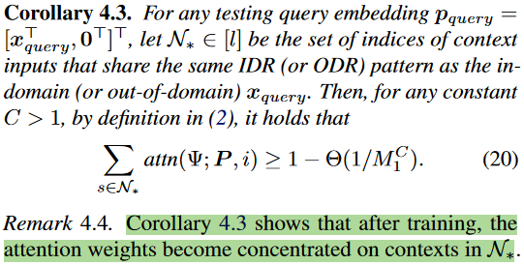


ICL mechanism:
Self-Attention Selects Contexts With the Same IDR/ODR Pattern as the Query
After ICL training,
Q/K maps query $p_{query}$/ICE $q_{i}$ closer to their corresponding relevant features;
Q/K maps query $p_{query}$/ICE $q_{i}$ farther from other relevant features or irrelevant features

Slide 12
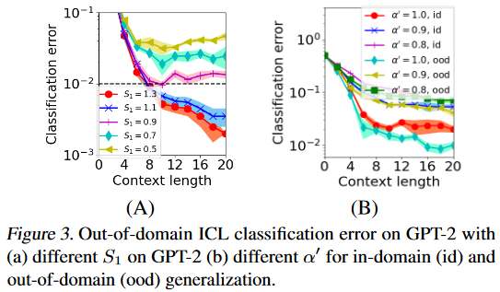
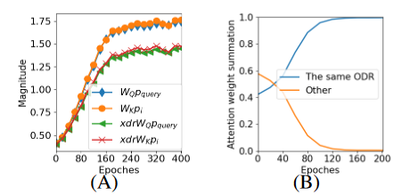
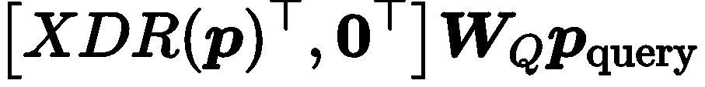
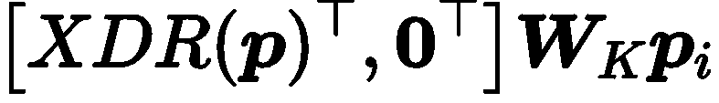
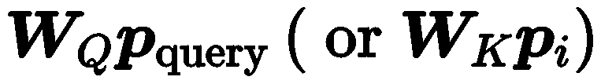



Experiments
Validation of the theories
(A) Similar norm between / and / , indicating that the components of / in directions other than are small.
(B) Attention concentrates on the samples with the same ODR as the query after training.
Fig. 3 (A) larger $S$, lower OOD error
Fig. 3 (B) larger ratio of same-relevant-feature$α$, lower error

Slide 13
Extension: more evidence of the retrieval mechanism of ICL in classification tasks
In-Context Language Learning: Architectures and Algorithms (Arxiv Jan 2024)
The Evolution of Statistical Induction Heads: In-Context Learning Markov Chains(Arxiv Feb 2024)
Label Words are Anchors: An Information Flow Perspective for Understanding In-Context Learning (EMNLP 2023)
How do Large Language Models Learn In-Context? Query and Key Matrices of In-Context Heads are Two Towers for Metric Learning (Arxiv Feb 2024)
Understanding In-Context Learning in Transformers and LLMs by Learning to Learn Discrete Functions (ICLR 2024)

Slide 14
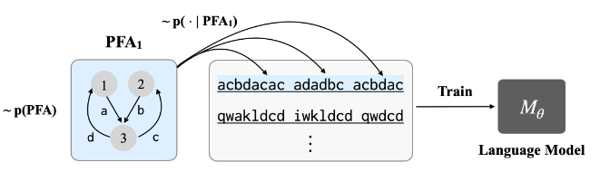
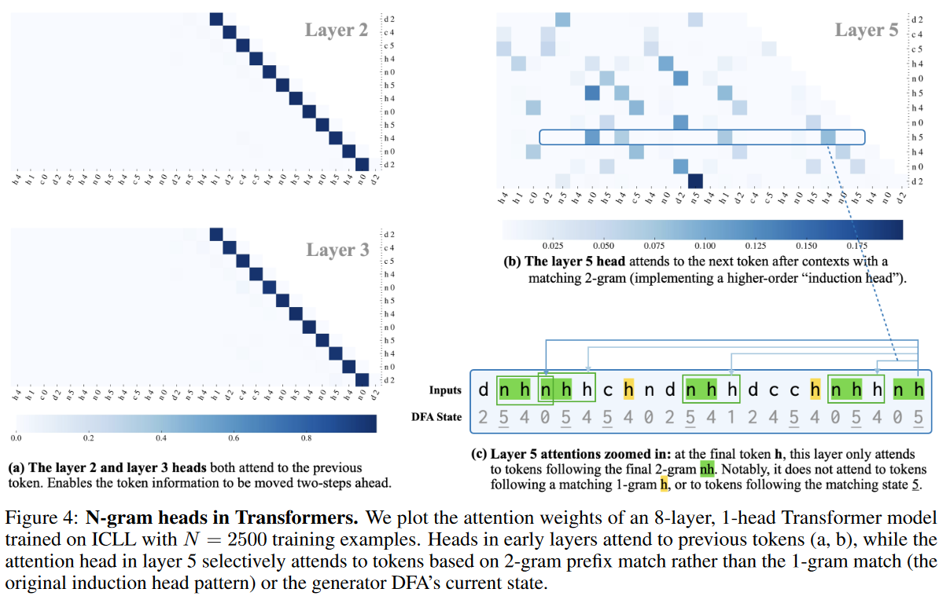

Extension: the evidence of the retrieval mechanism in ICL
In-Context Language Learning: Architectures and Algorithms (Arxiv Jan 2024)
Task: create some “language” (probabilistic finite automatas) , then sample sentences from the language. The goal is to predict the next token.
Observation:
Shallow layers: mainly attend to previous token
Deep layers: mainly attention to the tokens base on 2-gram match
Training objective: autoregressive

Slide 15
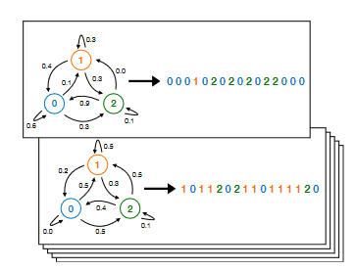
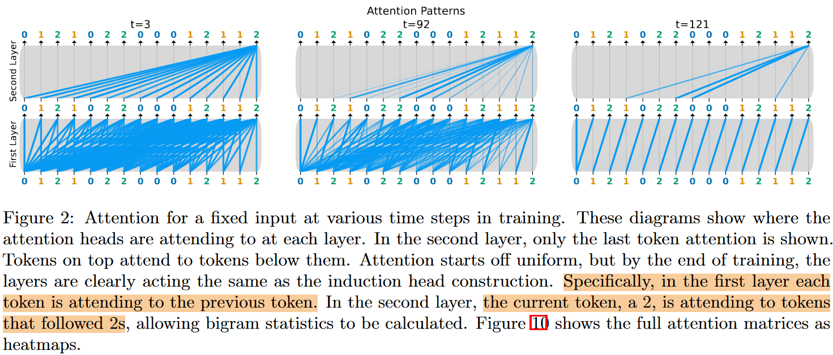
Extension: the evidence of the retrieval mechanism in ICL
The Evolution of Statistical Induction Heads: In-Context Learning Markov Chains(Arxiv Feb 2024)
Task: predict a Markov chain
Observation:
Shallow layers: mainly attend to previous token
Deep layers: mainly attention to the tokens after the tokens the same as the query token “2”.

Slide 16
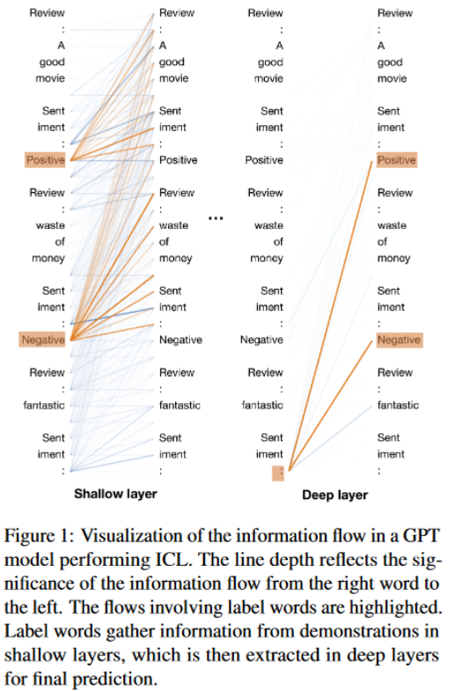
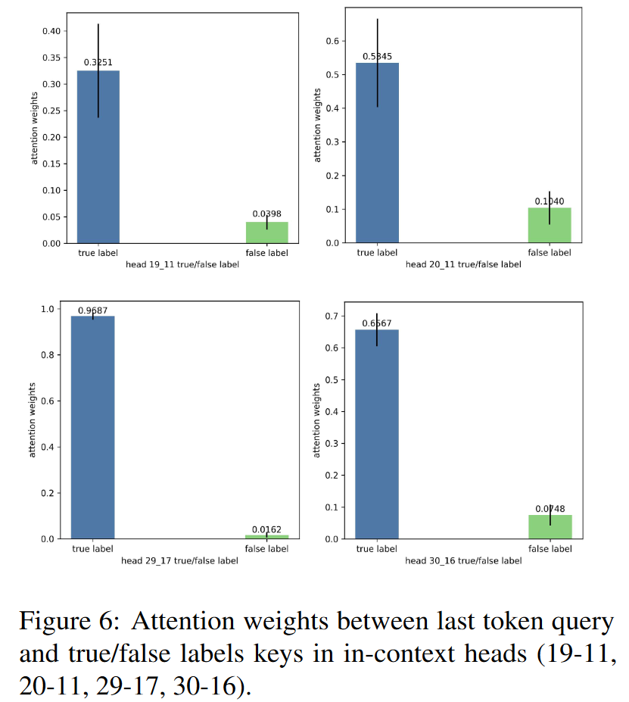
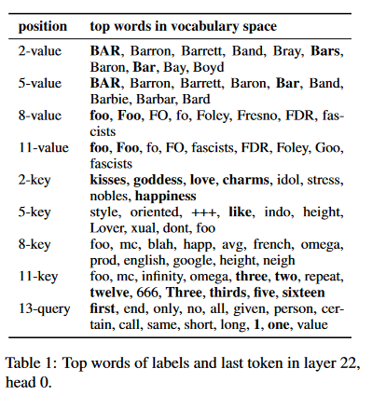
Extension: the evidence of the retrieval mechanism in ICL
How do Large Language Models Learn In-Context? Query and Key Matrices of In-Context Heads are Two Towers for Metric Learning (Arxiv Feb 2024)
Label Words are Anchors: An Information Flow Perspective for Understanding In-Context Learning (EMNLP 2023)
Prompt:
“love : bar like: bar eight: foo two: foo one:”
Label word’s keys encode the information of the example preceding it
Larger attention weights on the same labels in context rather than different labels.

Slide 17

Beyond classification tasks?
Most are from theoretical perspectives, with oversimplified/constrained settings.
Simplified models: one-layer linear attention, diagonal weight matrices, etc..
Simplified tasks: linear regression ($y=Wx$) or autoregression ($s_{t+1}=Ws_{t}$).
Unrealistic settings: ICL pretraining, rather than AR pretraining in realistic LLMs.

Slide 18
Beyond classification tasks?
Autoregression
Linear regression

Slide 19
Beyond classification tasks?
Autoregression
Linear regression

Slide 20
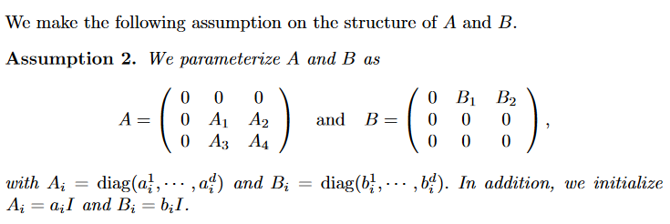


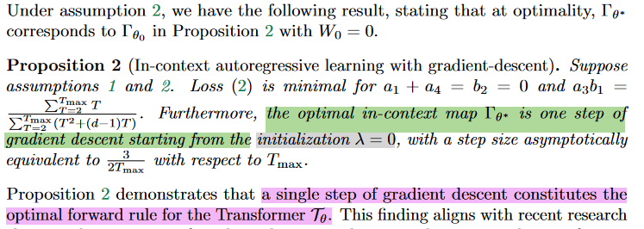
Beyond classification tasks? – AR pretraining
Most are from theoretical perspectives, with oversimplified/constrained settings.
How do Transformers perform In-Context Autoregressive Learning? (Arxiv Feb 2024)
Diagonal assumption
Target loss:
Result: find the optimal solution of the target loss, and prove that the optimal target loss can be reached in one step of GD starting from zero initialization.

Slide 21

Beyond classification tasks? – AR pretraining
Most are from theoretical perspectives, with oversimplified/constrained settings.
On Mesa-Optimization in Autoregressively Trained Transformers: Emergence and Capability
Task: predict $x_{T+1}$ after training on a autoregressive (AR) objective, where $x_{t+1}=Wx_{t}$

Slide 22
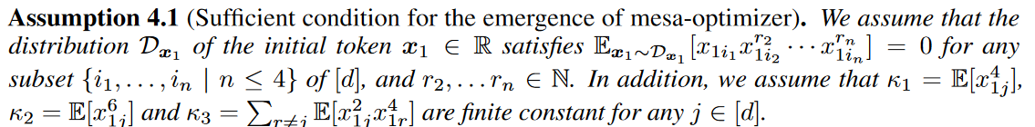
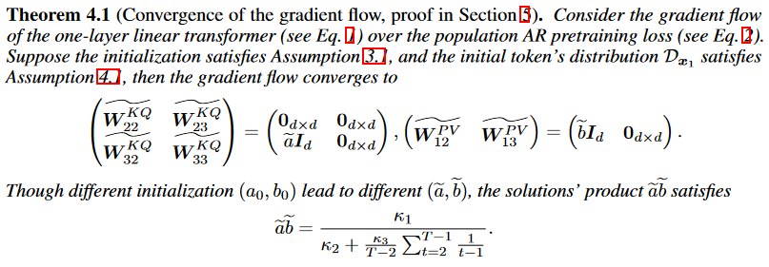
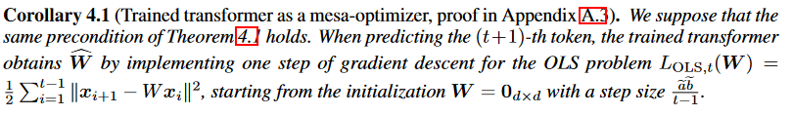
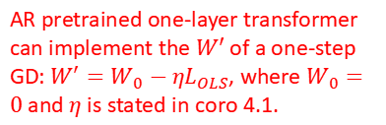

Beyond classification tasks? – AR pretraining
Theoretical results
Assumption on the distribution of $x_{1}$
Sufficient condition
Convergence guarantee of the AR pretraining
AR pretrained one-layer transformer can implement the $W′$ of a one-step GD: $W^{′}=W_{0}−ηL_{OLS}$, where $W_{0}=0$ and $η$ is stated in coro 4.1.

Slide 23

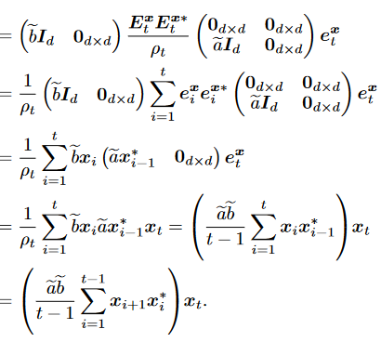
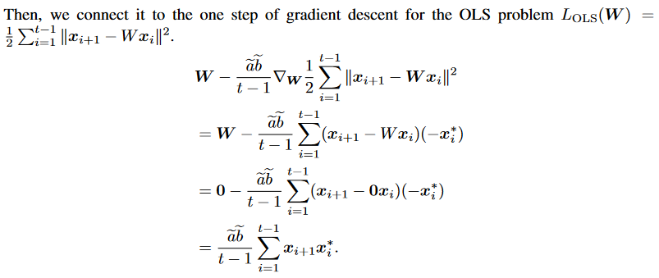

Beyond classification tasks? – AR pretraining
AR pretrained one-layer transformer can implement a $W^{′}=W_{0}−ηL_{OLS}$, where $W_{0}=0$ and $η$ is stated in coro 4.1.
Explanation:
=
$W$ after one-step GD on the AR loss
Prediction of the one-layer transformer after AR pretraining

Slide 24
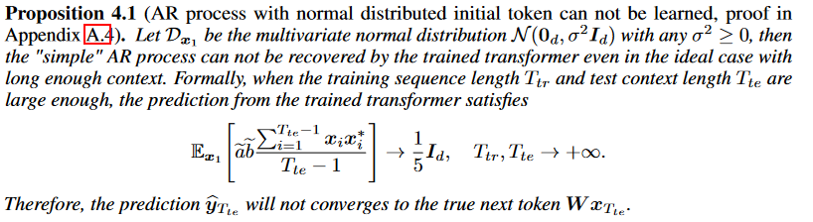


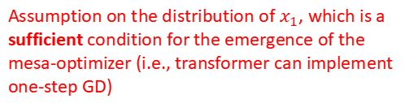
Beyond classification tasks? – AR pretraining
Limitation of the proposed sufficient condition
Assumption on the distribution of $x_{1}$, which is a sufficient condition for the emergence of the mesa-optimizer (i.e., transformer can implement one-step GD)
Cannot guarantee to recover the true $W$
Not all not all $D_{x_{1}}$ satisfies Assumption 4.1 can be recovered by the trained linear transformer.

Slide 25
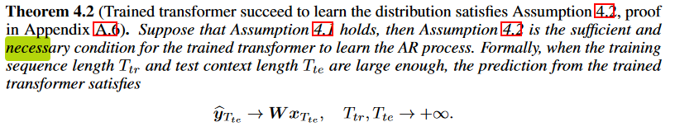

Beyond classification tasks? – AR pretraining
Limitation of the proposed sufficient condition
Further add a sufficient and necessary condition (but strong):
Can guarantee to recover the true $W$

Slide 26
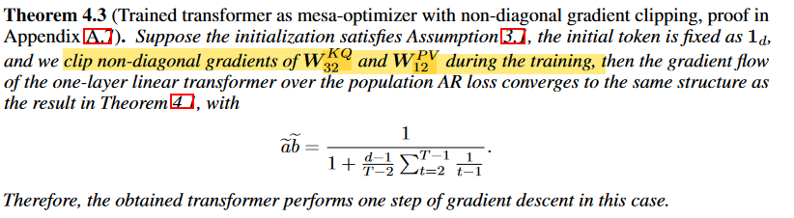
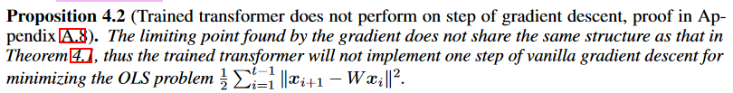
Beyond classification tasks? – AR pretraining
Go beyond Assumption 1
No Assumption 1, but assume diagonal weights during training, we get:
Theo 4.1
Coro 4.1, implement one-step GD
No Assumption 1, no diagonal weights during training assumption, then there is no guarantee that the transformer will implement one-step GD:

Slide 27
Beyond classification tasks?
Autoregression
Linear regression

Slide 28

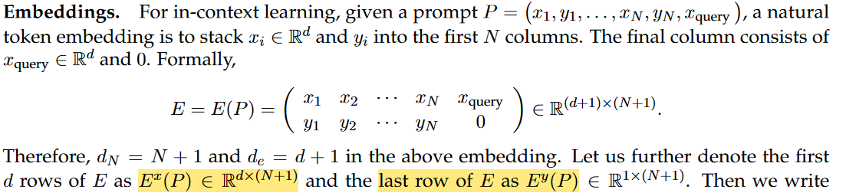


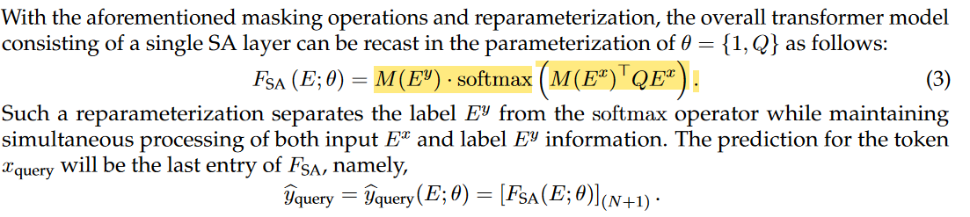

The only analysis of nonlinear transformer in linear regression tasks
In-Context Convergence of Transformers (NIPS 2023 workshop)
In comparison, the setting in Trained Transformers Learn Linear Models In-Context (JMLR 2024)
An analysis under a nonlinear setting, but still have other oversimplified settings:
Omit $y_{i}$in the attention calculation, using a retrieval mechanism prior.

Slide 29
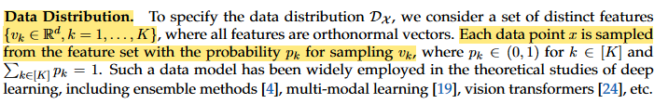
Mechanism explanation in linear regression tasks: a similar retrieval perspective
Query and examples share the same features:
Retrieval-like transformer:
Omit $y_{i}$in the attention calculation, using a retrieval mechanism prior.
Suppose

Slide 30

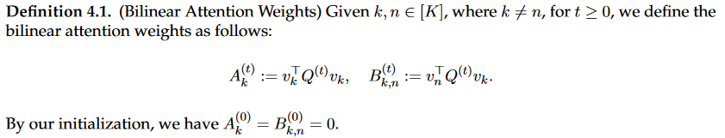
Mechanism explanation in linear regression tasks: a similar retrieval perspective
Suppose the query token corresponds to the feature $v_{k}$
Imbalanced features of the prompt: , i.e., $v_{1}$ is the dominated feature.
By analyzing the dynamics of

Slide 31

Mechanism explanation in linear regression tasks: a similar retrieval perspective
After theoretically analyze the dynamics of the attentions, the change of the leading weight over the learning process results in different training phases.
In a nut shell, the attention score of the same-feature examples as the query will increase monotonically to 1.

Slide 32

A conclusion of existing literatures
Pretraining paradigm | Task | Setting | Distributional shifts? | Works
Classic ICL $\left[x_{1},y_{1},…,x_{q}\right]→y_{q}$ | $$y_{i}=w^{⊤}x_{i}$$ | Linear attention | No | NIPS23
Classic ICL $\left[x_{1},y_{1},…,x_{q}\right]→y_{q}$ | $$y_{i}=w^{⊤}x_{i}$$ | Linear attention | Yes | JMLR24
Classic ICL $\left[x_{1},y_{1},…,x_{q}\right]→y_{q}$ | $$y_{i}=w^{⊤}x_{i}$$ | Non-linear attention | No | NIPSworkshop23(oversimplified TF)
Autoregressive $\left[x_{1},x_{2},…,x_{i}\right]→x_{i+1}$ | $$x_{i+1}=w^{⊤}x_{i}$$ | Linear attention | No | Arxiv24-05 Arxiv24-02
Classic ICL $\left[x_{1},y_{1},…,x_{q}\right]→y_{q}$ | Binary cls | Non-linear attention | yes | ICML24

