Slide 1
DevOps
NeiL ORZECHOWSKI

Slide 2
Summary:
DevOps is a set of best practices and tools which are designed to reduce the amount of time between when a change is made and when that change is fully delivered
Benefits of using DevOps tools
Ease of development
Ease of deployment & testing
Increased intra-team communication
Increased flexibility and ability to handle unplanned work
Mitigation of bugs/defects

Slide 3
Why is DevOps needed?
Building solutions in a linear manner is not always efficient
The communication between stakeholders and developers is limited
Relegating team members to strict roles is limiting
Bugs are hard to track down and even harder to fix
Analyze
Design
Implement
Test

Slide 4
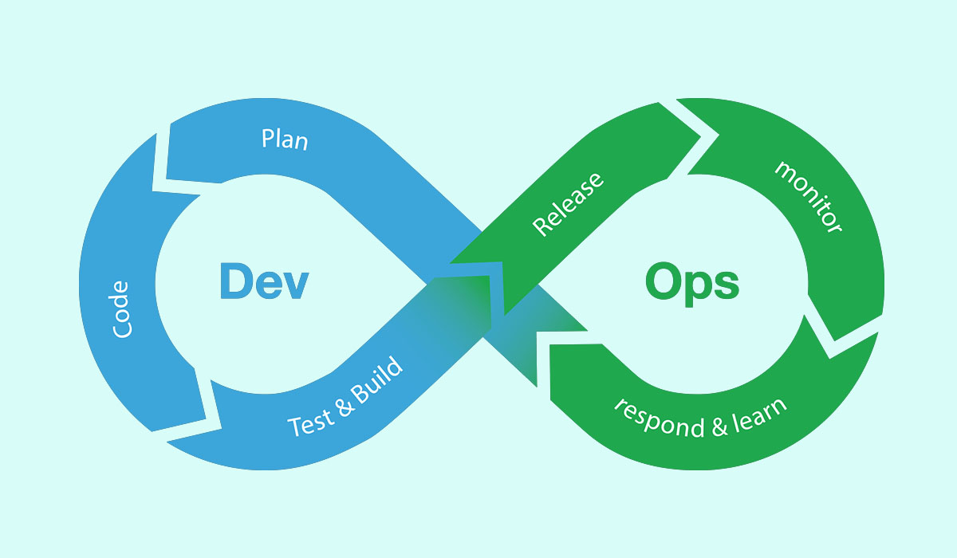
How DevOps can help
Development
Operations
QA
Provides cross functional capabilities
Reduces complexity as well as busywork
Increases free time and happiness
Provides real-time feedback

Slide 5
Types of DevOps Tools
Scope | Example Tools | Purpose
CI/CD | Jenkins, Azure, AWS, CircleCI | Continuous Integration means what your building is always being tested Continuous Deployment means your application is always available
Automation | Gradle, Selenium, SonarQube | Reduce time doing repetitive tasks, encourages individual/interactions over processes/configuration
Monitoring | ELK stack, Splunk | Provide logging, analytics and alerts on your application in all environments

Slide 6
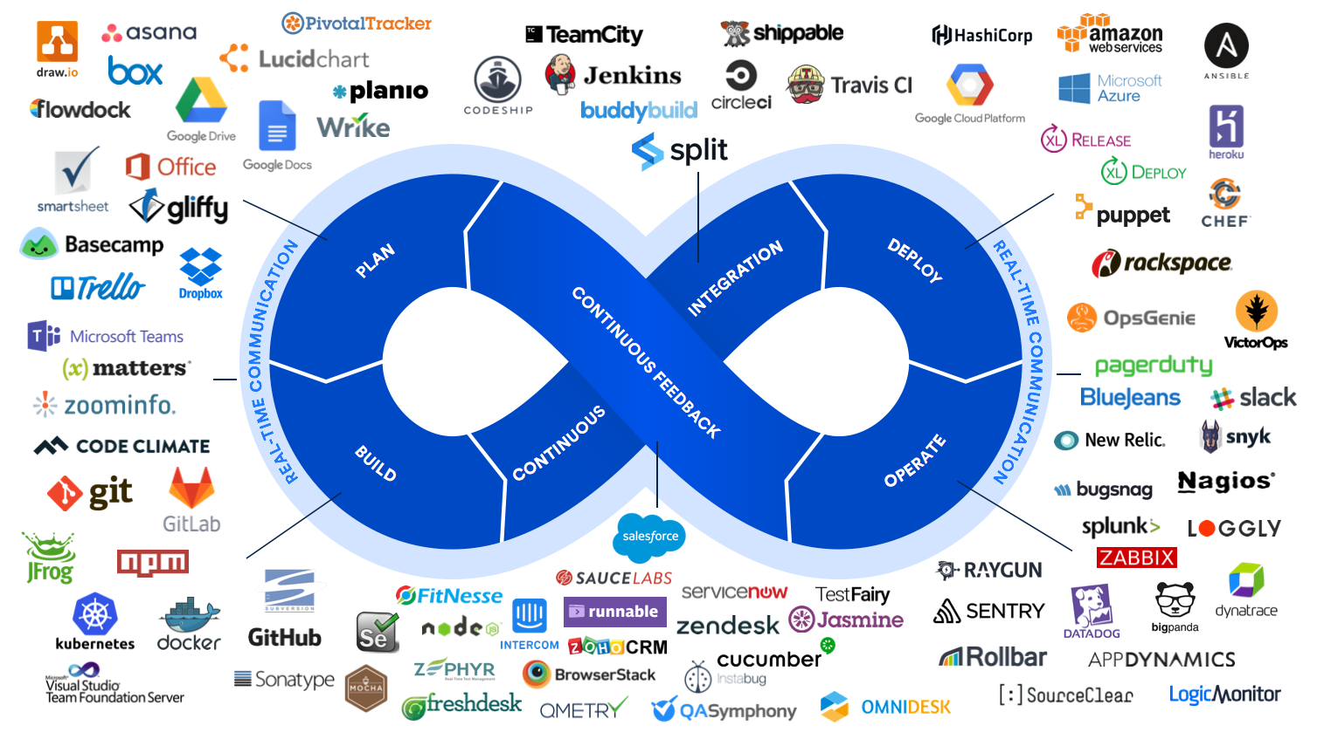
Types of DevOps Tools - continued

Slide 7
Case Study
A historically indecisive client is requesting an application to track what technologies their employees are good at
After discussing with them what their needs and “must have” features are and agreeing when the application will be delivered, you and your team begin development
You decide that the first unit of work you will complete will be a P.O.C web app that addresses the main functionality
How will you do this as fast as possible so you can immediately gather feedback and refine (or add) requirements?

Slide 8
Case Study (Solution)
Main technologies:
Java, JavaScript
DevOps tools used:
Git, Gradle, JaCoCo, Checkstyle, Azure*
Small initial investment, potentially large long term benefits
Demo
Goals
Deliver baseline product that can serve as the technological backbone going forward
Get second round of feedback from client as soon as possible

Slide 9
Questions?
Sample Question: Can DevOps (either the tools or the underlying concepts) be useful in the chemical industry?

