Slide 1



Rural Open-Sourcing
Open Source at RSI

Slide 2

Outline
What is open source?
Why is it important?
Who benefits from it?

Slide 3

What is Open Source?
A mechanism to allow for a legal and mutually beneficial way to share code
Can be freely redistributed and modified (depending on license)
Historically not popular with big companies (e.g. Microsoft)
Is a building block for many programs we all know and love – and use everyday

Slide 4
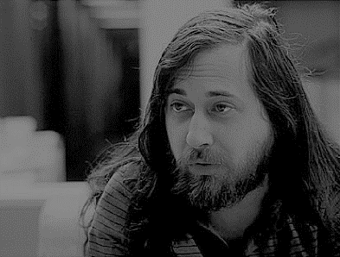
Free as in Freedom
Xerox 9700, Scribe, and other “crimes against humanity”
…led to Emacs, GNU, GCC, GPL, Copyleft, and Linux*
A controversial and important activist for Free and Open Source Software, Computer Science

Slide 5








Industry examples

Slide 6

Benefits
To developers
Personal growth
Exposure
Tools
To corporations
Exposure
Distributed and diverse contributions
A way to stay on the cutting edge
To consumers
- Increased safety
- Cost (Ubuntu = $0)
- Long term reliance

Slide 7

How can we use it?
Have a company wide Github account (https://github.com/Rural-Sourcing)
Showcase our talent and projects to clients
Bootstrap projects quickly for clients
Internal uses
Education
Coding challenges
Historical preservation

Slide 8

Next steps
Drawbacks
- Slow delivery time (large projects)
- Some code just needs to be proprietary
- Steep learning curve
What license should we use: https://choosealicense.com/
What you can do

Slide 9

Questions || Thoughts

