Slide 1
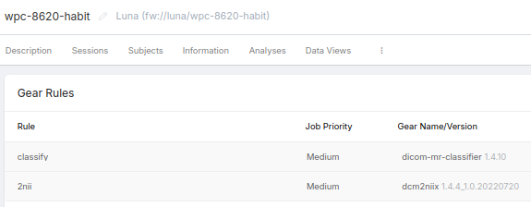
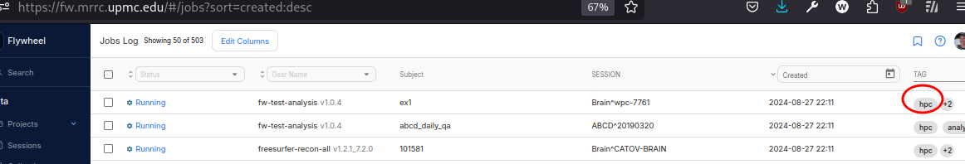
Containers for FW
Reproducible pipelines
Automation
External CPU
(HPC pending)

Slide 2
Translating
Code into container
  Matlab
    compile externally and include runtime
    OR use octave
  Add tests
Container into gear
  Script mods
  Inputs from /flywheel/v1/inputs/*
  Outputs to /flywheel/v1/outputs/
  ‘fw-beta gear’
    config – initialize json example
    run – to test locally
    upload – to send to flywheel

Slide 3
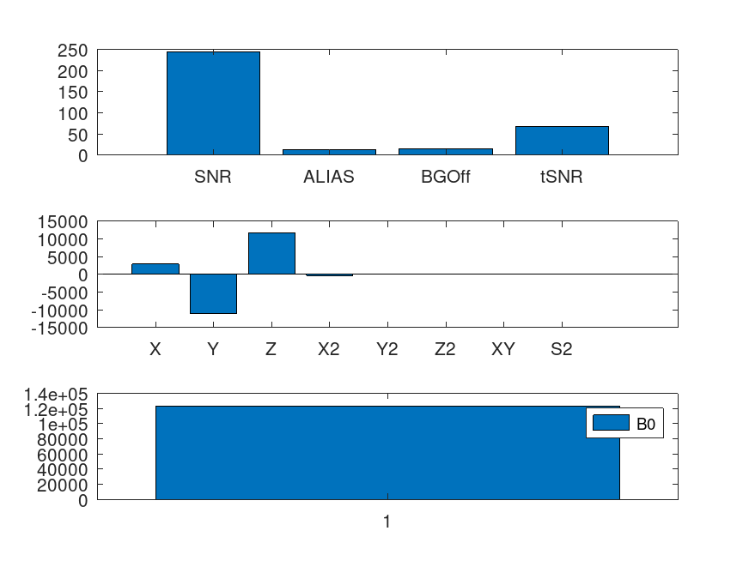
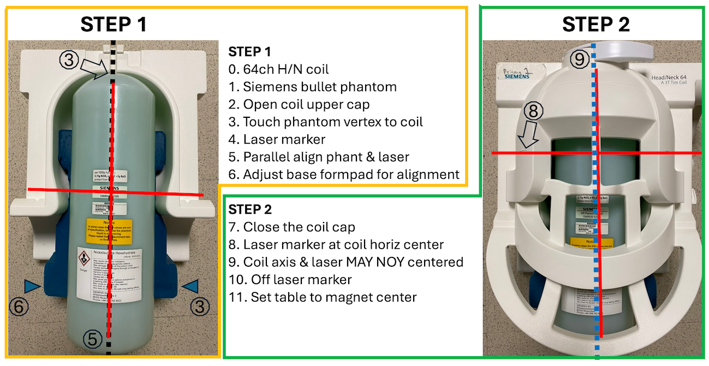
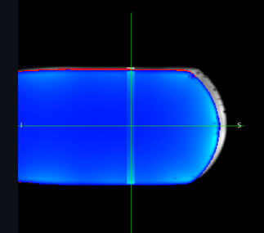
Containerize
Example: https://github.com/NPACore/fw-mrrcqa

Slide 4
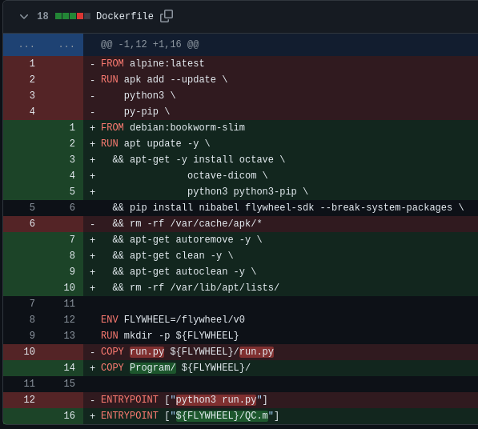
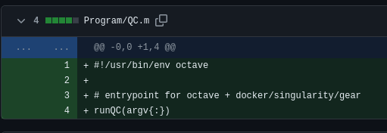
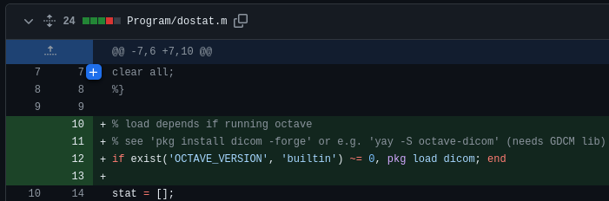
Containerize
Used later by flywheel’s python run file like

Slide 5
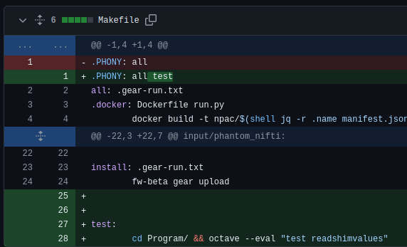


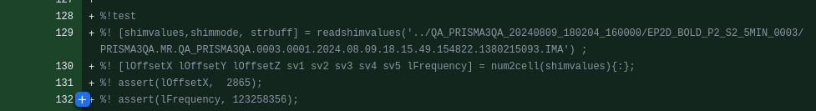
Adding tests

Slide 6
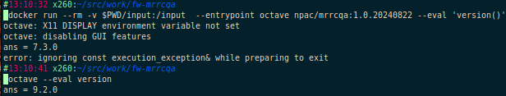
Reproducible
Octave version in container is debian stable
Outside is archlinux bleeding

Slide 7
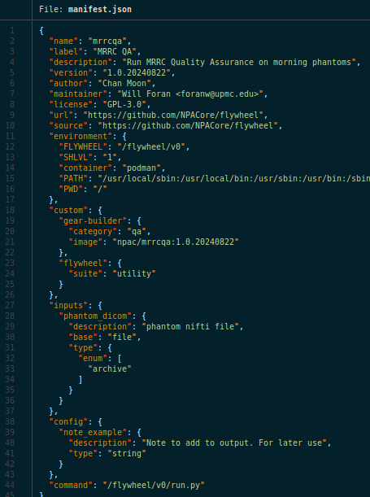
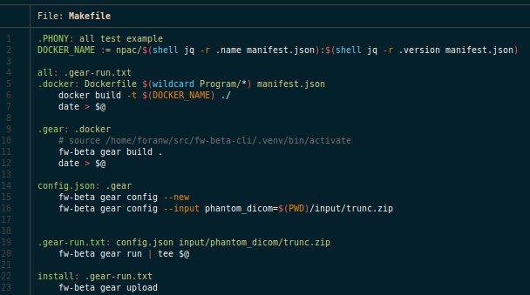
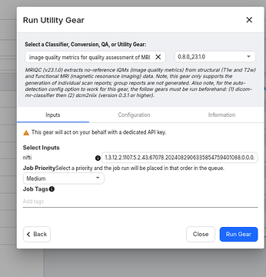
Flywheel
https://gitlab.com/flywheel-io/scientific-solutions/tutorials/Gear-Building-Tutorial/-/tree/hello-world

Slide 8
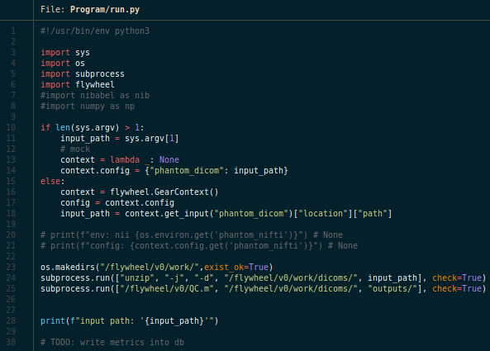
Flywheel

Slide 9
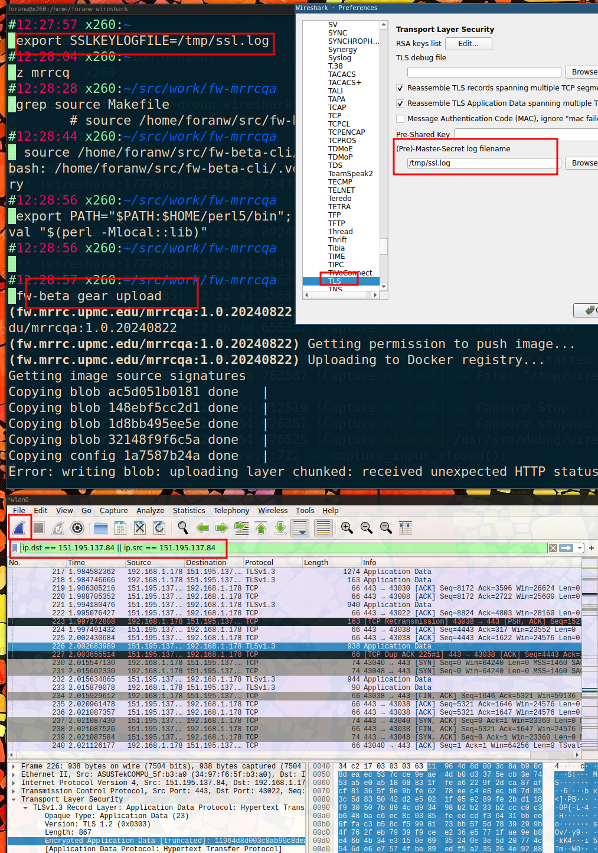
Wireshark
F5 enterprise middleware firewall
ASM previously blocking requests
Now have API WAF profile
Still problems.
SSL decrypt of docker push to debug?

Slide 10
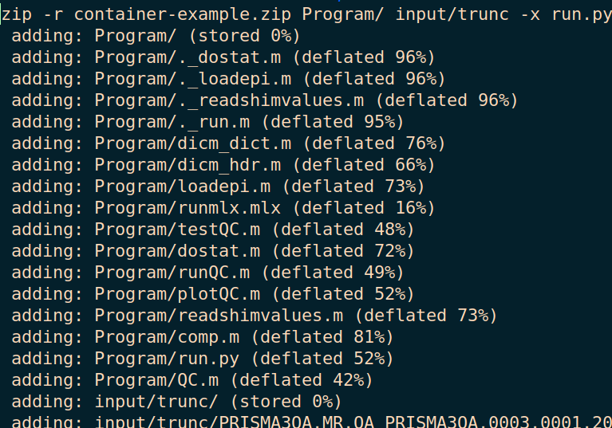
DIY
https://gitlab.com/flywheel-io/scientific-solutions/tutorials/Gear-Building-Tutorial/-/tree/hello-world
TODO:
Pitt accounts to flywheel
Zues
Wiki
CRC

