Slide 1
QA Prisma 3T
Chan Hong Moon, Don Hyuk Kim
MRRC, UPMC
@2024-08-09

Slide 2
Experiments
Sequence
Localizer
EPI_P2_S2_2mm_5min
Experiment1
P1 phantom
Scan @P1, P2, P3
P1 64ch coil
Experiment2
Each scanner phantom & coil

Slide 3
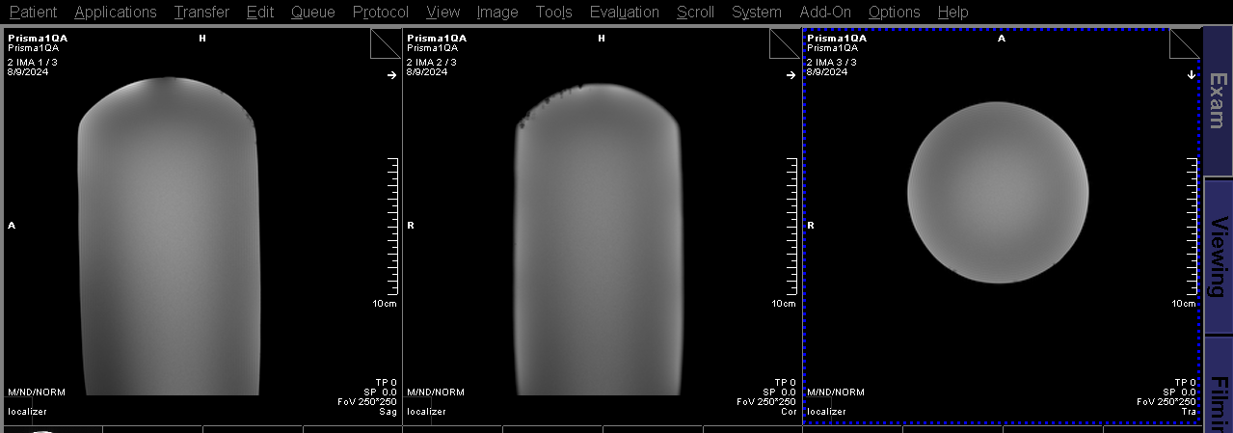
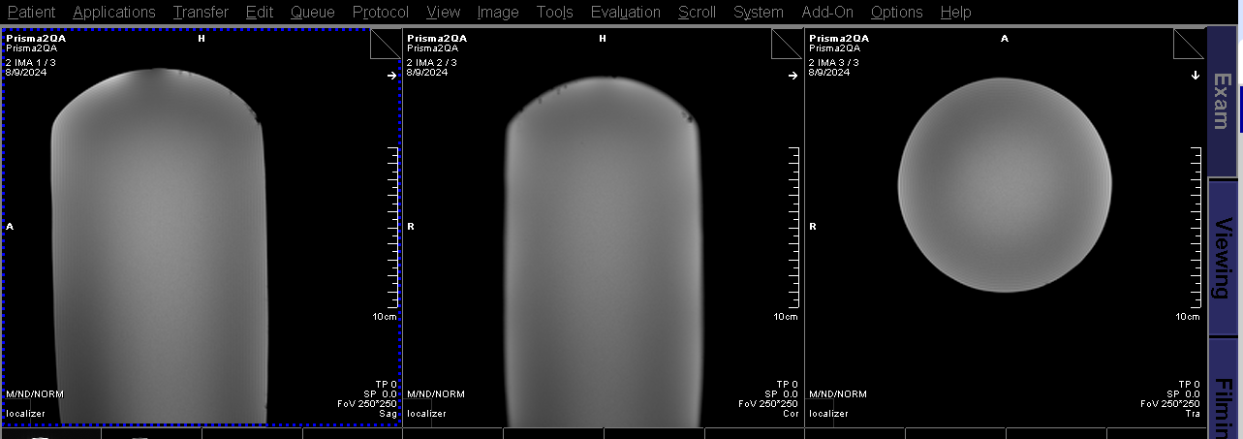
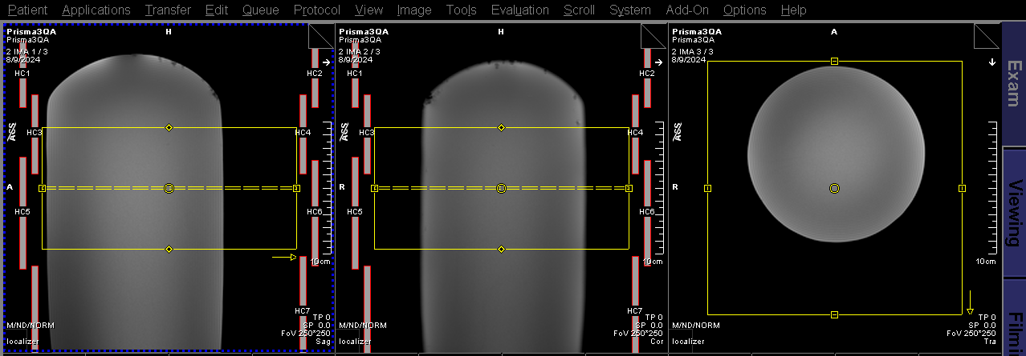
Exp1: phantom positioning

Slide 4
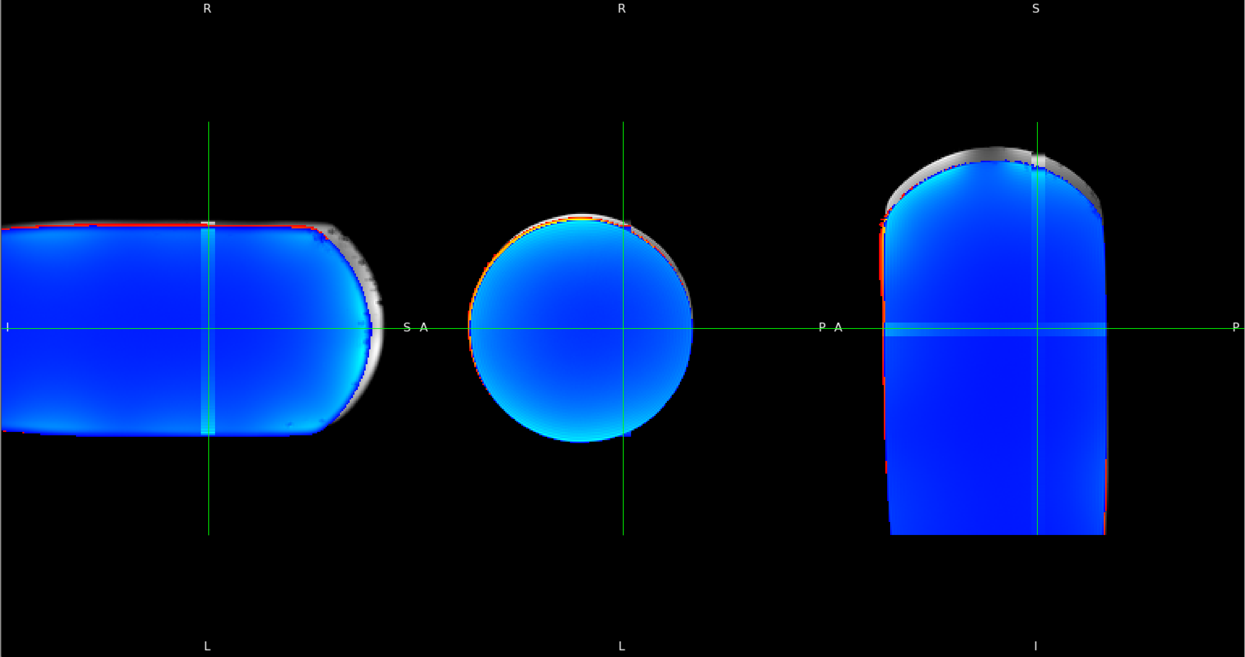
Exp1: Phantom positioning
Gray/yellow/blue = P1/P2/P3

Slide 6
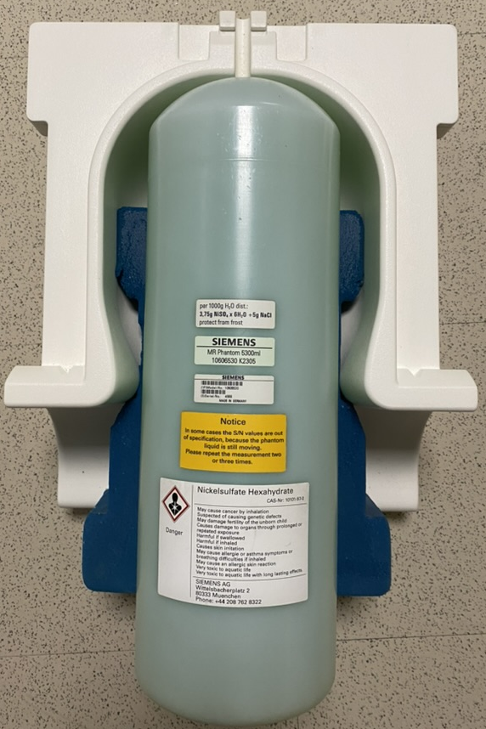
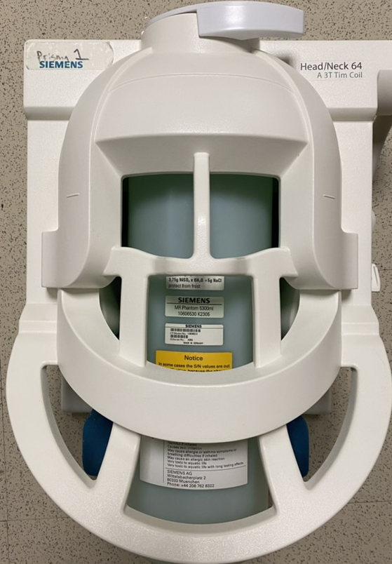
STEP 1
STEP 2
STEP 1
0. 64ch H/N coil
1. Siemens bullet phantom
2. Open coil upper cap
3. Touch phantom vertex to coil
4. Laser marker
5. Parallel align phant & laser
6. Adjust base formpad for alignment
STEP 2
7. Close the coil cap
8. Laser marker at coil horiz center
9. Coil axis & laser MAY NOY centered
10. Off laser marker
11. Set table to magnet center
3
9
8
6
3
5

