Slide 1
Read and Write Data
Working with data: text formats

Slide 2
ASCII or text file formats
Advantages of working with text formats:
They are usually human-readable.
They tend to be simple structures.
It is relatively easy to write code to interpret them.
Disadvantages include:
Inefficient storage for big data volumes.
Most people invent their own format so there is a lack of standardisation.

Slide 3
Using python to read text formats
As we have seen Python has a great toolkit for reading files and working with strings.
In this example we use a file that we found on the web, and then adapt some code to read it into a useful, re-usable form.

Slide 4
Our example file
We found a suitable data set on the web:
https://www.metoffice.gov.uk/climate/uk/summaries/datasets
Met Office monthly weather statistics for the UK since 1910.

Slide 5
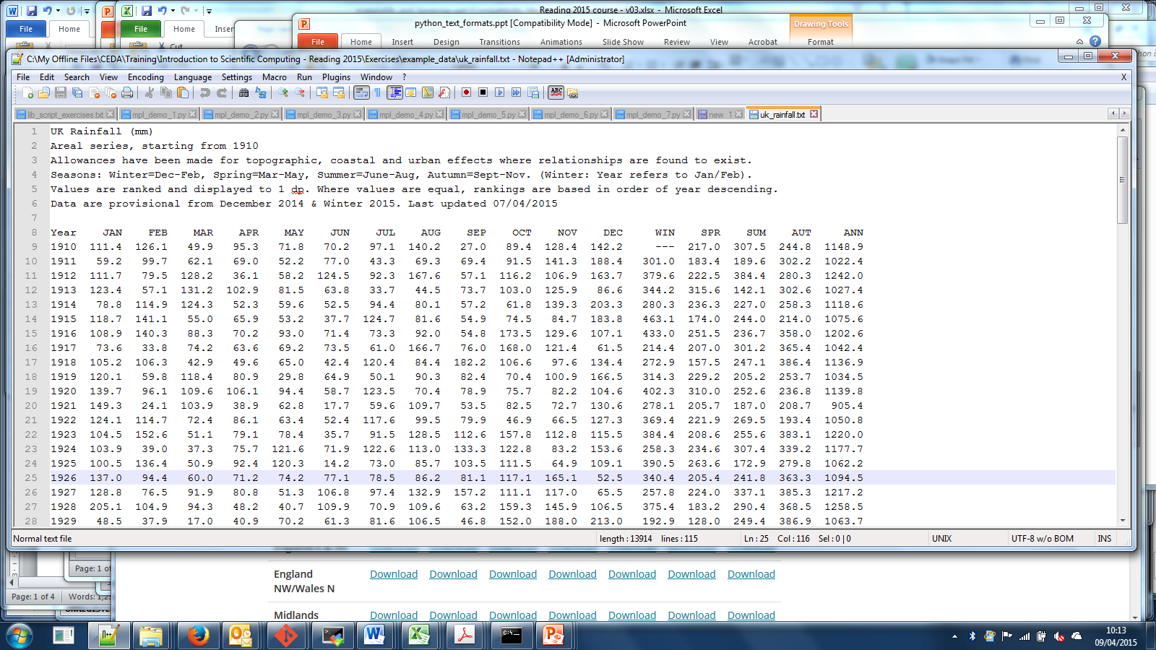
Header
Lines numbers (for reference only)

Slide 6
Data (first 9 columns)

Slide 7
Data (last 8 columns)

Slide 8
Look! A missing value!

Slide 9
Let's write some code to read it
We'll need:
To read the header and data separately
To think about the data structure (so it is easy to retrieve the data in a useful manner).
Let's put into practice what we have learnt:
Use NumPy to store the arrays
But we'll need to test for missing values and use Masked Array (numpy.ma)

Slide 10
Example code (and data)
Please refer to the example code:
example_code/test_read_rainfall.py
And data file:
example_data/uk_rainfall.txt

Slide 11
Reading the header
UK Rainfall (mm)
Areal series, starting from 1910
Allowances have been made for topographic, coastal and urban effects where relationships are found to exist.
Seasons: Winter=Dec-Feb, Spring=Mar-May, Summer=June-Aug, Autumn=Sept-Nov. (Winter: Year refers to Jan/Feb).
Values are ranked and displayed to 1 dp. Where values are equal, rankings are based in order of year descending.
Data are provisional from December 2014 & Winter 2015. Last updated 07/04/2015

Slide 12
Reading the header
UK Rainfall (mm)
Areal series, starting from 1910
Allowances have been made for topographic, coastal and urban effects where relationships are found to exist.
Seasons: Winter=Dec-Feb, Spring=Mar-May, Summer=June-Aug, Autumn=Sept-Nov. (Winter: Year refers to Jan/Feb).
Values are ranked and displayed to 1 dp. Where values are equal, rankings are based in order of year descending.
Data are provisional from December 2014 & Winter 2015. Last updated 07/04/2015
Line 1 is important information.
Other lines are useful information.
Let's capture the metadata in:
- location: UK
- variable: Rainfall
- units: mm

Slide 13
Reading the header
def readHeader(fname):
# Open the file and read the relevant lines
with open(fname) as f:
head = f.readlines()[:6]
# Get important stuff
location, variable, units = head[0].split()
units = units.replace("(", "").replace(")", "")
# Put others lines in comments
comments = head[1:6]
return (location, variable, units, comments)

Slide 14
Test the reader
>>> (location, variable, units, comments) = \
readHeader("../example_data/uk_rainfall.txt")
>>> print(location, variable, units)
UK Rainfall mm
>>> print(comments[1])
Allowances have been made for topographic, coastal and urban effects where relationships are found to exist.

Slide 15
Write a function to handle missing data properly
import numpy.ma as MA
def checkValue(value):
# Check if value should be a float
# or flagged as missing
if value == "---":
value = MA.masked
else:
value = float(value)
return value

Slide 16
Reading the data (part 1)
import numpy.ma as MA
def readData(fname):
# Open file and read column names and data block
with open(fname) as f:
# Ignore header
for i in range(7):
f.readline()
col_names = f.readline().split()
data_block = f.readlines()
# Create a data dictionary, containing
# a list of values for each variable
data = {}

Slide 17
Data (first 9 columns)

Slide 18
Reading the data (part 2)
# Add an entry to the dictionary for each column
for col_name in col_names:
data[col_name] = MA.zeros(len(data_block), 'f', fill_value = -999.999)

Slide 19
Reading the data (part 3)
# Loop through each value: append to each column
for (line_count, line) in enumerate(data_block):
items = line.split()
for (col_count, col_name) in enumerate(col_names):
value = items[col_count]
data[col_name][line_count] = checkValue(value)
return data

Slide 20
Testing the code
>>> data = readData("../example_data/uk_rainfall.txt")
>>> print(data["Year"])
[ 1910. 1911. 1912. ...
>>> print(data["JAN"])
[ 111.40000153 59.20000076 111.69999695 ...
>>> winter = data["WIN"]
>>> print(MA.is_masked(winter[0]))
True
>>> print(MA.is_masked(winter[1]))
False

Slide 21
Look! A missing value!

Slide 22
What about CSV or tab-delimited?
The above example will work exactly the same with a tab-delimited file (because the string split method splits on white space) .
If the file used commas (CSV) to separate columns then you could use:
line.split(",")

Slide 23
Or try the Python "csv" module
There is a python "csv" module that is able to read text files with various delimiters. E.g.:
>>> import csv
>>> r = csv.reader(open("../example_data/ uk_rainfall.txt "))
>>> for row in r:
... print(row)
['Date', 'Time', 'Temp', 'Rainfall']
['2014-01-01', '00:00', '2.34', '4.45']
['2014-01-01', '12:00', '6.70', '8.34']
['2014-01-02', '00:00', '-1.34', '10.25']
See: https://docs.python.org/3.7/library/csv.html

Slide 24
But really, use “pandas” instead!
# Read the first 6 lines with the old ways...
fpath = "example_data/uk_rainfall.txt"
metadata = [line.strip() for line in
open(fpath).readlines()[:6]]
for item in metadata:
print("Item:", item)

Slide 25

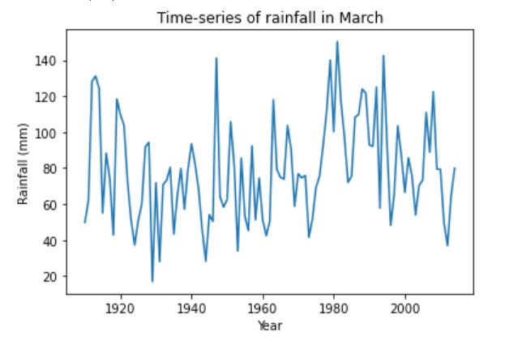
But really, use “pandas” instead!
import pandas as pd
df = pd.read_csv(fpath, skiprows=6, sep="\s+", index_col=0, na_values="---")
# DataFrames have loads of methods
df.columns.tolist()
df.index.name
df.describe()
df.info()
df.loc[1918, "WIN"]
df.MAR.plot(title="Time-series of rainfall in March",
ylabel="Rainfall (mm)")
https://pandas.pydata.org/pandas-docs/stable/reference/api/pandas.read_csv.html

