Slide 1
Introduction to Git and GitHub
Managing your code: introducing Git - a friend for life
Thanks to all contributors:
Alison Pamment, Sam Pepler, Ag Stephens, Stephen Pascoe, Kevin Marsh, Anabelle Guillory, Graham Parton, Esther Conway, Eduardo Damasio Da Costa, Wendy Garland, Alan Iwi, Matt Pritchard and Tommy Godfrey.

Slide 2
Contents
What is version control?
What are Git & GitHub?
Nice features of GitHub
What you need to know - the basic workflow

Slide 3
Foreword
Git is easy to use but will take a bit of practice to get comfortable with. With that in mind:
You only need to understand the basics
Use the Cheatsheet: https://education.github.com/git-cheat-sheet-education.pdf
The exercise following this presentation will get you set up to use Git and GitGub
(We will encourage you to commit your work at then end of every exercise)
Give it a try – you’ll learn by doing

Slide 4
What is a version control system (VCS)?
Version control software keeps track of your changes
Allows you to revert back to a previous points in history
Uses freeze points which won’t change
Can manage contributions from multiple people
Stores the full history of the things under version control including who did what, when?

Slide 5
Why might you need VCS?
Scientists are typically required to publish data and code (by their funders/institutions).
Collaboration between scientists requires data-sharing; this implicitly relies upon code-sharing.
There are tools that make it easy to record our changes, document our workflow and create “fixed” releases of our code at important steps along the way.
Reduce errors and admin burden ("latest", "new2"…)
Allows you test ideas with confidence, you can always go back.

Slide 6
Why use Git and GitHub?
There are a number of tools and web services that can do some, or all, of the tasks managed by Git/GitHub.
They are as good, if not better, than alternatives.
In your daily life as a scientist, we think that you will encounter these two tools most frequently.
If you learn how to use them, then the principles will be transferrable to other tools (if needed).

Slide 7
So, working on the premise that we accept that we need to know about, and use, version control…

Slide 8

We will use Git and GitHub
Notes:
There are lots of different version control systems. We recommend using Git as the tool, and that you use GitHub as the free on-line service to manage your repository.

Slide 9

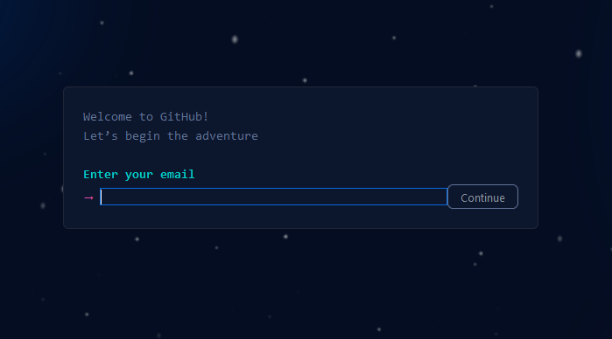
Introducing GitHub
https://github.com/

Slide 10

What is GitHub?
“A web-based Git repository hosting service”
GitHub allows you to:
Share your repositories with others
Access other users’ repositories
Store remote copies as a backup of your local repositories
Add bug tracking, feature requests, wikis, ...
GitHub is free for most use cases

Slide 11
Git vs GitHub
Git is a revision control system, a tool to manage your source code history.
GitHub is a hosting service for Git repositories.
They are not the same thing. Git is the tool, GitHub is a web service.
You do not need GitHub to use Git, but GitHub adds useful functionality.

Slide 12
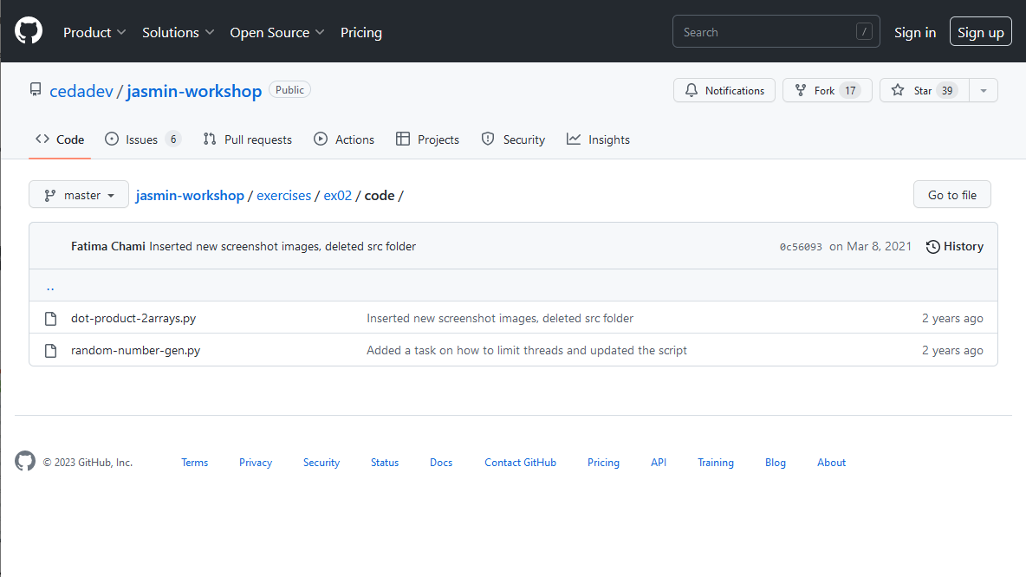
GitHub: repositories (public or private)
https://github.com/cedadev/jasmin-workshop
https:// github.com / <namespace> / <repository>
Notes:
You can create public or private code (and small data) repositories. A full version of your code is stored on the GitHub servers and can be shared with anyone you like.

Slide 13
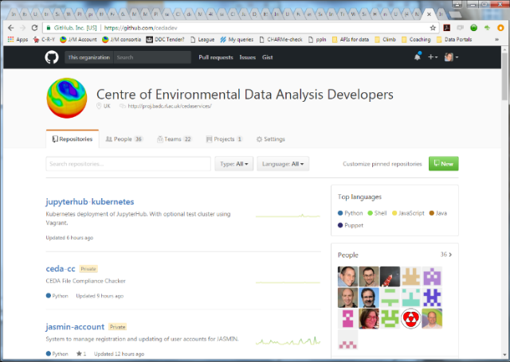
GitHub: organisations
https://github.com/cedadev
https:// github.com / <namespace>
Notes:
You can create organisations that group together a set of collaborators that work on projects collectively.

Slide 14
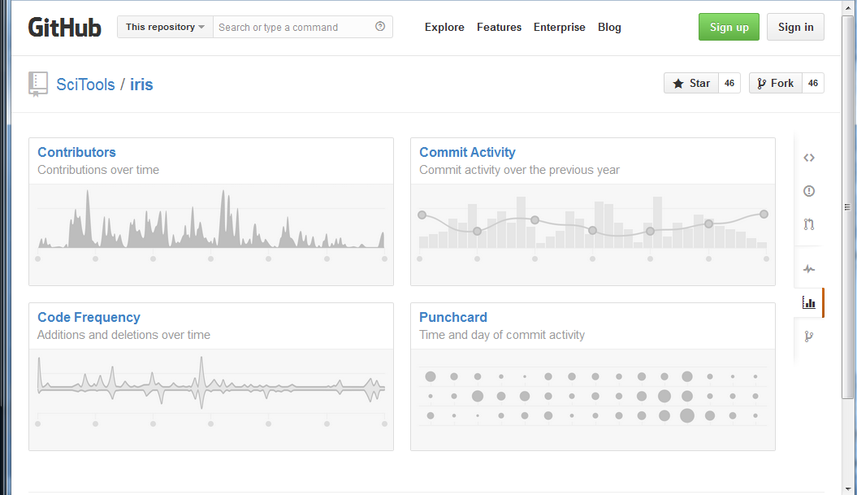
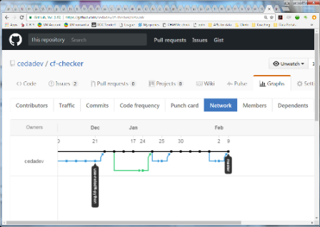
GitHub: collaboration (branch/fork)
Notes:
Multiple people can easily collaborate on code with tried-and-testing tools for branching and merging work in different strands.

Slide 15
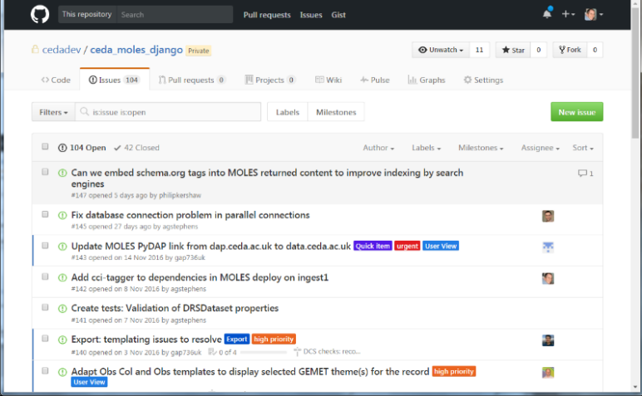
GitHub: Issue tracking
Notes:
You can manage all you bugs, problems and improvement plans as GitHub Issues - label them and even assign them to others in your team.

Slide 16
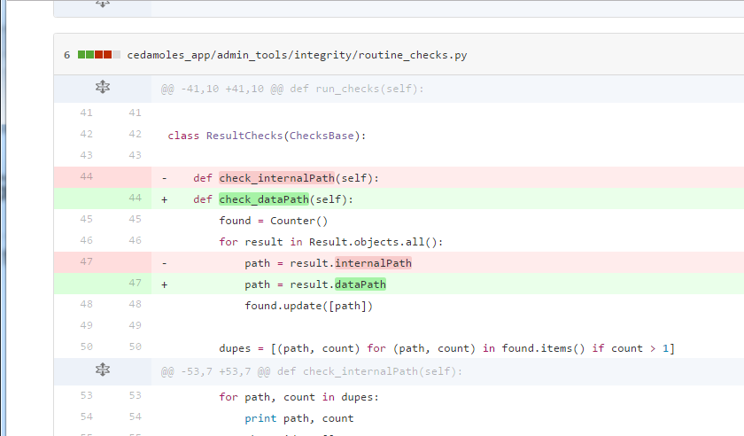
GitHub: history and change
Notes:
All changes made to the repository are stored in the history. At any point you can revert back (or across to other branches). Here we see an annotated difference between two versions in the history of the code. You can do this for individual files or the entire repository.

Slide 17
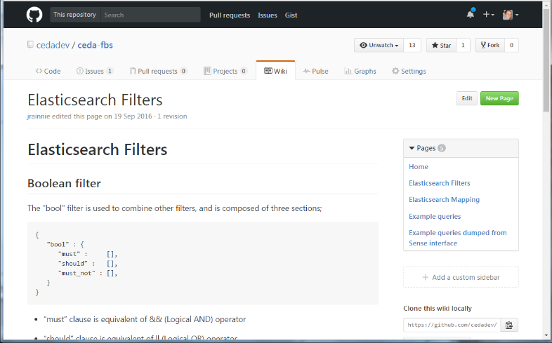
GitHub: wikis
Notes:
And you can document your code on the free wiki built in to each GitHub repo. And there are hundreds of other features and integrations with other tools that make code management easier.

Slide 18
GitHub does lots of funky things, but…
To start with, we want to learn how to use it as a remote repository.
We are going to concentrate on simply using Git.

Slide 19
Where to start?
There are three different start points when using Git:
1. Clone an existing repository from GitHub
2. Create a new, empty repo and clone it from GitHub
3. Turn an existing local directory into a Git repo; it can contain files or be empty
Most common

Slide 20
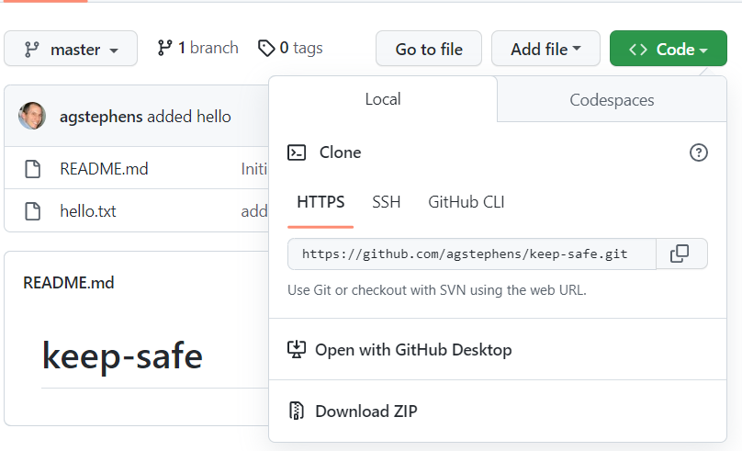
Option 1: Clone Existing Repo
This makes a copy of a repository locally.
$ git clone https://github.com/agstephens/keep-safe

Slide 21
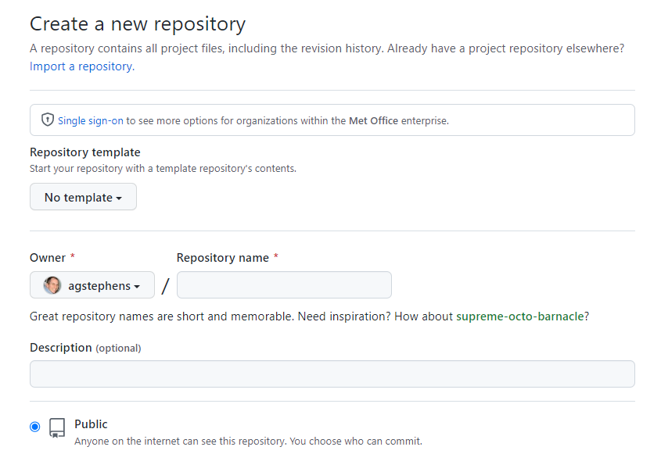
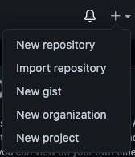
Option 2: Create a repository on GitHub
Click "+" in top right
You can then clone in the same way as “Option 1"
Click "New repository"

Slide 22
Option 3: repository from an existing local directory
$ ls
x y z
$ git init
Initialized empty Git repository in: /users/someone/test-package/.git/
$ git add .
$ git commit –m 'Initial commit from existing files'
[master (root-commit) 71ecfcf] Initial commit from existing files
3 files changed, 0 insertions(+), 0 deletions(-)
create mode 100644 x
create mode 100644 y
create mode 100644 z

Slide 23
The basic workflow: Adding a file
1. Enter the repository directory:
$ cd keep-safe/
2. Create a new file:
$ echo "hello world" > hello.txt
3. Tell Git about the file:
$ git add hello.txt
4. Commit the file to the local Git repository:
$ git commit -m "added hello"
5. Push any updates to the remote GitHub repo:
$ $ git push
ADD
COMMIT
PUSH

Slide 24
So, what just happened?
GitHub Local
We cloned the remote repository to our file system (using Option 1).
Now there are two identical copies of one repo.
Clone (& pull)
We created a new text file.
Change
We added and committed that new file to the local version of the repo.
Add/ Commit
We used push to update the remote repo.
Push

Slide 25
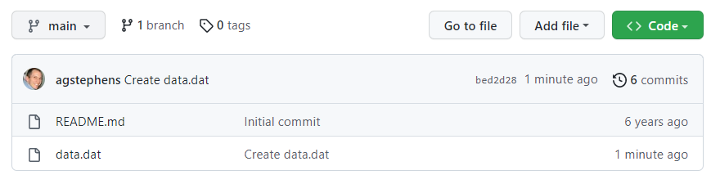
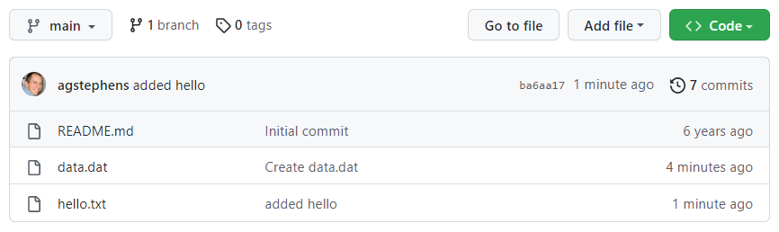
Let's look on GitHub
Before…
After…
New!

Slide 26
Learn by using
This stuff is hard to learn - we know that from experience.
A presentation is quickly forgotten.
So, we propose that you use Git/GitHub every day.
We encourage you to create and update your own GitHub repository with files from exercises throughout our courses, and in your daily work!

