Slide 1
PPL Insight Hub

Slide 2
PPL Insight Hub - UAT Overview
Overview
PPL Insight Hub is a fantasy football operations platform that helps leagues draft smarter, manage teams, and run season workflows in one place.
WHAT THE SITE IS
CURRENT DEVELOPMENT PROGRESS
The platform combines league management, draft support, AI guidance, roster operations, and commissioner controls. It is designed as a single destination for both weekly management and season-long planning.
Core user journeys are implemented and under UAT: login, home, roster flows, waivers, analytics, and commissioner settings. Current focus is usability validation, defect triage, and release-readiness hardening.
TIMELINE FOR IMPLEMENTATION
BENEFIT TO USERS
Phase 1 (Current): UAT execution on priority P0 and P1 workflows.
Phase 2 (Next): Address critical defects, stabilize integrations, and re-test blocked scenarios.
Phase 3 (Release): Final acceptance sign-off, production checklist, and rollout communication.
Saves time by centralizing fantasy workflows in one platform.
Improves decision quality with analytics and guided recommendations.
Creates a clearer, more consistent league experience for managers and commissioners.

Slide 3
PPL Insight Hub - UAT Overview
Page Directory
This directory gives users a quick map of each major page and the core reason to use it.
Page / Area | High-Level Context | Primary Users
Login | Sign in securely and access the right league context. | All users
Home | See standings, headlines, and shortcuts to common actions. | All users
War Room | Run the live auction draft experience in real time. | Managers + Commissioner
Chat Advisor | Ask league questions and get plain-language guidance. | All users
My Team | Set lineups, review roster health, and manage weekly decisions. | Managers
Matchups / Game Center | Compare teams, track outcomes, and review matchup detail. | Managers
Waiver Wire | Submit claims and make roster pickup/drop moves. | Managers
Keepers | Review and submit keeper selections for future seasons. | Managers + Commissioner
Analytics / Playoff Bracket | View trends, projections, and postseason status. | All users
Commissioner Tools | Manage owners, rules, trades, and divisions. | Commissioner
Admin Settings | Handle platform-level maintenance and configuration. | Admin
Report a Bug + UAT Handoff | Capture defects with evidence and pass results to triage. | All testers

Slide 4
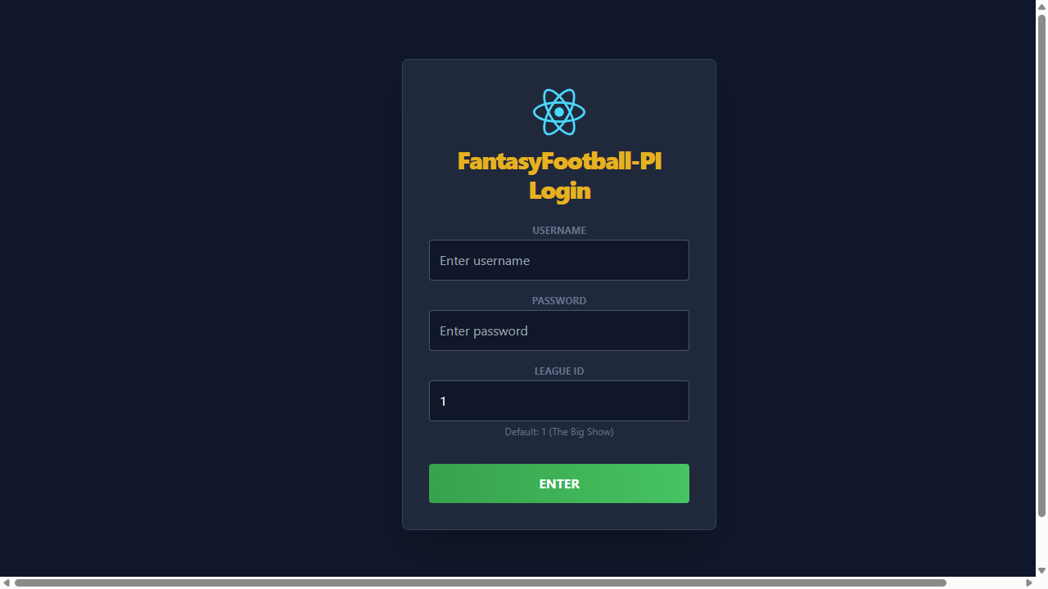
PPL Insight Hub - UAT Overview
Login Page
Login establishes authenticated access and league context for every workflow.
PURPOSE
Allow users to authenticate quickly and enter the app with the correct league selected.
CORE FUNCTIONALITY
User enters credentials and league details from a single entry screen.
Validation errors are clear and actionable before retry.
Successful sign-in routes directly into the authenticated app shell.

Slide 5
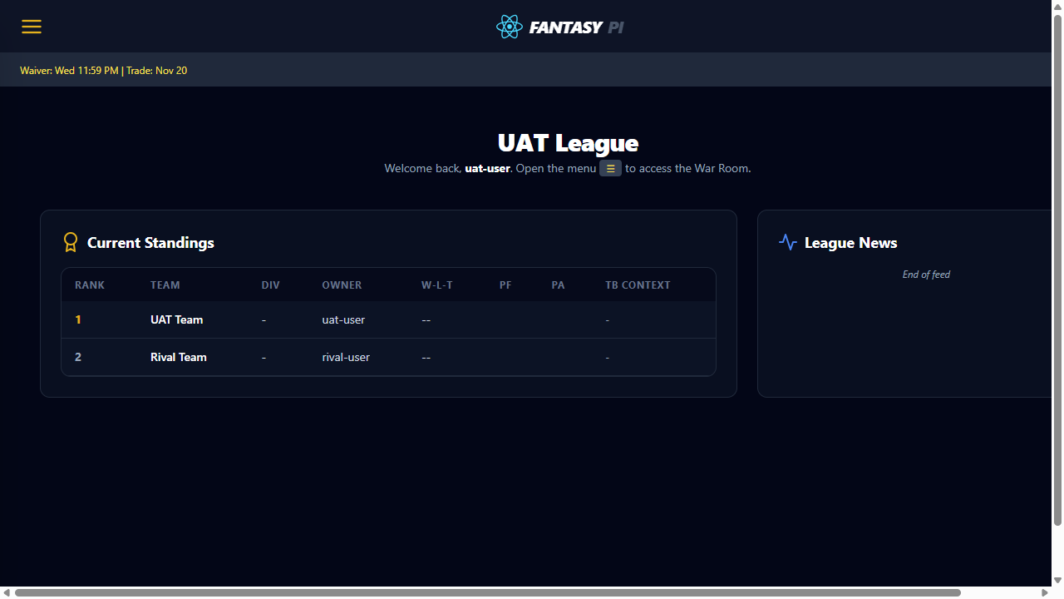
PPL Insight Hub - UAT Overview
Home Page
Home is the launch point for standings, status, and fast navigation to core tools.
PURPOSE
Give managers immediate league context and quick access to team and roster decisions.
CORE FUNCTIONALITY
Surface standing, activity, and key league state at a glance.
Provide clear navigation to roster, waivers, and commissioner workflows.
Keep summary content readable without requiring scrolling for first actions.

Slide 6
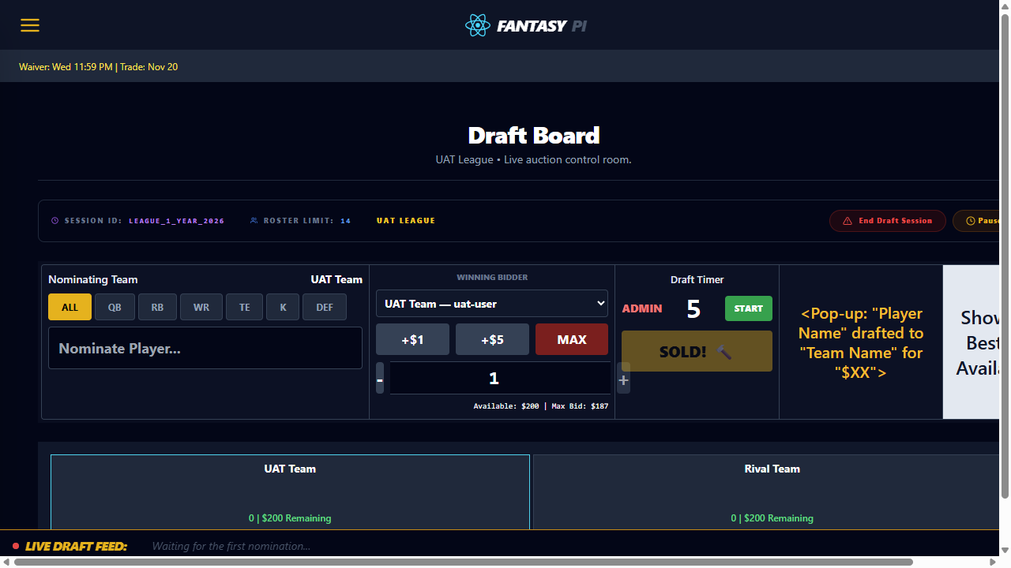
PPL Insight Hub - UAT Overview
War Room
War Room supports live draft execution with board state and nomination controls.
PURPOSE
Enable managers and commissioners to execute draft actions with full context.
CORE FUNCTIONALITY
Draft board shows picks, owners, and roster pressure in real time.
Nomination and bid flow keeps amounts and owner turns visible.
Best available panel augments pick quality during draft windows.

Slide 7
PPL Insight Hub - UAT Overview
Chat Advisor
Chat Advisor provides conversational guidance for lineup and roster choices.
PURPOSE
Help users ask natural-language questions and receive actionable football guidance.
CORE FUNCTIONALITY
Prompt entry and response pane remain readable during long exchanges.
Response format supports quick decisions before lineup lock.
Error and loading states are explicit when advisor data is unavailable.

Slide 8
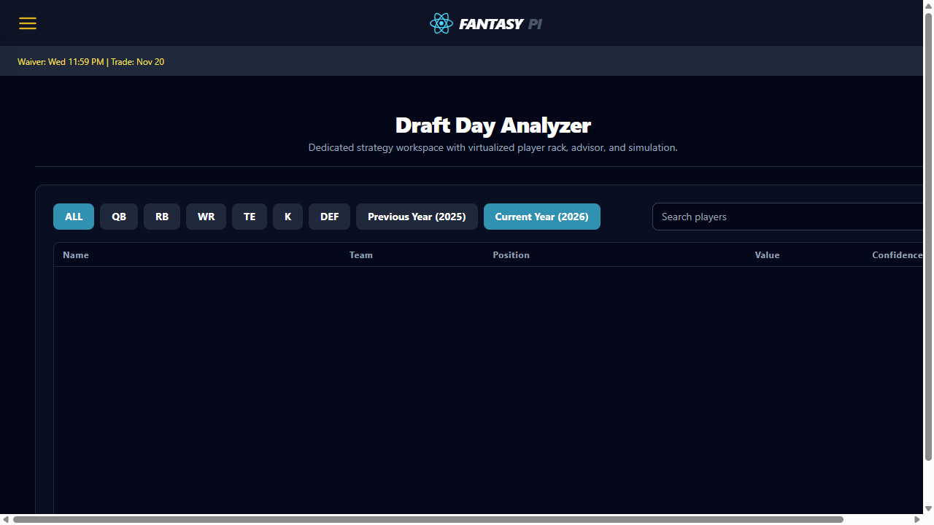
PPL Insight Hub - UAT Overview
Draft Day Analyzer
Draft Day Analyzer evaluates value and roster construction signals during draft.
PURPOSE
Identify high-value picks and positional risk before submitting bids or selections.
CORE FUNCTIONALITY
Show value indicators for candidate players by position.
Highlight roster balance and positional scarcity impact.
Support pick strategy without requiring manual spreadsheet analysis.

Slide 9
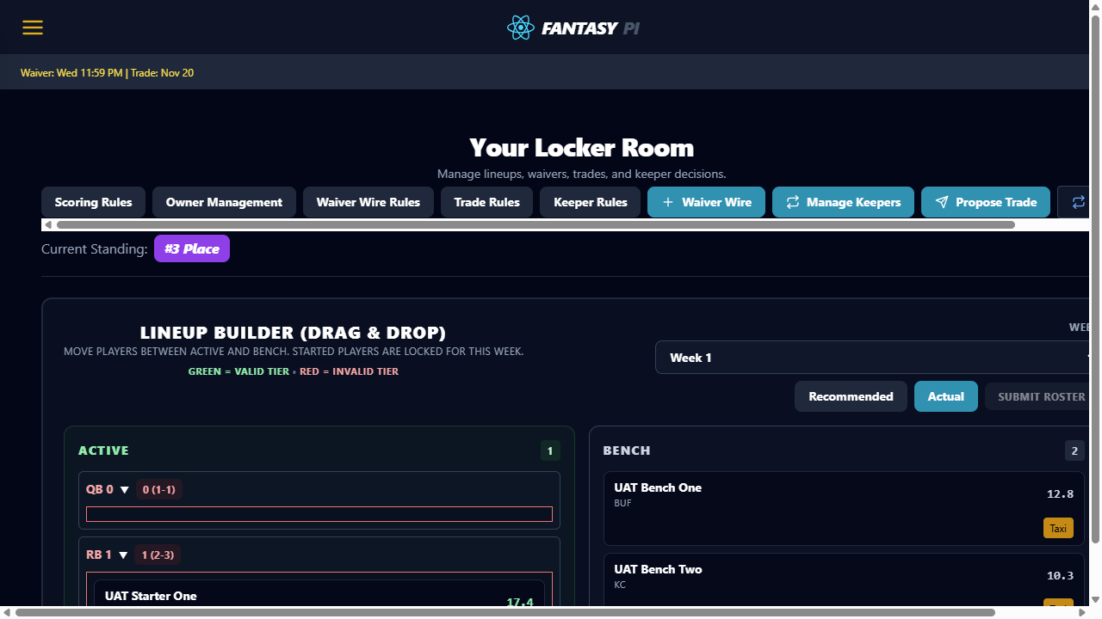
PPL Insight Hub - UAT Overview
My Team
My Team is the primary roster management surface for weekly lineup control.
PURPOSE
Let users review roster slots, submit legal lineups, and evaluate bench options.
CORE FUNCTIONALITY
Starter and bench groupings are clearly separated by role.
Lineup actions enforce league rules with clear validation feedback.
Trade and player detail actions are accessible from the roster cards.

Slide 10
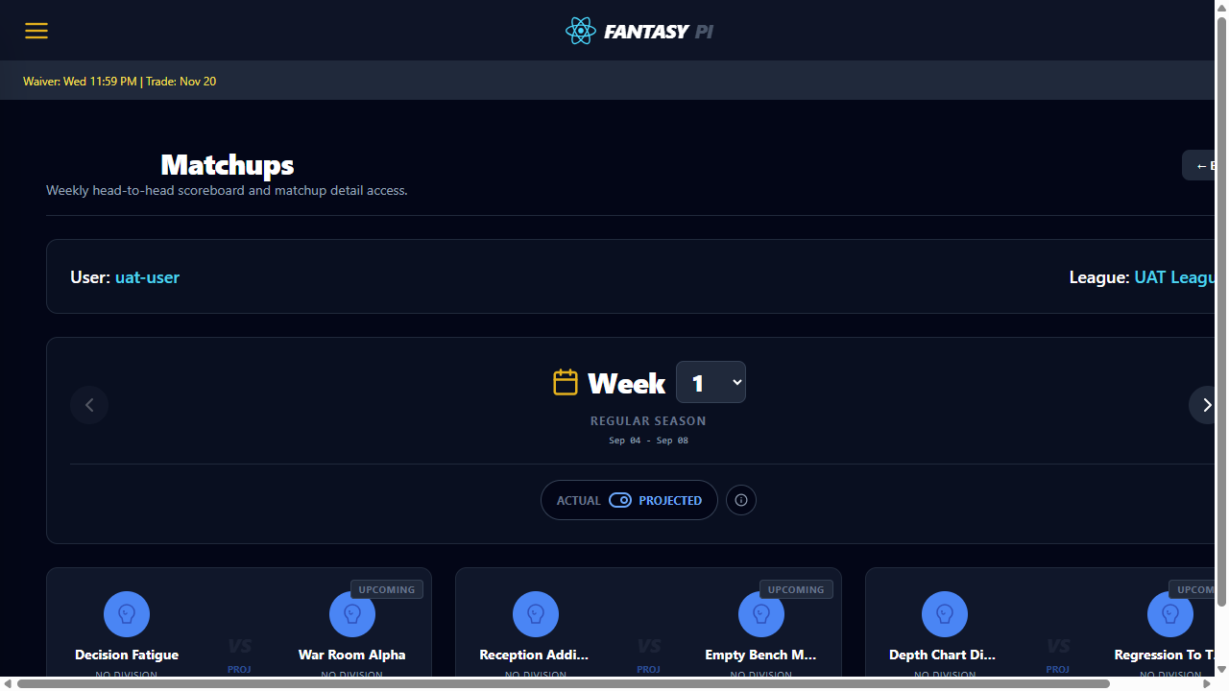
PPL Insight Hub - UAT Overview
Matchups
Matchups summarizes head-to-head outcomes and weekly scoreboard context.
PURPOSE
Allow users to compare teams quickly and navigate to game-level detail.
CORE FUNCTIONALITY
Weekly matchup cards are visible with team totals and status.
Navigation between matchup weeks is consistent and predictable.
Entry points to Game Center are obvious for deeper analysis.

Slide 11
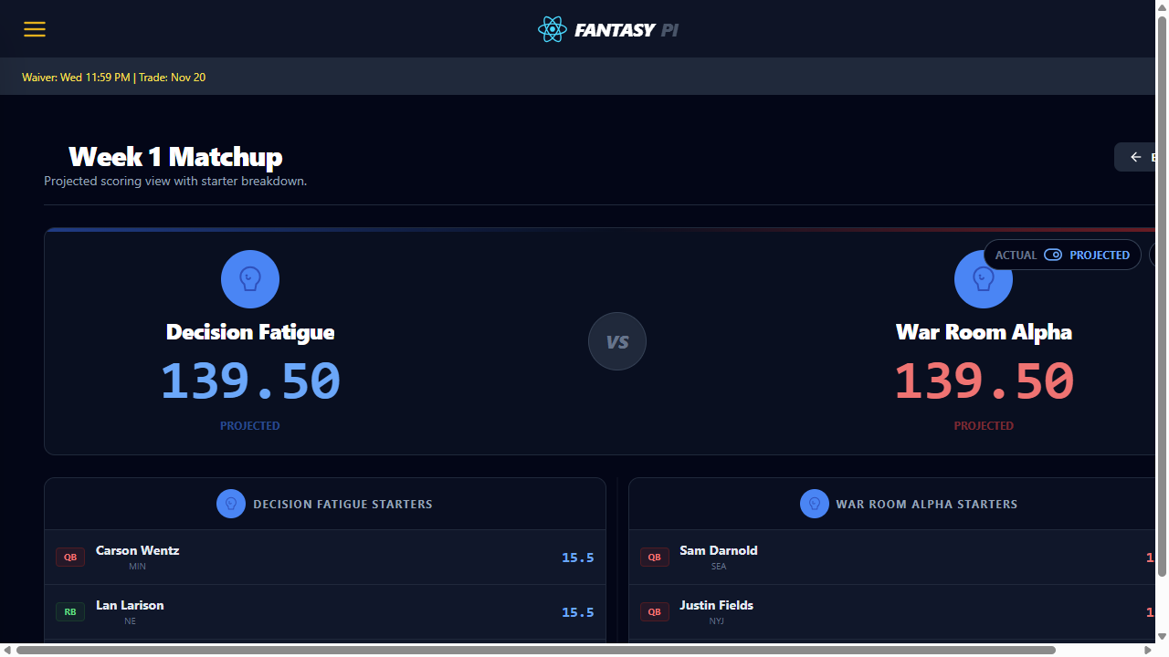
PPL Insight Hub - UAT Overview
Game Center
Game Center provides detailed scoring context for a single matchup.
PURPOSE
Help users understand where points are gained or lost across starters and bench.
CORE FUNCTIONALITY
Per-player scoring context is visible for both teams.
Remaining game and matchup trend information stays readable.
Comparative view supports start/sit and waiver decisions.

Slide 12

PPL Insight Hub - UAT Overview
Waiver Wire
Waiver Wire supports claim, drop, and priority-based player acquisition.
PURPOSE
Let managers add players safely while preserving waiver policy constraints.
CORE FUNCTIONALITY
Player pool is filterable and claim actions are clearly presented.
Claim confirmation protects users from accidental submissions.
Roster-full flow clearly transitions into drop-player selection.

Slide 13
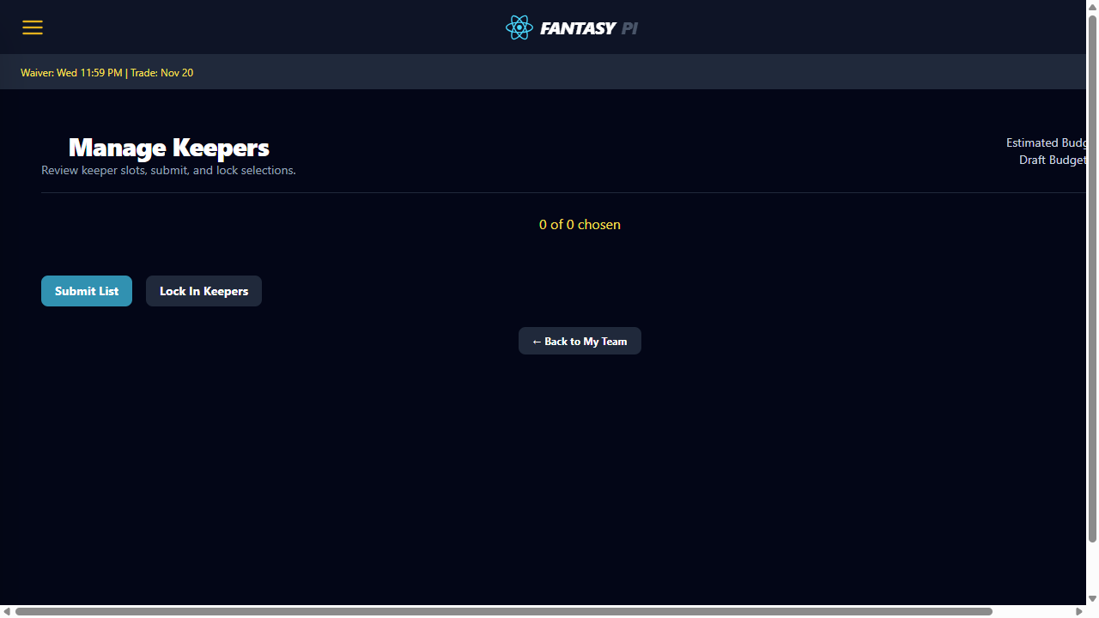
PPL Insight Hub - UAT Overview
Keepers
Keepers allows managers to select and lock eligible retained players.
PURPOSE
Support off-season retention with rule-aware selections and lock workflow.
CORE FUNCTIONALITY
Eligible players and keeper cost context are visible before submit.
Submit and lock actions are separated to prevent premature finalization.
Keeper status remains visible after save and refresh cycles.

Slide 14
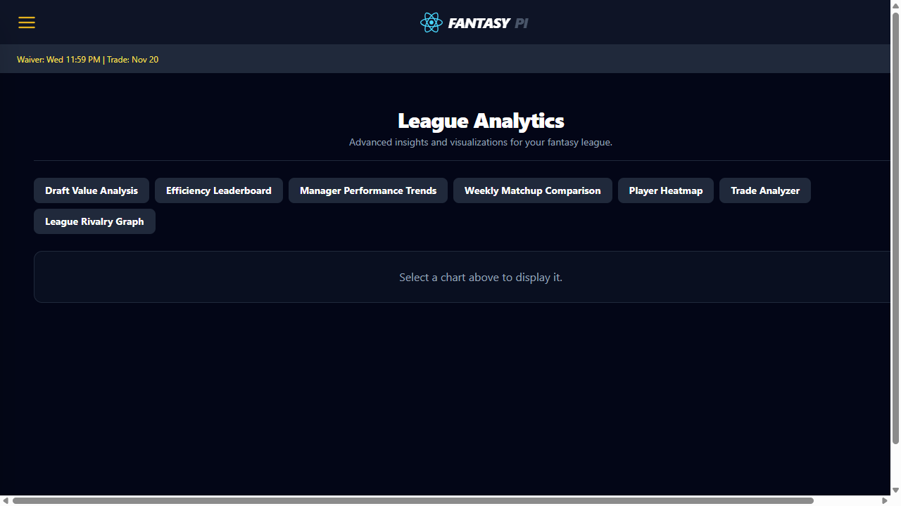
PPL Insight Hub - UAT Overview
Analytics
Analytics Dashboard is the chart navigation hub for league insight modules.
PURPOSE
Provide one-click access to trend, value, efficiency, and trade analysis tools.
CORE FUNCTIONALITY
Chart selector buttons expose each analytics module explicitly.
Selected chart panel renders within a consistent card surface.
Users can pivot between chart types without leaving the page.

Slide 15
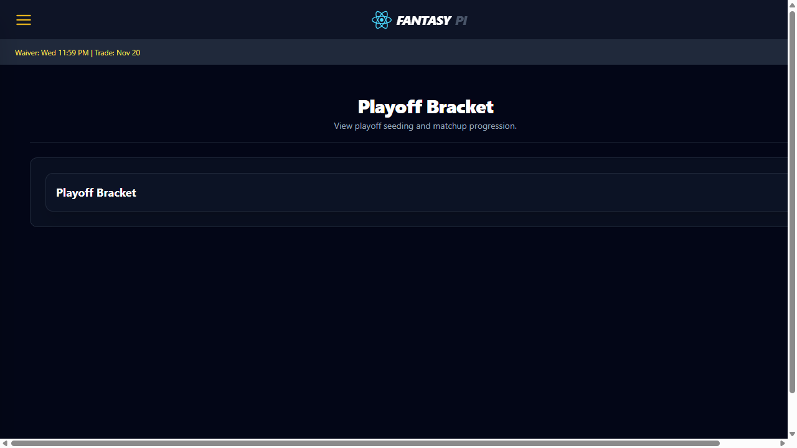
PPL Insight Hub - UAT Overview
Playoff Bracket
Playoff Bracket visualizes elimination paths and round progression.
PURPOSE
Enable users to verify playoff seeding and advancement paths at a glance.
CORE FUNCTIONALITY
Round and matchup progression is structurally easy to follow.
Team placement reflects latest playoff state from league data.
Bracket remains readable on standard desktop viewport captures.

Slide 16
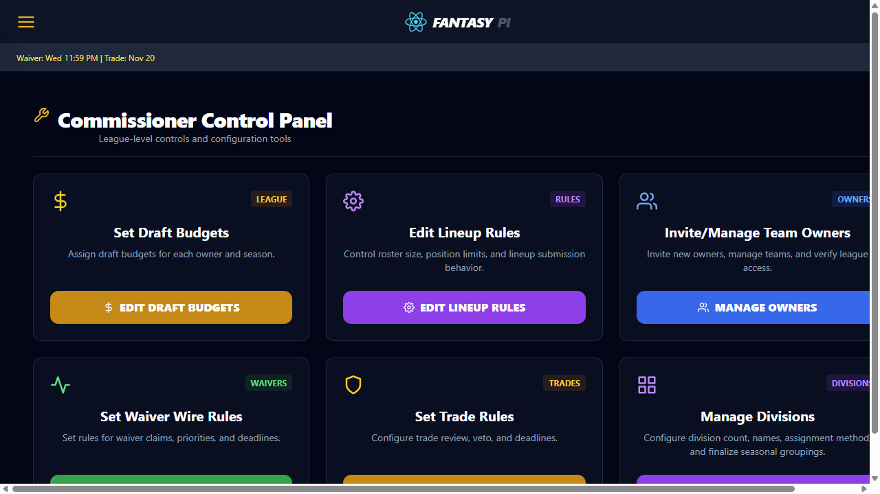
PPL Insight Hub - UAT Overview
Commissioner Dashboard
Commissioner Dashboard centralizes league governance and admin entry points.
PURPOSE
Give commissioners a single launch surface for all league configuration actions.
CORE FUNCTIONALITY
Control cards route to lineup, waiver, trade, and division management.
Commissioner-only access boundaries are visible and testable.
Primary edit actions are clearly labeled per governance area.

Slide 17
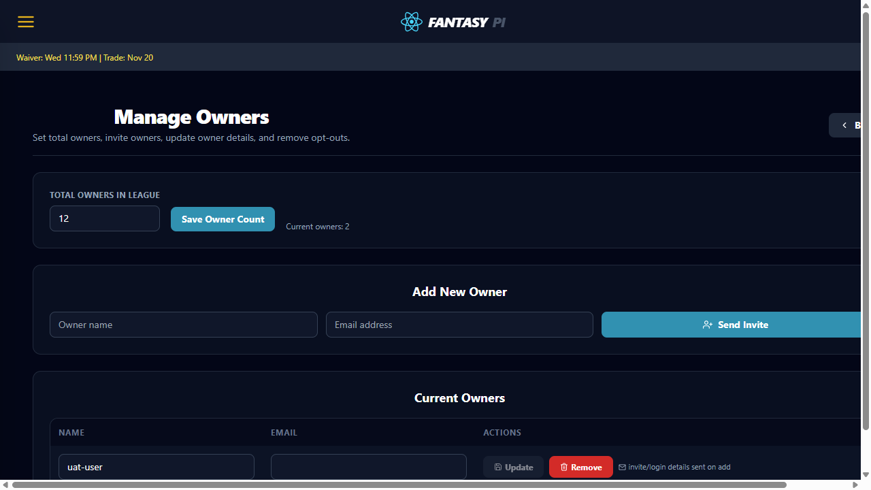
PPL Insight Hub - UAT Overview
Commissioner - Manage Owners
Manage Owners controls league member profile and team metadata.
PURPOSE
Allow commissioner updates to owner records with safe edit/save flow.
CORE FUNCTIONALITY
Owner rows are editable with clear validation boundaries.
Unsaved and saved states are distinct for change confidence.
Updated owner metadata persists and is visible after refresh.

Slide 18
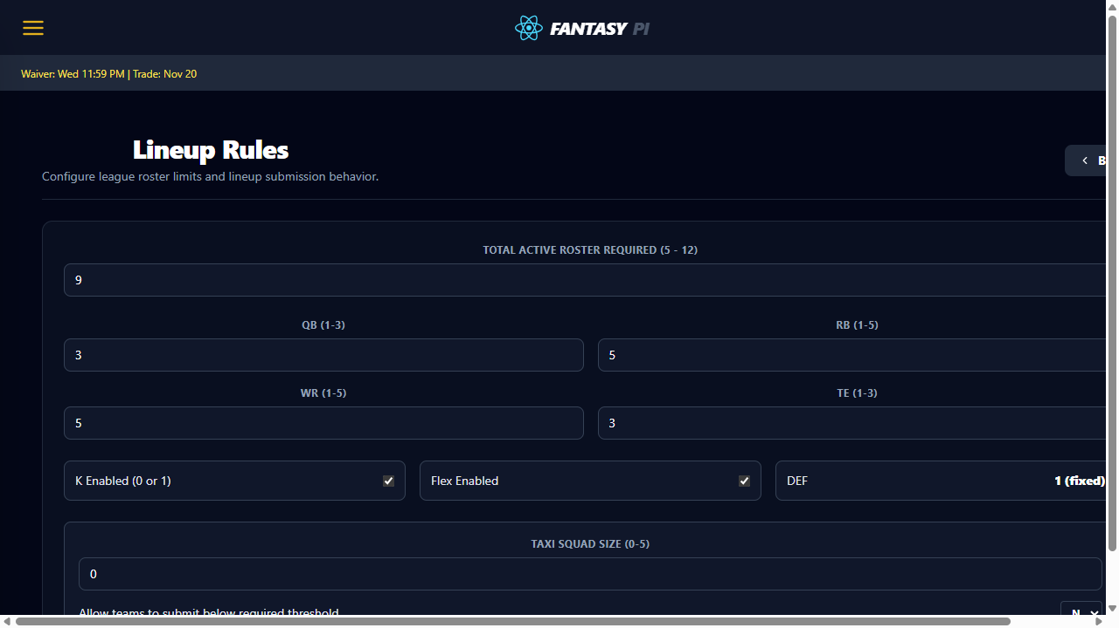

PPL Insight Hub - UAT Overview
Commissioner - Lineup Rules
Lineup Rules configures legal roster slot behavior for all teams.
PURPOSE
Define and enforce lineup constraints that downstream team pages must honor.
CORE FUNCTIONALITY
Rule controls are editable with explicit save action.
Lineup validation behavior maps to configured slot rules.
Rule changes are durable and visible after navigation.

Slide 19
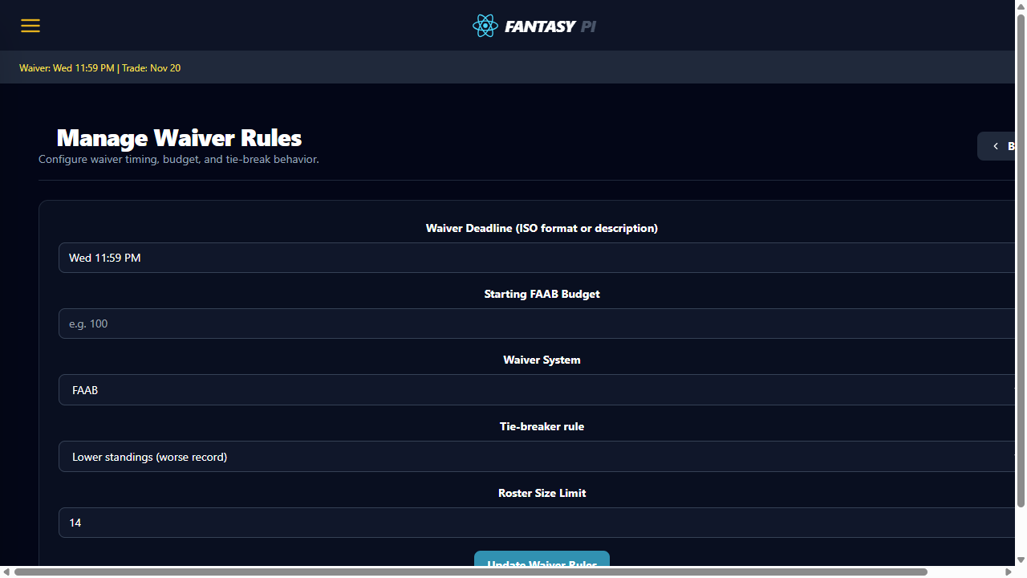
PPL Insight Hub - UAT Overview
Commissioner - Waiver Rules
Waiver Rules configures timing, priority, and claim policy behavior.
PURPOSE
Allow commissioners to update waiver policy that directly governs claim outcomes.
CORE FUNCTIONALITY
Current and editable waiver settings are shown together for review.
Update Waiver Rules action writes policy changes explicitly.
Saved settings persist and reflect on member-facing waiver flows.

Slide 20
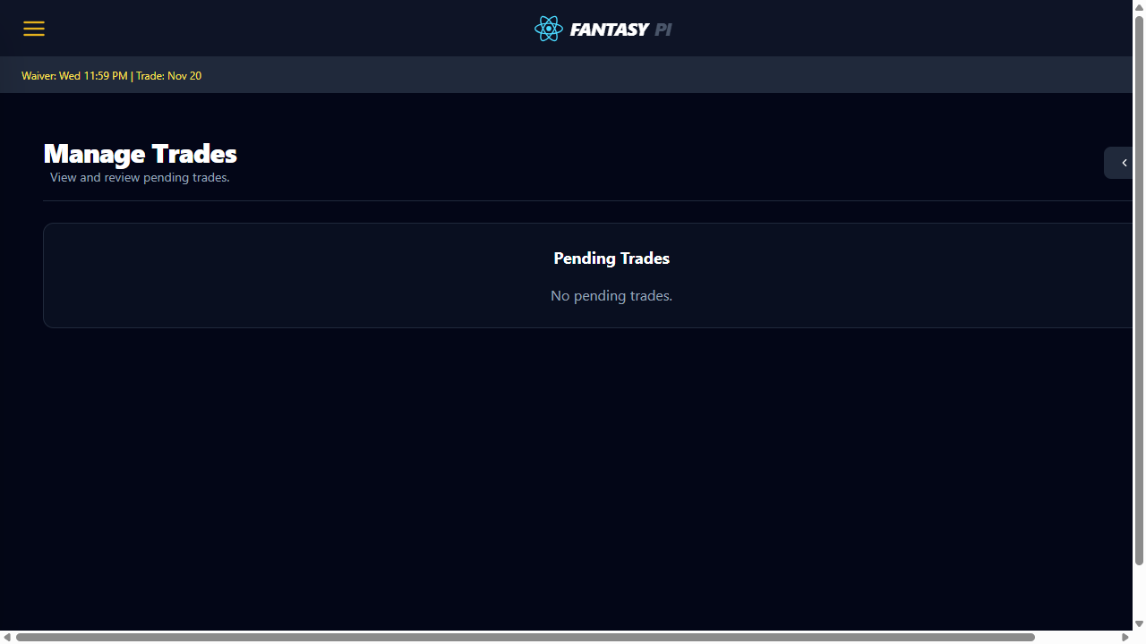
PPL Insight Hub - UAT Overview
Commissioner - Manage Trades
Manage Trades is the commissioner approval/rejection workflow for trade requests.
PURPOSE
Support auditable trade moderation with immediate status transitions.
CORE FUNCTIONALITY
Pending trades are visible with ownership context.
Approve/reject actions are explicit and actionable.
Trade status updates are durable after refresh.

Slide 21
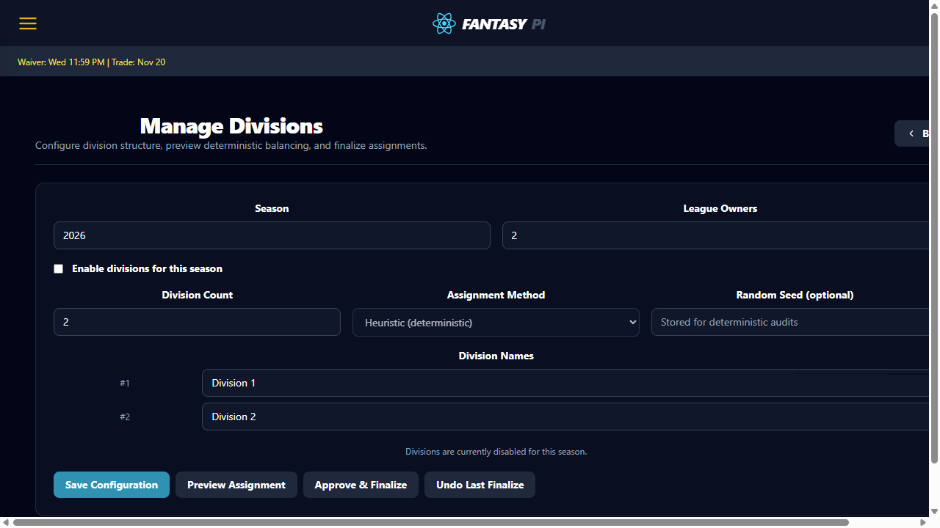
PPL Insight Hub - UAT Overview
Commissioner - Manage Divisions
Manage Divisions defines group structure used by standings and scheduling.
PURPOSE
Allow commissioner to edit division assignments without ambiguity.
CORE FUNCTIONALITY
Division assignment controls are visible and deterministic.
Save/confirm path protects against partial updates.
Division changes propagate into standings context.

Slide 22
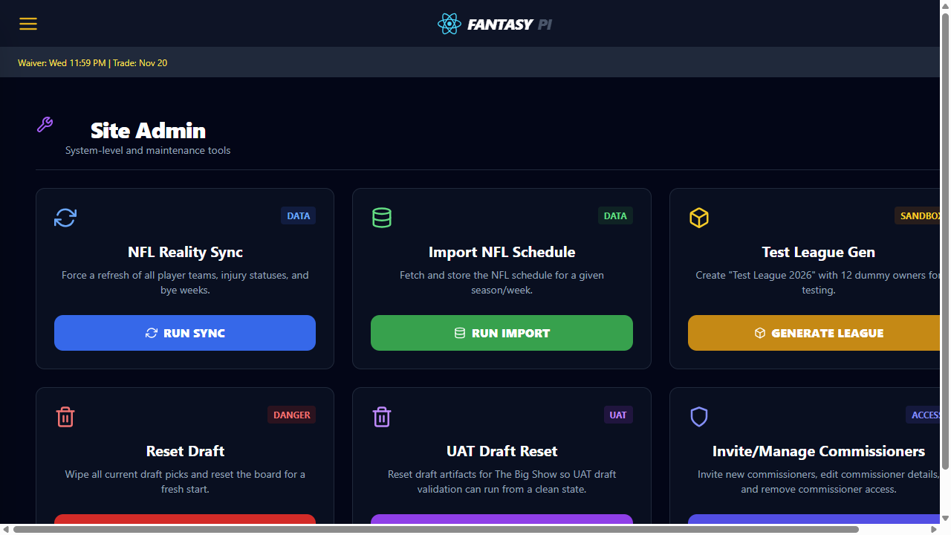
PPL Insight Hub - UAT Overview
Admin Settings
Admin Settings manages global controls beyond league-level permissions.
PURPOSE
Provide site administrators with role and platform-level control points.
CORE FUNCTIONALITY
Admin-only controls are isolated from standard user pages.
Role management actions include clear confirmation feedback.
Operational updates remain visible after refresh.

Slide 23
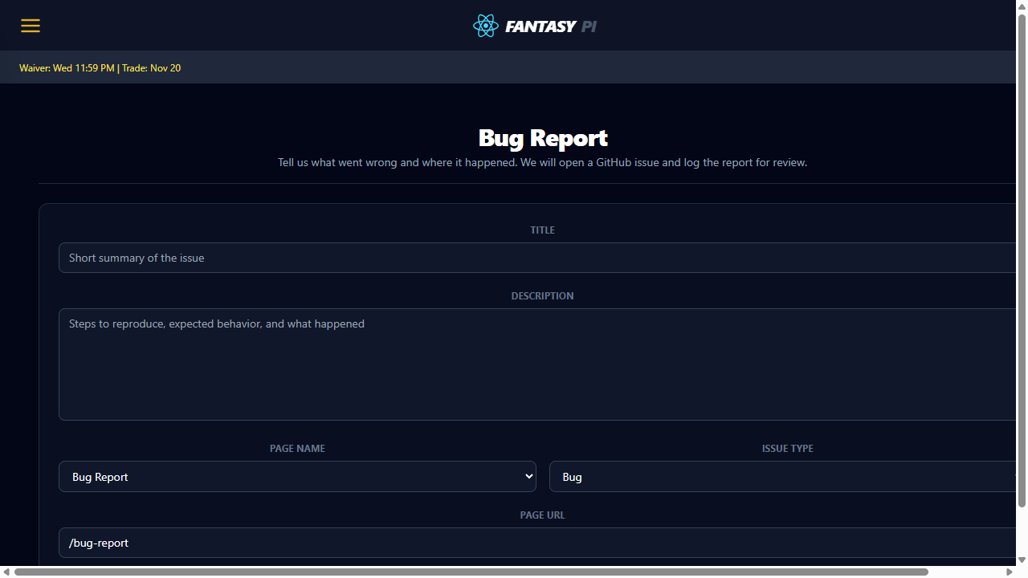
PPL Insight Hub - UAT Overview
Report a Bug + UAT Handoff
Bug report flow closes the loop between UAT findings and engineering action.
PURPOSE
Ensure tester evidence and defect details are captured before release decisions.
CORE FUNCTIONALITY
Bug report form captures reproducible issue context for triage.
UAT workbook references are visible for pass/fail traceability.
Handoff path from tester to fix owner is explicit.

Slide 24
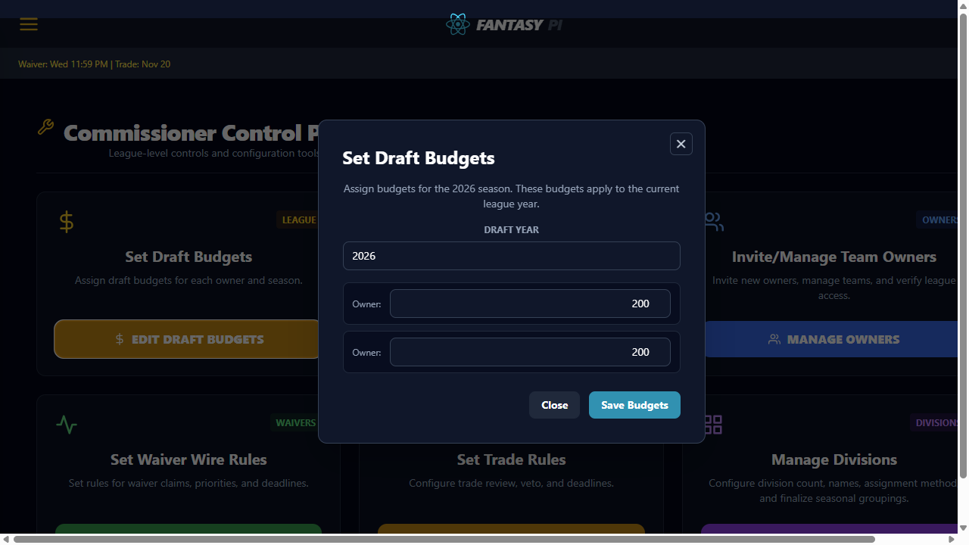
PPL Insight Hub - UAT Overview
Key Modals and Overlays
Modal states are captured separately for workflows requiring explicit confirmation.
PURPOSE
Highlight commissioner-only overlay behavior for draft budget governance.
CORE FUNCTIONALITY
Set Draft Budgets modal opens from Commissioner Dashboard.
Budget entry controls and action placement are visible and readable.
Modal close and save affordances are obvious for testers.

Slide 25
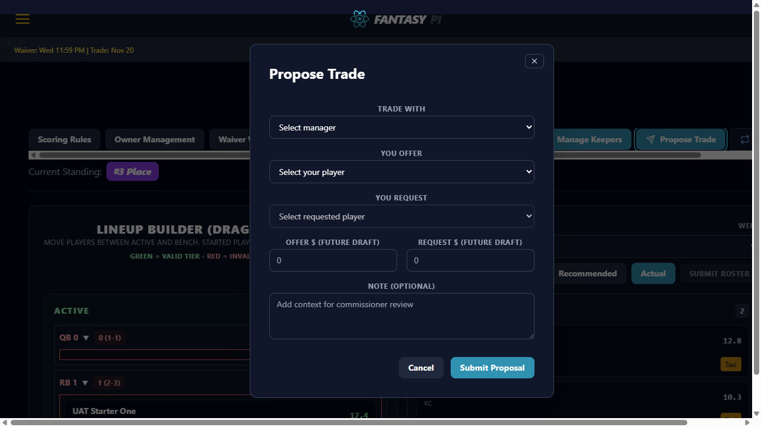
PPL Insight Hub - UAT Overview
Trade Proposal Modal
Modal states are captured separately for workflows requiring explicit confirmation.
PURPOSE
Capture trade proposal inputs before submit so field behavior can be validated.
CORE FUNCTIONALITY
Manager, offered player, and requested player fields are visible.
Submit and cancel controls are accessible and unambiguous.
Labels match the user-facing trade workflow language.

Slide 26
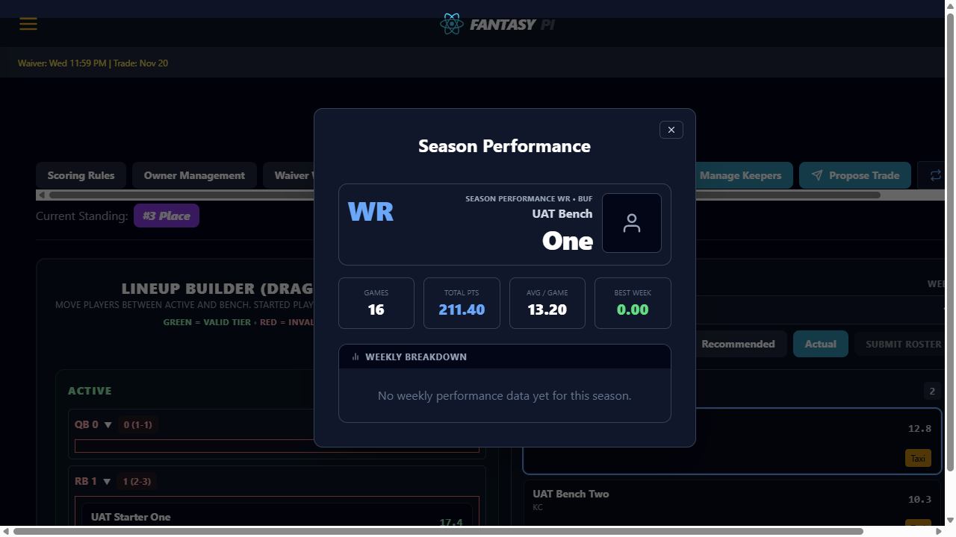
PPL Insight Hub - UAT Overview
Player Season Performance Modal
Modal states are captured separately for workflows requiring explicit confirmation.
PURPOSE
Display player season detail context used for start/sit and trade decisions.
CORE FUNCTIONALITY
Identity block and season metrics render in one consolidated modal.
Key stats remain legible on desktop viewport capture.
Exit control closes modal without losing page state.

Slide 27
PPL Insight Hub - UAT Overview
Waiver Wire Modal Targets
Modal states are captured separately for workflows requiring explicit confirmation.
PURPOSE
Validate waiver claim confirmation and roster-full drop workflow behavior.
CORE FUNCTIONALITY
Confirm Waiver Action modal is captured when claim controls are available.
Roster Full drop-player modal is captured for forced replacement flow.
Deterministic fallback artifacts are generated if claim controls are suppressed.

Slide 28
PPL Insight Hub - UAT Overview
Commissioner - Keeper Rules
Keeper Rules control retention limits and commissioner override operations.
PURPOSE
Allow commissioner to configure keeper policy and admin-level keeper operations.
CORE FUNCTIONALITY
Max keepers, max years, and deadlines are editable from one form.
Save action applies keeper settings for downstream owner selection.
Admin operations (veto/reset) are visible for governance workflows.

Slide 29
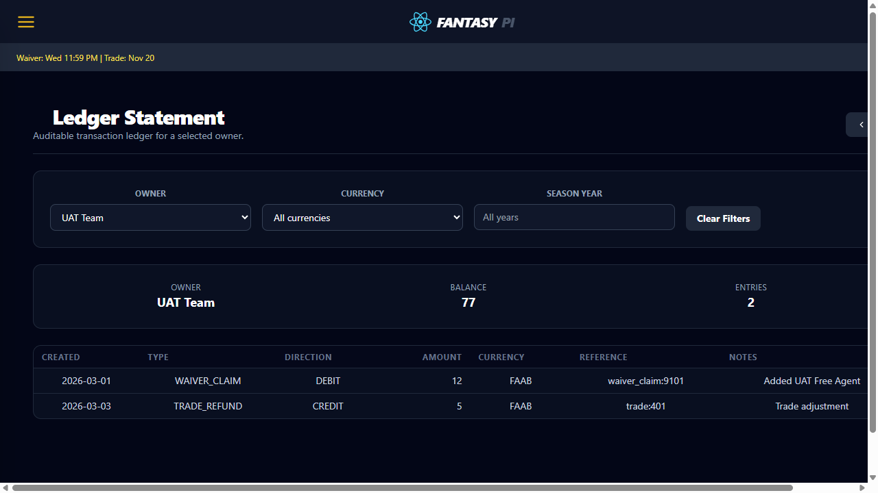
PPL Insight Hub - UAT Overview
Commissioner - General Ledger Statement
Ledger Statement provides auditable transaction history by selected owner.
PURPOSE
Enable commissioner audit of financial and budget-related transactions.
CORE FUNCTIONALITY
Owner, currency, and season filters constrain statement output.
Summary cards expose balance and entry counts before table review.
Entry table includes type, direction, amount, and references.

Slide 30
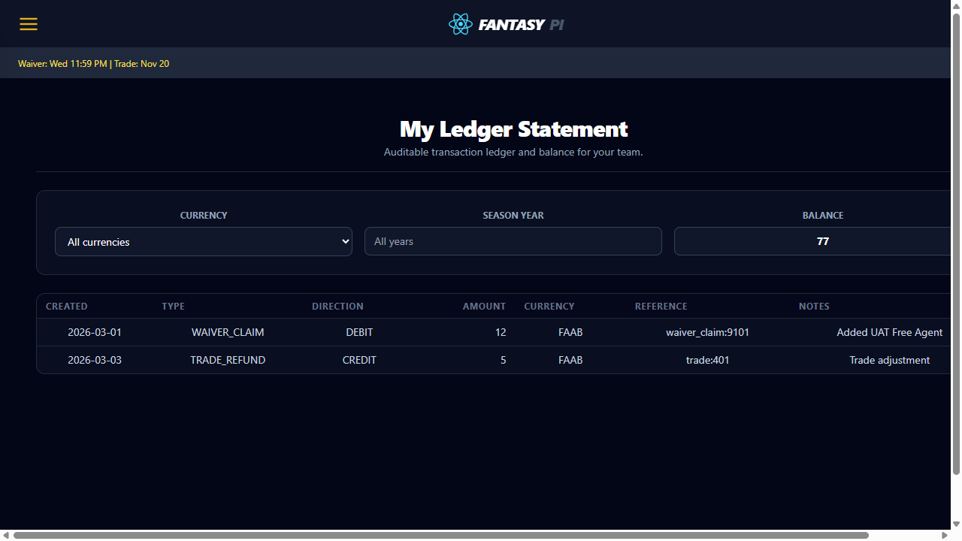
PPL Insight Hub - UAT Overview
Owner - My Ledger Statement
Owner ledger view exposes personal transaction history and running balance.
PURPOSE
Allow each manager to self-audit credits, debits, and transaction notes.
CORE FUNCTIONALITY
Owner can filter by currency and season year.
Balance is visible without leaving the statement page.
Transaction table remains readable with references and notes.

Slide 31
PPL Insight Hub - UAT Overview
War Room - Show Best Available
Best Available panel surfaces filtered candidate targets during active drafting.
PURPOSE
Support faster draft decisions with sortable player and value context.
CORE FUNCTIONALITY
Panel includes rank, player identity, and projected value fields.
Position filters narrow candidate list by roster need.
Sidebar can be toggled without losing draft board visibility.

Slide 32

PPL Insight Hub - UAT Overview
Player Card Detail
Player card detail highlights identity and context before deeper stat review.
PURPOSE
Ensure player identity data is clear at the top of detail modal workflows.
CORE FUNCTIONALITY
Player name, position, and NFL team are immediately visible.
Identity section anchors the season metrics shown below.
Card layout remains readable for quick in-draft decisions.

Slide 33
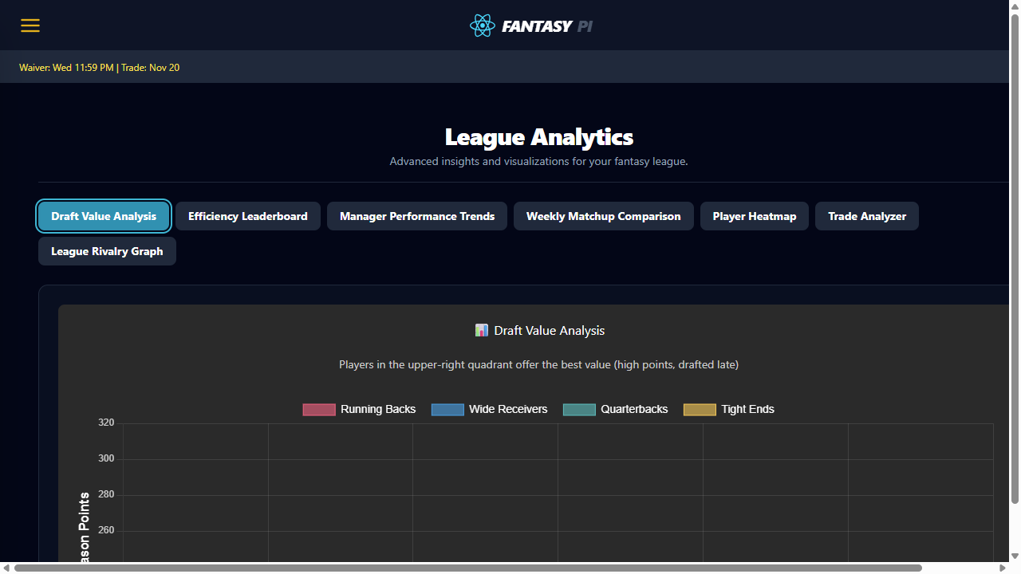
PPL Insight Hub - UAT Overview
Analytics - Draft Value Analysis
Draft Value Analysis compares pick outcomes and value efficiency.
PURPOSE
Help users identify where draft capital produced surplus or deficit value.
CORE FUNCTIONALITY
Draft Value Analysis module is selected from analytics controls.
Chart panel reflects selected analytics mode in-place.
Outputs support trade and roster planning decisions.

Slide 34
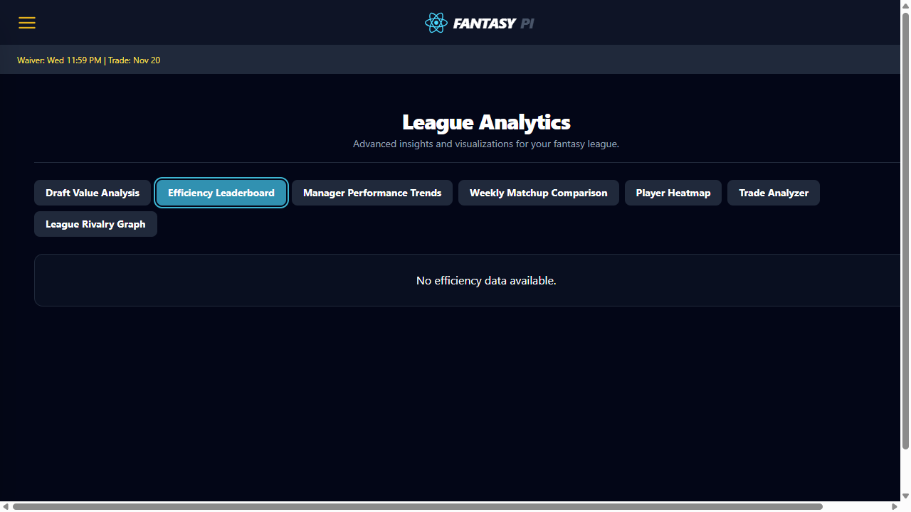
PPL Insight Hub - UAT Overview
Analytics - Efficiency Leaderboard
Efficiency Leaderboard ranks managers by performance and execution quality.
PURPOSE
Expose comparative manager efficiency for weekly strategic adjustments.
CORE FUNCTIONALITY
Leaderboard mode is selected from analytics module buttons.
Manager ranking output is readable within analytics panel.
Comparative results support lineup and waiver prioritization.

Slide 35
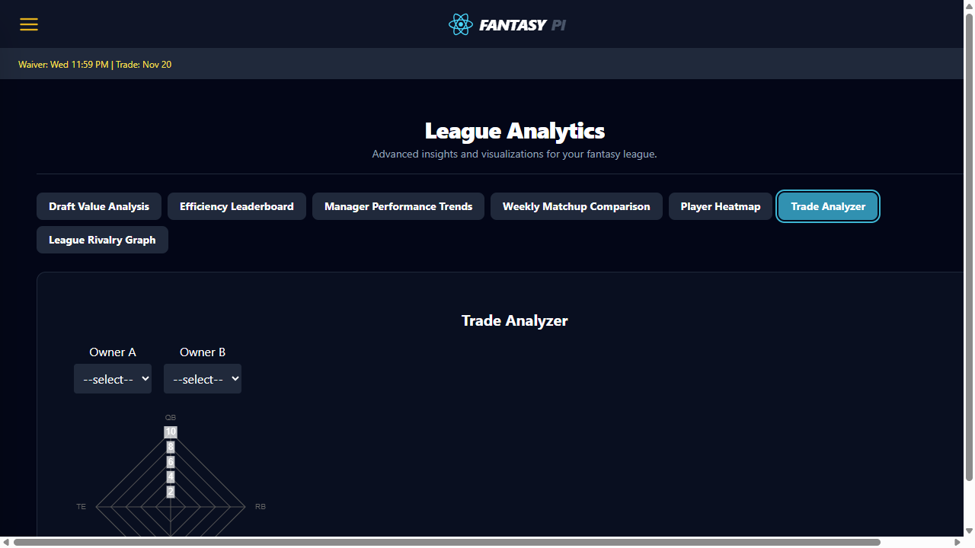
PPL Insight Hub - UAT Overview
Analytics - Trade Analyzer
Trade Analyzer models likely impact before proposing a trade package.
PURPOSE
Allow users to evaluate trade scenarios before submitting proposals.
CORE FUNCTIONALITY
Trade Analyzer mode is selected from analytics controls.
Scenario output appears within the standard analytics card layout.
Result context helps users avoid negative-value trade submissions.

