Slide 1
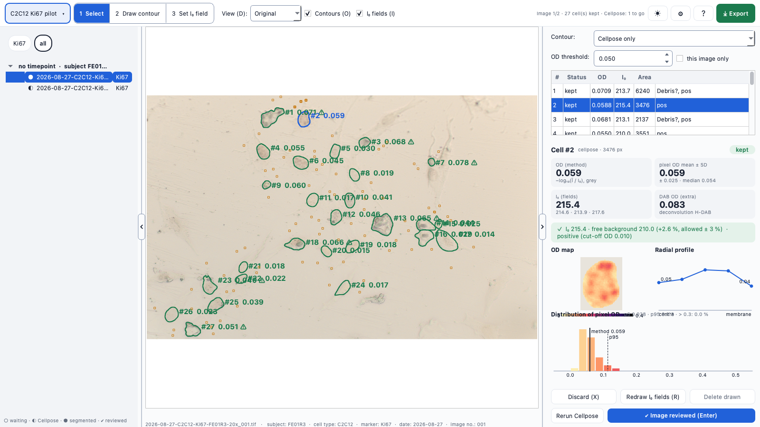
One window from image to OD
NKReview · desktop app (Python · Qt · Cellpose-SAM) for the optical density of DAB-stained cells and nuclei
1
5
1
Studies & templates
Folders, file-name roles and measurement settings; templates per experiment type
2
2
Image list
Grouped by timepoint · subject, filtered by marker; status from waiting to reviewed
3
Image view
Contours, the three I₀ fields per cell, OD per cell; draw or discard cells
3
4
Cell panel
OD (method), pixel-OD distribution, OD map and radial profile
4
5
Toolbar
Tools, brightness & contrast (display only), settings, help, export
Workflow: study → Cellpose in the background → review image by image → export cells.csv / summary.csv
Notes:
NKReview is built on the ErysReview interface. You start with a study: one or more image folders, how file names are read, and the measurement settings – or a template for the experiment type. Cellpose runs in the background while you go through the images: check the contours and the three background fields of each cell, discard or draw cells, mark the image as reviewed. The export writes one row per cell plus a summary per subject.

Slide 2
How it works: image to OD per cell
1
2
3
4
5
6
Import
Study, folders, file-name roles
DAB pre-filter
H-DAB deconvolution; only stained regions
Segmentation
Cellpose-SAM finds cells or nuclei
Background I₀
3 random 9 × 9 px fields per cell
Optical density
OD of the mean grey value (Fiji)
Review & export
Check, then cells.csv + summary.csv
Whole cell · NK (63×)
Nucleus · C2C12 Ki67 (20×)
Cellpose on the colour image
Cellpose on the DAB map (pale nuclei visible)
Edge redrawn from total OD > 0.05 (hybrid contour)
Min. area 500 px; debris flagged by its H channel
I₀ fields 14–40 px from the contour
I₀ fields 40–90 px; ±3 % of the free background
I₀ must lie within 210–220 (method)
Positive above grey OD 0.01 (noise floor)
Step 3 and 4 differ by target; every OD uses the original image (brightness is display only).
Notes:
Six steps. The DAB pre-filter cuts out stained regions so Cellpose only works where there is signal – a sparse image takes seconds instead of a minute. Segmentation differs by target: whole NK cells are found on the colour image and their edge is redrawn from the optical density; C2C12 nuclei are found on the DAB map, where pale Ki67 nuclei are much clearer. The background I₀ is measured per cell from three fields next to it, with a fixed range for NK and a relative check for the C2C12 series, whose exposure varies.

Slide 3
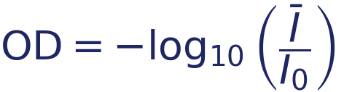
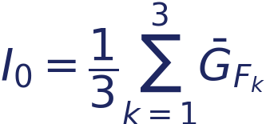

Measurement and pilot results
27 vs 8
Per cell, as in the Fiji method
nuclei found on a C2C12 pilot image – Cellpose on the DAB map vs. on the colour image
4 s vs 76 s
Cellpose time on the NK test image with vs. without the DAB pre-filter
Ī mean grey value inside the contour · G = (R+G+B)/3
Worked example · NK cell, 5515 px
91 of 92
I₀ = (217.4 + 217.0 + 217.5) / 3 = 217.3 · Ī = 149.0
pilot nuclei kept with the relative I₀ check (fixed 210–220 would drop whole series)
Open: the Fiji macro (Appendix E) to confirm grey conversion and field size; Ki67-negative nuclei need a counterstain or manual drawing.
Notes:
The main value is the optical density of the mean grey value, exactly as the Fiji workflow computes it, with I₀ from three background fields next to the cell. For the NK test cell this gives 0.164. The pilot showed three things: the DAB map finds far more C2C12 nuclei than the colour image, the pre-filter makes Cellpose fast on sparse images, and a relative I₀ check keeps nearly every nucleus although exposure varies between series. Still open: the original Fiji macro, and Ki67-negative nuclei, which are invisible without a counterstain.

