Slide 1
FUNNEL ANALYSIS
CONVERSION
RETENTION
FULFILMENT
34M+
3
10
6
15
Total rows
Datasets
Phases
Stat tests
Charts
Google Merchandise Store · Instacart Grocery Delivery · Olist Brazilian E-Commerce
github.com/NPK05/funnel-analysis-project · March 2026

Slide 2
Funnel Analysis Portfolio
METHODOLOGY
Technical Methodology
1
Problem Definition
6
Statistical Testing
Hypotheses, KPIs, analytical questions
Chi-square, Mann-Whitney U, Spearman
2
Environment Setup
7
Visualization
Python venv, Git/GitHub connected
15 interactive Plotly charts built
3
Data Cleaning
8
Business Insights
38 issues identified and resolved
Recommendations with revenue impact
4
Exploratory Analysis
9
Cross-dataset Comparison
16 charts, 26 key patterns per dataset
Three funnel archetypes contrasted
5
Core Funnel Analysis
10
Portfolio Packaging
Conversion rates, revenue leakage
GitHub README, report, dashboard
Funnel Analysis Portfolio · NPK05
github.com/NPK05/funnel-analysis-project

Slide 3
Funnel Analysis Portfolio
DATASETS
Dataset Descriptions & Cleaning
CONVERSION
RETENTION
FULFILMENT
Google Merchandise Store
Instacart Grocery Delivery
Olist Brazilian E-Commerce
719,386 events
33.8M rows
99,441 orders
14,701 users
206,209 users
99,441 customers
Nov 2020 - Jan 2021
Historical 2017
Sep 2016 - Oct 2018
34M+ total rows across all datasets
34M+ total rows across all datasets
34M+ total rows across all datasets
38 Data Quality Issues Resolved · Core Principle:
Never fill blindly. Null values were categorised as random missing, structural missing, or not-random missing (the signal). Every decision documented.
Funnel Analysis Portfolio · NPK05
github.com/NPK05/funnel-analysis-project

Slide 4
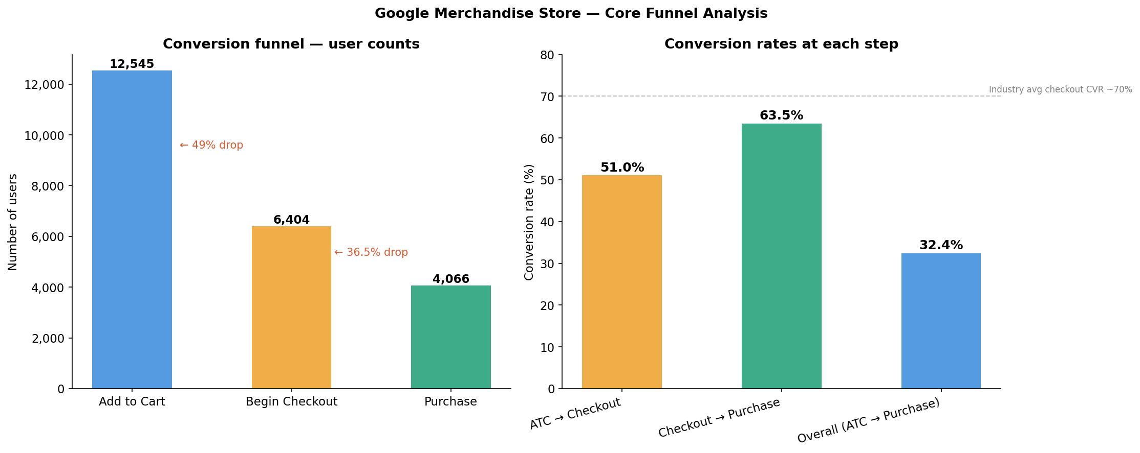
Funnel Analysis Portfolio
GOOGLE MERCH
Conversion Funnel - Key Findings
32.4%
49%
$552K
$65.12
Overall CVR (ATC→Purchase)
Primary drop-off (ATC→Checkout)
Revenue leakage (3 months)
Avg order value per session
Hypothesis disproved:
Mobile (28.25%) vs desktop (27.28%) — p=0.208, NOT significant. Problem is checkout friction, not mobile UX.
Monthly cohorts:
Nov CVR 71.4% vs Dec 26.5% vs Jan 19.8%. Fundamentally different user intent cohorts.
Category gap:
Notebooks & Journals: 0.2% CVR catastrophically low — 16,514 ATCs, only 36 purchases.
Funnel Analysis Portfolio · NPK05
github.com/NPK05/funnel-analysis-project

Slide 5
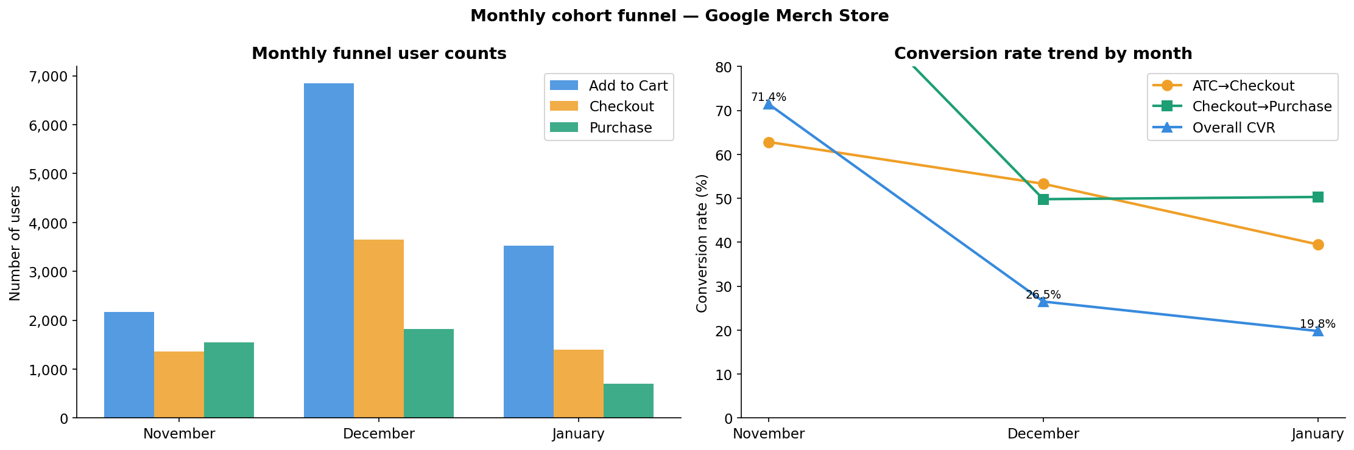
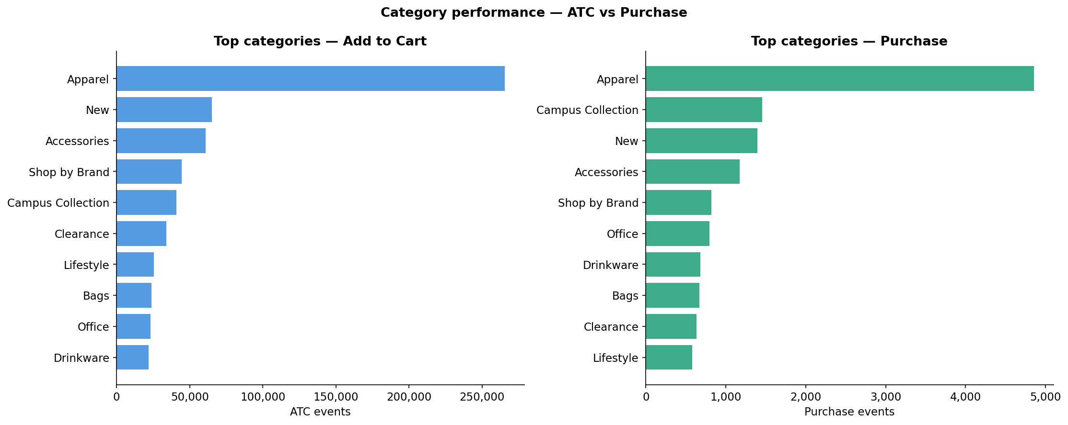
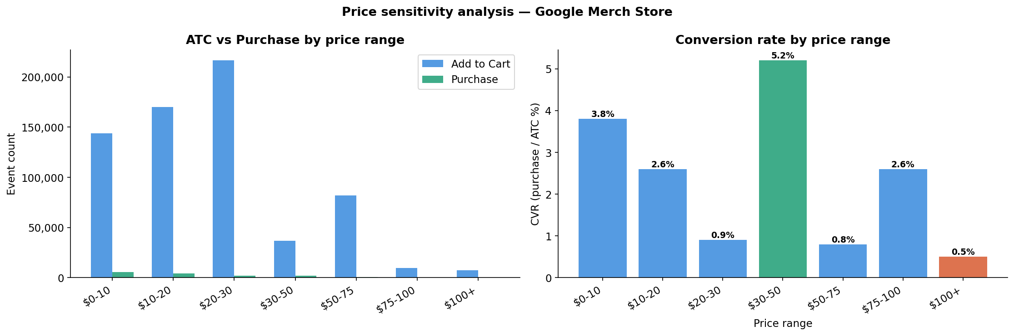
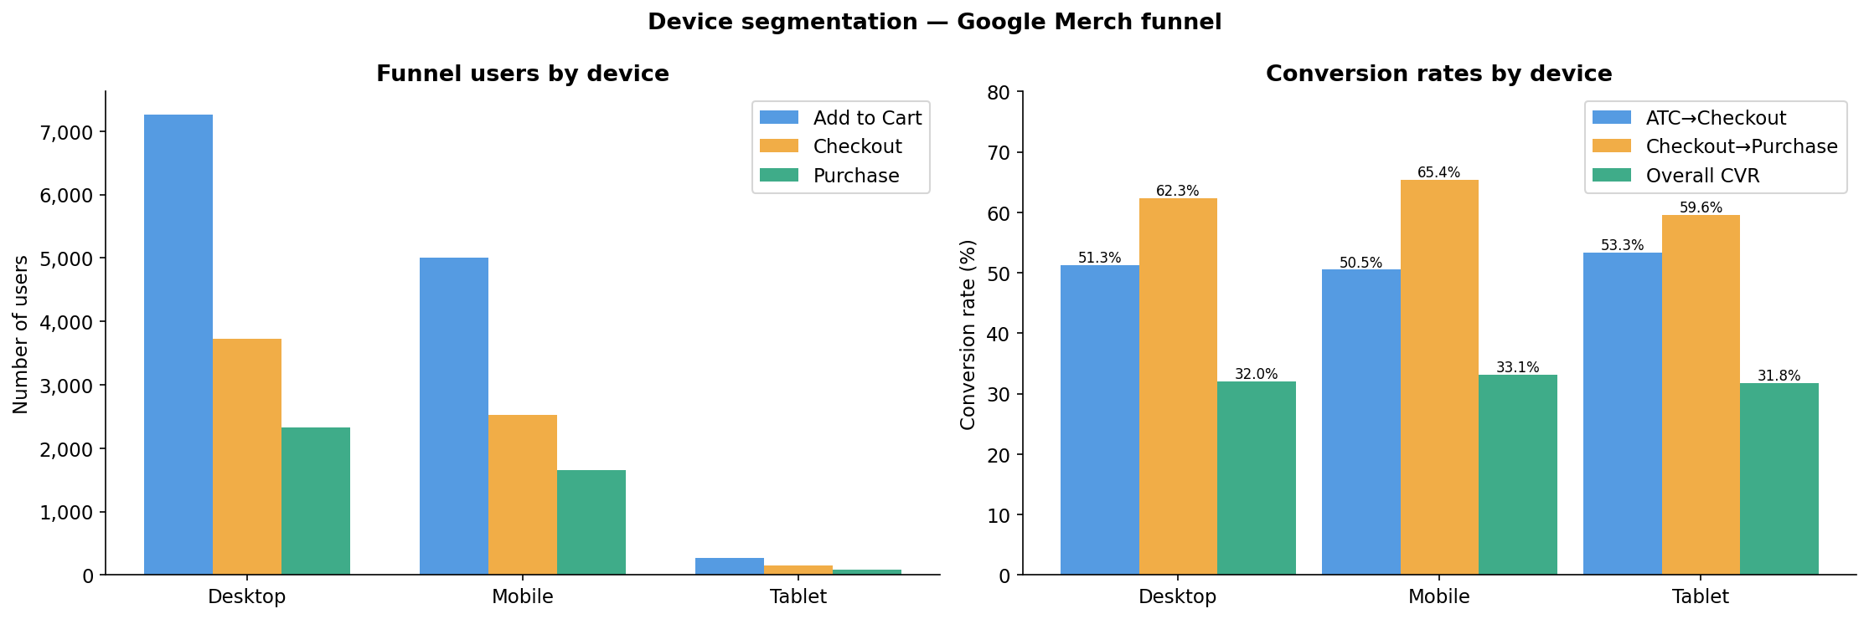
Funnel Analysis Portfolio
GOOGLE MERCH
Conversion Analysis - Visual Deep Dive
Fig 1: Monthly CVR cohorts
Fig 2: Category ATC vs Purchase
Fig 3: Price sensitivity
Fig 4: Device funnel comparison
Funnel Analysis Portfolio · NPK05
github.com/NPK05/funnel-analysis-project

Slide 6
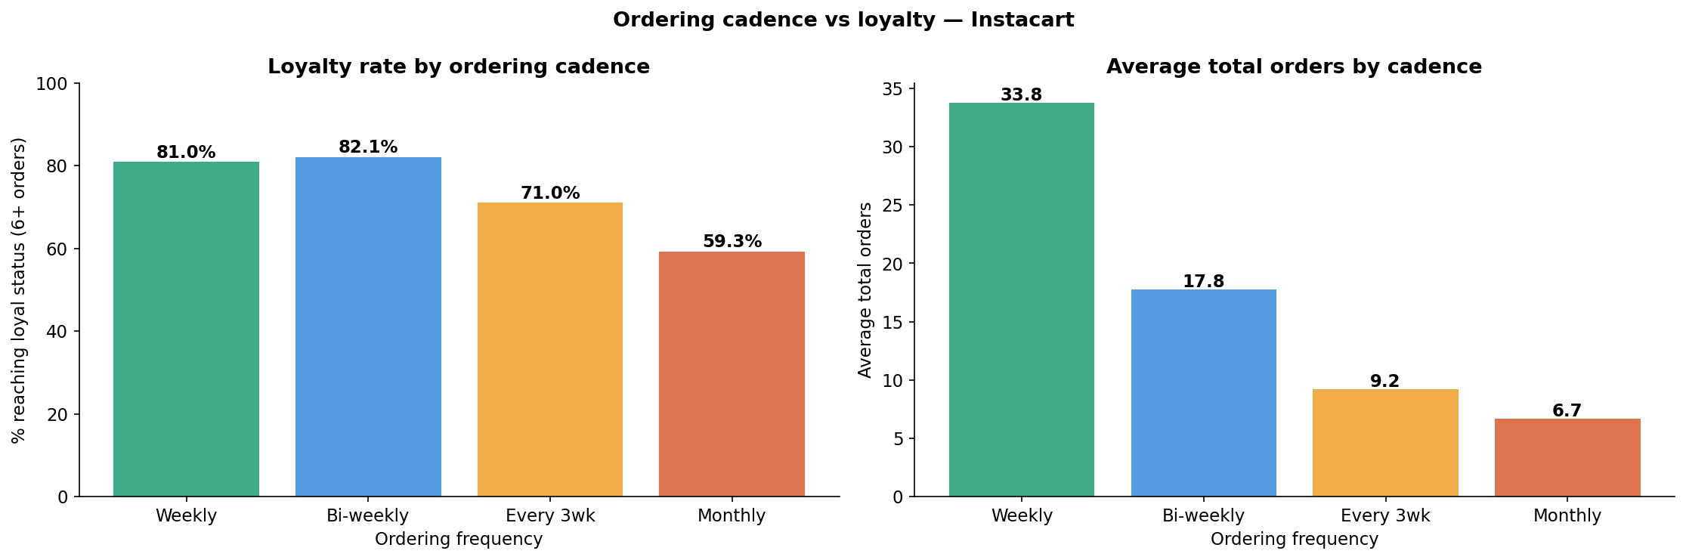
Funnel Analysis Portfolio
INSTACART
Retention Funnel - Key Findings
76.0%
49,404
21.7pp
5x
Loyalty rate (6+ orders) CI [75.9%, 76.2%]
Users at risk — stop at 3-5 orders
Cadence gap — Weekly 81% vs Monthly 59.3%
LTV ratio — Weekly vs Monthly users
Strongest finding in project:
Weekly users retain at 81.0% vs monthly at 59.3% — 21.7pp gap. Chi-square = 2,731, p=0.000000. 5x LTV difference.
Critical intervention point:
Steepest drop is between order 4 and 5 — losing 10.9% at a single step. This is 2x the average drop rate.
Cadence is everything:
Weekly users place 33.8 orders on average vs 6.7 for monthly. Converting monthly to bi-weekly = 22pp loyalty gain.
Funnel Analysis Portfolio · NPK05
github.com/NPK05/funnel-analysis-project

Slide 7
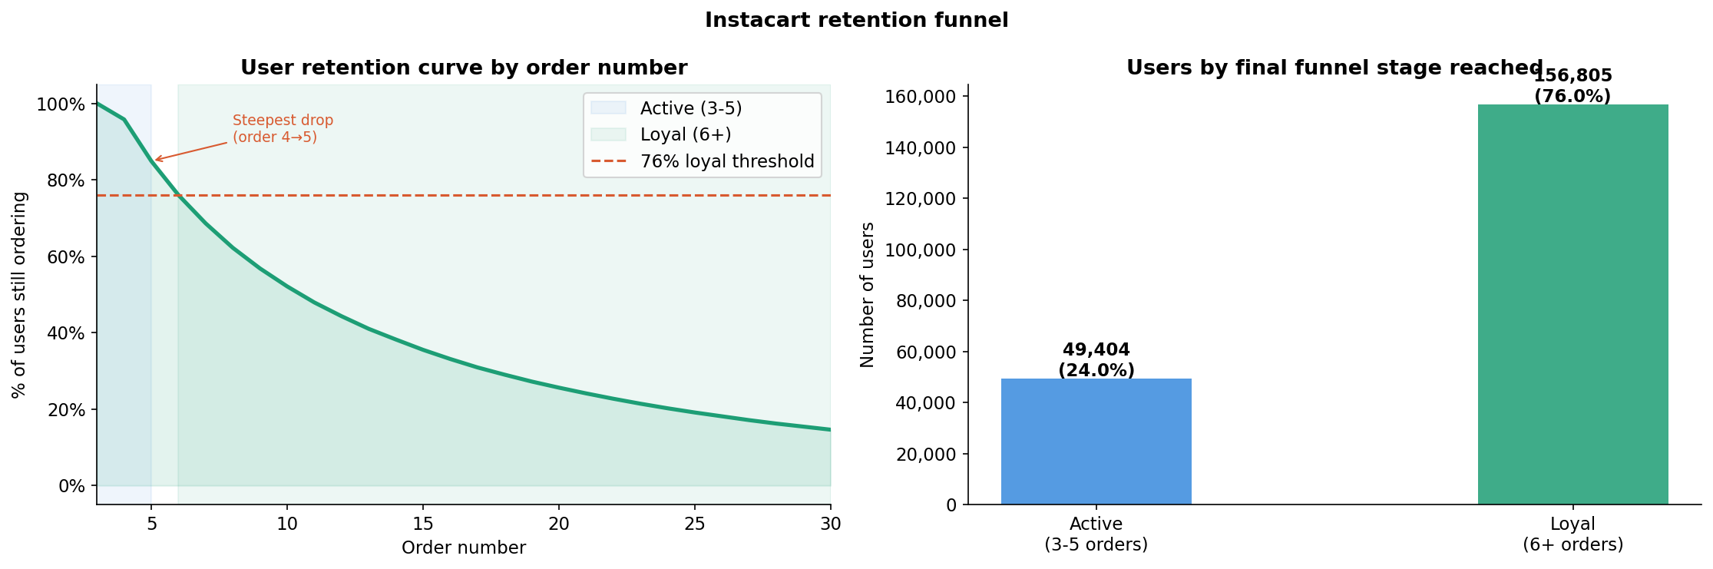
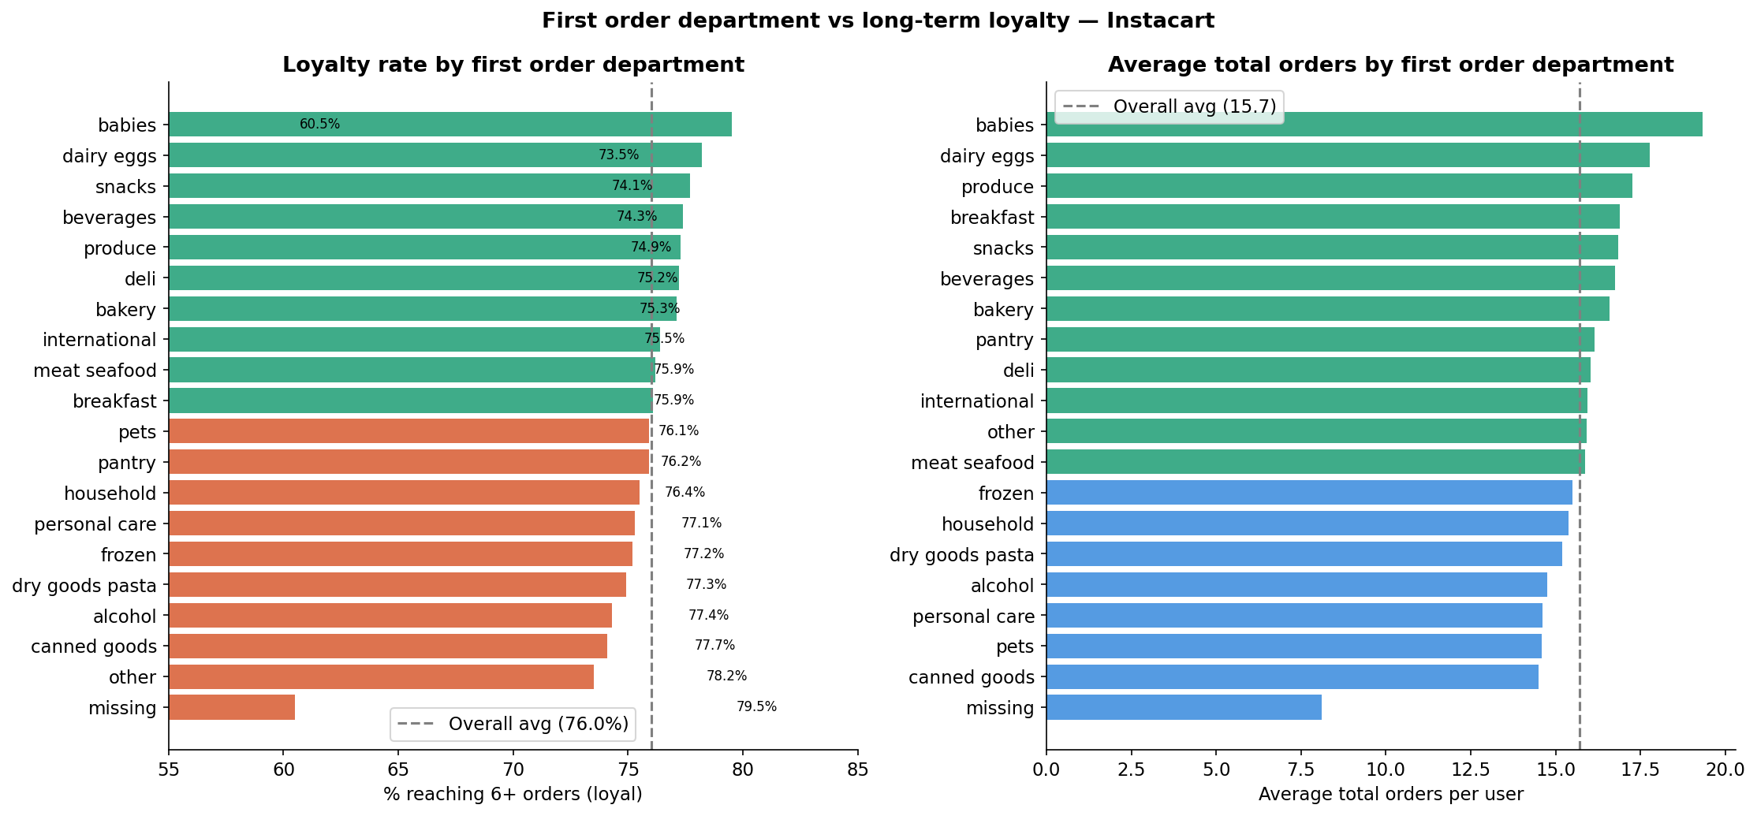
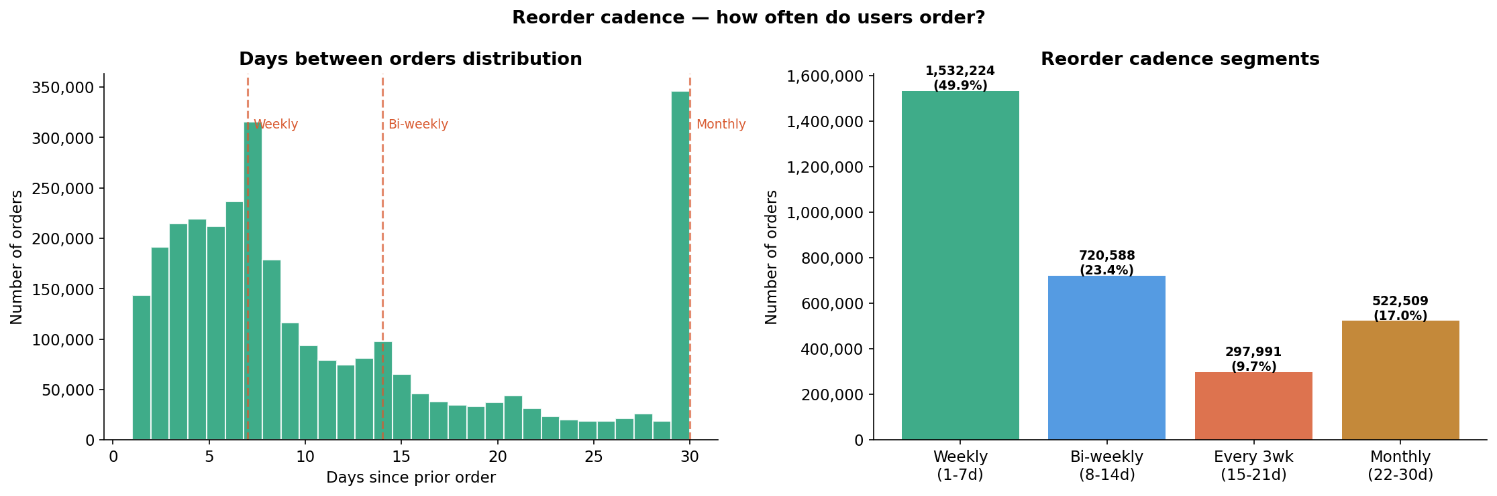
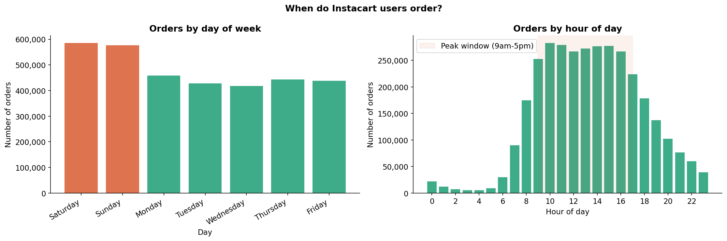
Funnel Analysis Portfolio
INSTACART
Retention Analysis - Visual Deep Dive
Fig 5: Retention funnel stages
Fig 6: Department retention rates
Fig 7: Reorder cadence distribution
Fig 8: Order timing heatmap (Sat 10am peak)
Funnel Analysis Portfolio · NPK05
github.com/NPK05/funnel-analysis-project

Slide 8
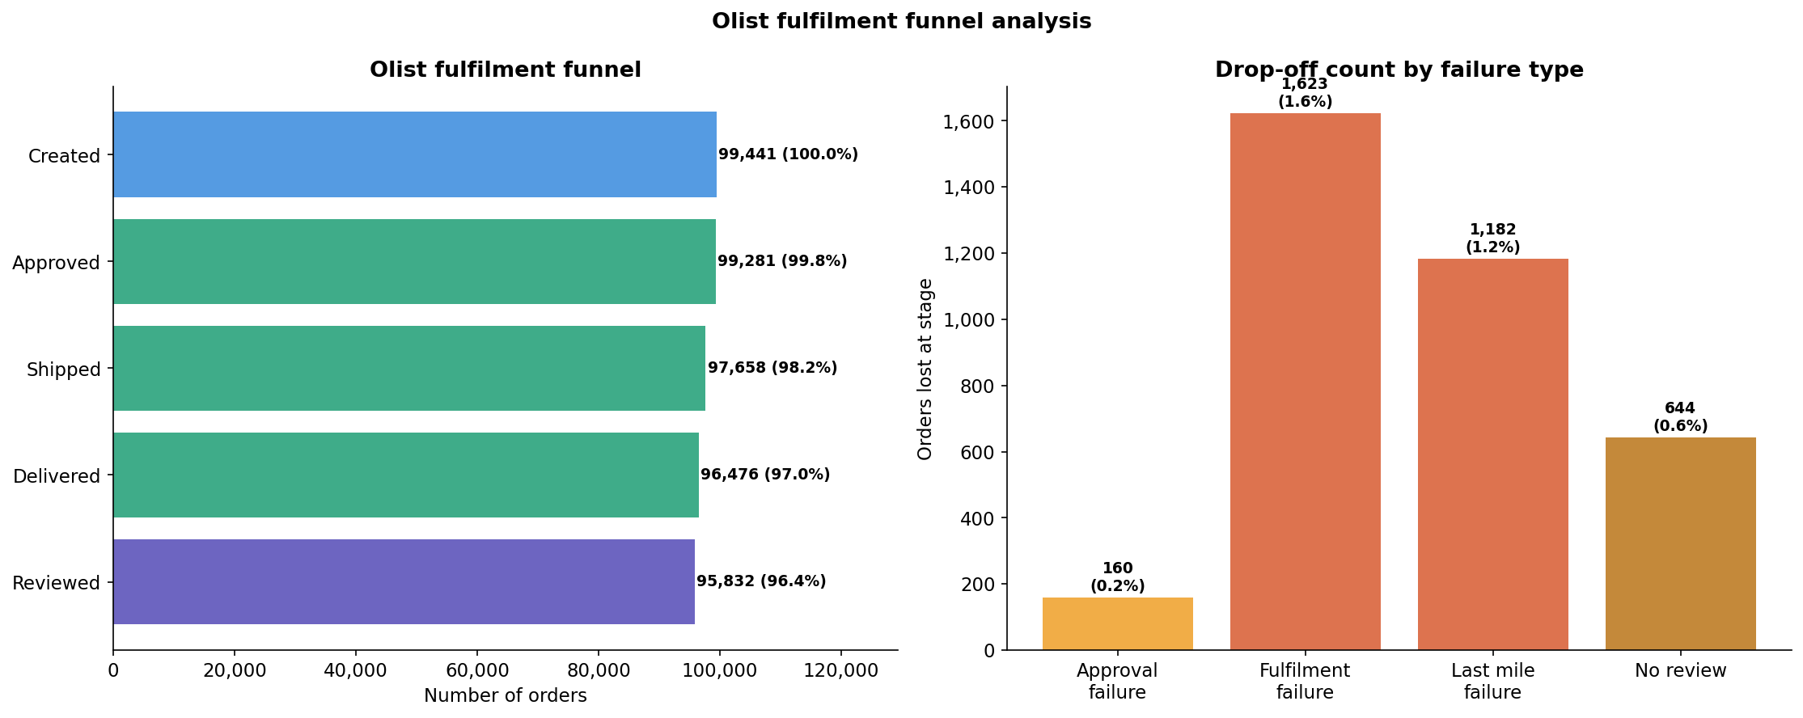
Funnel Analysis Portfolio
OLIST
Fulfilment Funnel - Key Findings
97.0%
8.11%
1.73pts
R$1.85M
Fulfilment rate CI [96.9%, 97.1%]
Late delivery rate CI [7.94%, 8.28%]
Review score gap — Late 2.56 vs On-time 4.29
Revenue at risk — direct + reputation
Non-linear threshold effect:
Crossing from early to late drops median review 5→2 stars — a cliff, not gradient. Once >1 week late, 68-69% give 1 star.
Geographic gap proven:
AL (23.9% late) has 4x the rate of SP (5.9%). RJ is highest-volume problem at 13.5% across 12,350 orders.
Seller failure is largest drop:
1,623 orders approved but not shipped. Customers paid and received nothing.
Funnel Analysis Portfolio · NPK05
github.com/NPK05/funnel-analysis-project

Slide 9
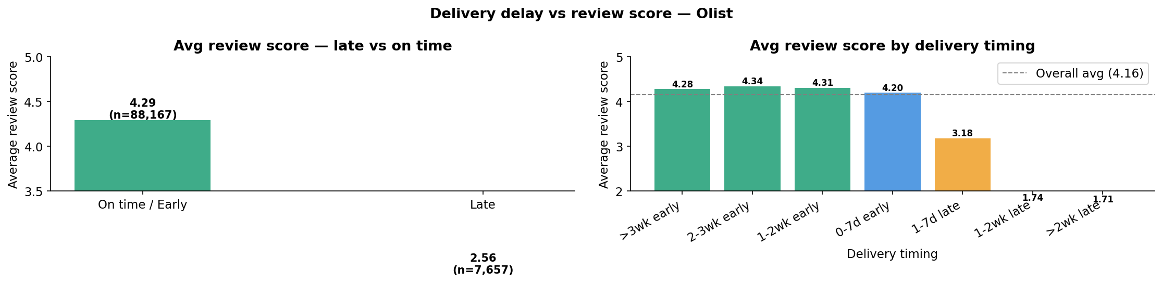
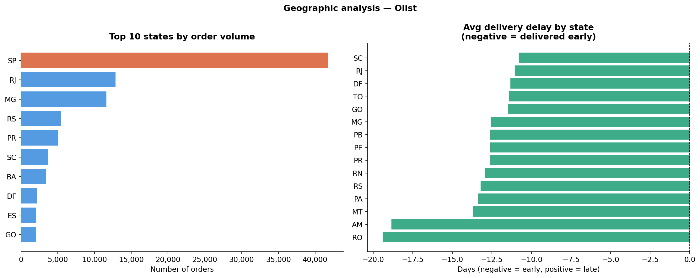
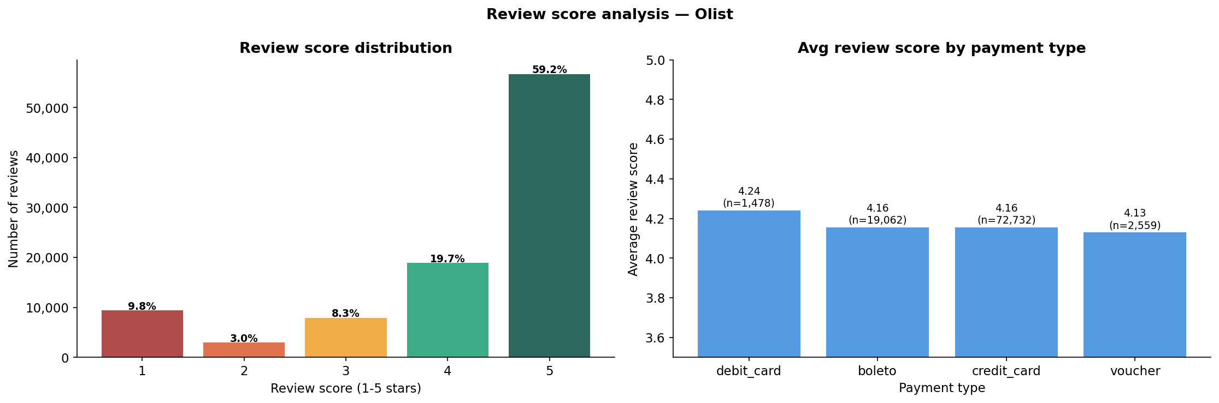
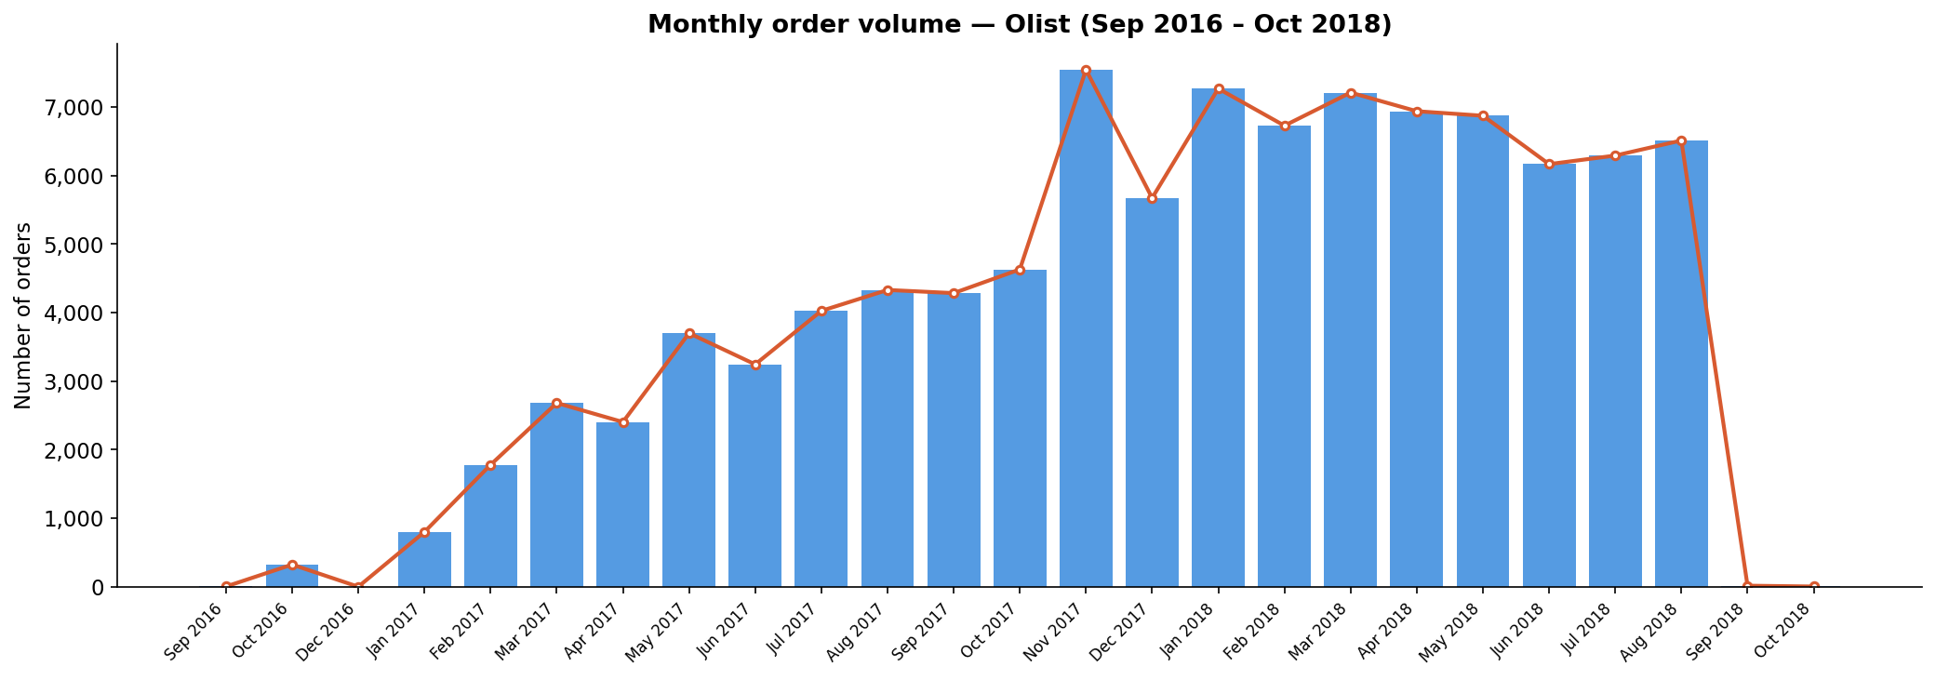
Funnel Analysis Portfolio
OLIST
Fulfilment Analysis - Visual Deep Dive
Fig 9: Delivery delay vs review score
Fig 10: Geographic late rate by state
Fig 11: Review score distribution
Fig 12: Monthly order volume
Funnel Analysis Portfolio · NPK05
github.com/NPK05/funnel-analysis-project

Slide 10
Funnel Analysis Portfolio
STATISTICS
Statistical Test Results
Test | Dataset | Comparison | p-value | Conclusion
Chi-square | Google Merch | Mobile vs Desktop CVR | 0.208 | NOT SIGNIFICANT - Device not the problem
Chi-square | Google Merch | Campus vs Apparel CVR | <0.001 | SIGNIFICANT - Category differences real
Chi-square | Google Merch | Nov vs Dec CVR | <0.001 | SIGNIFICANT - Different user cohorts
Chi-square | Instacart | Weekly vs Monthly loyalty | 0.000000 | HIGHLY SIGNIFICANT - Strongest finding
Mann-Whitney U | Instacart | Weekly vs Monthly orders | 0.000000 | HIGHLY SIGNIFICANT - 5x LTV difference
Mann-Whitney U | Olist | Late vs On-time review scores | 0.000000 | HIGHLY SIGNIFICANT - 1.73pt gap proven
Spearman r | Olist | Delay days vs review score | 0.000000 | SIGNIFICANT but WEAK - Non-linear effect
Wilson CI | Instacart | Loyalty rate 76.0% | [75.9%, 76.2%] | VERY TIGHT CI - Most precise metric (0.37pp)
Funnel Analysis Portfolio · NPK05
github.com/NPK05/funnel-analysis-project

Slide 11
Funnel Analysis Portfolio
RECOMMENDATIONS
Business Recommendations - Prioritised by Revenue Impact
G HIGH PRIORITY
I HIGH PRIORITY
O HIGH PRIORITY
Fix cart-to-checkout CTA friction
Intervene at order 4-5 with nudge/discount
Fix RJ delivery reliability
Est. impact: $46K/quarter
Est. impact: ~22,500 users
Est. impact: ~R$269K direct
G HIGH PRIORITY
I HIGH PRIORITY
O HIGH PRIORITY
Investigate Notebooks & Journals 0.2% CVR
Cadence acceleration: monthly to bi-weekly
Late delivery early warning system
Est. impact: Quick win
Est. impact: 22pp loyalty gain
Est. impact: Protect R$1.35M
G = Google Merch
I = Instacart
O = Olist
Funnel Analysis Portfolio · NPK05
github.com/NPK05/funnel-analysis-project

Slide 12
Funnel Analysis Portfolio
COMPARISON
Cross-Dataset Comparison - Three Funnel Archetypes
Google Merch
CONVERSION
Instacart
RETENTION
Olist
FULFILMENT
Completion rate
32.4%
76.0%
97.0%
Biggest drop
ATC→Checkout 49%
Active→Loyal 24%
Approved→Shipped 1.6%
Root cause
UX/price friction
Habit not formed
Seller/logistics failure
Intervention
Reduce checkout friction
Nudge at order 4-5
Accountability + infra
Revenue impact
$552K leakage (3mo)
5x LTV gap weekly/monthly
R$1.85M at risk
Peak behaviour
Wednesday office hours
Saturday 10am grocery
November Black Friday BR
Core insight: The right metric and intervention are completely determined by the funnel archetype. Wrong archetype = misleading conclusions.
Funnel Analysis Portfolio · NPK05
github.com/NPK05/funnel-analysis-project

Slide 13
Project Deliverables
GitHub Repository
Jupyter Notebooks
Public repo — all notebooks, scripts, outputs
4 notebooks covering all 10 analytical phases
github.com/NPK05/funnel-analysis-project
01_google_merch · 02_instacart · 03_olist · 04_comparison
15 Interactive Charts
Streamlit Dashboard
Plotly HTML charts covering all 3 datasets
Live dashboard with dataset selector + tabs
outputs/dashboard/ — fully interactive in browser
Deployed on Streamlit Community Cloud
Cleaned Data
This Report
6 production-ready CSV files (34M+ rows)
Full PDF + DOCX documentation
Reproducible from notebooks — excluded from Git
Funnel Analysis Portfolio Report · March 2026
Funnel Analysis Portfolio Project · NPK05 · github.com/NPK05/funnel-analysis-project · March 2026

