Slide 1





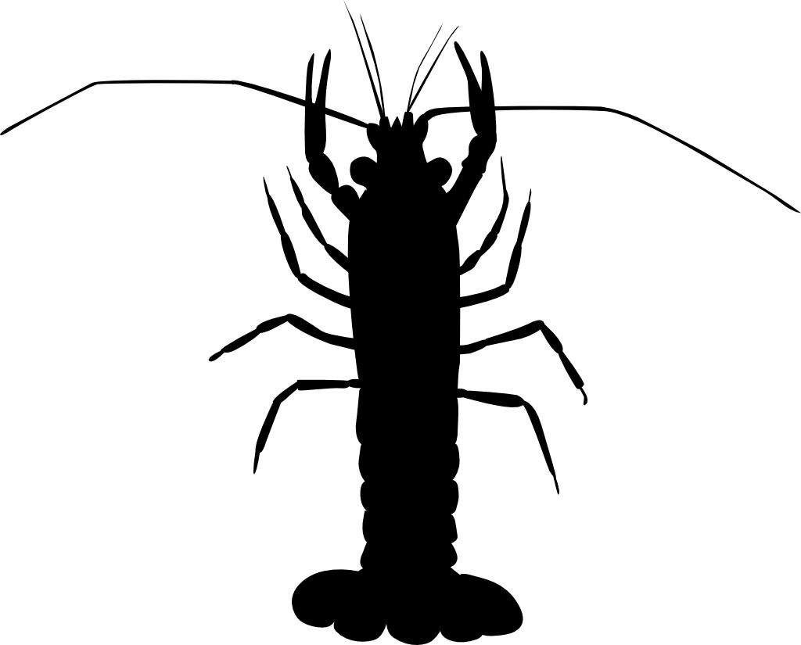




Interspecific-
I. Consumer/resource or plant/animal mutualism-antagonism continuum:
+
-
mutualism antagonism
Types of interacting organisms: Any two species with a degree of control over a shared resource, which may include one or both species
Examples of relevant ITV: foraging tactics or preferences, competitor avoidance behaviour; pollination rewards and seed production rates
II. Host/symbiont mutualism-parasitism continuum:
+
-
mutualism parasitism
Types of interacting organisms: host species and their endosymbiotic or ectosymbiotic partner species
Examples of relevant ITV: symbiont dependence, protective effects against pathogens/predators/parasites, exploiting or cheating behavioural phenotypes
Intraspecific-
III. Conspecific cooperation-competition continuum:
+
-
cooperation competition/conflict
Types of interacting organisms: conspecifics in socially interacting dyads or networks; cooperative breeding groups
Examples of relevant ITV : competitive and cooperative behavioural phenotype, resource use, hormonal variation
♀
IV. Female/male cooperation-conflict continuum:
+
-
cooperation competition/conflict
♂
Types of interacting organisms: male and female partners in a breeding pair
Examples of relevant ITV : behavioural phenotype, individual condition or attractiveness, reproductive potential
V. Parent/offspring care-conflict continuum:
+
-
parental care competition/conflict
Types of interacting organisms: parents and offspring in species with parental care behaviour
Examples of relevant ITV : behavioural phenotype, individual condition, reproductive potential

