Slide 1


An open Gravimetric Phenotyping system
Finding low-cost solutions to continuous plant monitoring for scientific purposes
Notes:
Intro -
Hi, I’m Nathan
Undergraduate Student at Aberystwyth University
Working for a year at the NPPC
This talk is about one of the systems I’ve been developing
As you can see from the title it’s an open source system
That hopefully some people wlll find interesting

Slide 2
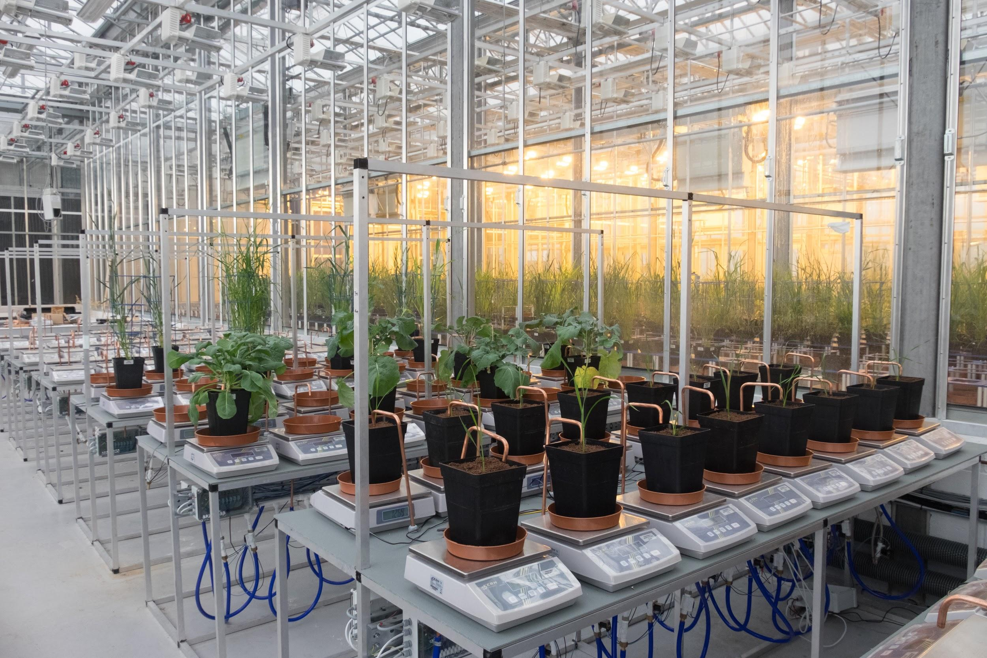
What is it?
Automated monitoring system for plants
Accurately record biomass growth and water usage
Watering system
Has capacity to augment with additional sensory devices
Notes:
What is it?
An automated system for monitoring plants as they grow and mature
Main aim is to accurately measure bio-mass growth and water evaporation
Entirely automated watering system
Records data directly into a SQL DB
Has capactity to augment with any additional sensory equipment you might want
E.g. temperature sensors
Soil salinity
Light level recorders
That sort of thing

Slide 3
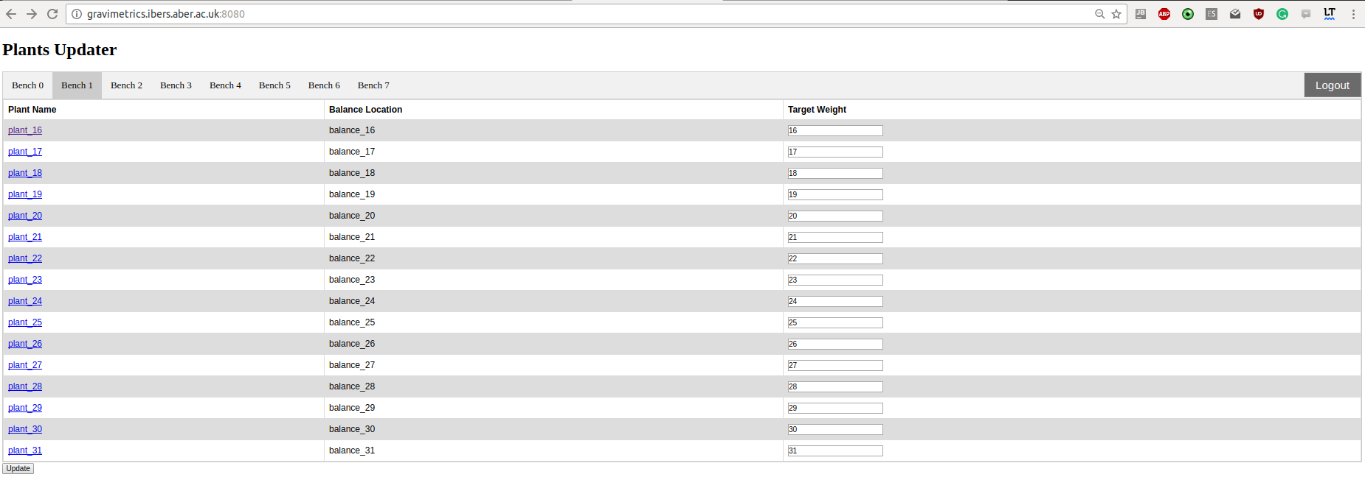
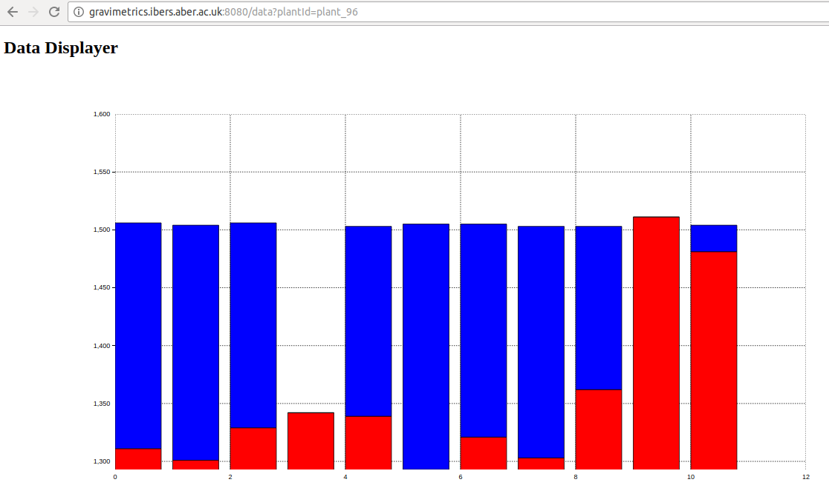
Real-Time Information and Monitoring
Web based interface to give individual plot information
All written in Python
Notes:
The latest part being worked on is the ease of use components
Producing a easy to access web portal
That in real-time generates useful data
Allows management of individual plants by assigning them treatments
This side f things is all python
And uses matplotlib to generate graphs
Also useful to diagnostics
E.g. the graph on the right shows water given each morning
You can see on the 4th day I accidently turned off the water taps and forgot to put back on!

Slide 4
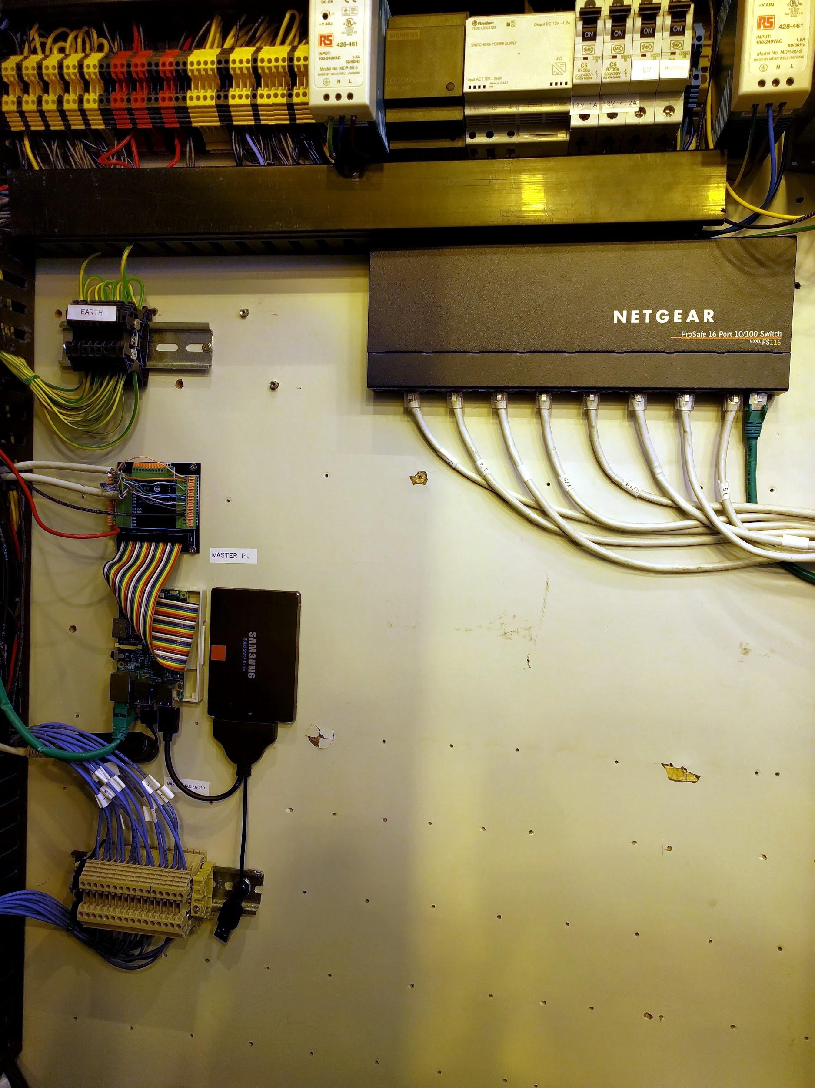
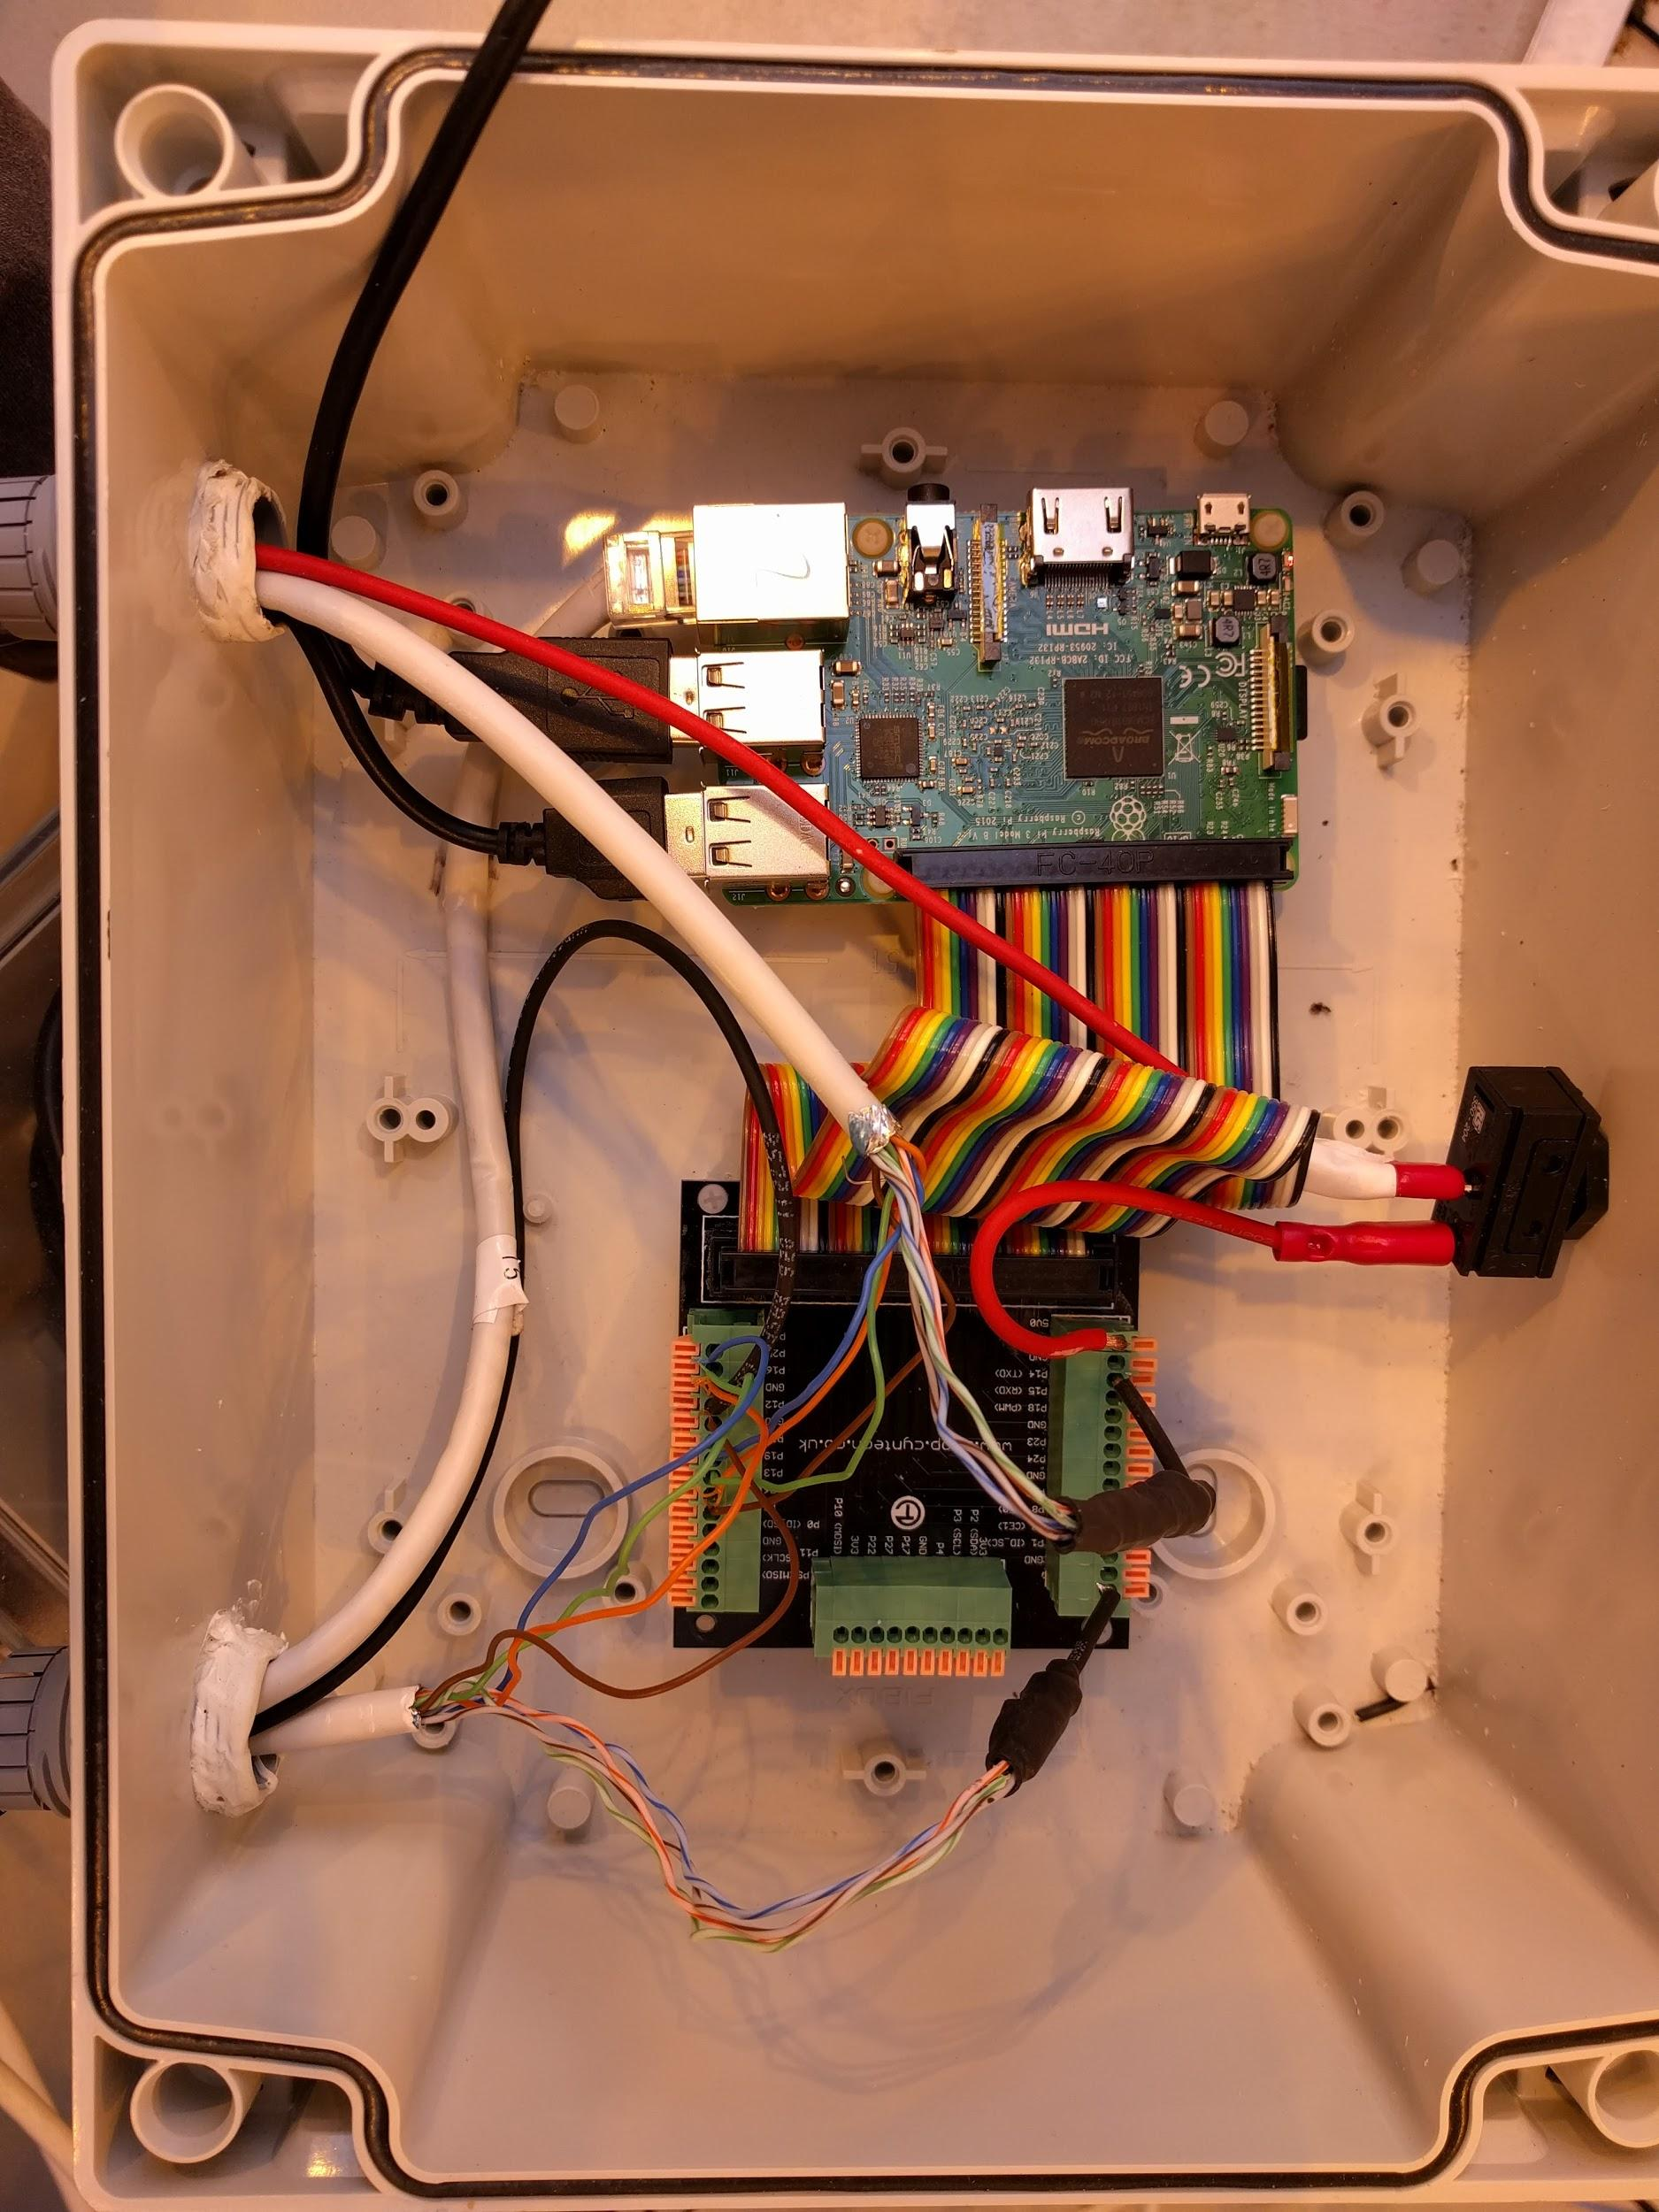
What controls it all?
Raspberry Pi controlled system
Master Pi running Linux sends commands to nodes that carry out reading/watering tasks
All core hardware interactions done in C
Notes:
All Controlled by a master rasp Pi
With 1 node pi assigned to 16 plots
All network booted
Has a Python script that runs everything
Real hardware interaction is done all in pure C

Slide 5
Why would you want a system like this?
It’s scalable, high throughput and completely open!
Allows for creation of data accurate enough for scientific research
The alternative to the automated system is by using people which takes up:
Time
Money
Humans make mistakes and find it difficult to be consistent in treatments
Continuous sensor readings delivered in real-time
Notes:
It’s very scalable
Cheap to get setup with just a few spaces
Cheap to expand
Cheap to modify
Allows for accurate data to be produced, properly formatted and ready to be analysed
Saves you lots of manpower
Humans make mistakes
If you try to water a hundred plants with 1g accuracy you will make mistakes
Computers and harware make mistakes too! But we record those mistakes and are *hopefully* consistent in the mistakes
Constant 24/7 readings

Slide 6
Why not just use an off-the-shelf commercial system?
Notes:
Why would you not just buy a system
There are several companies (I won’t name names) that offer these systems
Why would you want to do it yourself?

Slide 7
Problems with current commercial systems
Most (all?) of the systems available are completely closed off in regards to their hardware and software
Inflexible
We don’t know what experiments are going to require in the future
We may not even know what kind of data we want to capture
Expensive initially and to expand
Almost impossible to maintain without the manufacturer's help
Notes:
Professional Companies who design and build these systems tend not to be flexible in giving access to source
Explaining how things work under the hood
This causes issues for finding and reporting bugs that happen when these systems are in the real world
And support is a bad internet connection away…
They’re not adaptable:
Your needs may change overtime and you can’t afford the downtime or the expense to rebuild the system
Maintenance for these huge commercial systems use very hard to source parts, they have single suppliers
Takes months to get parts and have to pay far too much!

Slide 8
Proprietary Black boxes are bad!
??????
You put plants on the system
The data recorded is recorded and processed without allowing us to see raw readings
Some systems are insistent upon storing data we produce on their remote servers
This creates a lot of issues...
Data
Remote
Server
Plants
Notes:
The other problem and the one I’m very concerned with is the data that these systems produce
They quickly become black boxes!
Plants go in, data gets put into some magical database box, some systems even ship the data off to their private servers that customers don’t have proper access to
Data is possibly censored and given back
Personally I don’t trust this data too much
If you’ve ever worked with hardware sensors you’ll know that your data out isn’t always perfect...

Slide 9
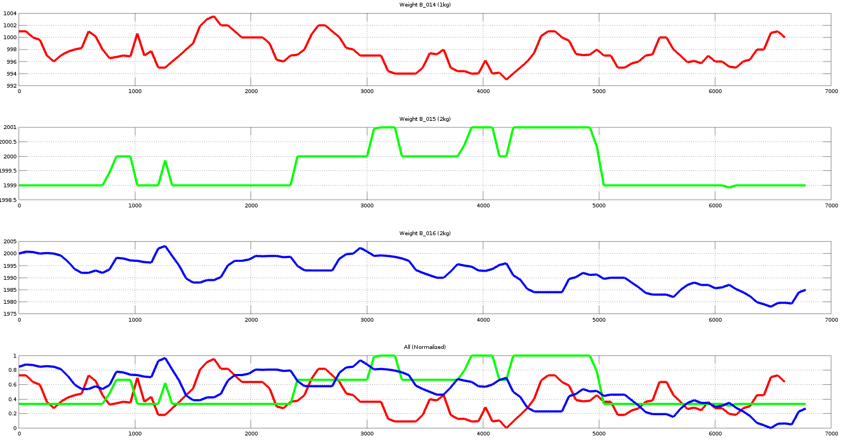
Our observations on data accuracy
Through putting together this system ourselves we experienced first-hand how much noise there is in raw-sensor output
Notes:
This is my favourite graph to show off, and everyone I know is surely sick of me talking about it
These three lines show 3 different weighing stations (load-cells)
Each with a constant weight on them
Readings taken every minute for 5 days~
There is a lot of noise and it’s things like this that make me not trust proprietary systems I can’t inspect myself.
We know we need to find workaroudns for this, but the correction methods we apply will greatly change the output.
And makes things a lot harder to replicate for others
It’s rather important in science if we can replicate the experiments of others…

Slide 10
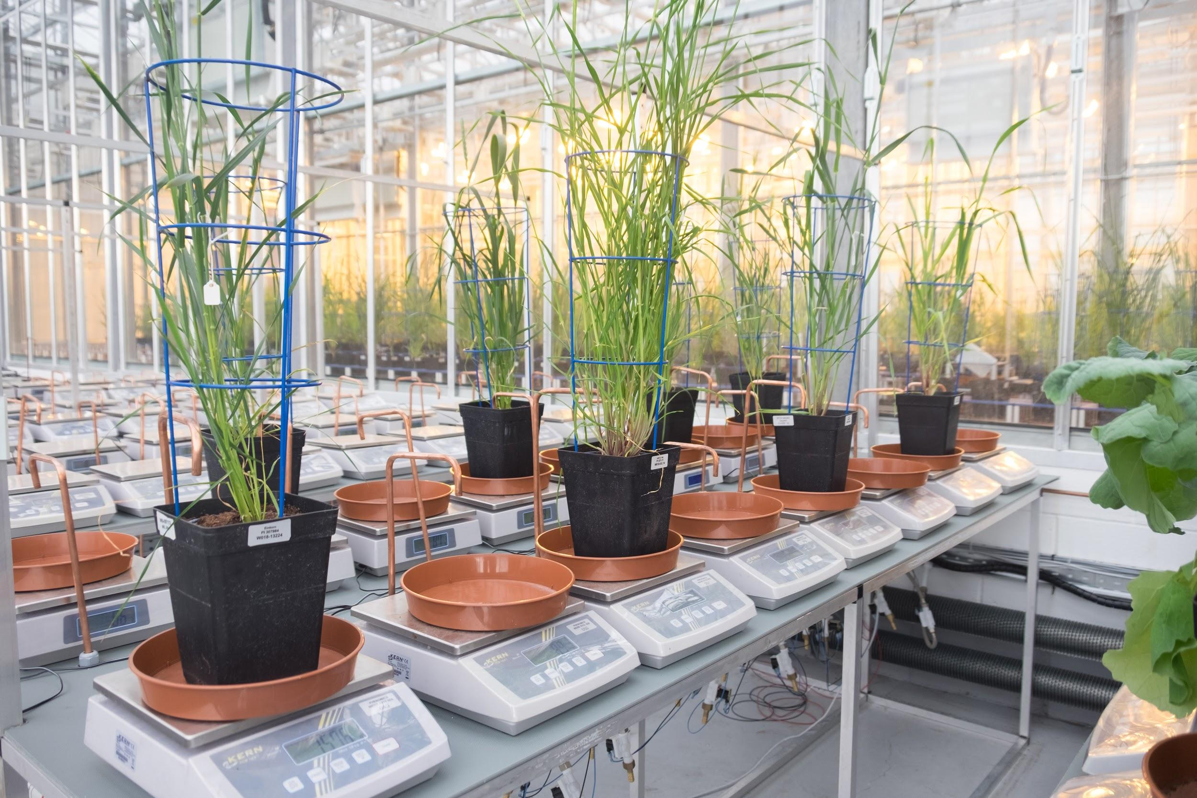
What we have opened up!
Everything from sketches we have done to parts lists we’ve priced and sourced are completely open
As is all of the software we have written is completely libre.
We feel that complete data transparency is the only way to trust what is produced
Open-source suits this for constantly rolling new
techniques into the system
Notes:
And that’s why we’ve made this system open!
So that there is complete transparency
We have open-sourced everything in our system that we’ve built
From rough sketches and ideas
To parts lists, suppliers and costs

Slide 11

Thanks!
FOSDEM lightning talks for having me!
Aberystwyth University
National Plant Phenomics Centre
Contributions from so many people at the University
BBSRC for funding us.
And Bruce Springsteen for being the backing track whilst all this work was done
Notes:
Thanks for letting me give this talk!
Thanks for listening
And thank you to everyone at Aber U, NPPC and BBSRC for the funding of this!

Slide 12
Source Code and Contact
All components are freely available:
Main Repo - https://github.com/NPPC-UK/Gravimetrics
Controller - https://github.com/NPPC-UK/Gravimetrics/tree/master/Controller
Web - https://github.com/NPPC-UK/Gravimetrics/tree/master/Website
Contact:
nah31@aber.ac.uk | nathan1hughes@gmail.com | Twitter: @SirSharpest
Notes:
Would love it for people to have a look at our code
Especially if you fix any bugs I’ve made (surely must be a few)
Each component was a submodule at one point, but became too much for what was needed.
Would also love if anyone wants to have a chat about anything to drop me an email, tweet or hunt me down before I leave tomorrow!

