Slide 1

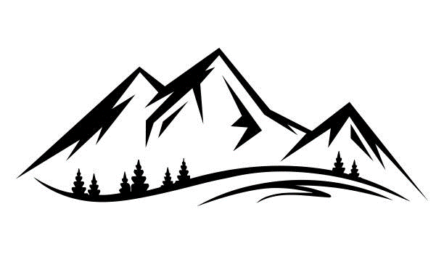
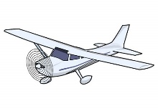
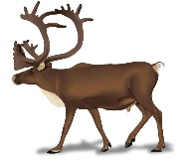
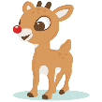
VHF collars help locate animal groups
GPS collar ‘pings’ captured by
Animal_Movement database
Aerial survey detects
an animal group
NPS Animal Movement
database
Caribou group attributes recorded
and captured in WRST_Caribou
database
GPS/VHF collar
NPS WRST Caribou database
Group # | Lat | Lon | Bull | Cow | Calf
1 | 62.467633 | -144.2366 | 3 | 0 | 1

Slide 2
NPS Animal Movement
database
NPS WRST Caribou database
AnimalID

Slide 3
Chisana PE Survey
1. Survey area delineated by locating all radio collared animals
2. Search for caribou groups without radiolocating. Simultaneously, a fixed-wing aircraft locates radiocollared caribou to determine their locations and group sizes

