Slide 1
Project Samael - “The Blind God“ -
Christoph Lämmerhirt
Sarah Pauksch
Tim Benedict Jagla
Advanced Topics in Image Understanding - SS13

Slide 2
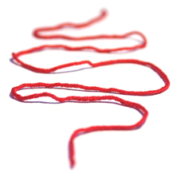
Outline
Occured Problems
Approach
Explorative Data Analysis
Project Samael

Slide 3
1. Occured Problems
Qt doesn't provide the necessary OpenGL functionality → native OpenGL
Large Dataset Iteration (unoptimized / windows)
QtDir::entryList() – Slow (Known Bug)
QtDirIterator –9200 Files ~5min
Project Samael

Slide 4
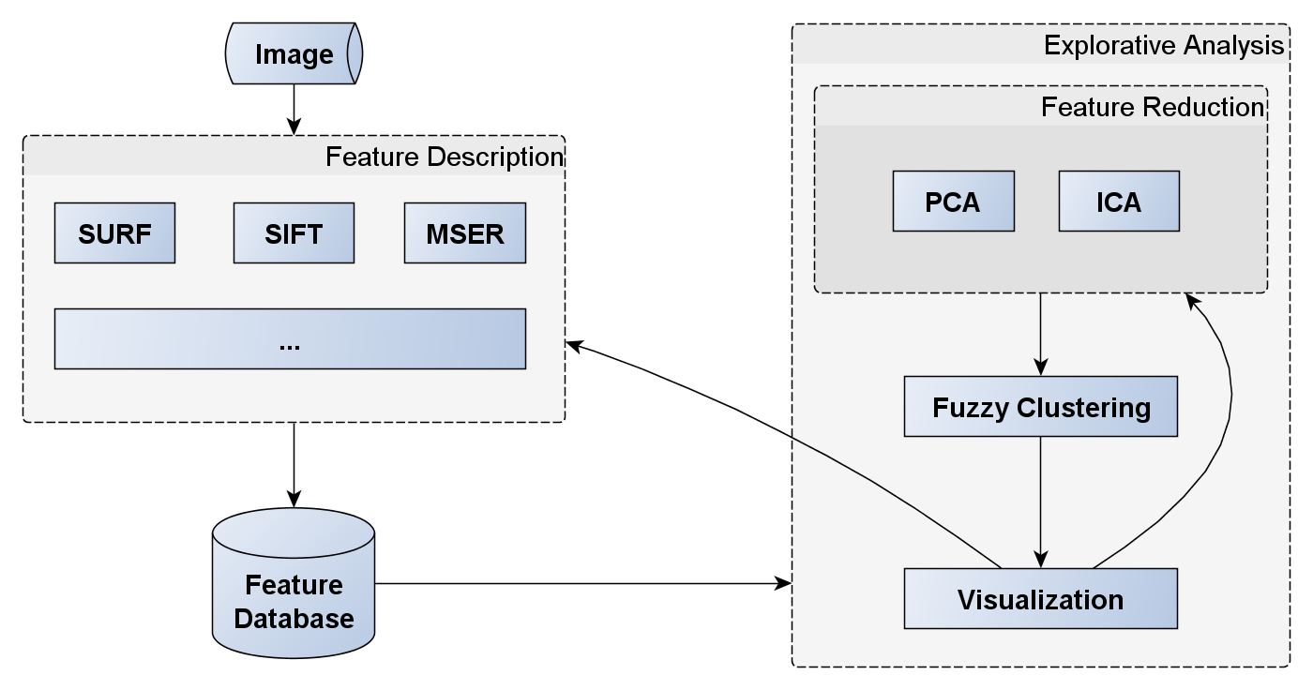
3. Approach
Project Samael

Slide 5
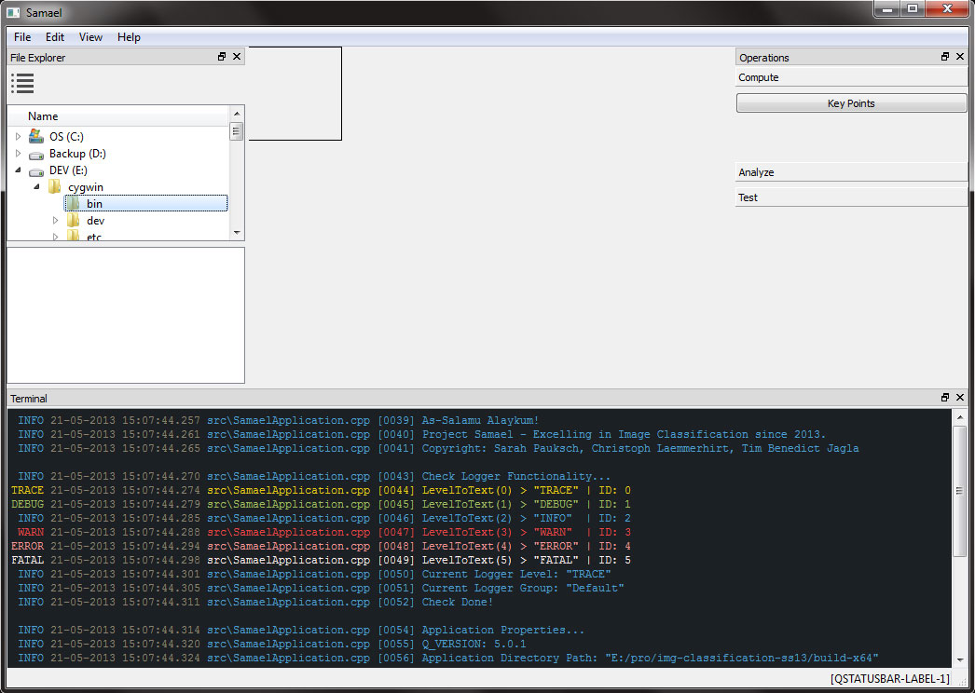
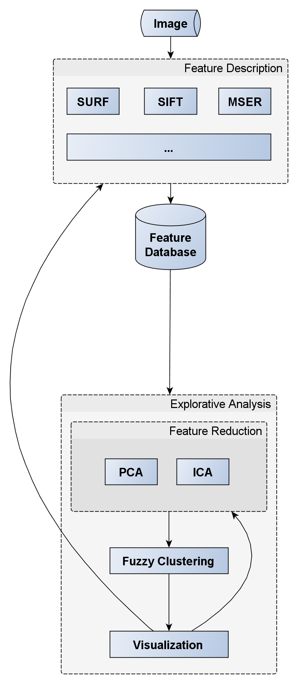
3. Approach
Project Samael

Slide 6
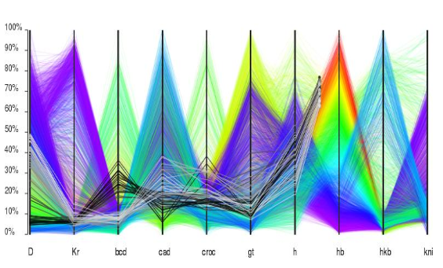
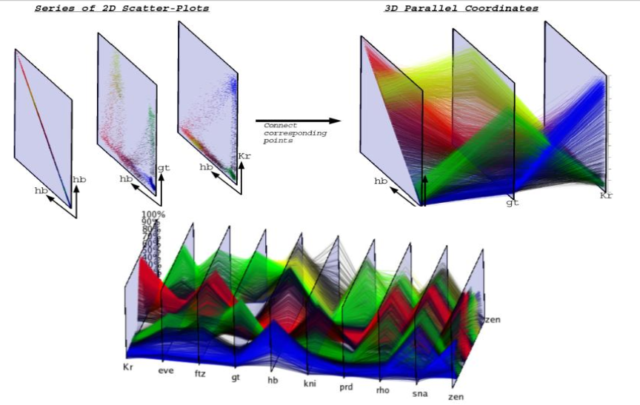
Explorative Data Analysis
Parallel coordinates
Continuous 3D Scatterplots
Project Samael

Slide 7
Thank you
for your attention.

