Slide 1
Project Samael - “The Blind God“ -
Christoph Lämmerhirt
Sarah Pauksch
Tim Benedict Jagla
Advanced Topics in Image Understanding - SS13

Slide 2
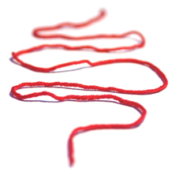
Outline
Repetition
Feature Space
Classification
Project Samael

Slide 3
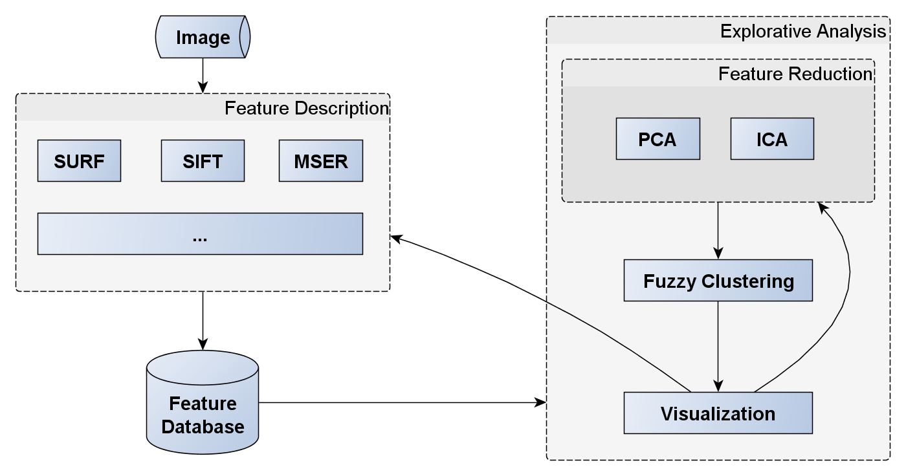
Repetition: Our Plan
Project Samael

Slide 4
Feature Space
SIFT keypoints:
unknown number of points
SIFT descriptors:
gradient location (4 x 4 grid)
gradient orientation (8 bins)
4 * 4 * 8 = 128 dimensional descriptor
Project Samael

Slide 5
Feature Space
Bag of Words dictionary/vocabulary
all descriptors from the training dataset are clustered by a K-Means algorithm
creation of histograms for each cluster
…each filled with the keypoints of their respective cluster
Project Samael

Slide 6
SVM Training
now the histograms represent our feature vectors
Support-Vector-Machine training
the currently trained class will always be marked as positive, everything else as negative
this enables a 1-vs-all classifier
Project Samael

Slide 7
Classification
Input Image
search for the best separation of the histogram of our test image in regard to the existing classes
Project Samael

Slide 8
Thank you
for your attention.

