Slide 1
Project Samael - “The Blind God“ -
Christoph Lämmerhirt
Sarah Pauksch
Tim Benedict Jagla
Advanced Topics in Image Understanding - SS13

Slide 2
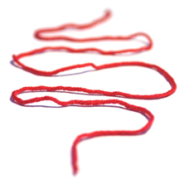
Outline
Occured Problems
Solutions
Explorative Data Analysis
Project Samael

Slide 3
1. Occured Problems
QPainter vs. OpenGL
QtDir entryList() → langsam
QtDirOperator benötigt ebenfalls 5 Minuten
Project Samael

Slide 4
2. Solutions
...
Project Samael

Slide 5
3. Explorative Data Analysis
Project Samael

Slide 6
Thank you
for your attention.

