Slide 1
Project Samael - “The Blind God“ -
Christoph Lämmerhirt
Sarah Pauksch
Tim Benedict Jagla
Advanced Topics in Image Understanding - SS13

Slide 2
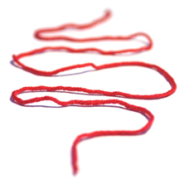
Outline
Occured Problems
Solutions
Approach
Explorative Data Analysis
Project Samael

Slide 3
1. Occured Problems
QPainter vs. OpenGL
Large Dataset Iteration (unoptimized / windows)
QtDir::entryList() – Slow (Known Bug)
QtDirIterator –9200 Files ~5min
Project Samael

Slide 4
2. Solutions
...
Project Samael

Slide 5
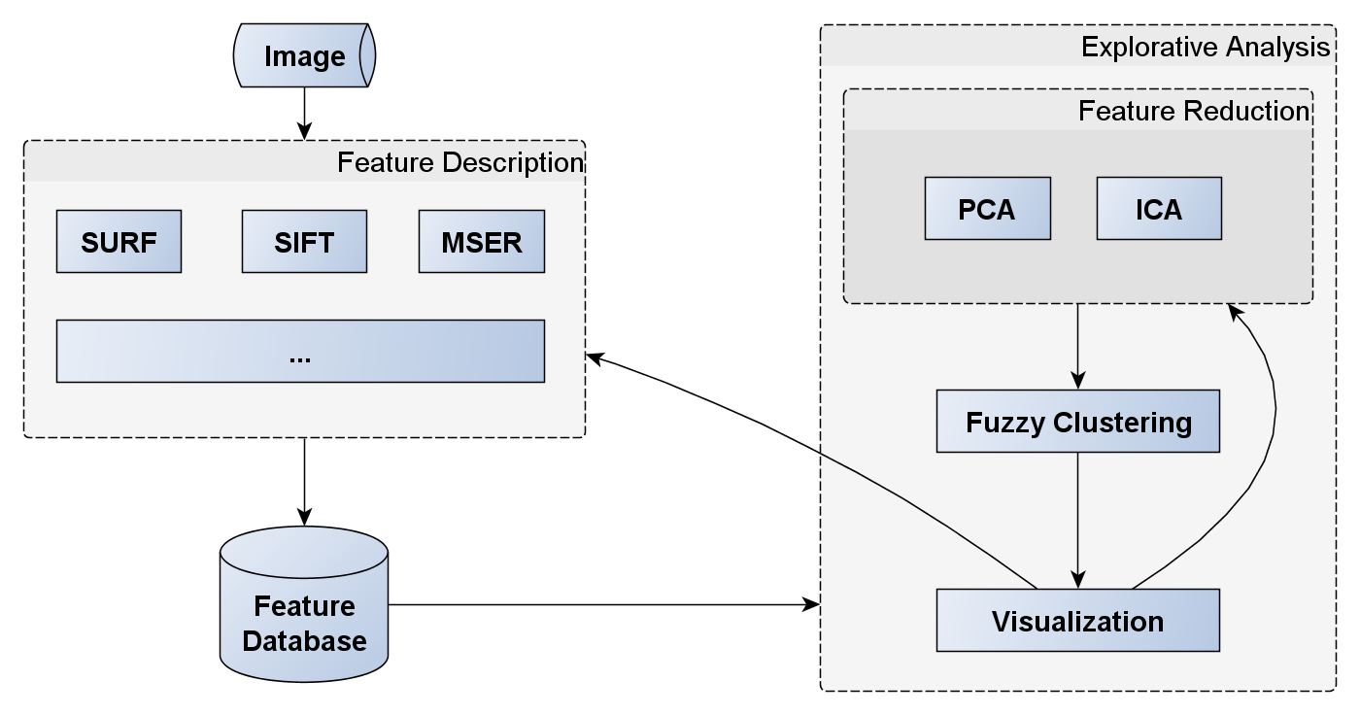
3. Approach
Project Samael

Slide 6
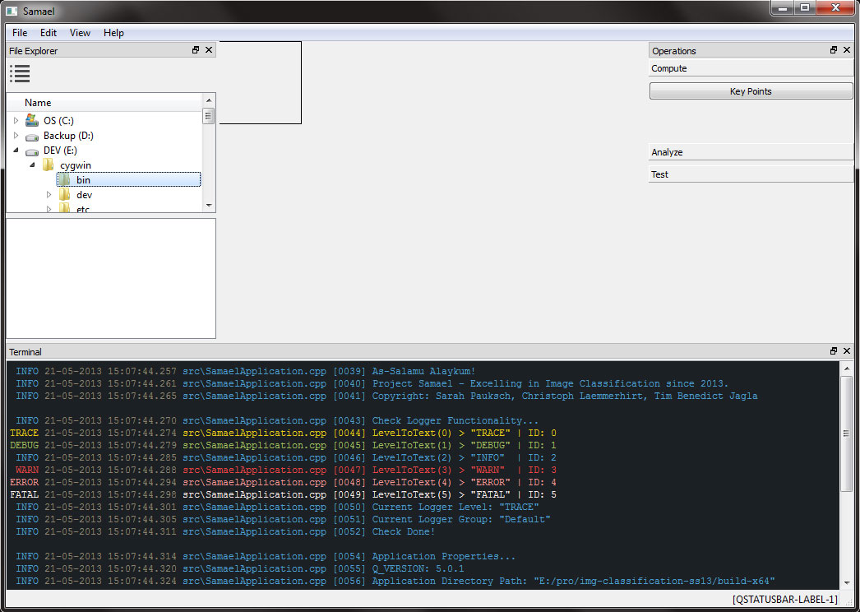
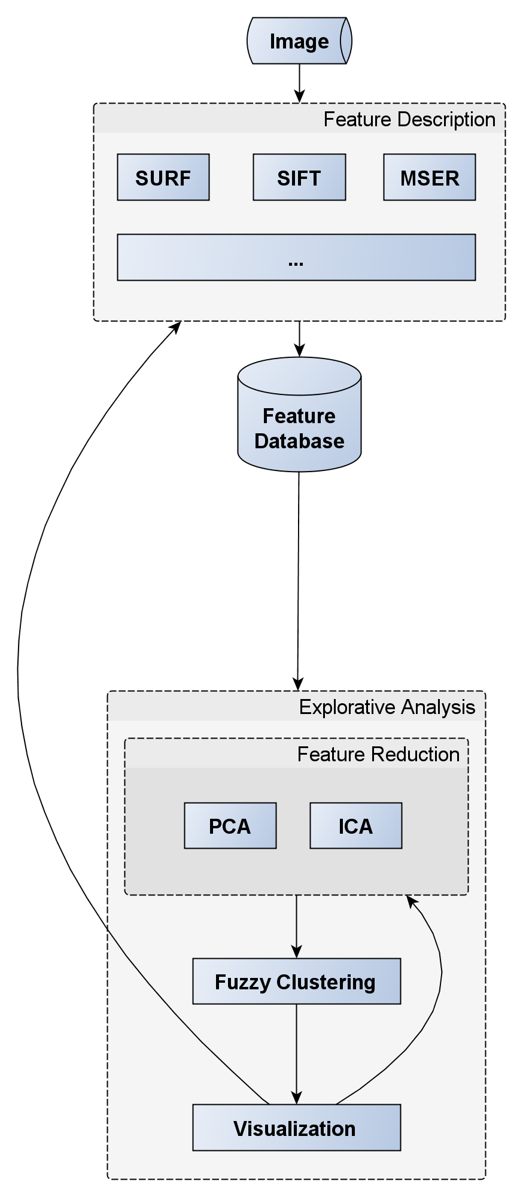
3. Approach
Project Samael

Slide 7
Explorative Data Analysis
Project Samael

Slide 8
Thank you
for your attention.

