Slide 1
Währungsrechner
Klara, Sandra, Nadine

Slide 2
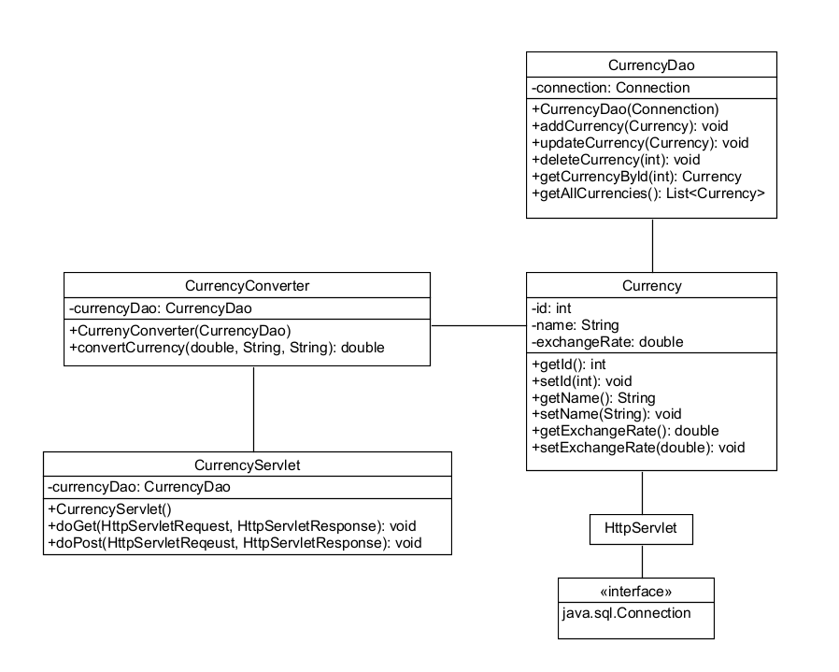
Aufbau

Slide 3
Datenbank
// Create a SQL script to create the database and the currencies table
CREATE DATABASE currency_converter;
USE currency_converter;
CREATE TABLE currencies (
id INT NOT NULL AUTO_INCREMENT,
name VARCHAR(50) NOT NULL,
exchange_rate DOUBLE NOT NULL,
PRIMARY KEY (id)
);
INSERT INTO currencies (name, exchange_rate) VALUES ('USD', 1);
INSERT INTO currencies (name, exchange_rate) VALUES ('EUR', 0.84);
INSERT INTO currencies (name, exchange_rate) VALUES ('GBP', 0.72);
INSERT INTO currencies (name, exchange_rate) VALUES ('JPY', 109.98);
INSERT INTO currencies (name, exchange_rate) VALUES ('AUD', 1.28);

Slide 4
Interface
</c:forEach>
</select><br><br>
<label for="to_currency">To:</label>
<select name="to_currency" id="to_currency">
<c:forEach items="${currencies}" var="currency">
<option value="${currency.name}">${currency.name}</option>
</c:forEach>
</select><br><br>
<input type="submit" value="Convert">
</form>
<c:if test="${not empty result}">
<p>${amount} ${from_currency} = ${result} ${to_currency}</p>
</c:if>
</body>
</html>
<!DOCTYPE html>
<html>
<head>
<title>Currency Converter</title>
</head>
<body>
<h1>Currency Converter</h1>
<form method="post">
<label for="amount">Amount:</label>
<input type="number" name="amount" id="amount"><br><br>
<label for="from_currency">From:</label>
<select name="from_currency" id="from_currency">
<c:forEach items="${currencies}" var="currency">
<option value="${currency.name}">${currency.name}</option>

Slide 5
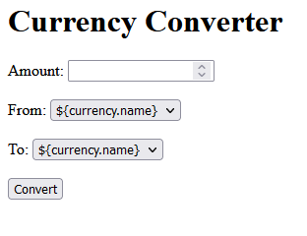

Slide 6
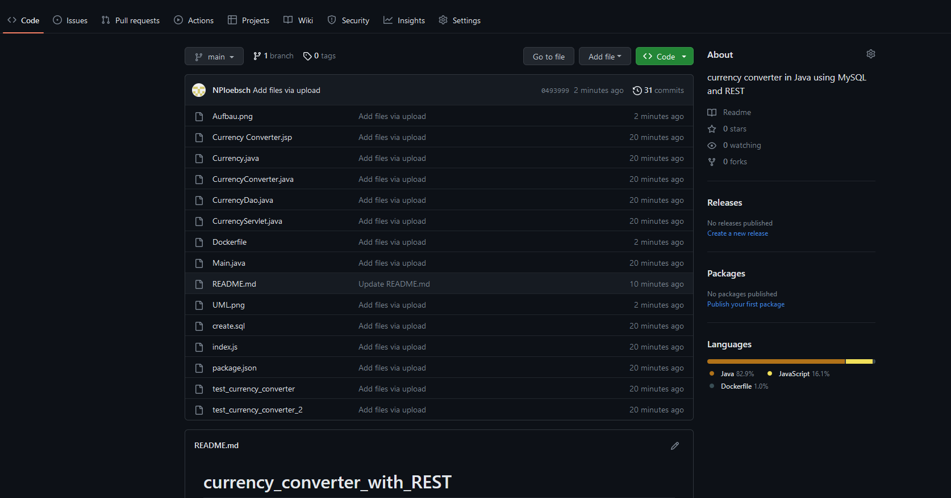
Status: https://github.com/NPloebsch/currency_converter_with_REST.git

Slide 7
