Slide 1
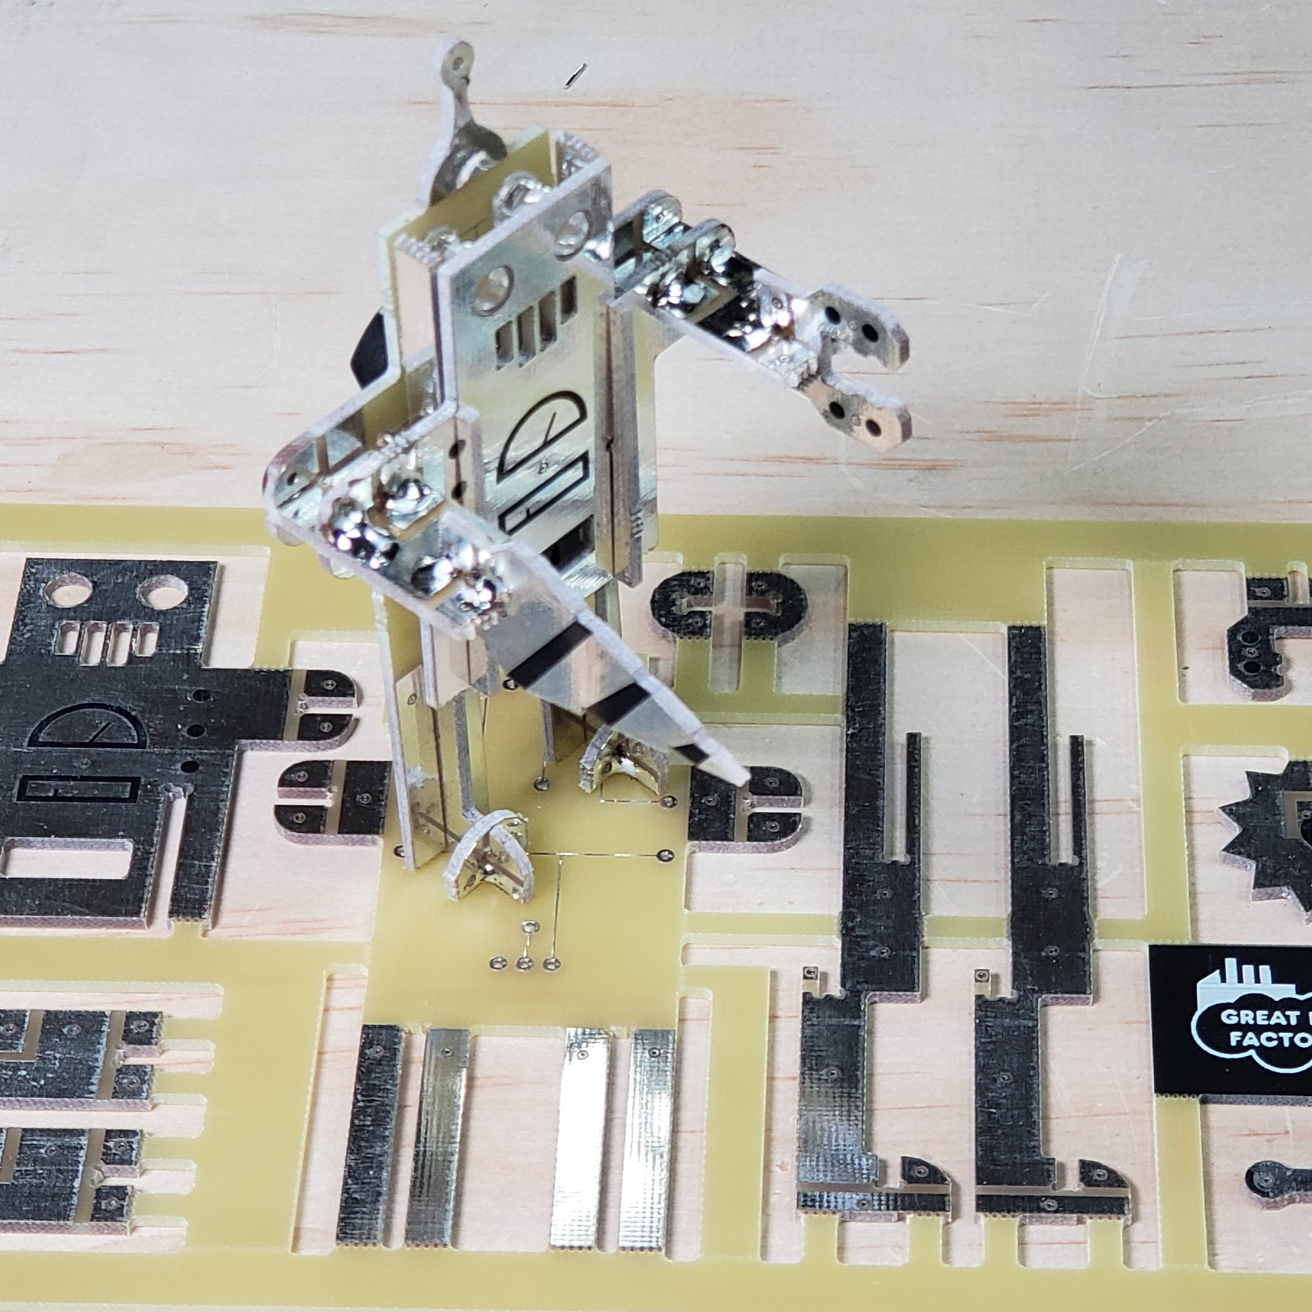
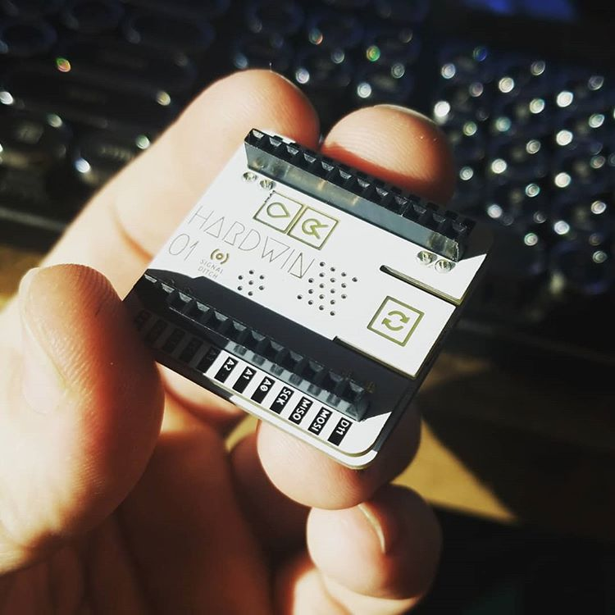
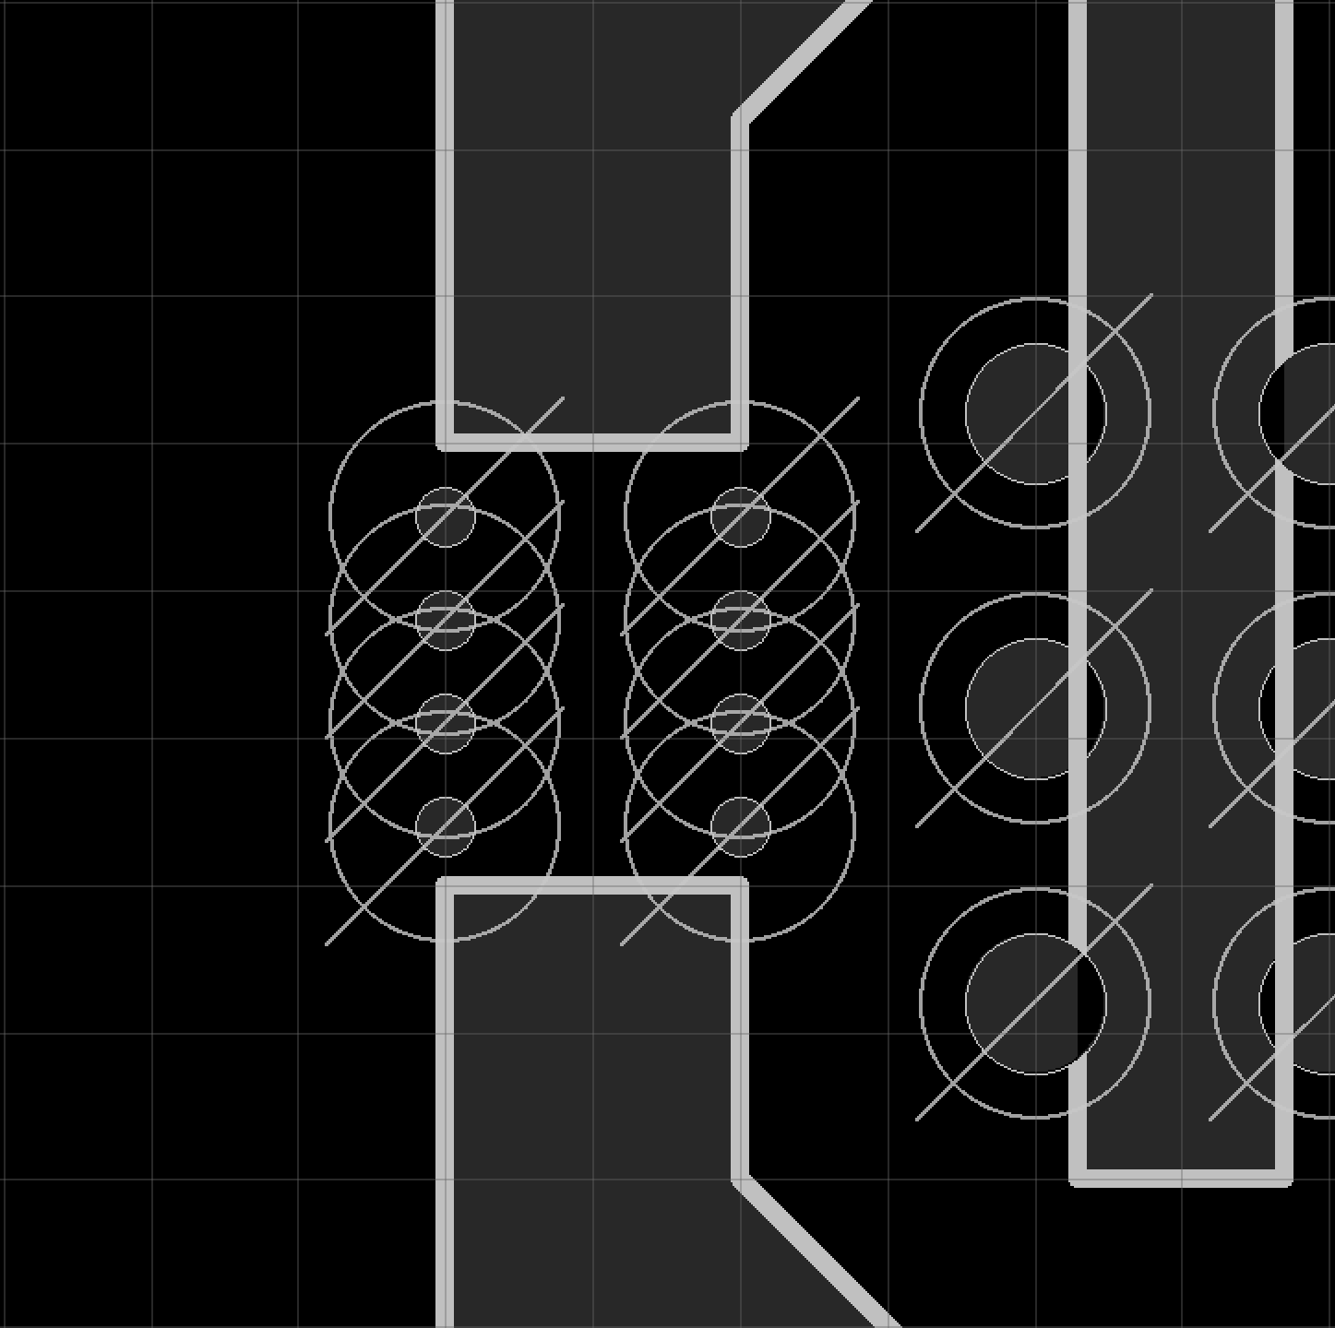
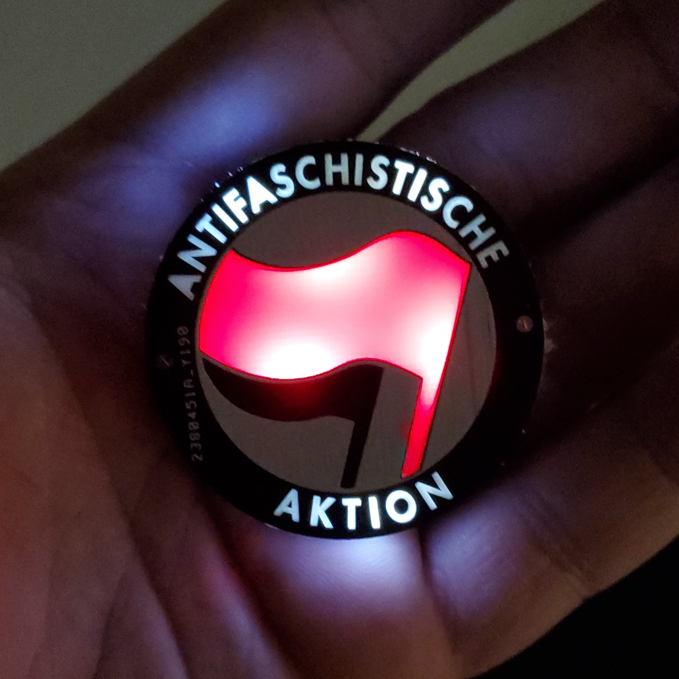
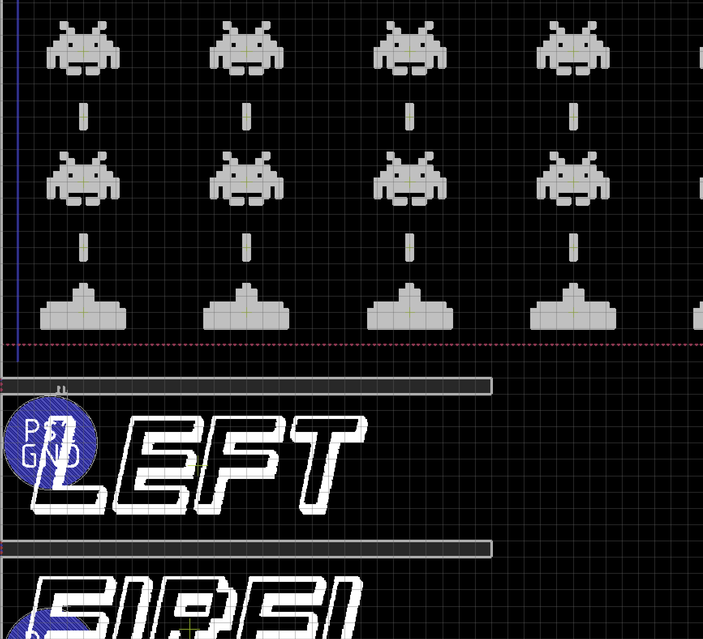
Boggling the Boardhouse
Designing 3D Structures, Circuits, and Sensors from PCBs

Slide 2
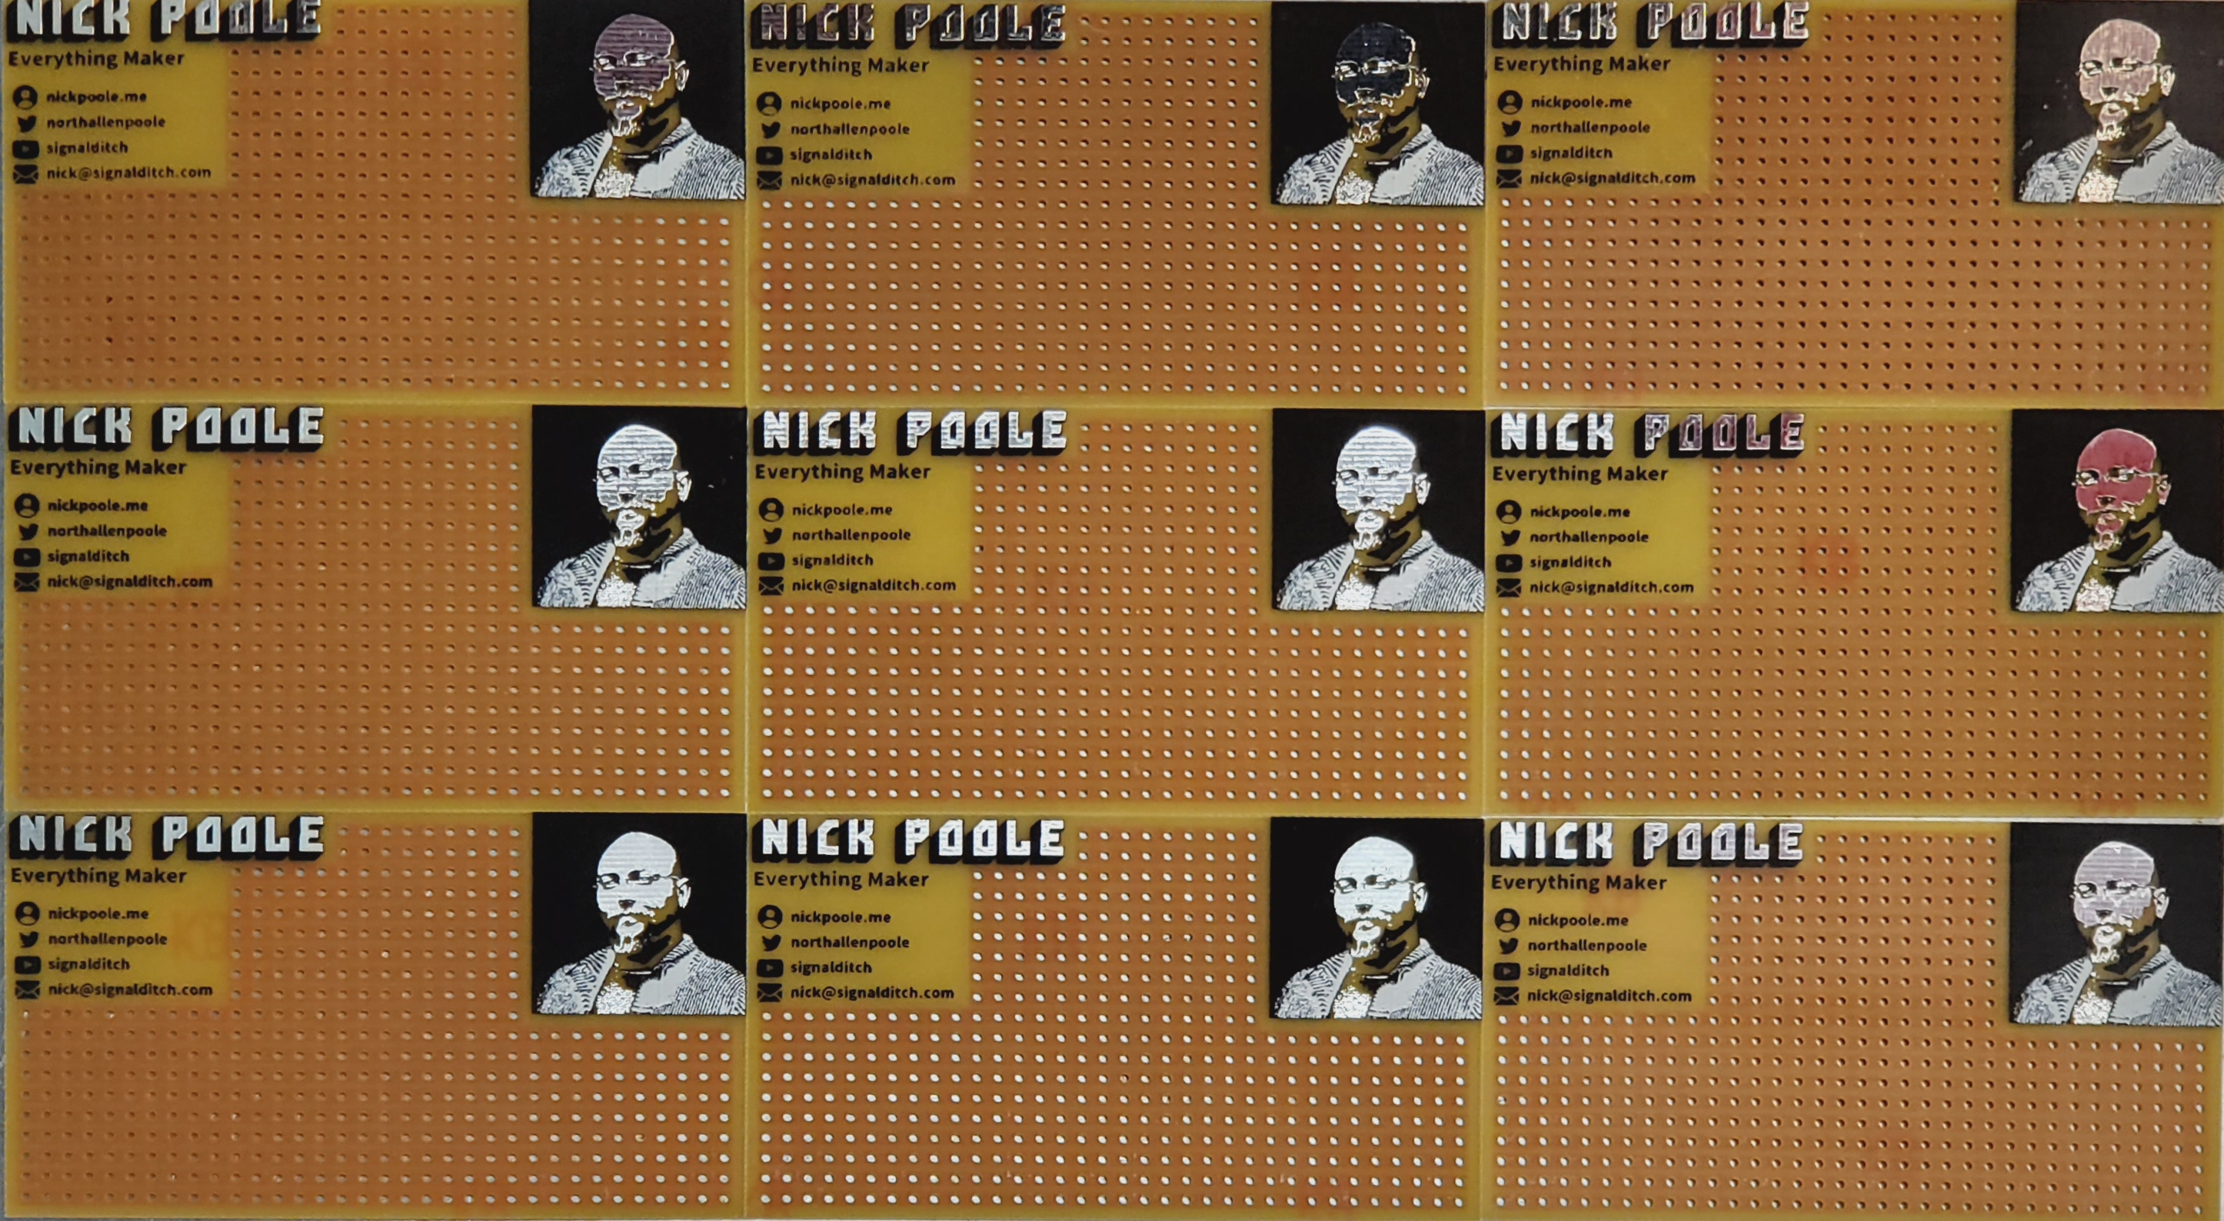
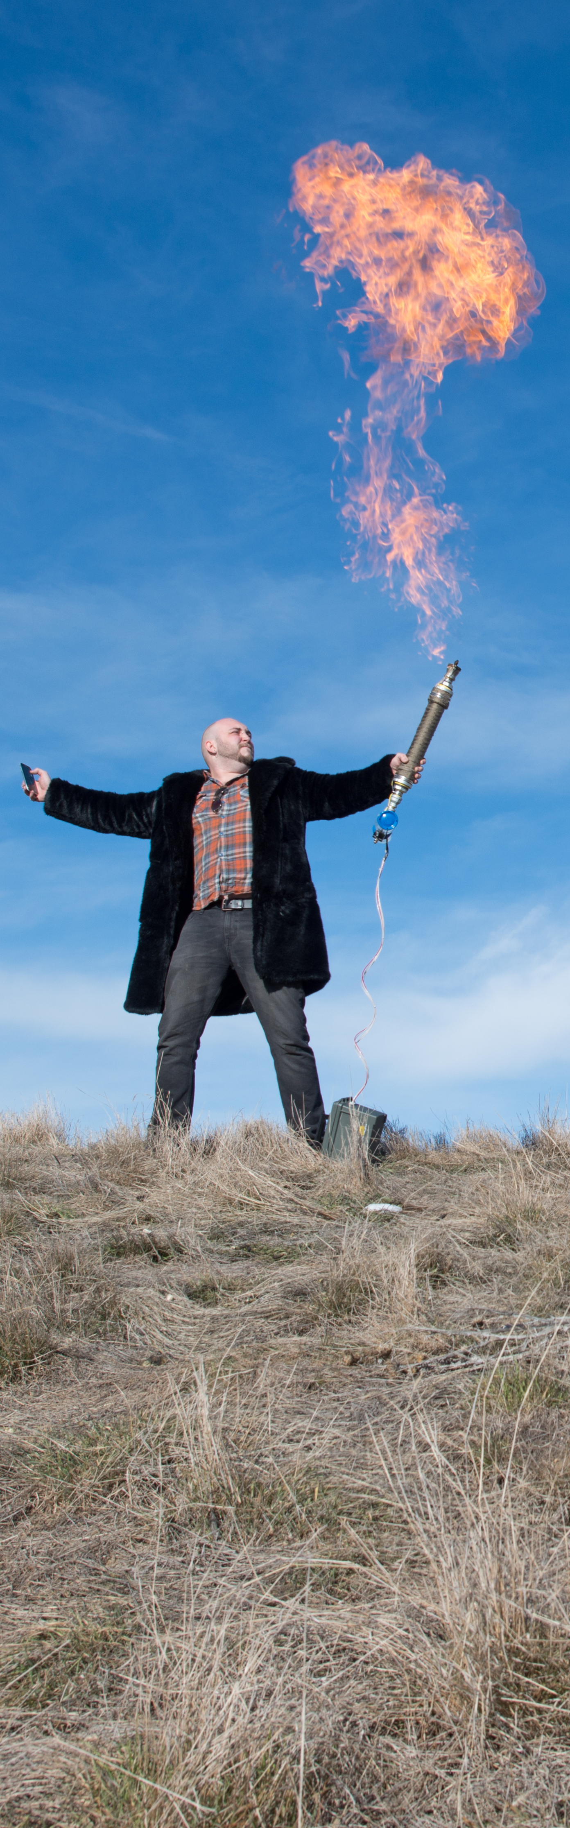

About Me

Slide 3
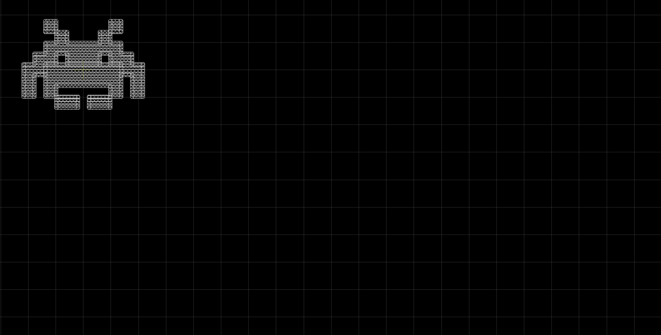
The Basics:
Bringing Weird Shapes into EDA

Slide 4




Bringing Weird Shapes into EDA
Method 1: “svgtoeagle” by Gordon Williams
svgtoeagle

Slide 5

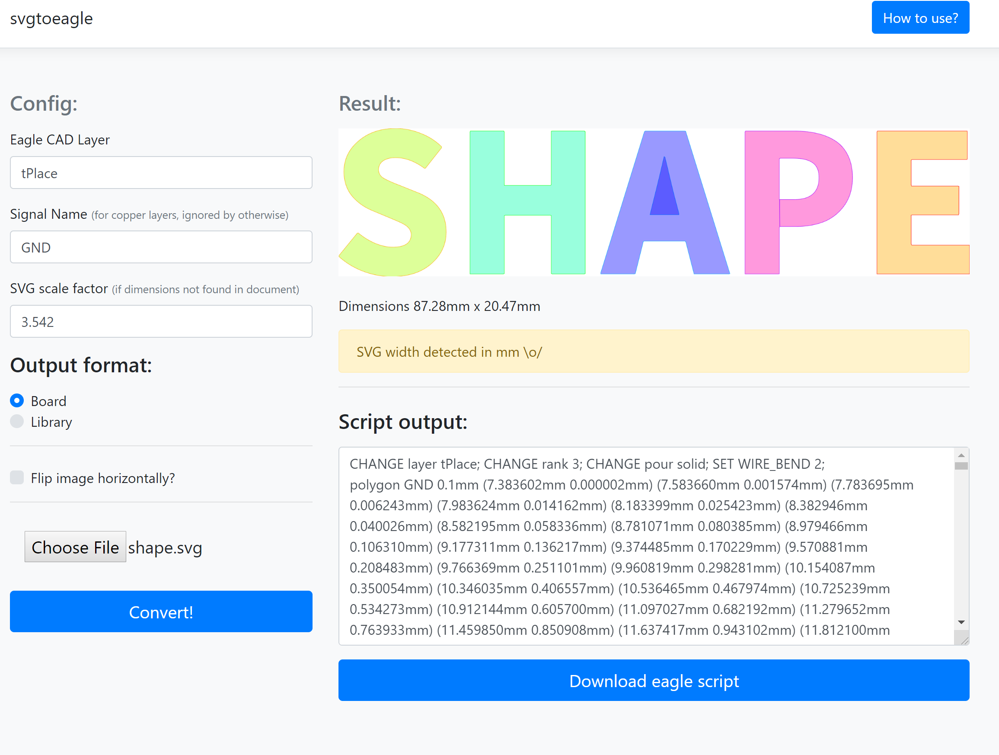

Bringing Weird Shapes into EDA
Method 1: “svgtoeagle” by Gordon Williams

Slide 6
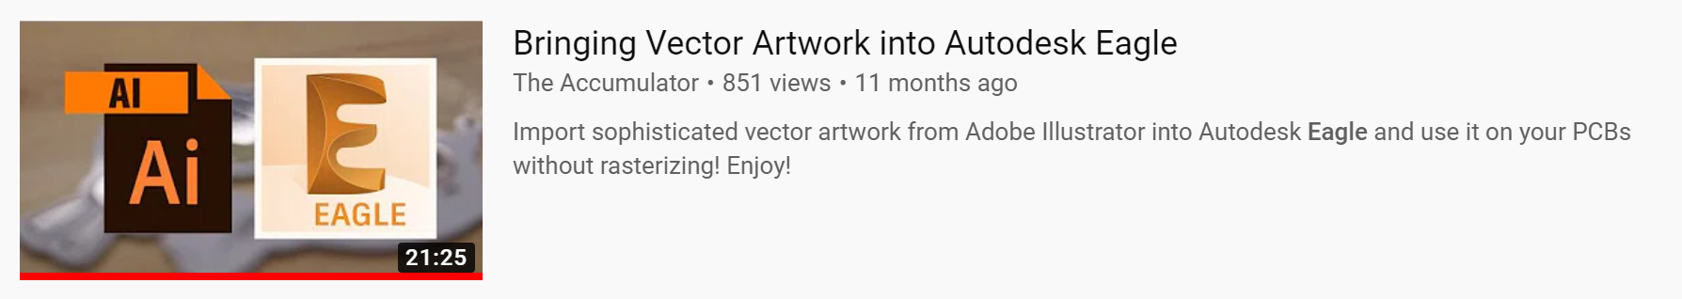
Bringing Weird Shapes into EDA
Method 1: “svgtoeagle” by Gordon Williams

Slide 7
Bringing Weird Shapes into EDA
Method 1: “svgtoeagle” by Gordon Williams
Advantages
Disadvantages
Small file sizes
Image must be a vector drawing
Accurate dimensions
Some pre-processing is required
Create filled polygons / pours
Moving imported items is a pain
(unless you create a footprint)

Slide 8


Bringing Weird Shapes into EDA
Method 2: Buzzard Image Importer

Slide 9

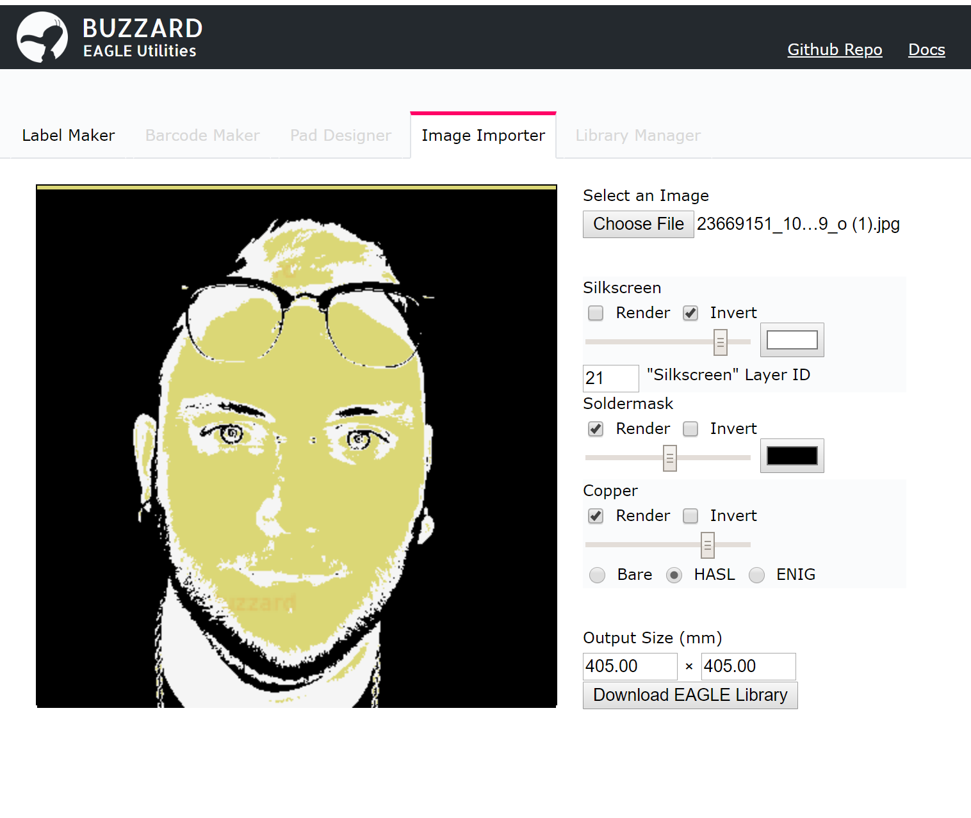
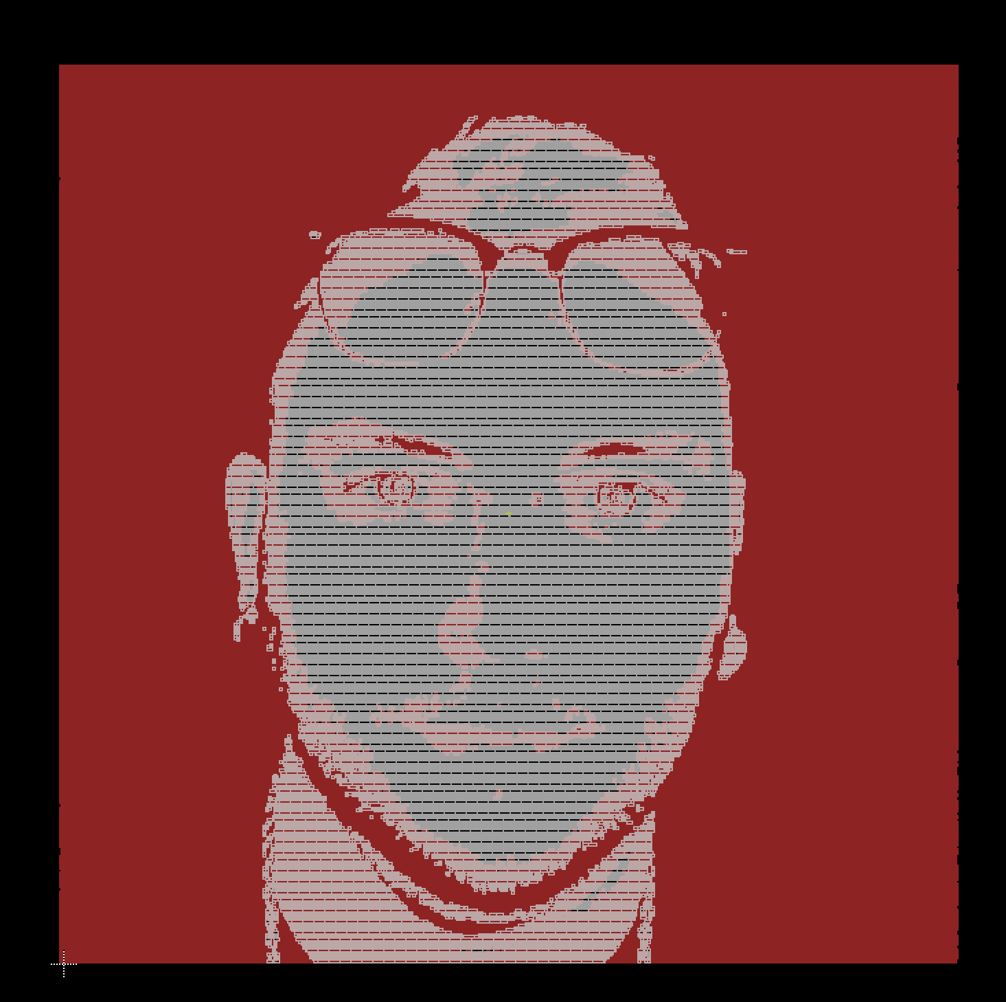
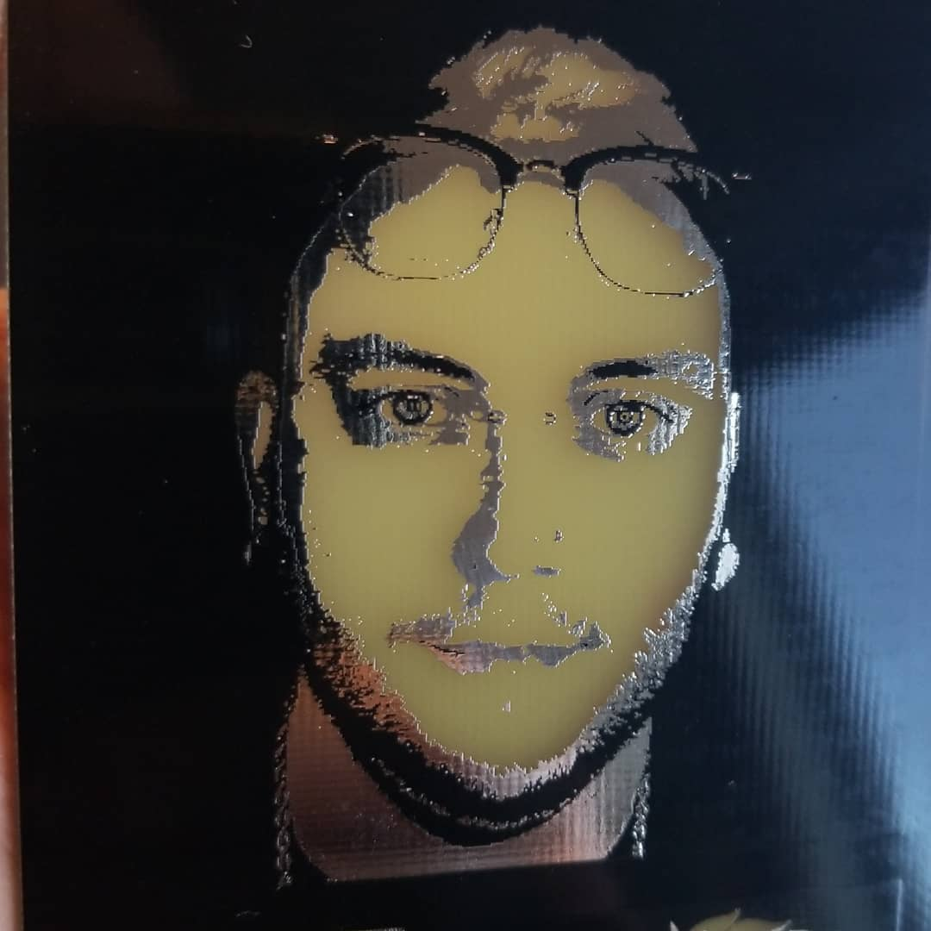
Bringing Weird Shapes into EDA
Method 2: Buzzard Image Importer

Slide 10
Bringing Weird Shapes into EDA
Method 2: Buzzard Image Importer
Advantages
Disadvantages
Basically any image format
Very large file sizes
Preview and generate
Silk, mask, and copper
Layers together
Long CAM processing times
Fixed import resolution
Exports library footprint

Slide 11
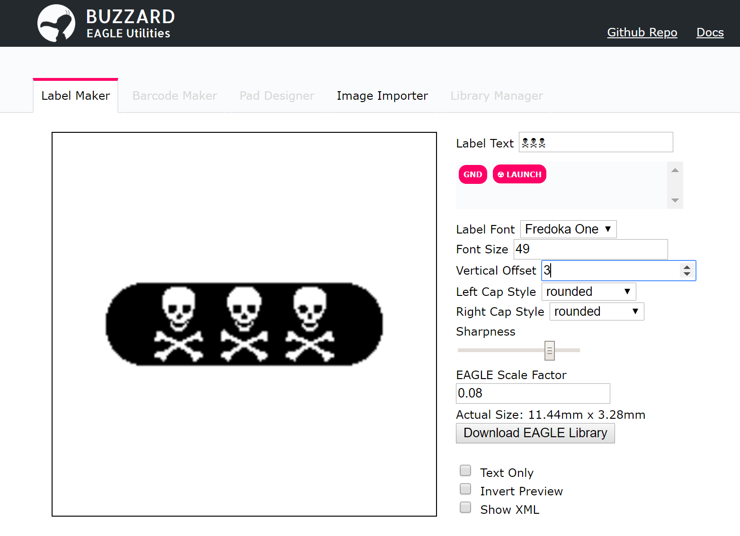

Bringing Weird Shapes into EDA
Method 2b: Buzzard Label Maker

Slide 12
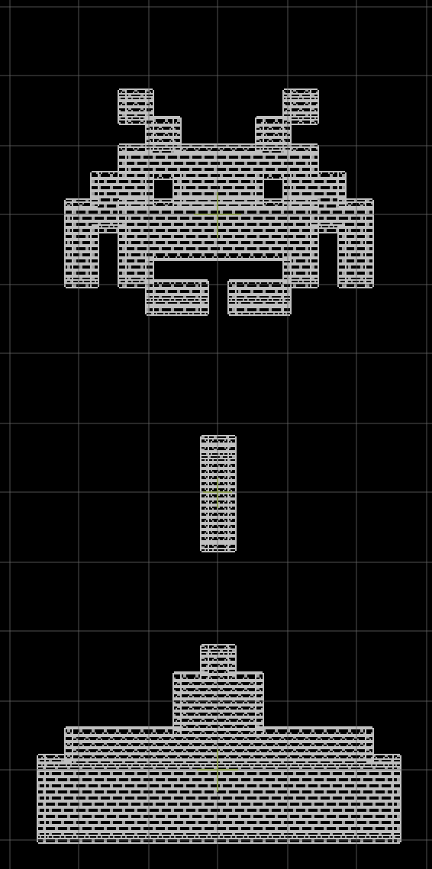
Bringing Weird Shapes into EDA
Method 3: Just Draw it with Lines

Slide 13
Bringing Weird Shapes into EDA
Method 3: Just Draw it with Lines
Advantages
Disadvantages
Works in any EDA
EDA tools are bad for drawing
No external tools
You have to draw a thing
Great for pixel art

Slide 14
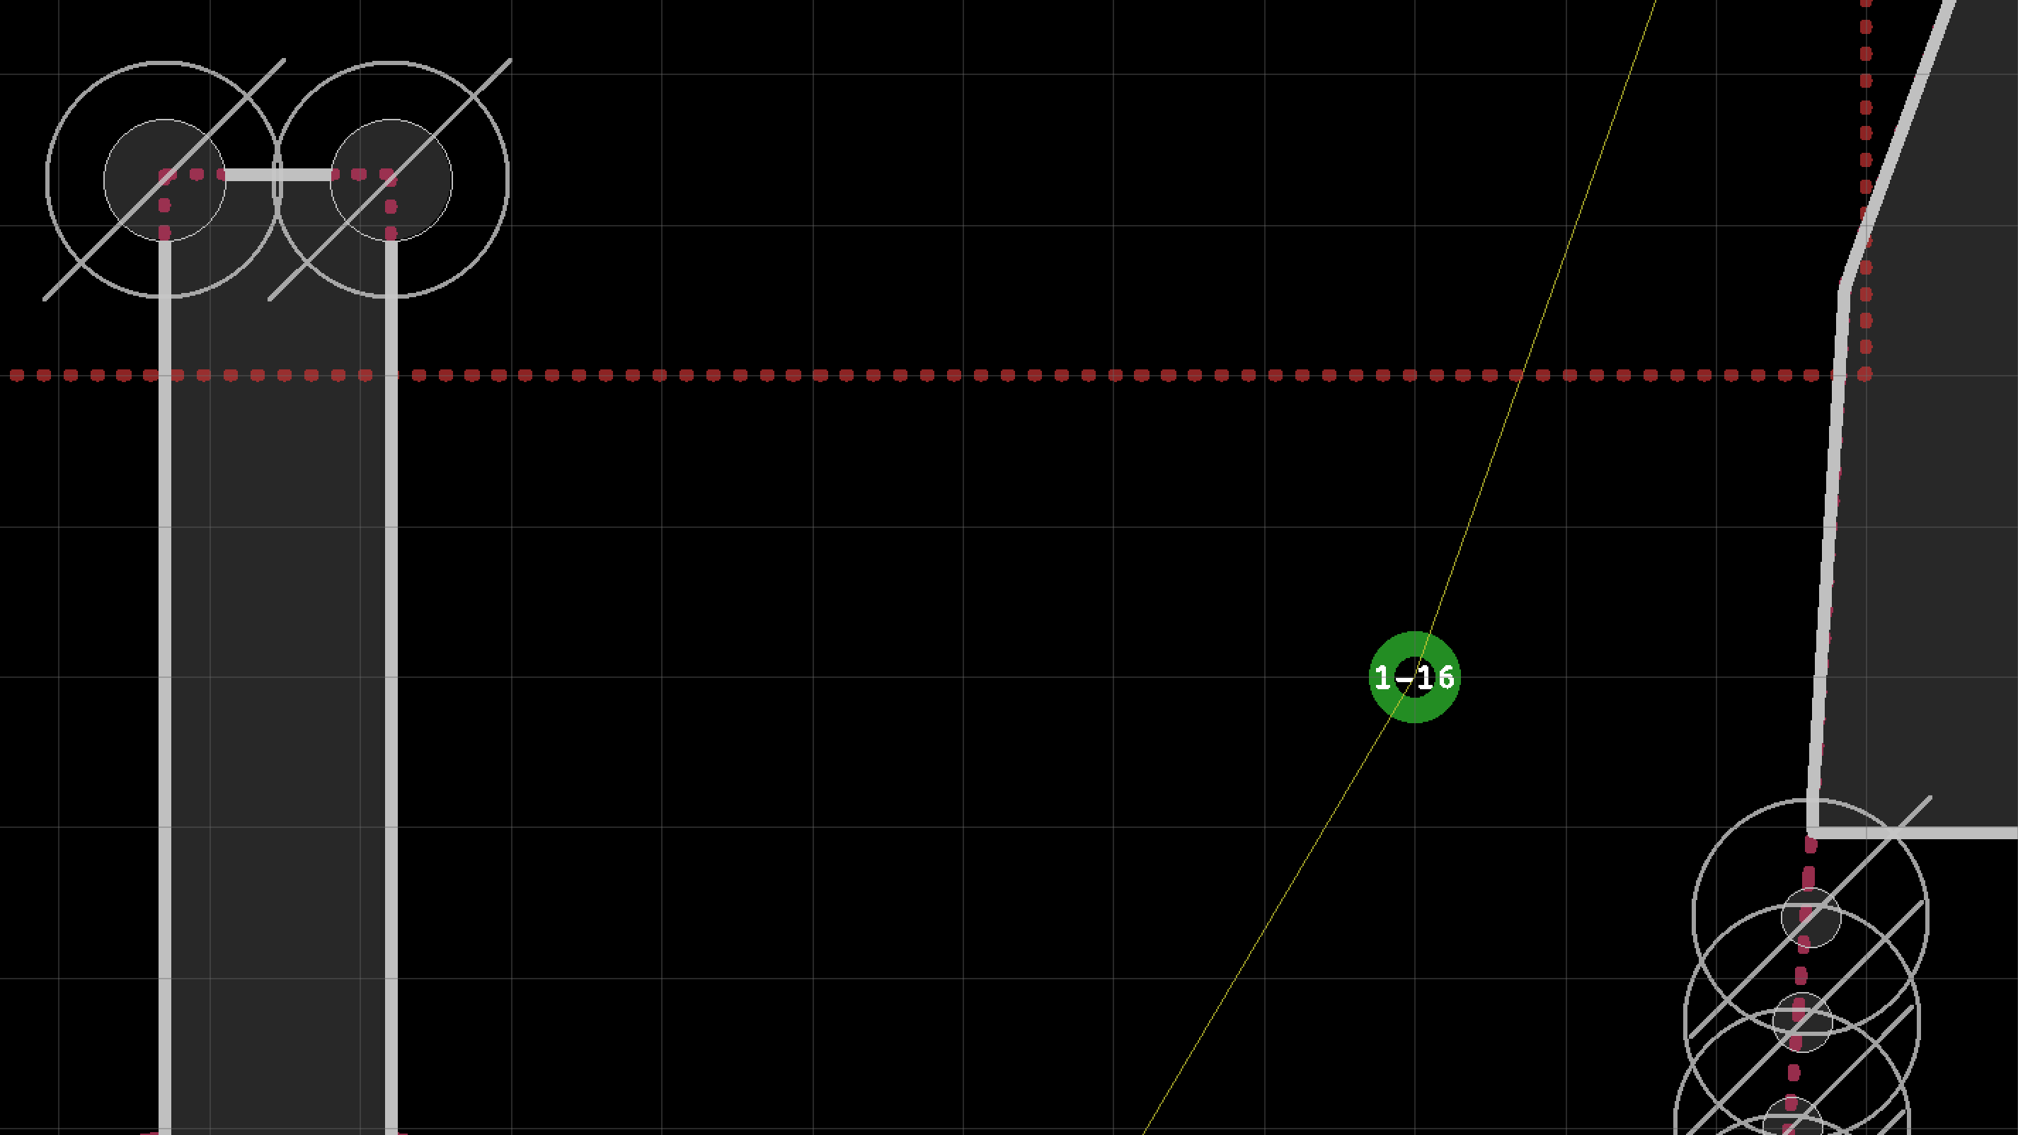
Tab and Slot:
The Inside Corner Problem

Slide 15
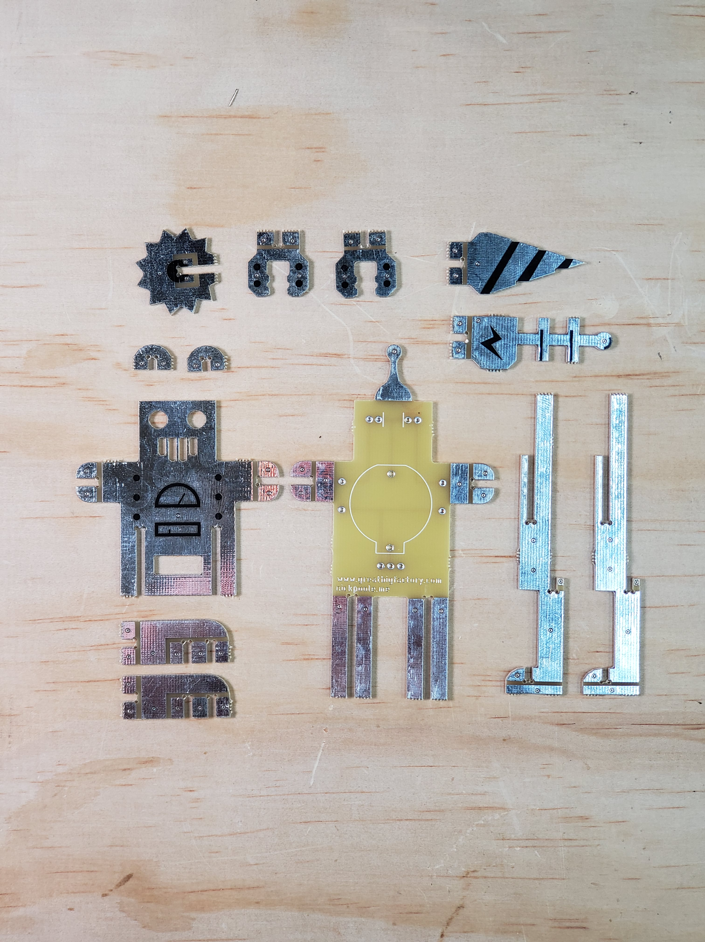
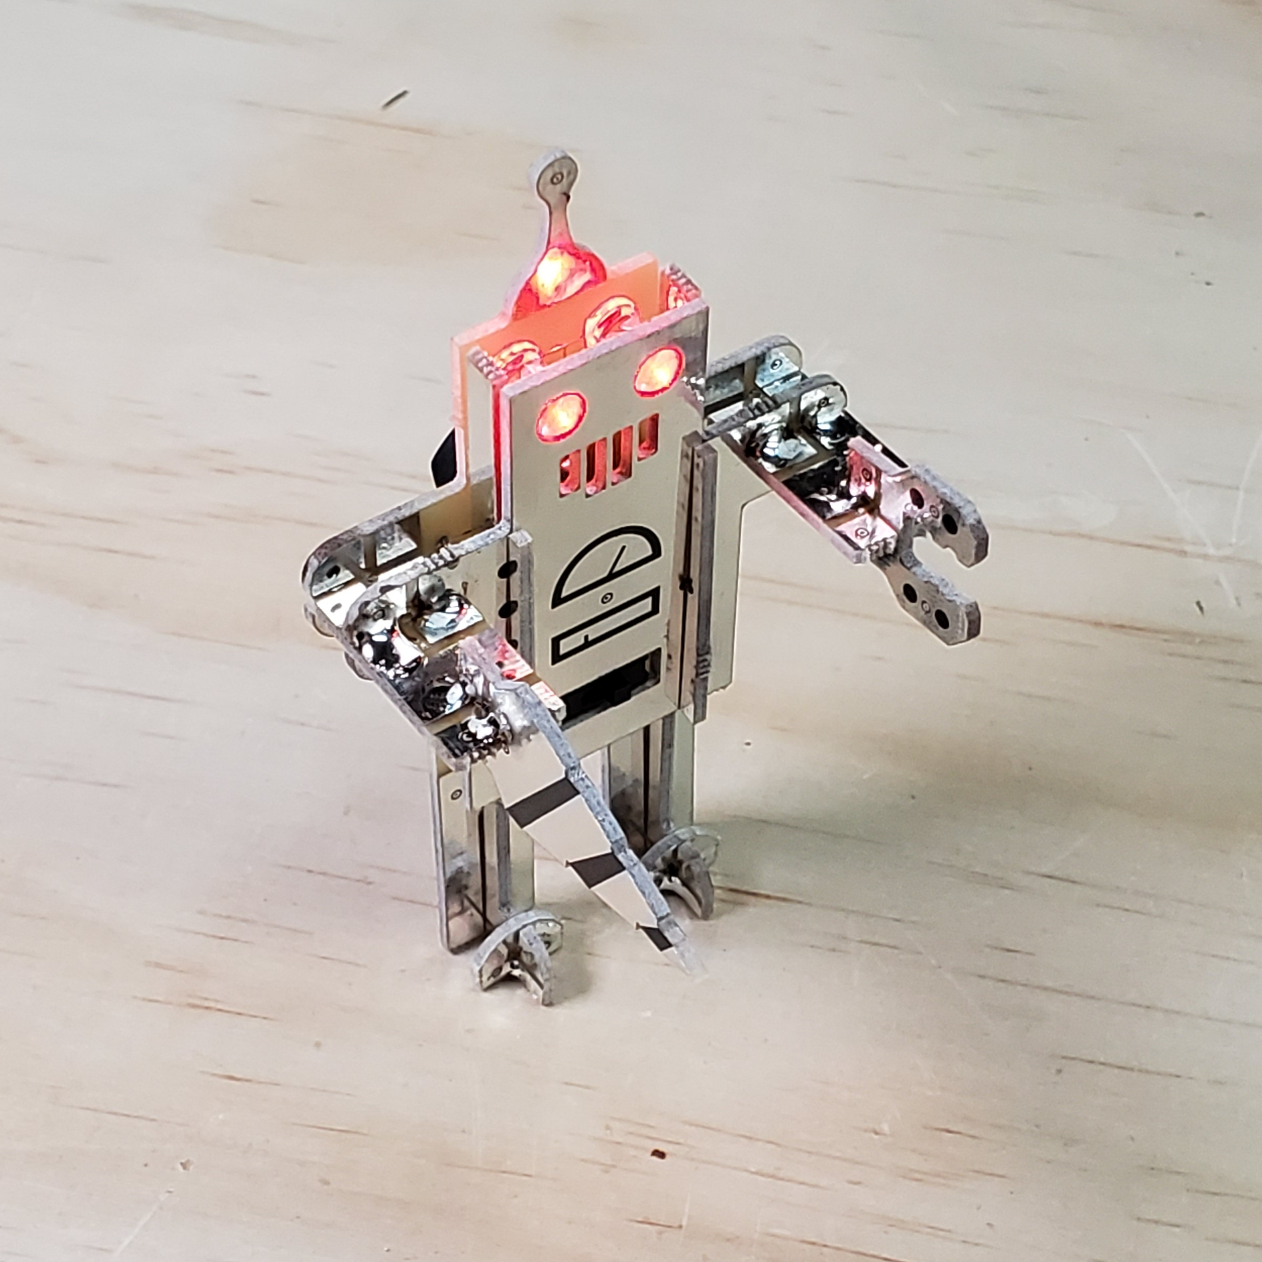
The Inside Corner Problem
What’s the problem?

Slide 16
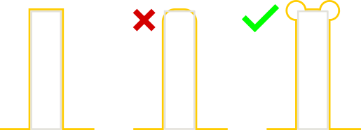
The Inside Corner Problem
What’s the problem?

Slide 17
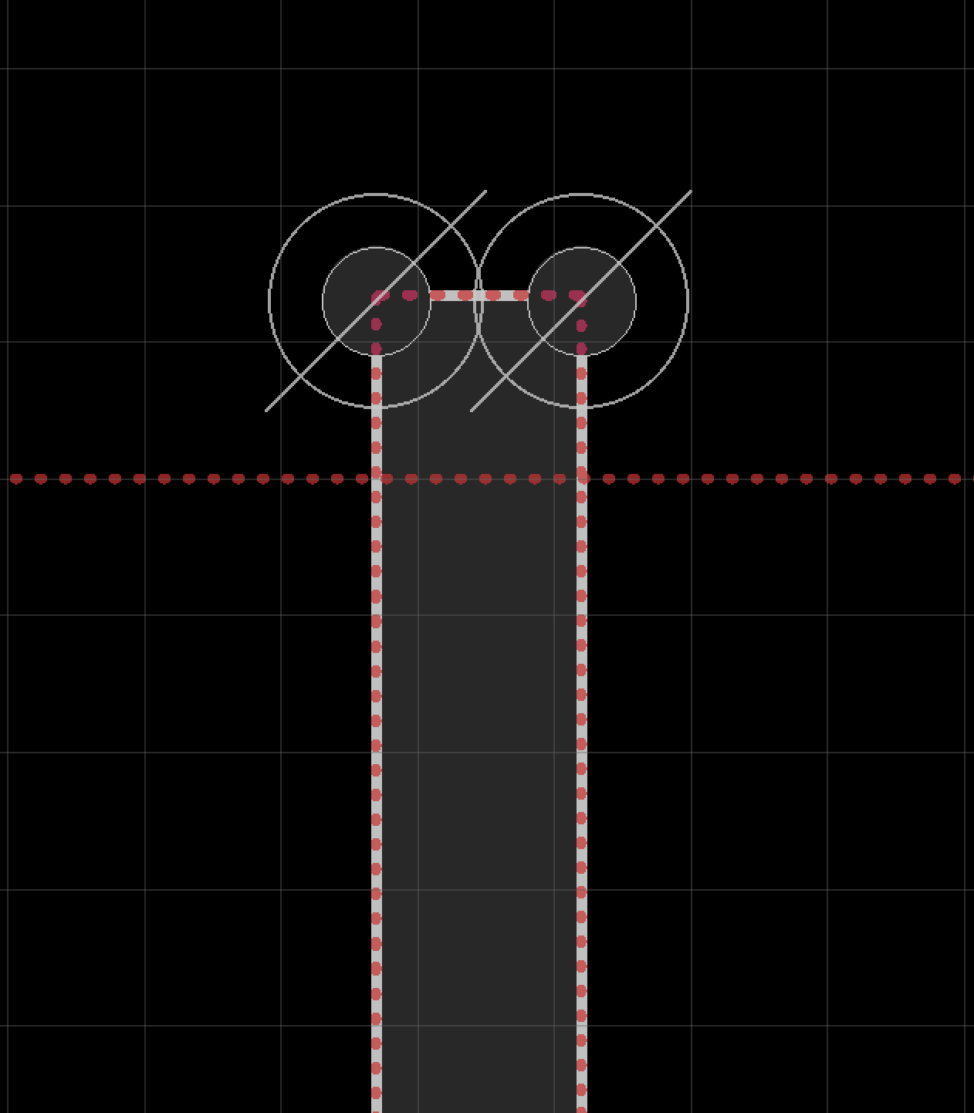
The Inside Corner Problem
How Do We Solve It? Corner Relief!

Slide 18
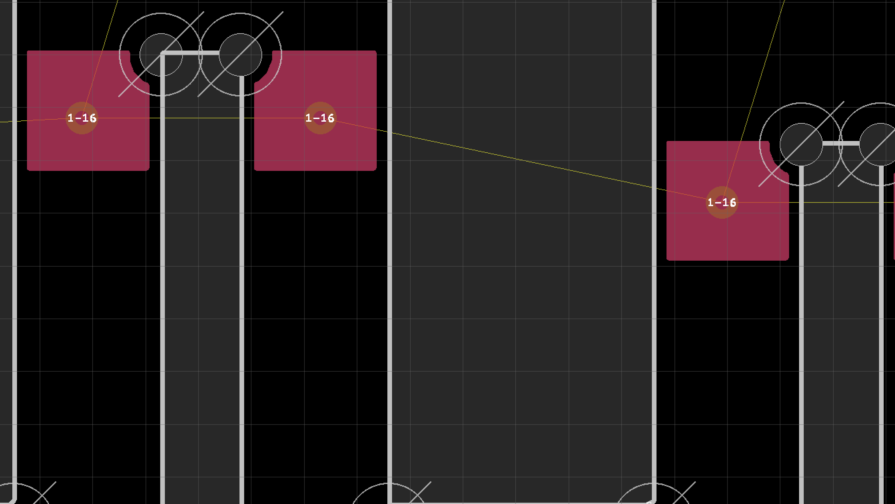
Fillet Soldering:
How to Avoid Lifting Pads

Slide 19
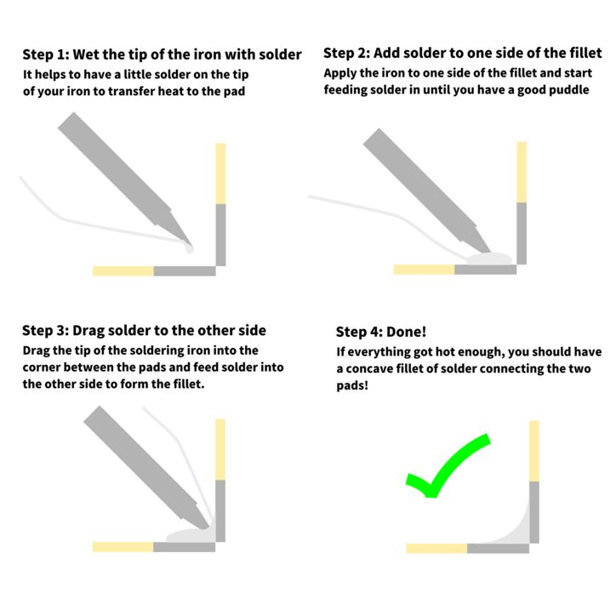
Fillet Soldering
What’s a Fillet?
- Not a “fil-ay”
- Rounded corner
- Joins two surfaces
at an angle

Slide 20
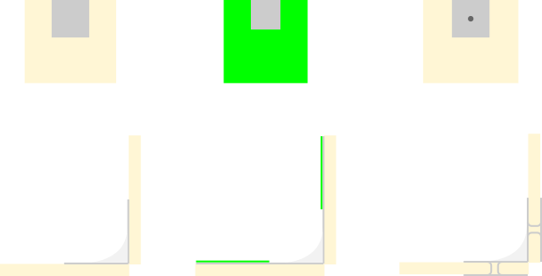
Fillet Soldering
Designing a Fillet Joint

Slide 21
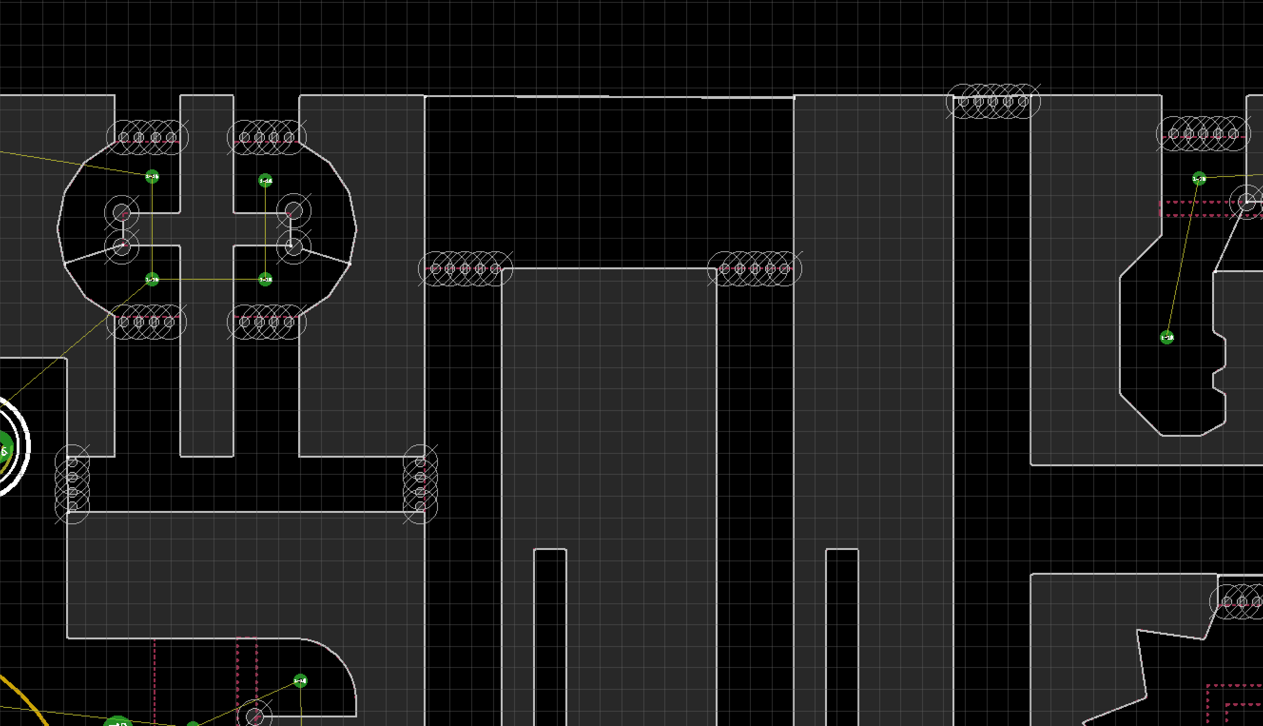
Imitating Model Sprues
w/ Mouse Bites

Slide 22
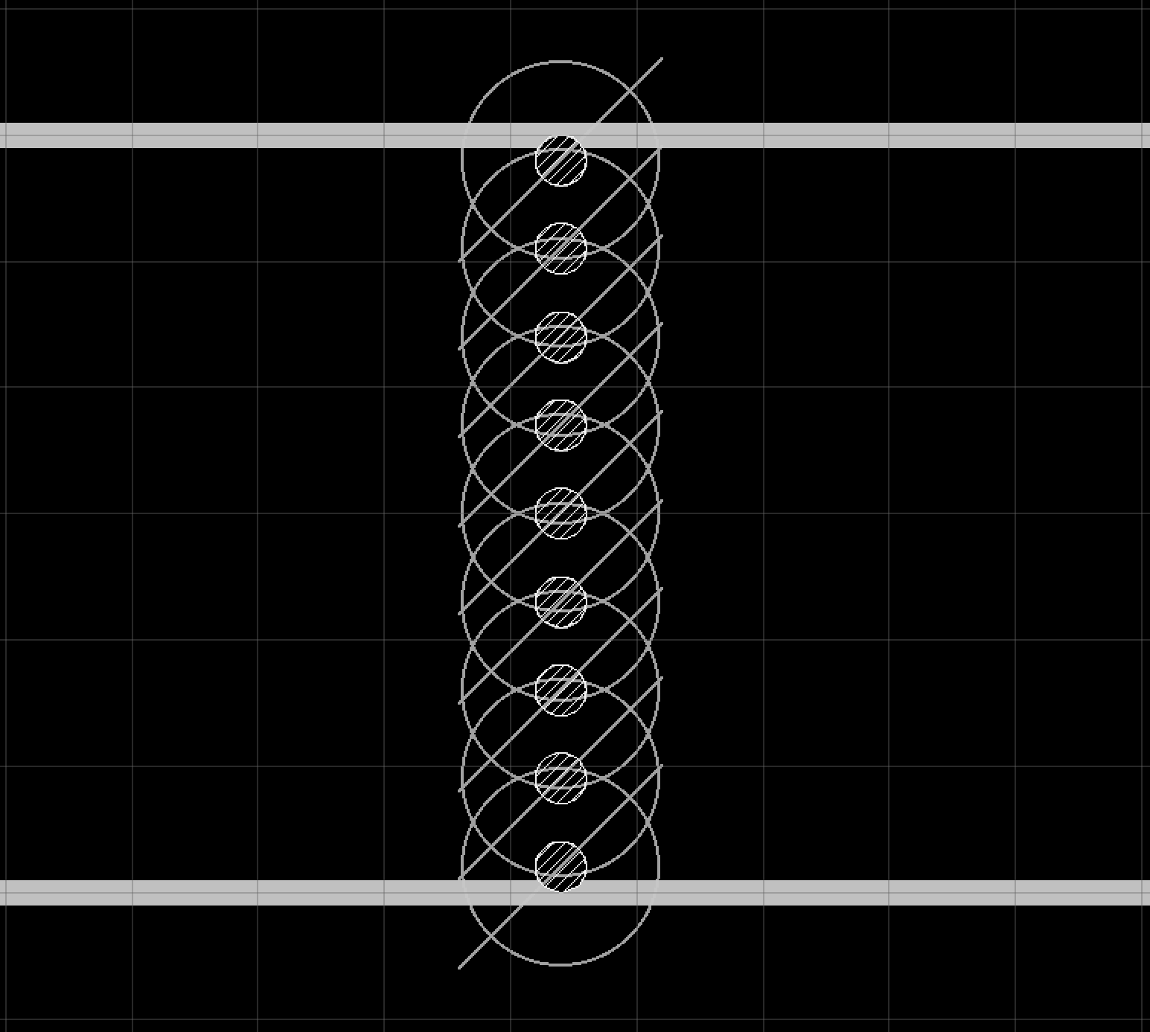
Imitating Model Sprues
w/ Mouse Bites
- Diameter
0.02” (20mil/0.5mm)
- Spacing between centers
0.04” (40mil/1mm)
- Snaps easily by hand at
0.8mm thickness
- Pliers help at 1.6mm

Slide 23
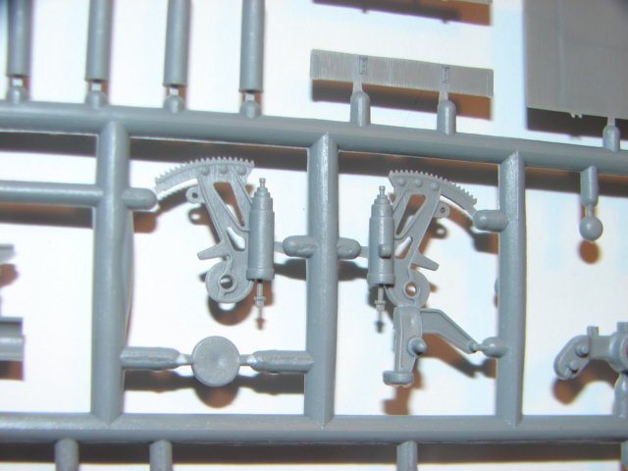
Imitating Model Sprues
w/ Mouse Bites
DMorpheus (https://commons.wikimedia.org/wiki/File:Sprue.JPG), „Sprue“, https://creativecommons.org/licenses/by-sa/3.0/legalcode

Slide 24
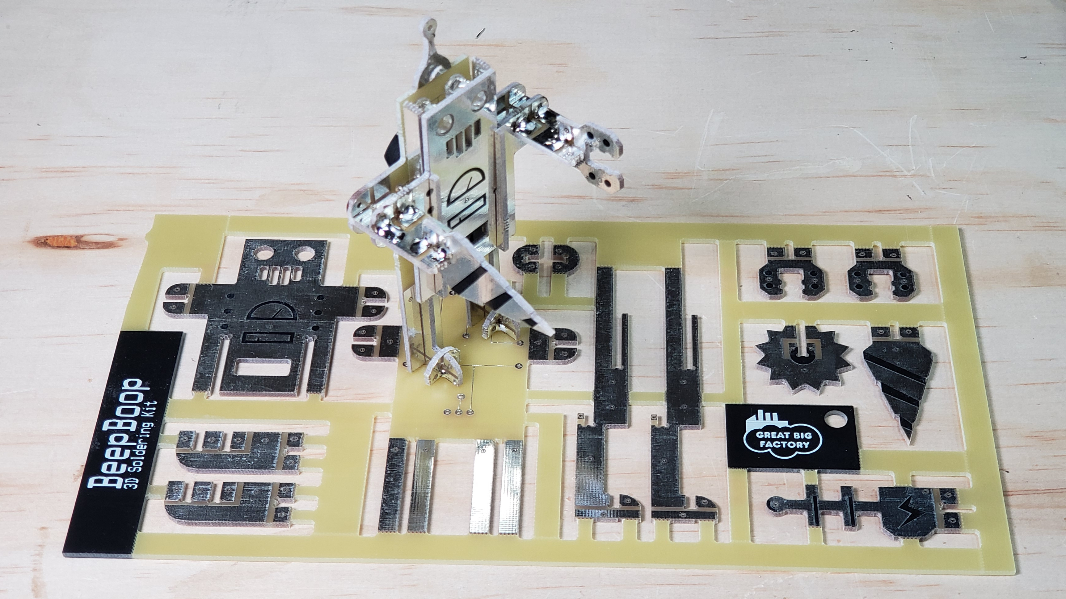
Imitating Model Sprues
w/ Mouse Bites

Slide 25
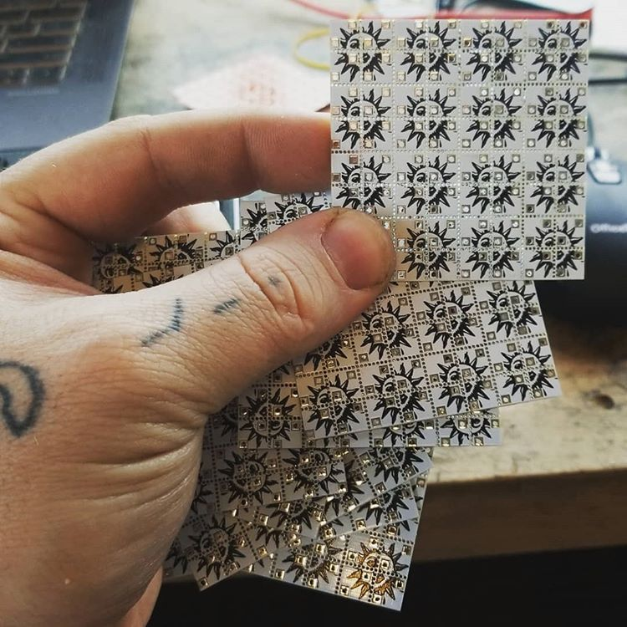
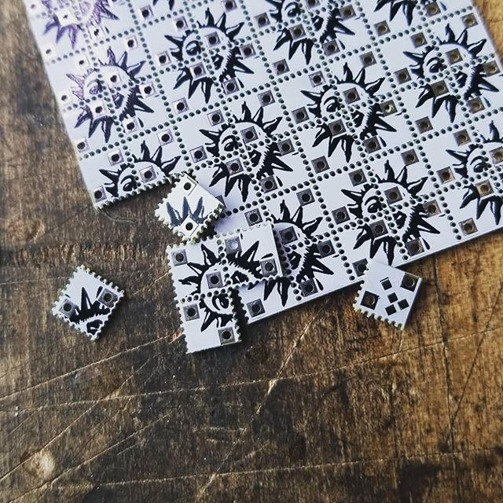
Imitating Model Sprues
w/ Mouse Bites

Slide 26
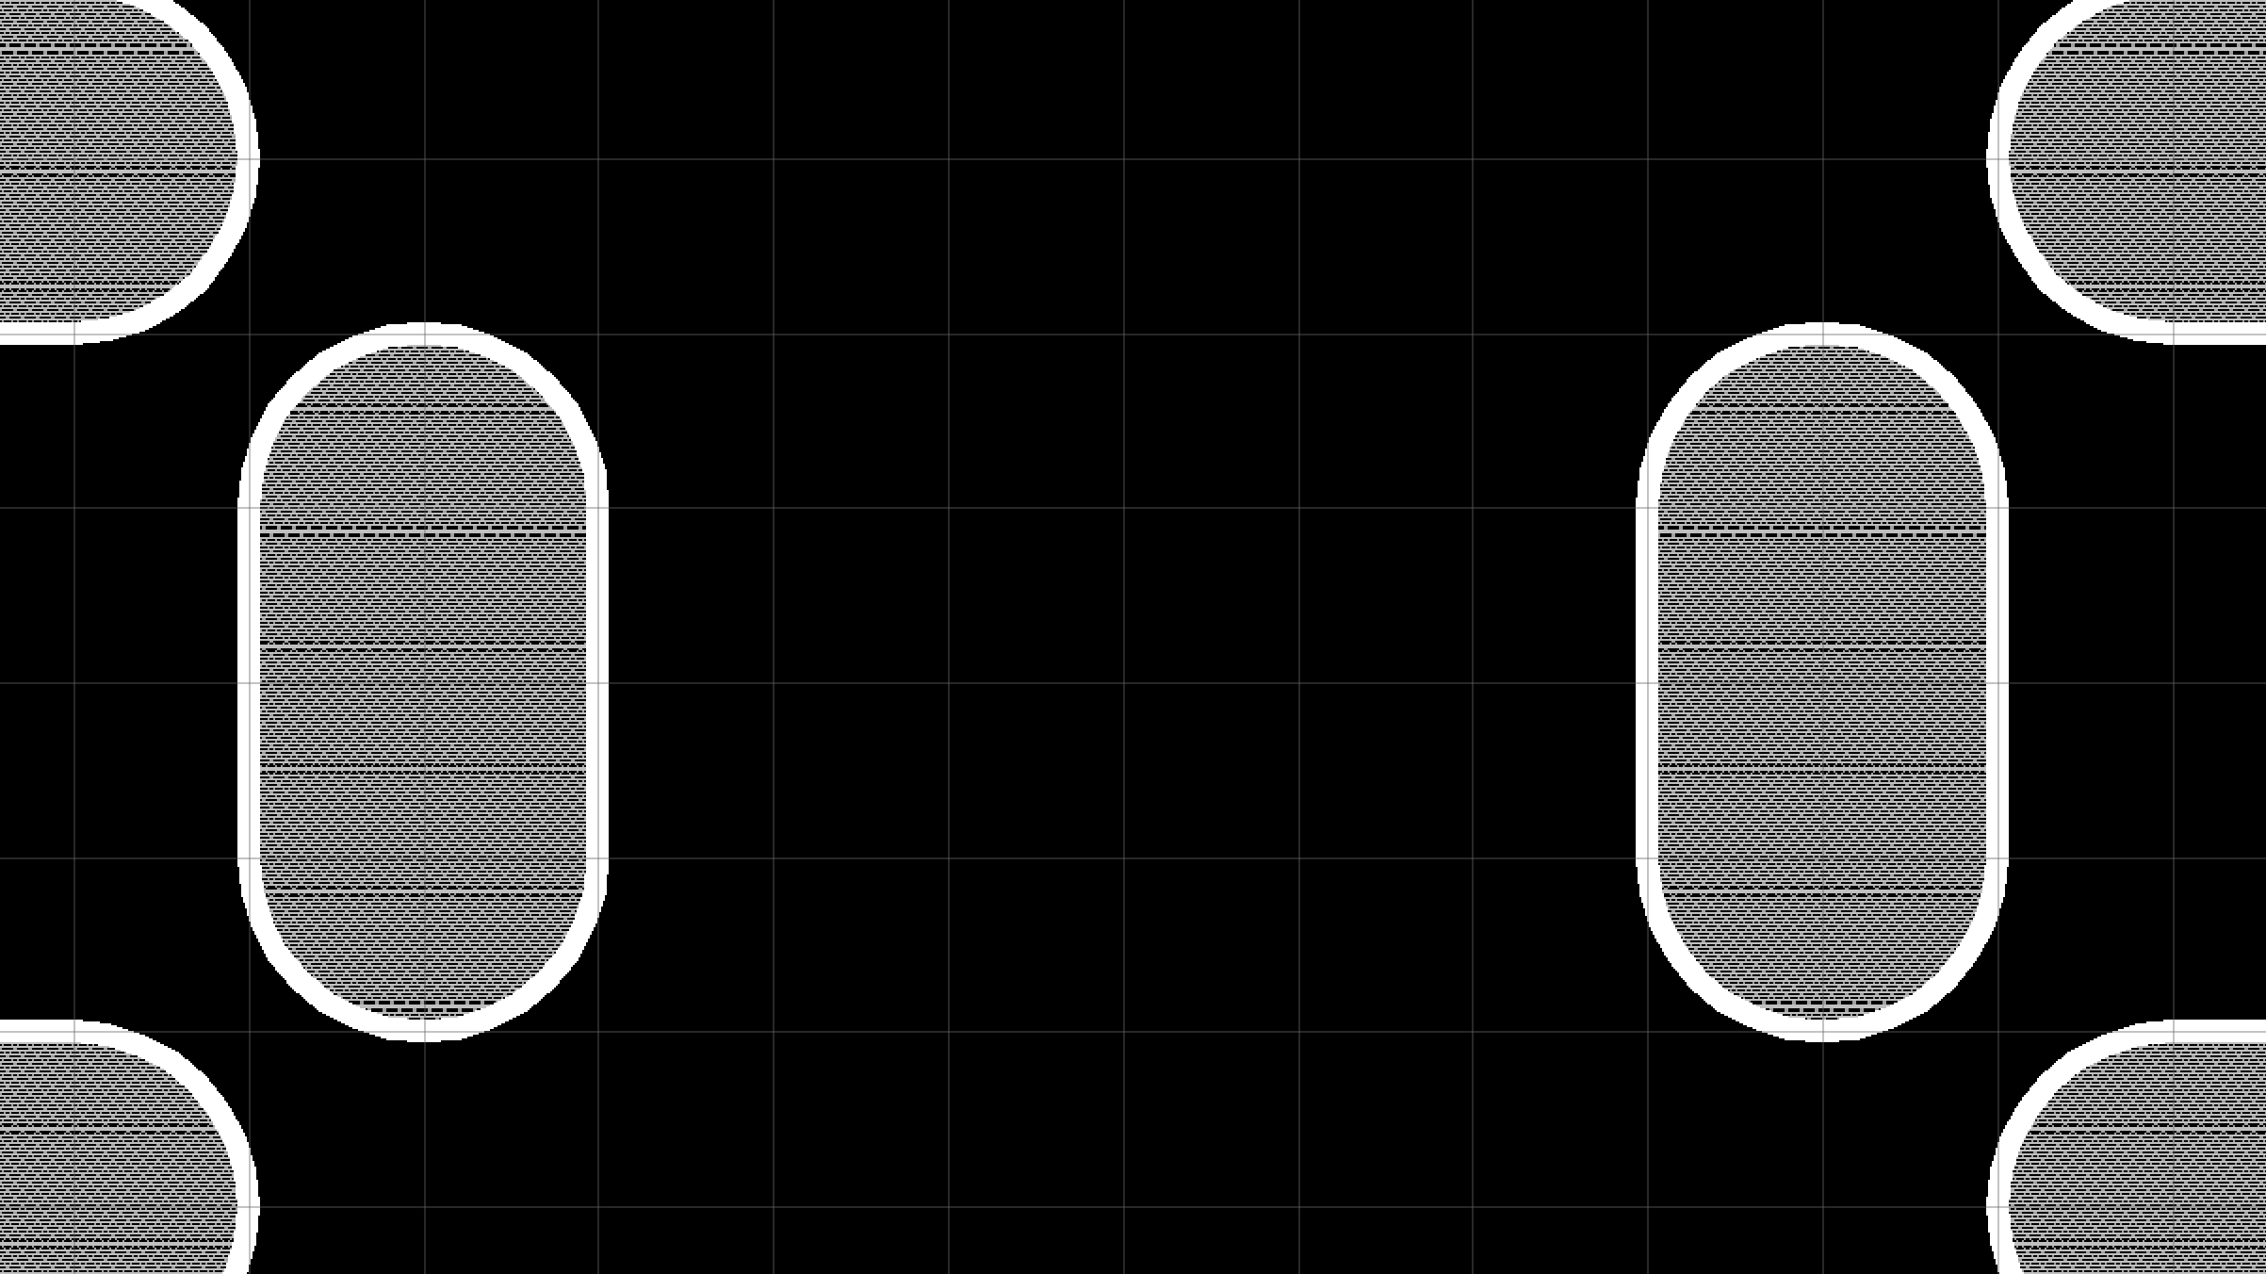
Manipulating the Mask Layer for Custom Displays

Slide 27
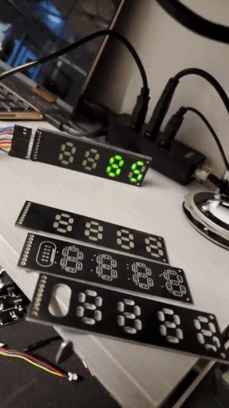
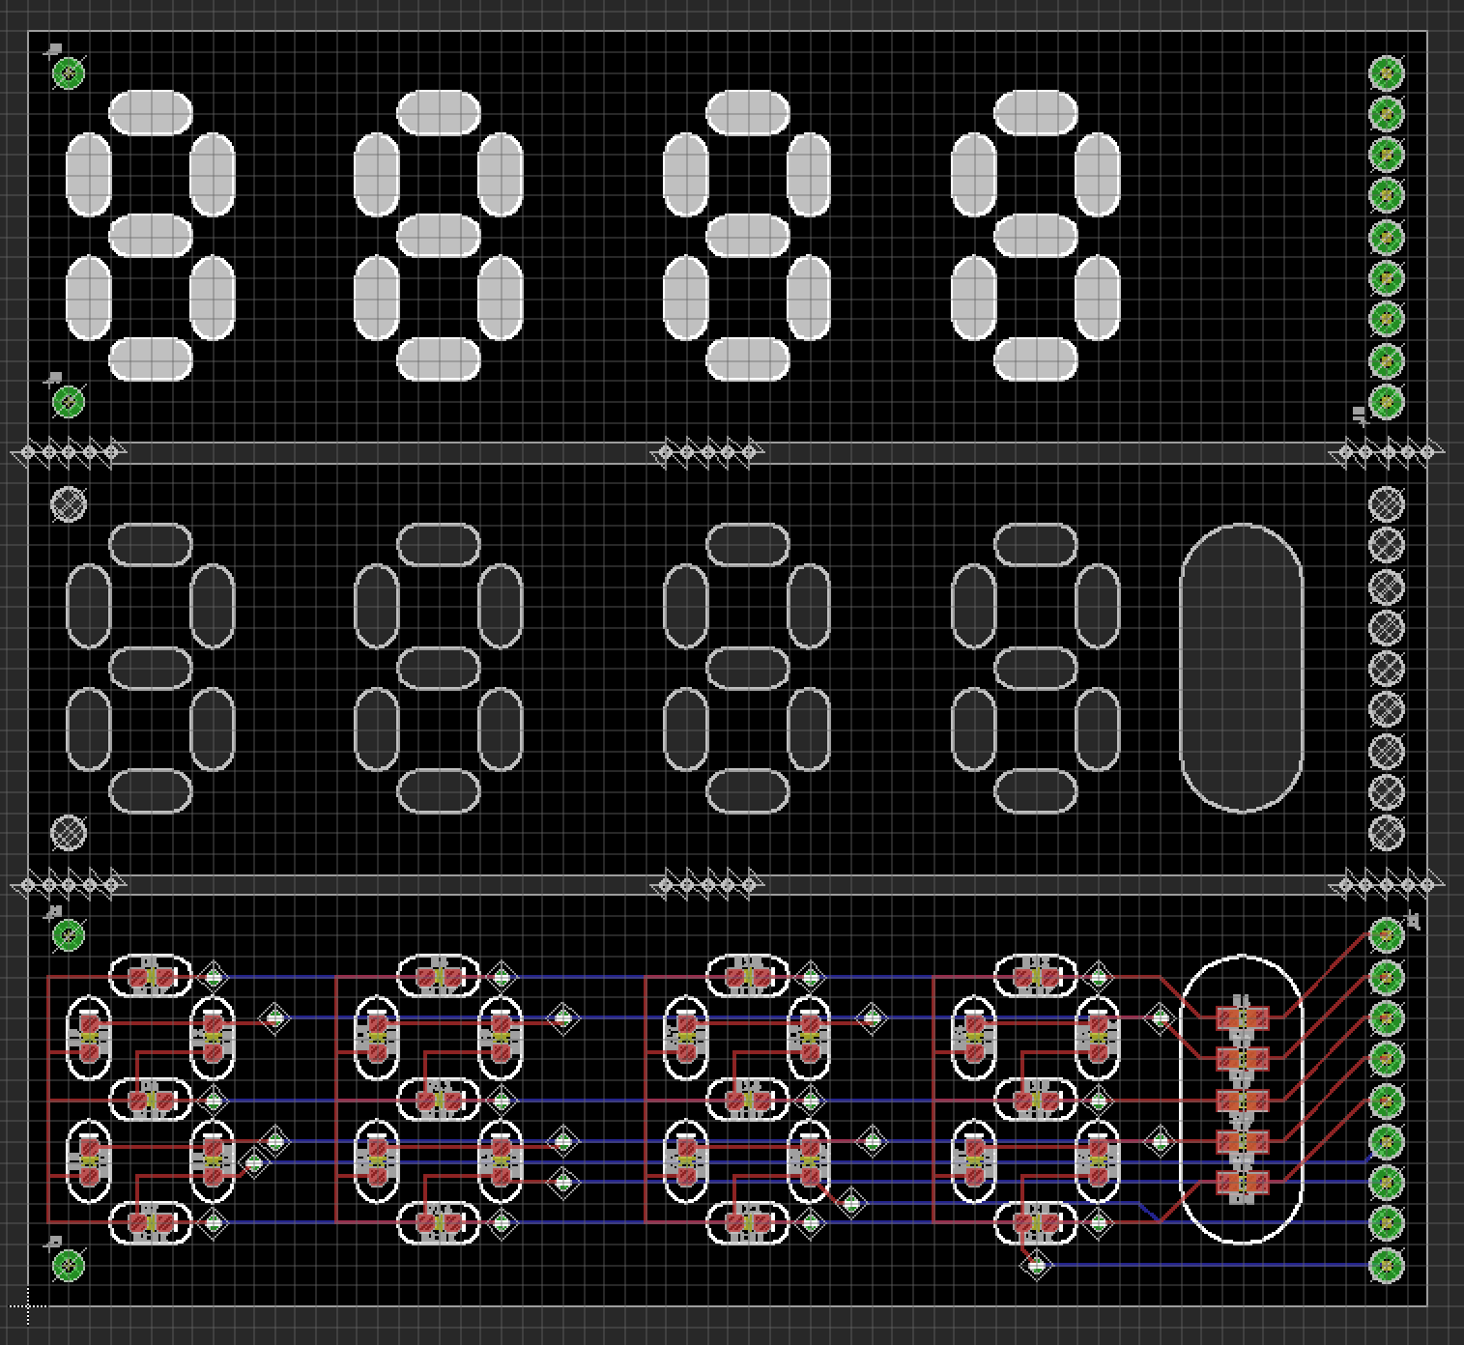
Manipulating the Mask Layer:
Custom Displays
- Fiberglass is
translucent!
- tStop & bStop
layers
- Make sure the
copper layer is
clear

Slide 28
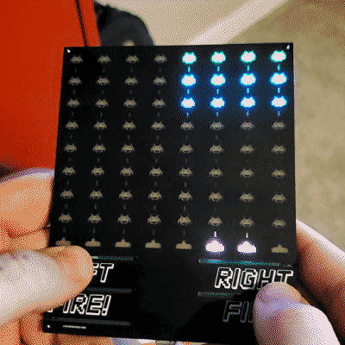
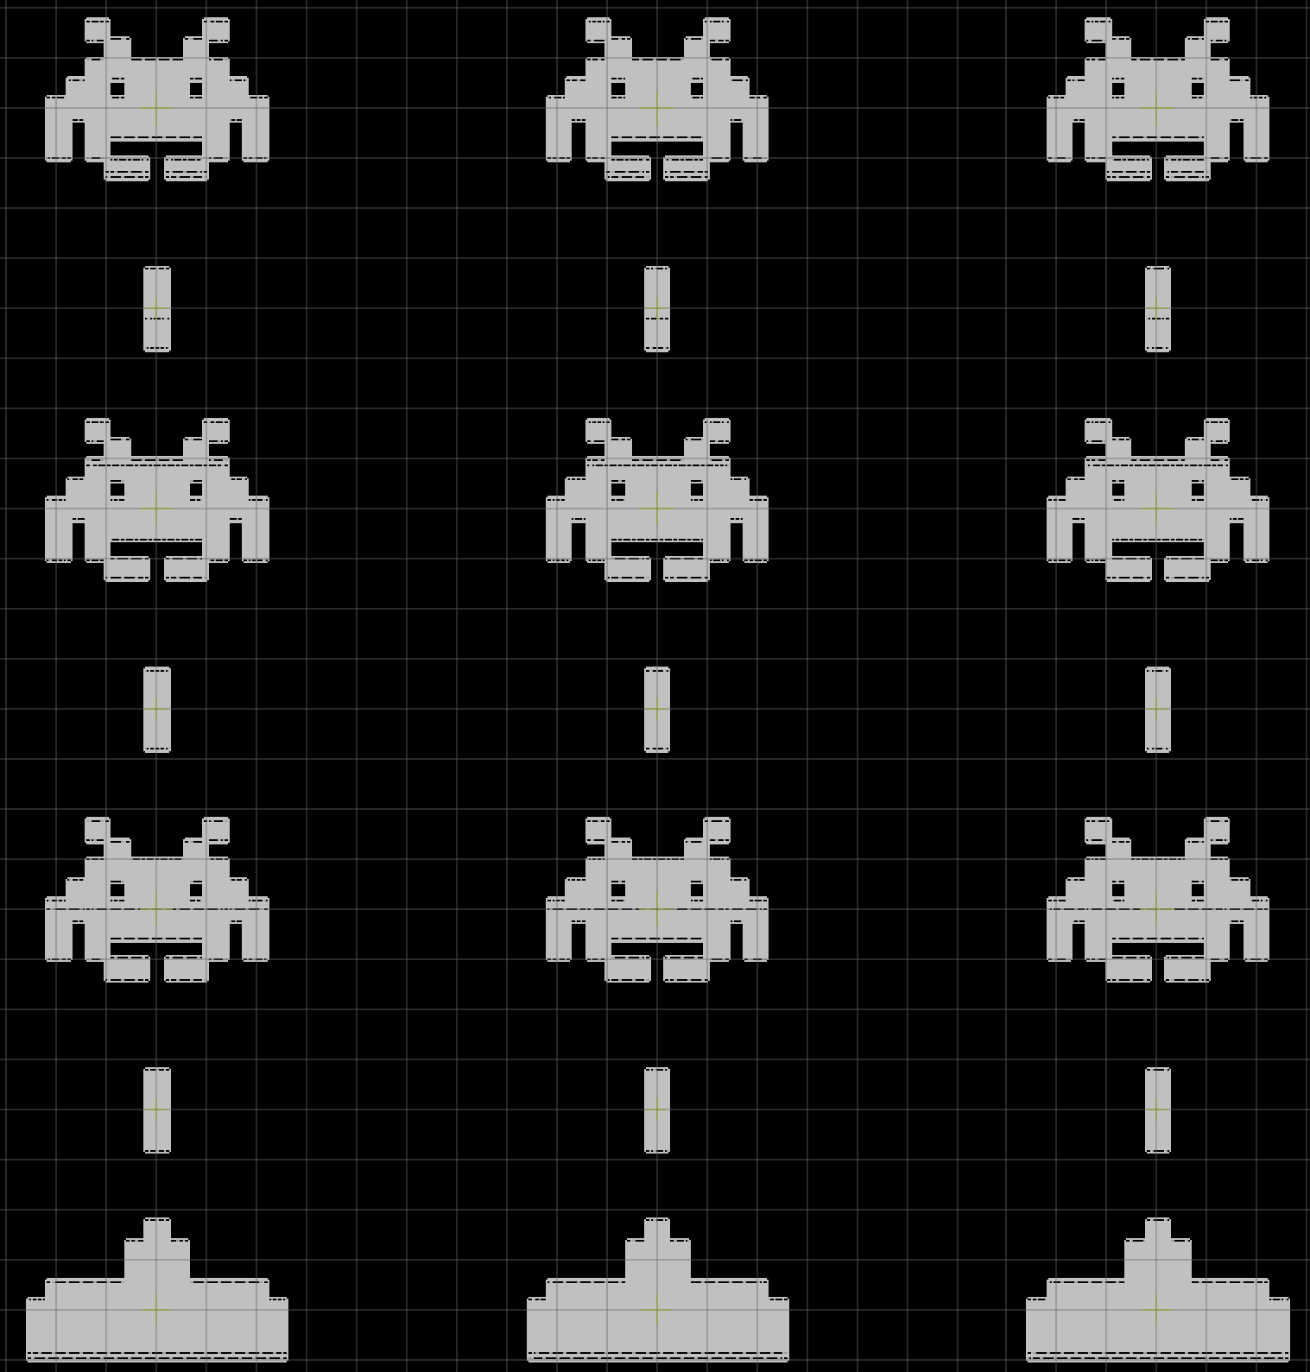
Manipulating the Mask Layer:
Custom Displays

Slide 29
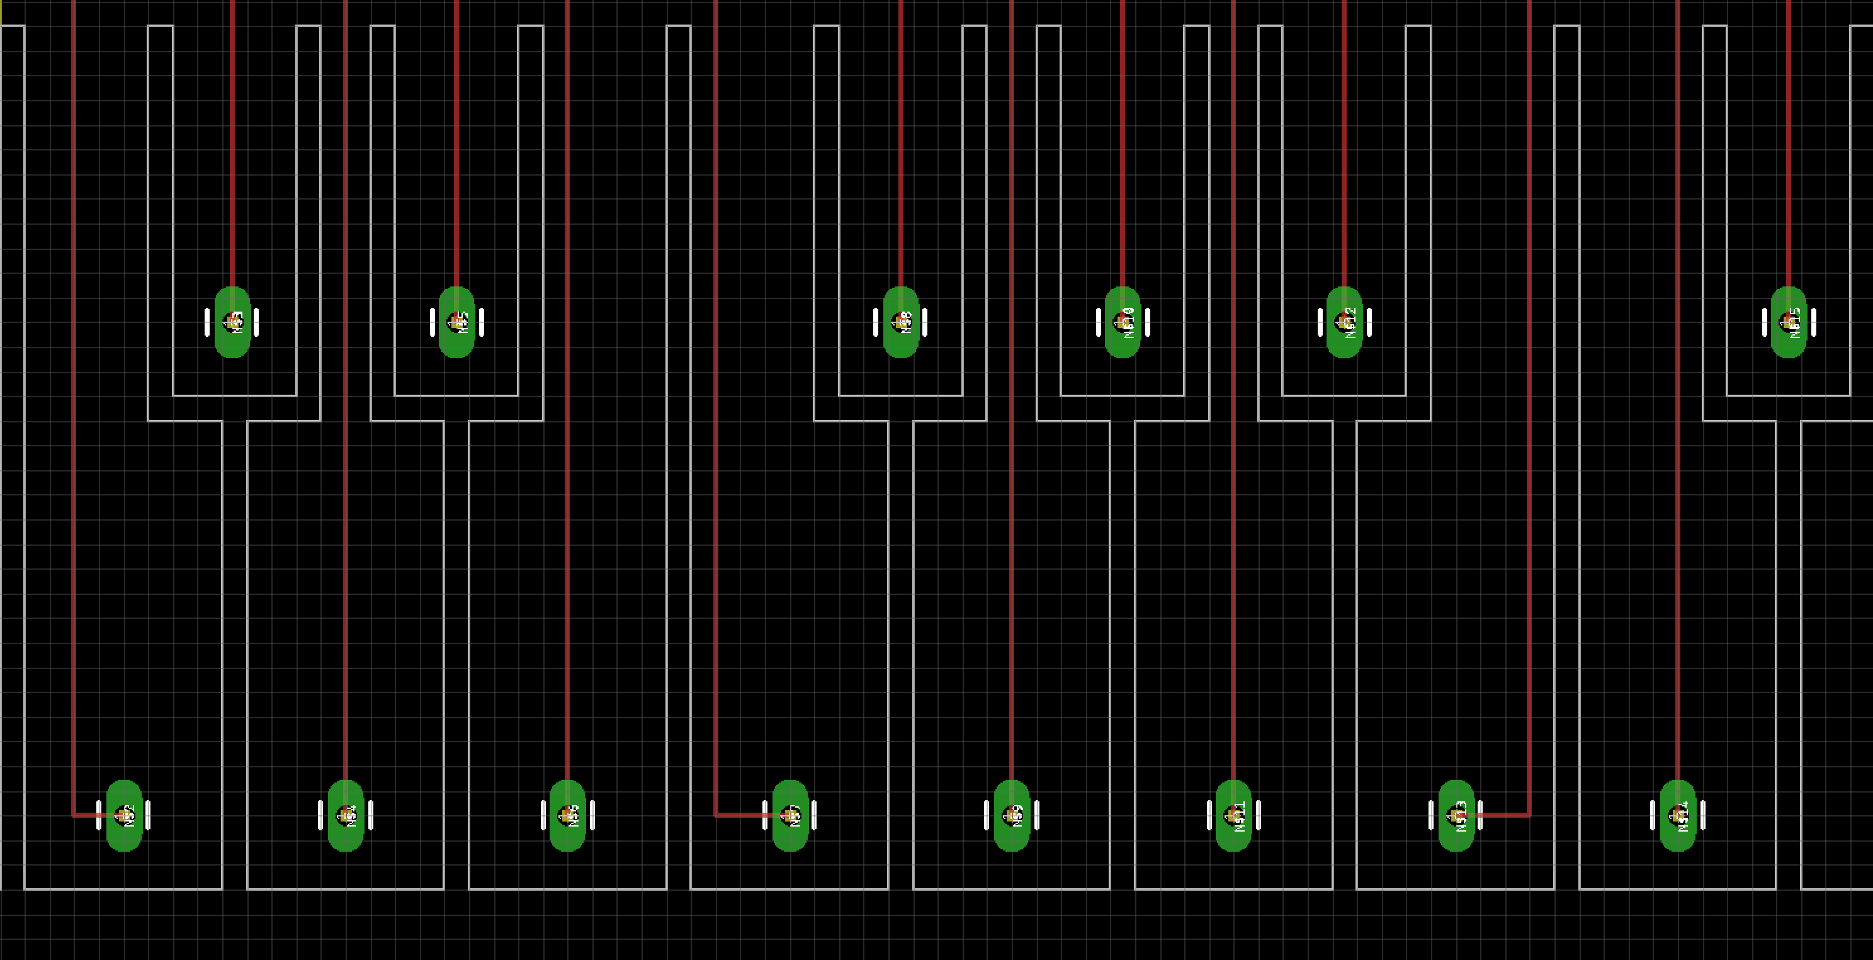
Bendy Tab Buttons

Slide 30
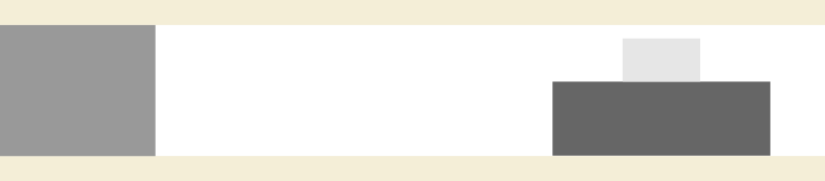
Bendy Tab Buttons

Slide 31
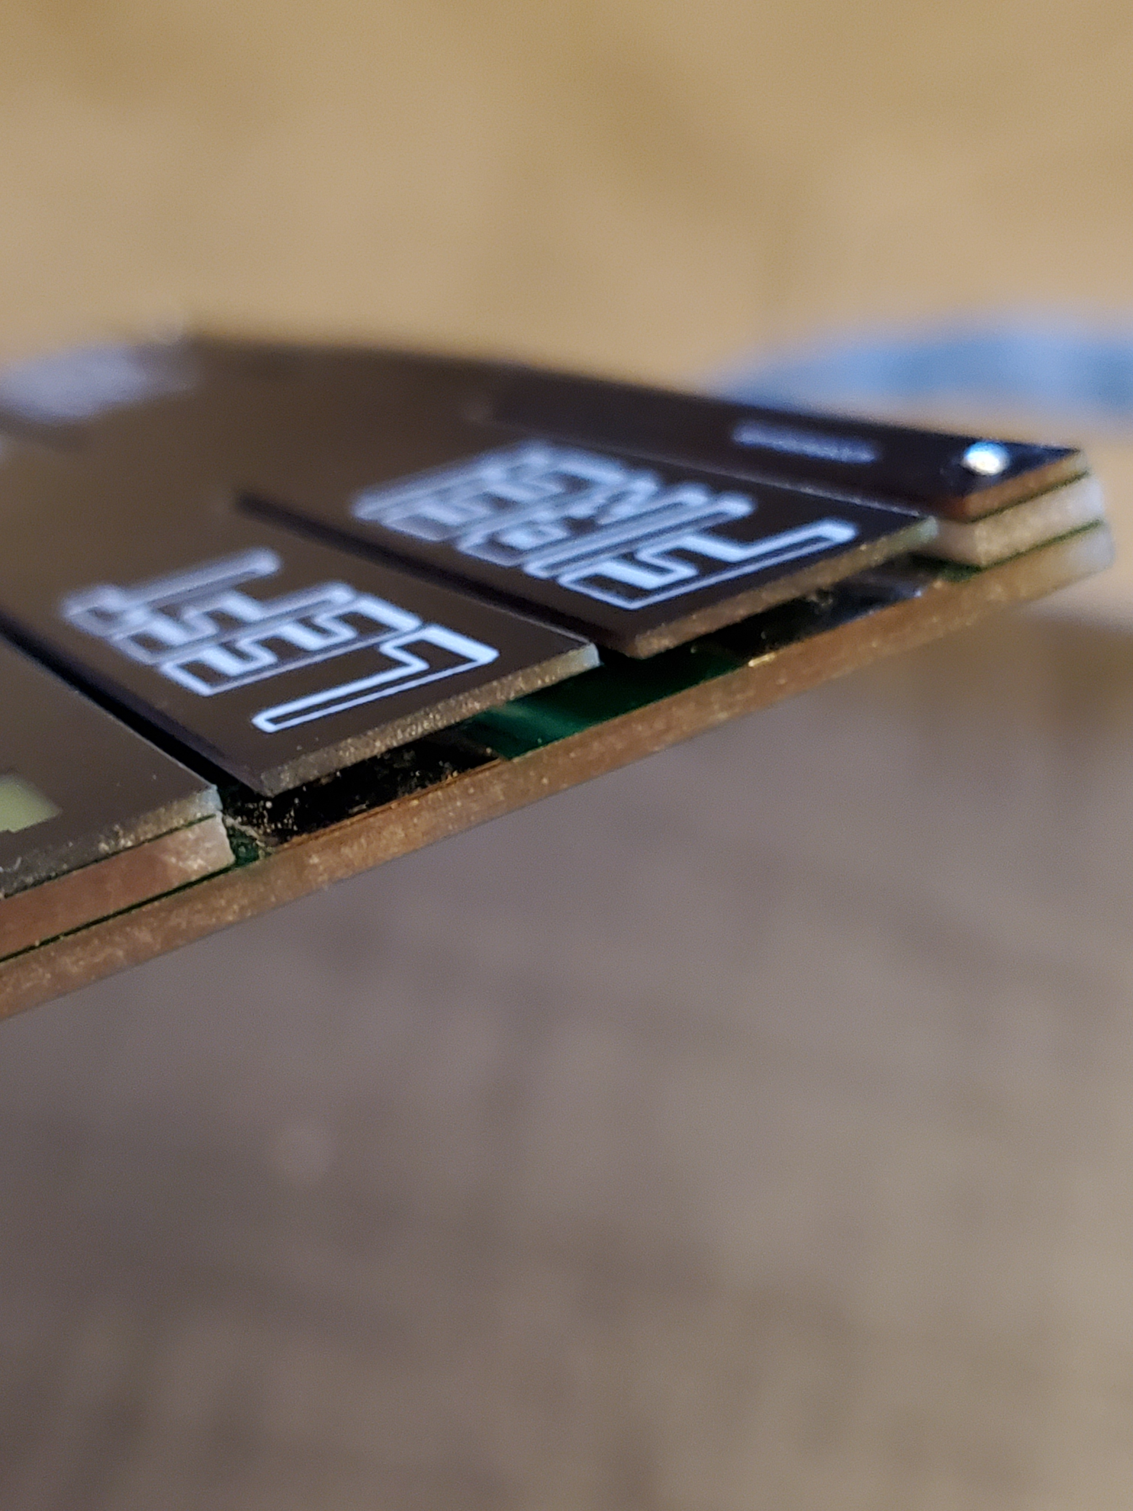

Bendy Tab Buttons

Slide 32
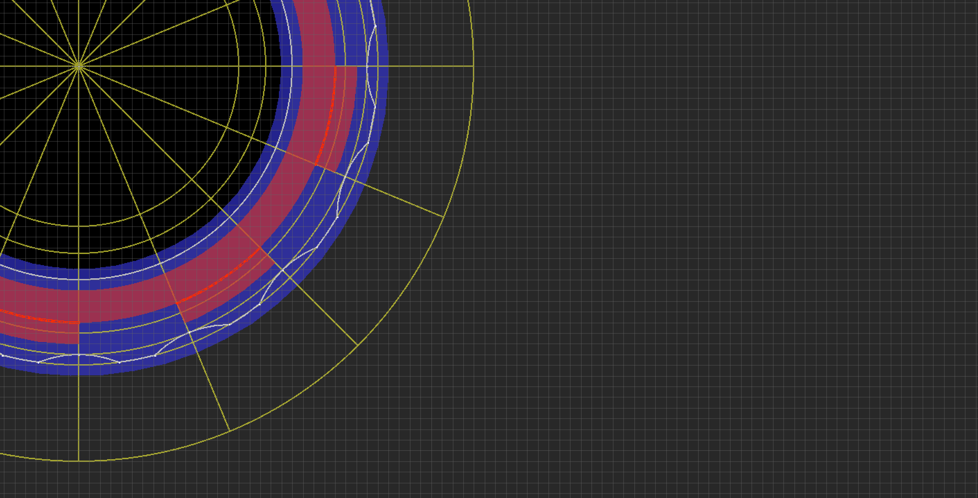
Wipers and Contacts:
A Working Rotary Encoder

Slide 33
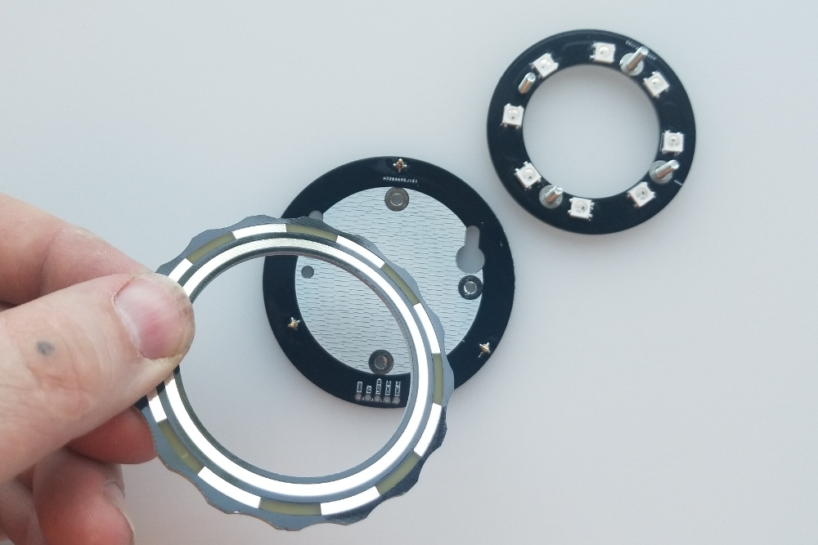
Wipers and Contacts:
A Working Rotary Encoder

Slide 34
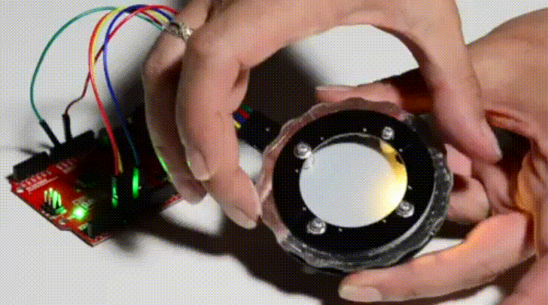
Wipers and Contacts:
A Working Rotary Encoder

Slide 35
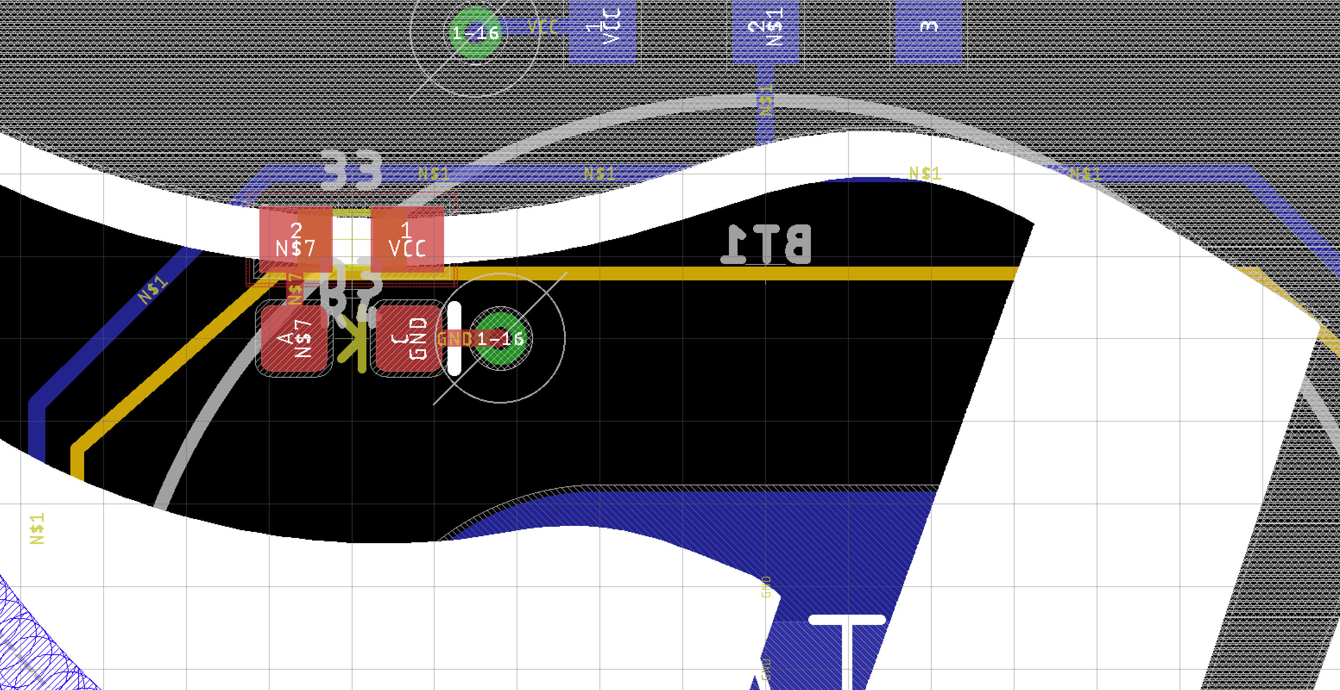
Stacking Boards

Slide 36
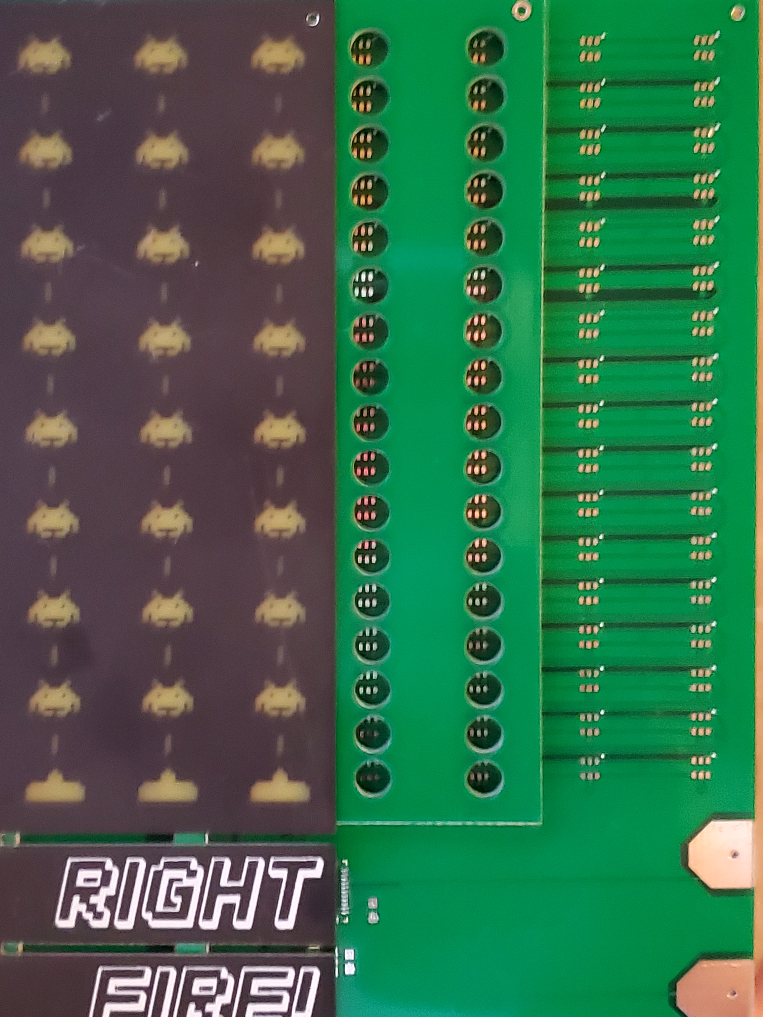
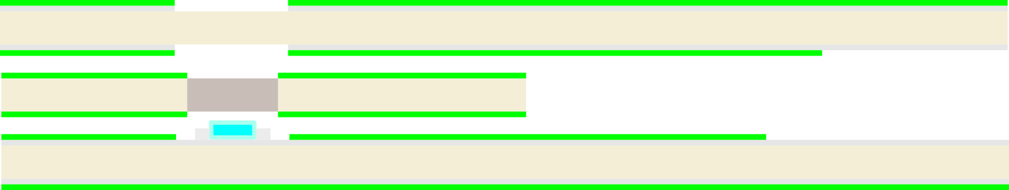
Stacking Boards
Mask & Copper Removed
Drill Hit
LED

Slide 37
Stacking Boards
Copper pad on bottom
Spacer Board
Copper pad on top

Slide 38
Leaving Clues for the Production Engineer
- Check up on your fabhouse’s capabilities (drill sizes,
min spacing, min slot width, etc)
- Leave notes (in a layer that makes it to gerbers)
- Label “mill out” or “route out” shapes
- Label v-score lines
- Don’t order silk if there’s no silk
- If two pours don’t connect, make it clear that they’re
not supposed to

Slide 39

Thank You!
Slides, Example Projects and Links to Resources
https://github.com/NPoole/Boggling_the_Boardhouse

